Slide 1

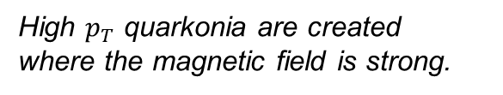
Quarkonia under Magnetic Field
Pengfei Zhuang
Physics Department, Tsinghua University
●
●
High $p_{T}$ quarkonia are created where the magnetic field is strong.
Other hadrons are created where the magnetic effect is weak.
G.Huang et. al., PRD107, 114035(2023)
G.Huang et. al., PRD108, L091503(2023)

Slide 2
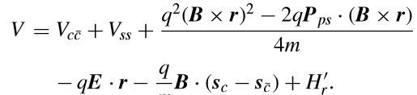
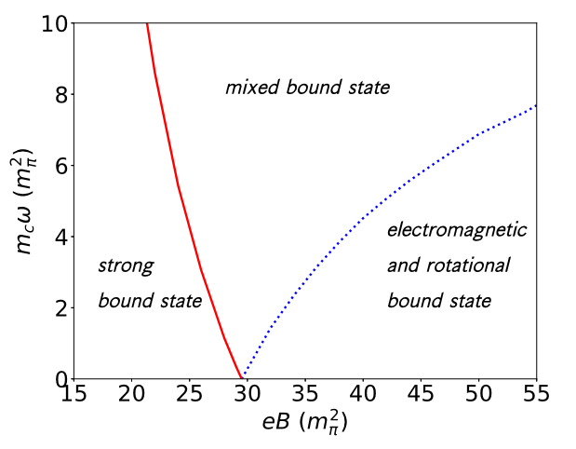
Charmonium transition in electromagnetic and rotational fields
S.Chen et. al., PRC103, L031902(2021)

Slide 3
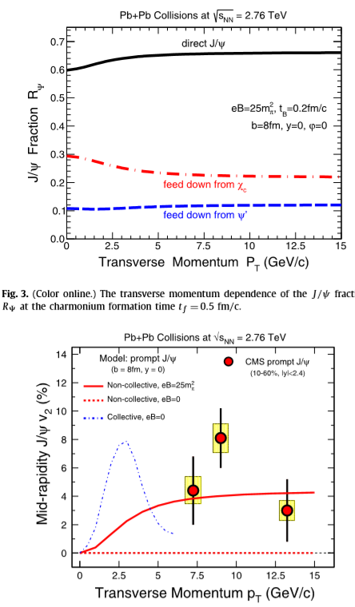

Magnetic field effect on charmonium production in high energy nuclear collisions
X.Guo et. al., PLB751, 215(2015)
$$i\frac{∂}{∂t}Φ_{c\overline{c}}=\hat{H}Φ_{c\overline{c}}$$

Slide 4
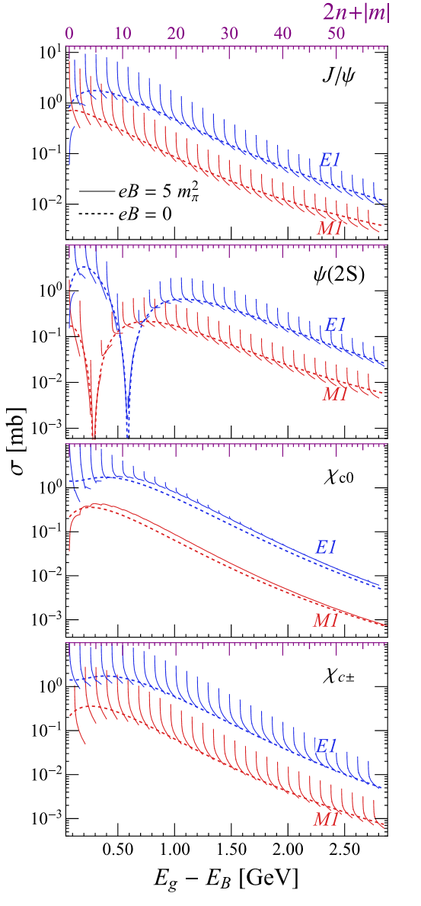
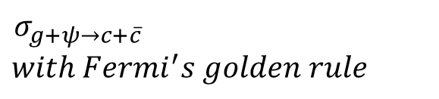
Magnetic field induced hair structure in charmonium dissociation
J.Hu et’. al., PRD105, 094013(2022)
$$σ_{g+ψ→c+\overline{c}}$$
$with Fermi^{′}s golden rule$

Slide 5
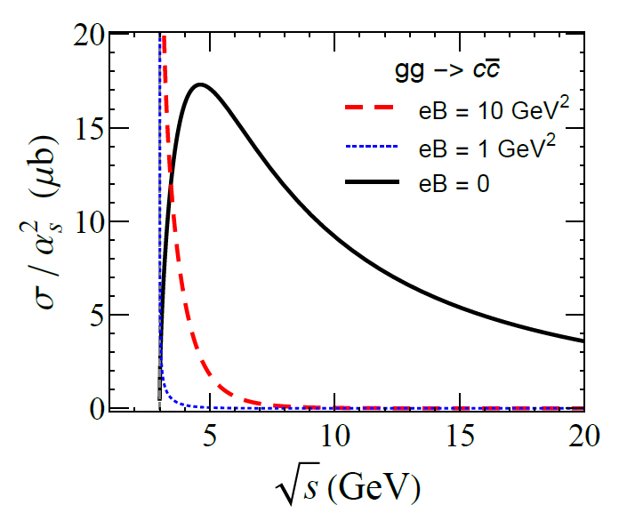
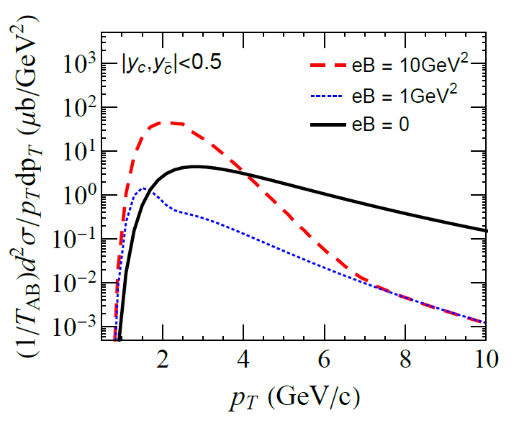
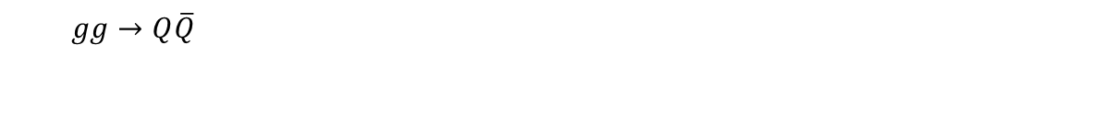
Heavy quark production under magnetic field
S.Chen et. al., arXiv: 2401.17559
$gg→Q\overline{Q}$

Slide 6
Summary
Quarkonia (dileptons) created in the very beginning are more sensitive to the magnetic field than those particles created in the fireball.

