Slide 1
Photon-photon scattering and axion-like particle generation
Baifei Shen
Shanghai Normal University
SIOM, CAS

Slide 2
Outline
Background
High field Photon-photon scattering
High field axion-like particle generation

Slide 3
Outline
Background
High field Photon-photon scattering
High field axion-like particle generation

Slide 4
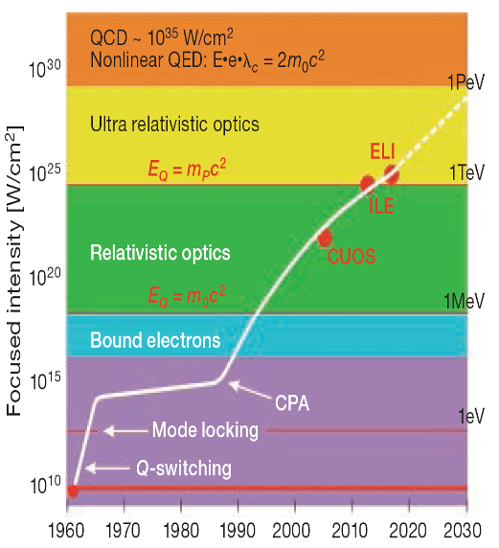
超强超短激光的发展历程与科学新领域的开拓
超强超短激光：
峰值功率> 1TW(10¹²W)
脉冲宽度<100 fs (10⁻¹⁵s )
电子特征能量
电弱相互作用
时代
1Pev
超强超短激光
最大光强已达
2×10²²W/cm²
宇宙中γ -爆对应的光强10²⁰W/cm^{2 *}
夸克时代
1Tev
正负电子对
时代
1Mev
超强超短激光
超强超短激光是人类已知的最亮光源，可以提供前所未有的全新实验手段与极端物理条件。
等离子体时代
1ev
原子时代
OPN July(2011)
Science 331, 41 (2011)
* NewScientist April 9, 2008
年 份
Notes:
4

Slide 5
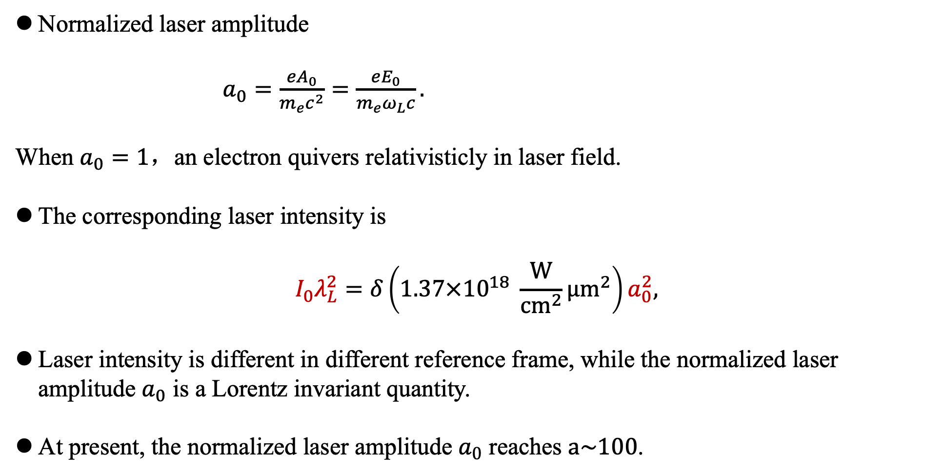
Optical laser parameters
Normalized laser amplitude
$\begin{aligned}a_{0}=\frac{eA_{0}}{m_{e}c^{2}}=\frac{eE_{0}}{m_{e}ω_{L}c}.\#\end{aligned}$
When $a_{0}=1$，an electron quivers relativisticly in laser field.
The corresponding laser intensity is
$$\begin{aligned}I_{0}λ_{L}^{2}=δ\left(1.37×10^{18} \frac{W}{cm^{2}}μm^{2}\right)a_{0}^{2},\end{aligned}$$
Laser intensity is different in different reference frame, while the normalized laser amplitude $a_{0}$ is a Lorentz invariant quantity.
At present, the normalized laser amplitude $a_{0}$ reaches $a\sim 100$.

Slide 6
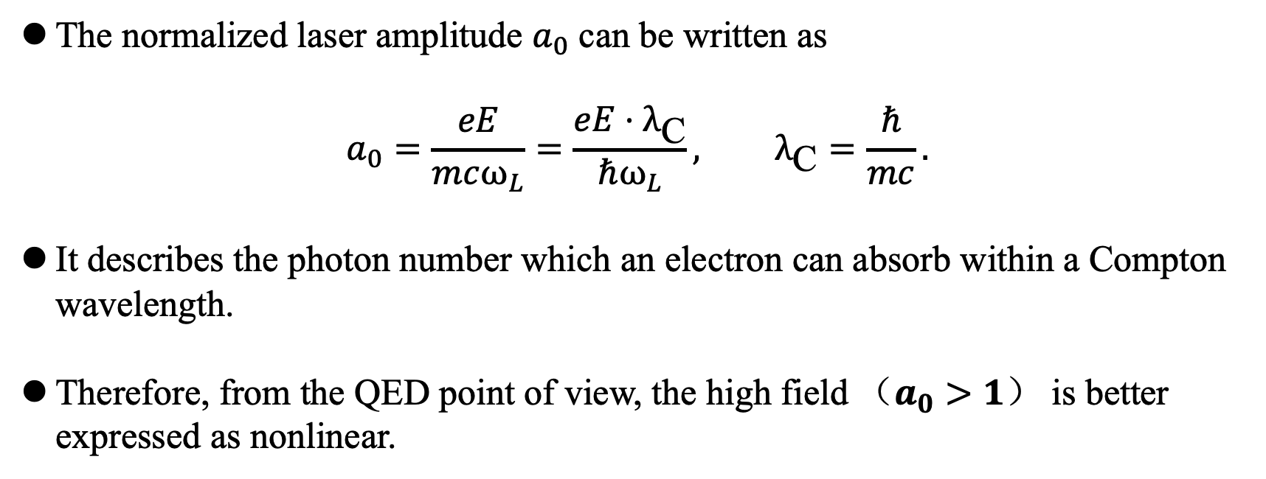
Optical laser parameters
The normalized laser amplitude $a_{0}$ can be written as
$$\begin{aligned}a_{0}=\frac{eE}{mcω_{L}}=\frac{eE⋅λ_{\text{C}}}{ℏω_{L}}, λ_{\text{C}}=\frac{ℏ}{mc}.\#\end{aligned}$$
It describes the photon number which an electron can absorb within a Compton wavelength.
Therefore, from the QED point of view, the high field （$a_{0}>1$） is better expressed as nonlinear.

Slide 7
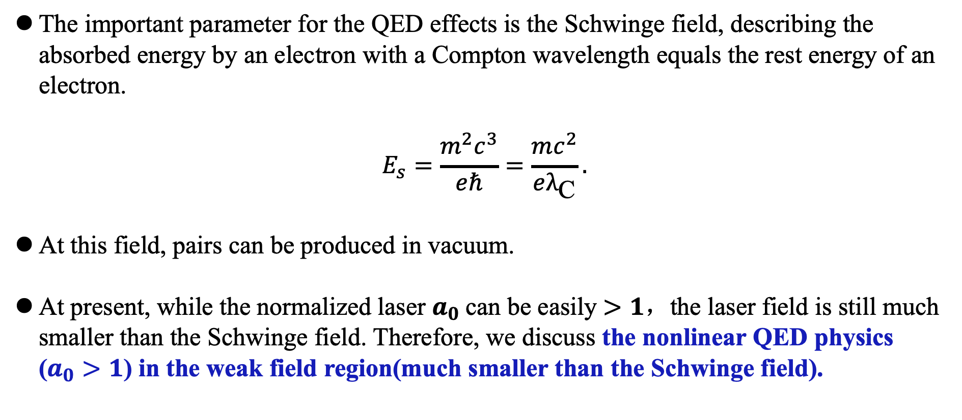
Optical laser parameters
The important parameter for the QED effects is the Schwinge field, describing the absorbed energy by an electron with a Compton wavelength equals the rest energy of an electron.
$$\begin{aligned}E_{s}=\frac{m^{2}c^{3}}{eℏ}=\frac{mc^{2}}{eλ_{\text{C}}}.\#\end{aligned}$$
At this field, pairs can be produced in vacuum.
At present, while the normalized laser $a_{0}$can be easily $>1$，the laser field is still much smaller than the Schwinge field. Therefore, we discuss the nonlinear QED physics ($a_{0}>1$) in the weak field region(much smaller than the Schwinge field).

Slide 8
Why we need XFEL for QED physics?
Since the optical laser field is still weak compared to the Schwinge field, we need another beam, such as electron beam or gamma beam to boost the QED effects. Here we consider to use XFEL.
Compared to electron beams, the XFEL is cleaner without any maters of mass and charge.
Compared to gamma beams, the XFEL can be measured precisely.

Slide 9
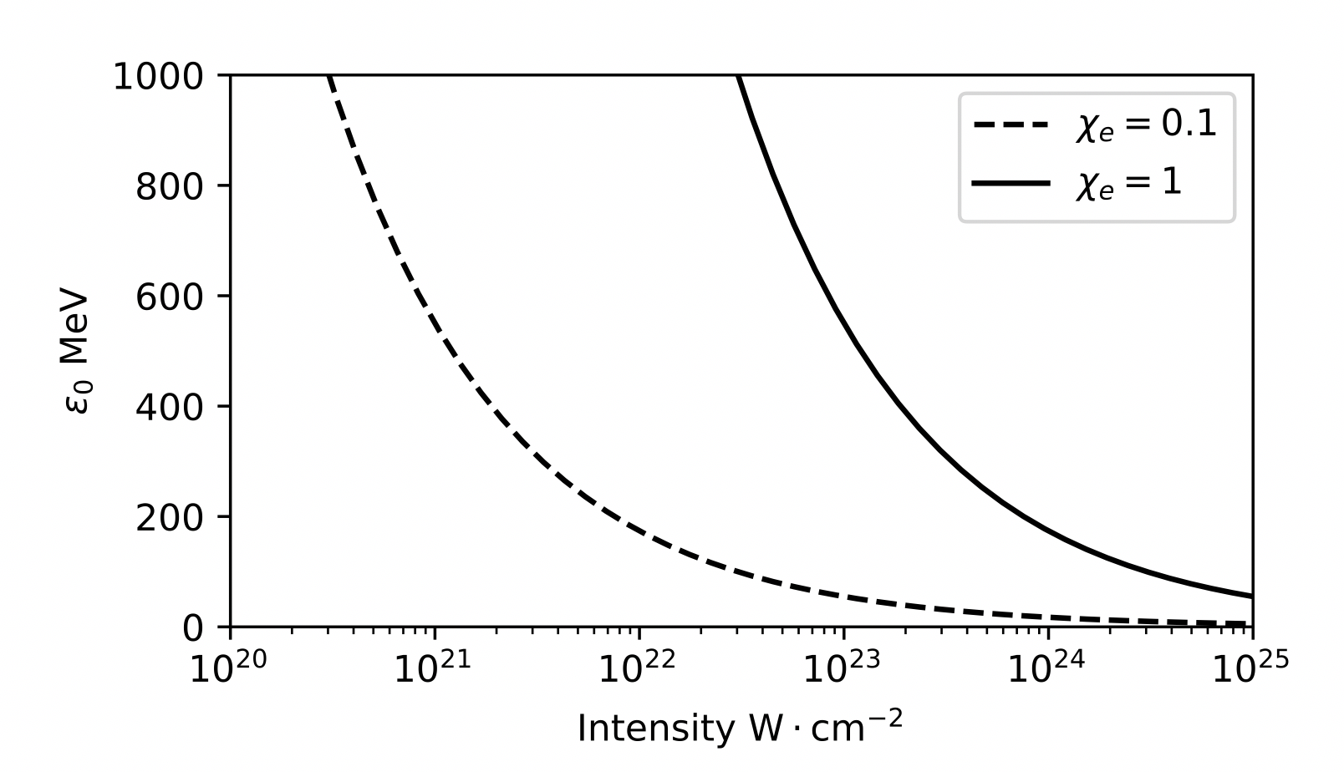
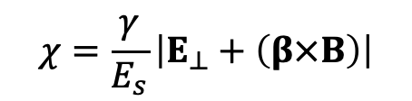
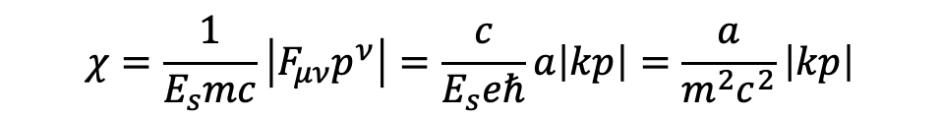
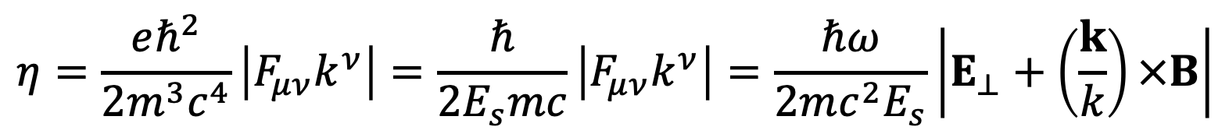
决定高能电子（光子）和强场相互作用QED效应的参数
$$χ=\frac{1}{E_{s}mc}\left|F_{μν}p^{ν}\right|=\frac{c}{E_{s}eℏ}a\left|kp\right|=\frac{a}{m^{2}c^{2}}\left|kp\right|$$
$$χ=\frac{γ}{E_{s}}\left|E_{⊥}+\left(β×B\right)\right|$$
$$η=\frac{eℏ^{2}}{2m^{3}c^{4}}\left|F_{μν}k^{ν}\right|=\frac{ℏ}{2E_{s}mc}\left|F_{μν}k^{ν}\right|=\frac{ℏω}{2mc^{2}E_{s}}\left|E_{⊥}+\left(\frac{k}{k}\right)×B\right|$$

Slide 10
Short wavelength laser may provide low cost new generation laser facilities of intensity approaching the Schwinger limit.
XFEL with CPA technique may provide attosecond 10 keV laser of focal size less than 10 nm.
10 or 100 PW laser may produce 1EW laser of 1 J and 1 as.
Laser-produced ultra-intense gamma radiation may drive a gamma-ray laser.
Schwinger limit is not the ultimate limit for laser intensity, since plane wave dose not produce pairs in vacuum.

Slide 11

Station of Extreme Light (SEL) at XFEL
The marriage of two most intense light sources：
1TW XFEL at 0.1nm + 100PW optical laser at 900nm
SULF
Hard XFEL at Shanghai
Laser Gamma Rays
Laser THz Rays
Synchrotron Radiation
Sun light

Slide 12
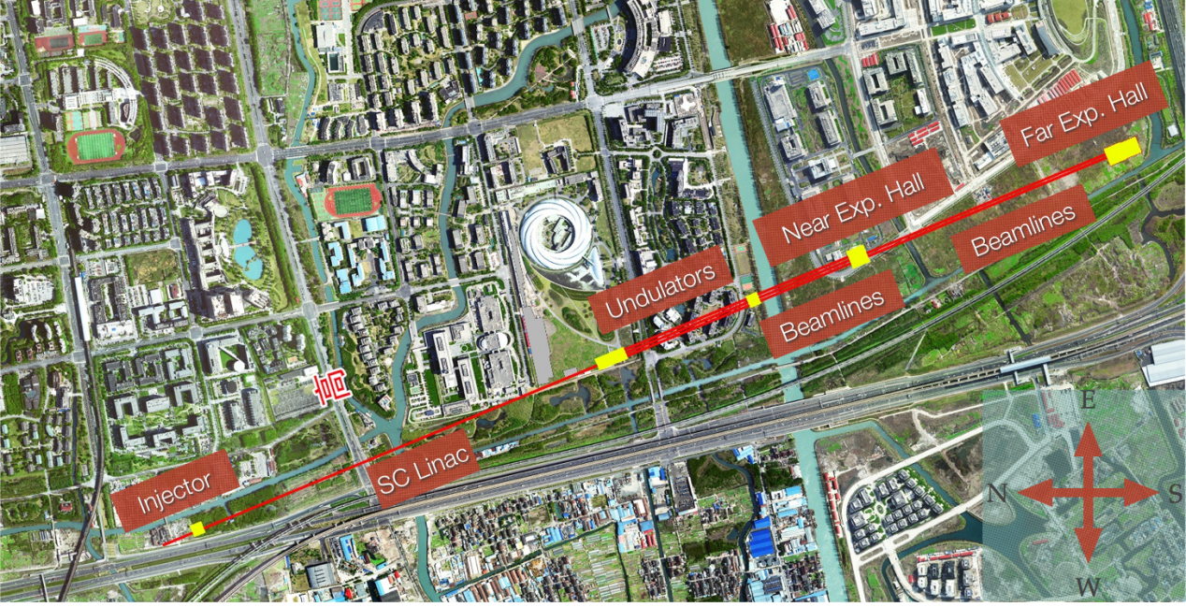
The building of Shanghai HIgh repetition XFEL aNd Extreme light facility (SHINE) was started on 27 April, 2018.
SULF
Station of Extreme Light (SEL)

Slide 13
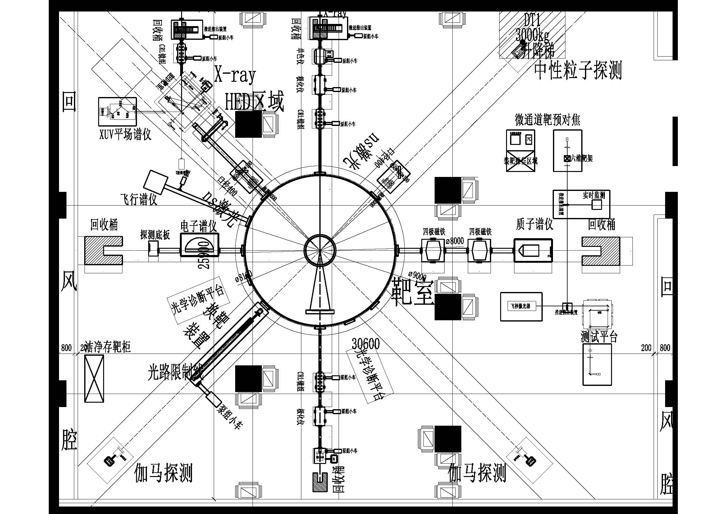
Top view of the experimental area
33m x26m
FEL-III
For HED chamber, 1PW laser
FEL-I
For SEL chamber
1PW
XFELdetectors
25PW

Slide 14
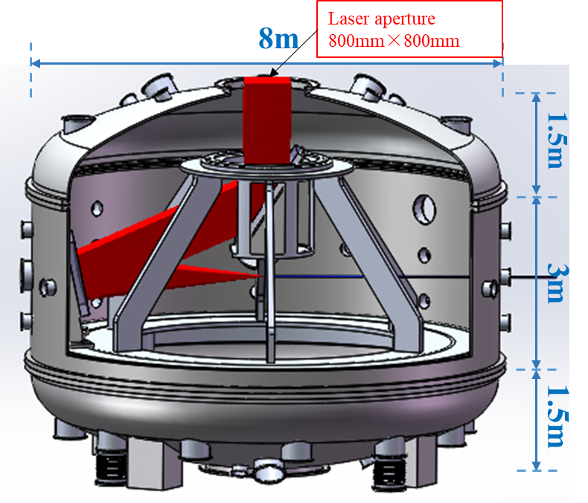

Interaction chamber
1000x1000 mm² 100PW laser pulse (1500J/15fs) coming from top is reflected to off-axis parabola near the chamber wall and then focused to XFEL in the middle of the chamber.
Top
chamber：
diameter 8 m
height 6m
Reflection mirror
XFEL
off-axis parabola (F3)
Station size：
(33×26) m²
Working plane
Target position：fixed

Slide 15
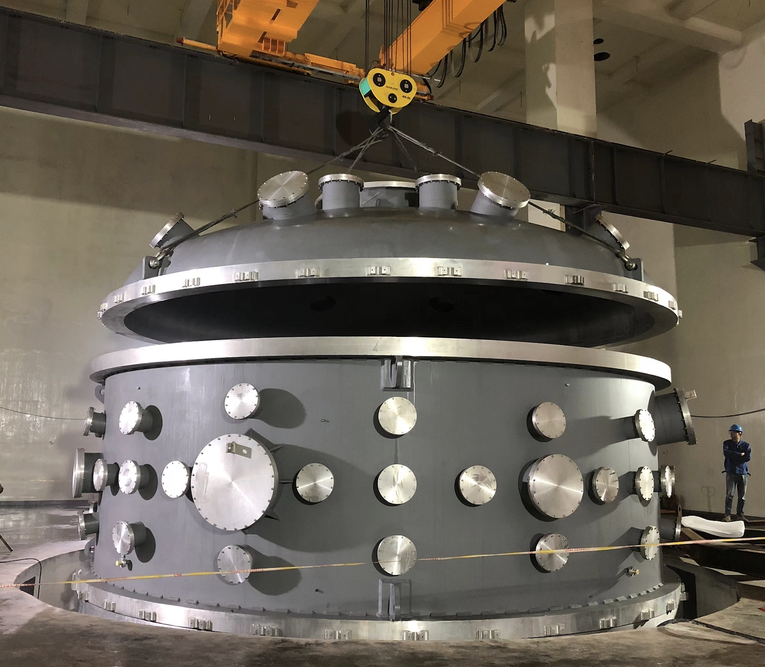
The interaction chamber has been installed.

Slide 16
Outline
Background
High field Photon-photon scattering
High field axion-like particle generation

Slide 17
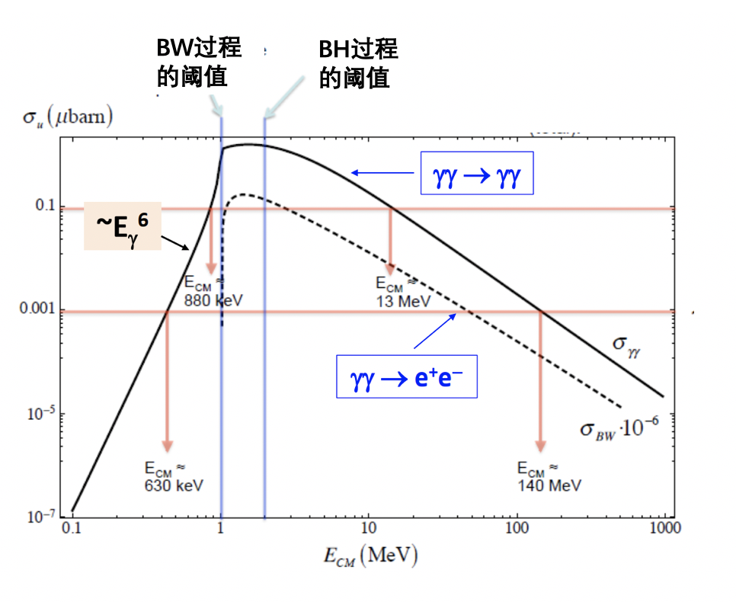
（单光子）光光总散射截面随质心光子能量的变化

Slide 18
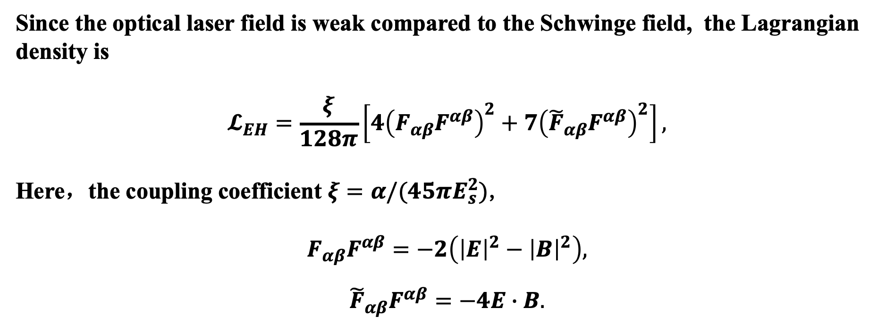
High field Photon-photon scattering
Theoretical methods：
Since the optical laser field is weak compared to the Schwinge field, the Lagrangian density is
$$\begin{aligned}𝓛_{EH}=\frac{ξ}{128π}\left[4{\left(F_{αβ}F^{αβ}\right)}^{2}+7{\left({\tilde{F}}_{αβ}F^{αβ}\right)}^{2}\right],\#\end{aligned}$$
Here，the coupling coefficient $ξ=α/(45πE_{s}^{2})$,
$$\begin{aligned}F_{αβ}F^{αβ}=−2\left({\left|E\right|}^{2}−{\left|B\right|}^{2}\right), \\ \#\end{aligned}$$
$$\begin{aligned}{\tilde{F}}_{αβ}F^{αβ}=−4E∙B.\#\end{aligned}$$

Slide 19
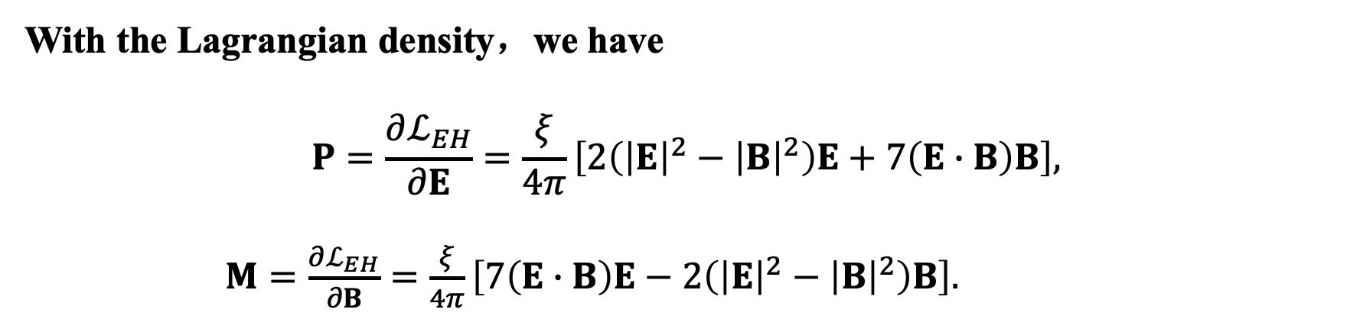
High field Photon-photon scattering
Theoretical methods：
With the Lagrangian density，we have
$$\begin{aligned}P=\frac{∂ℒ_{EH}}{∂E}=\frac{ξ}{4π}\left[2\left({\left|E\right|}^{2}−{\left|B\right|}^{2}\right)E+7\left(E∙B\right)B\right],\#\end{aligned}$$
$\begin{aligned}M=\frac{∂ℒ_{EH}}{∂B}=\frac{ξ}{4π}\left[7\left(E∙B\right)E−2\left({\left|E\right|}^{2}−{\left|B\right|}^{2}\right)B\right].\#\end{aligned}$
Photon-photon scattering can changes the polarization, energy and transverse momentum of the photons.

Slide 20

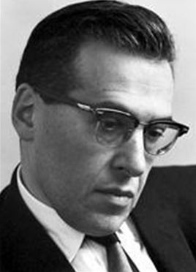
Detecting vacuum birefringence with XFEL + 100 PW laser
In 1930’s, W. Heisenberg et al. predicted vacuum birefringence, the QED effect in vacuum. But it has never been observed in laboratory.
In 1940-50’s, Schwinger et al. established the systematic theory on QED and defined the Schwinger critical field.
In 1960, Maiman invented laser. the Schwinger critical field correspond to the laser intensity 10²⁹W/cm². CPA technology helps the quick increase of laser intensity. But, with single ultra intense laser alone, it is still very difficult to study vacuum birefringence.
XFEL provides an excellent solution for us to detect high field vacuum birefringence in laboratory.

Slide 21
Detecting vacuum birefringence with XFEL + 100 PW laser
The refractive factors for the XFEL beam along the laser electric field and magnetic field is
One efficient way is to collide the two beams to maximize the difference of the refractive factors.
Taking into account the pulse profile in space and time domain, the modified ellipticity of the XFEL beam is
Laser intensity
Wavelength of XFEL

Slide 22
The phusical design for the experiment of vacuum birefringence has been published .
(2018)

Slide 23
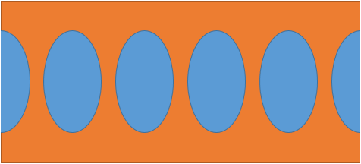

Detecting vacuum birefringence with XFEL + 100 PW laser
f=100 m
L=1100 m
f=5 m
f=5 m
………
Chamber
CRLs
Analyzer
CRLs
CRL
Detector
XFEL
T₃=0.81
T₄=0.81
T₂=0.3
T₅=0.3
T₂=0.96
Propagation efficiency：T=T₁*T₂*T₃*T₄*T₅=0.055
XFEL Photon number for detection per shot is
10¹² x 1.74x10⁻¹⁰ x 0.055 = 9.6

Slide 24
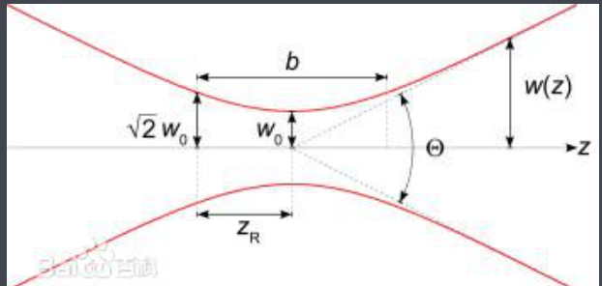
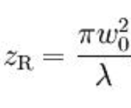
Detecting vacuum birefringence with XFEL + 100 PW laser
f=100 m
L=1100 m
f=5 m
f=5 m
………
Chamber
Analyzer
Polarizer
CRL
Detector
XFEL
For focal size 5μm
Damage threshold ?
Nuclear Inst. and Methods in Physics Research, A 982 (2020) 164553

Slide 25
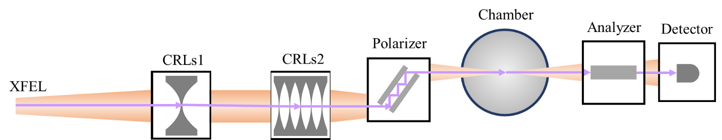
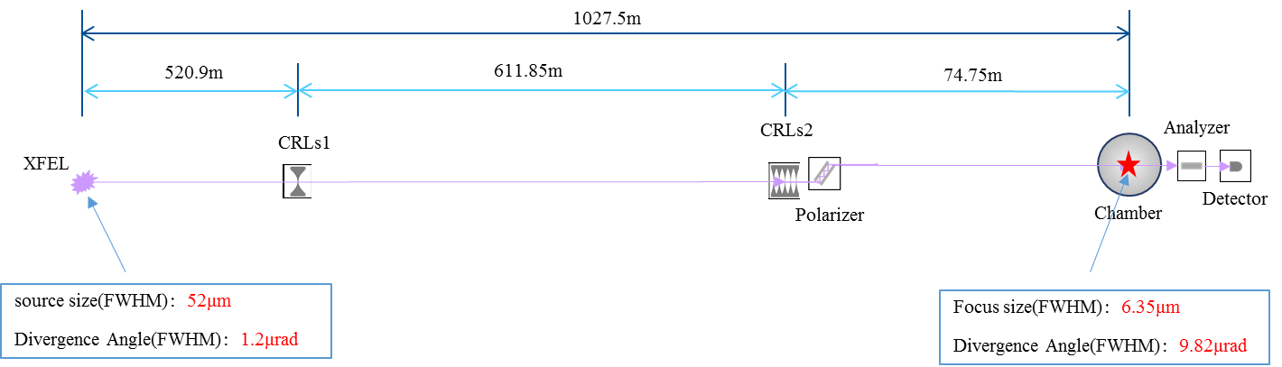
XFEL beamline layout for vacuum birefringence experiment
Nuclear Inst. and Methods in Physics Research, A 982 (2020) 164553

Slide 26
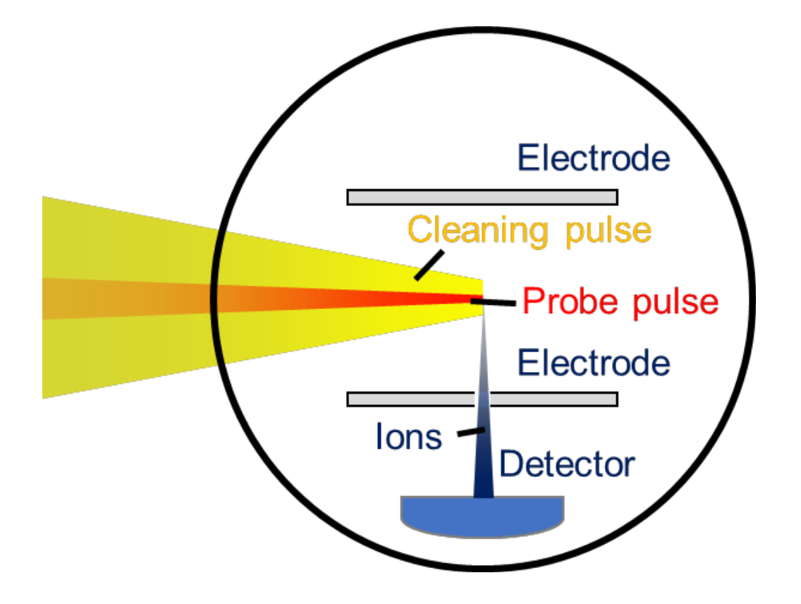
The cleaning method of vacuum is studied to improve the vacuum degree.

Slide 27
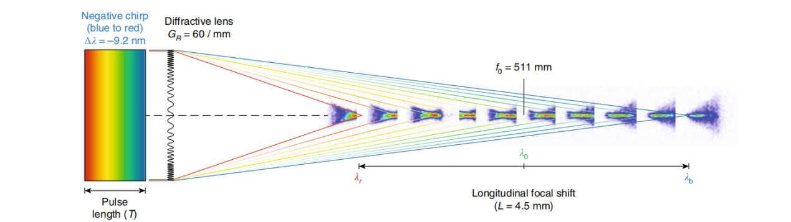

Enhancement of vacuum birefringence with pump laser of flying focus
XFEL
The velocity of the focal spot
The lights of different frequencies are focused to the different positions.
Froula D H, Turnbull D, Davies A S, et al. Spatiotemporal control of laser intensity[J]. Nature photonics, 2018, 12(5): 262-265.

Slide 28
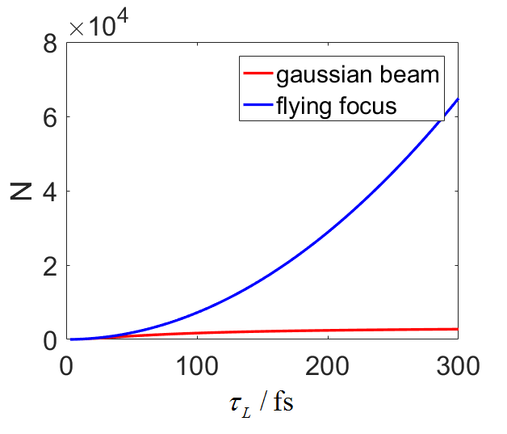
Enhancement of vacuum birefringence with pump laser of flying focus
The velocity of the focal spot is –c.
The probe light move together with the focal spot, so the interaction area is increased.
B. Jin and Baifei Shen, Phys. Rev. A 107, 062213 – Published 27 June 2023

Slide 29
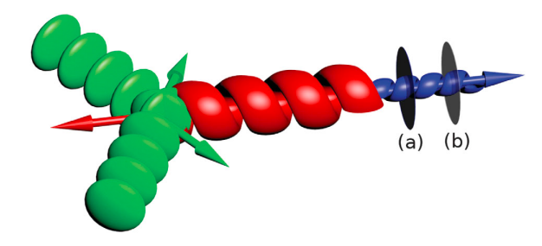
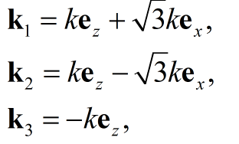



Angular momentum may be used to increase the signal to noise ratio
Input laser
Scattering
light
Aboushelbaya R, Glize K, Savin A F, et al. Orbital angular momentum coupling in elastic photon-photon scattering[J]. Physical Review Letters, 2019, 123(11): 113604.

Slide 30

Four wave mixing in vacuum
1. For the case of using XFEL and optical laser, one XFEL photon absorbs two optical photons, emitting a new signal photons.
The photon energy is changed: one can measure the change of 1eV@10keV
2. For planar waves propagating in the same direction, the process of four wave mixing does not happen.

Slide 31
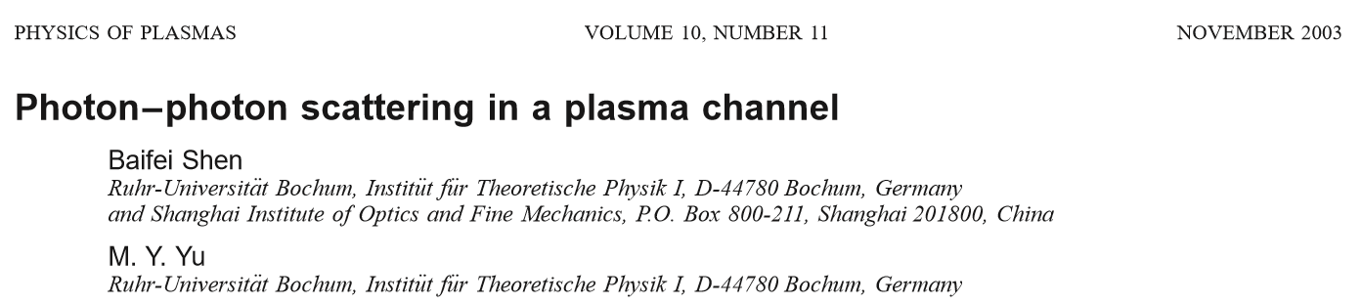

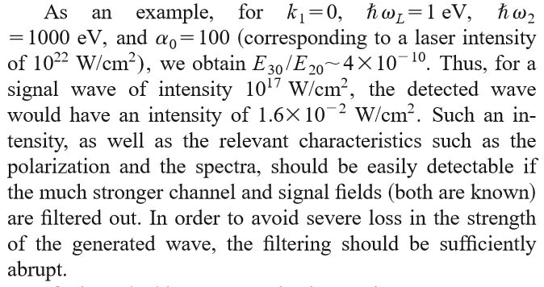
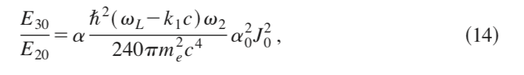
Wave mixing in plasma channel
Four wave mixing
10²²W/cm² Optical laser
+10¹⁷W/cm², 1 KeV XFEL
2003

Slide 32
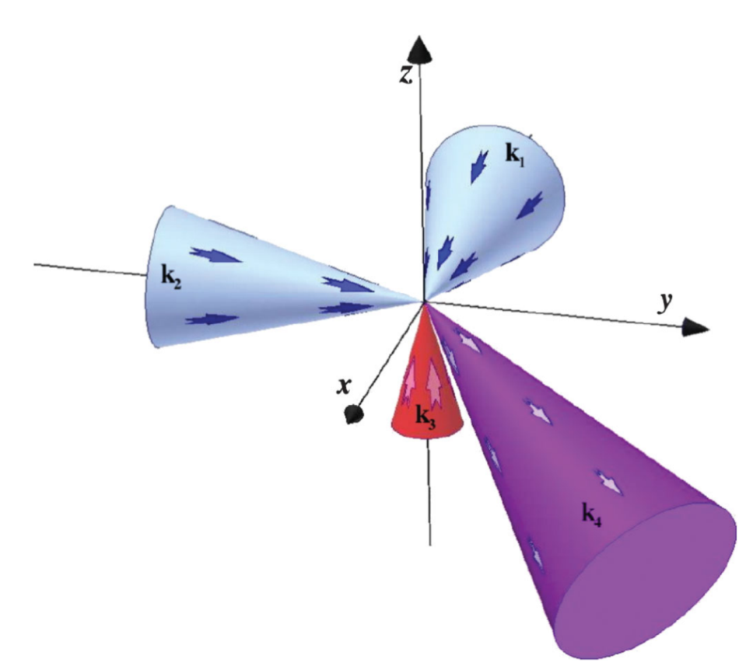
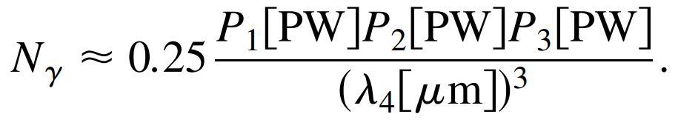
Wave mixing with three pulses
Laser powers
Signal photon
Wave length of X-ray
k1, k2: colliding lasers
K3 probe x-ray
K4: signal
Phys. Rev. Lett. 96, 083602 (2006).
Phys. Plasmas14, 064503 (2007).

Slide 33
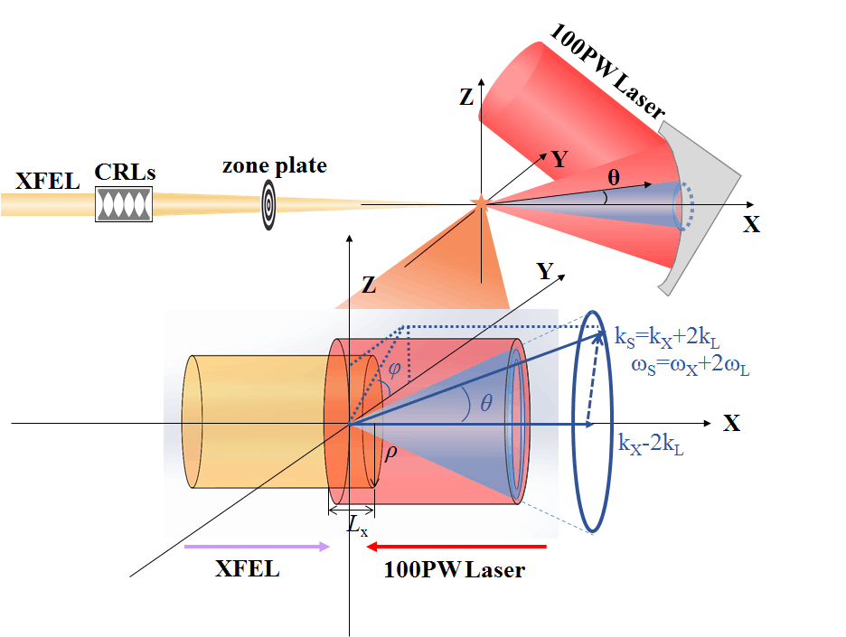
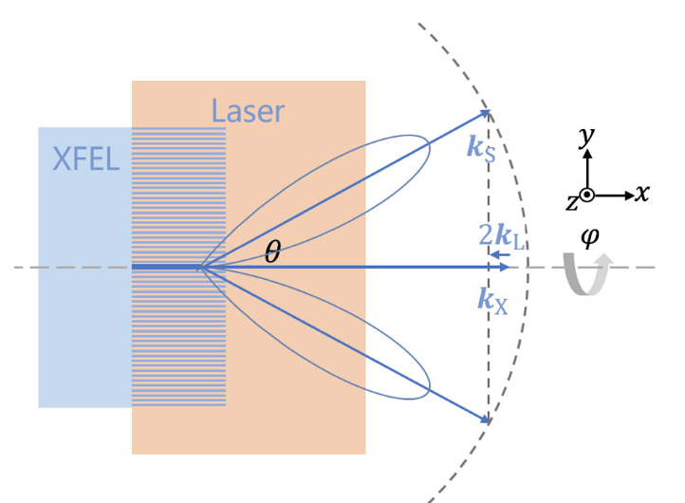
We propose to use colliding XFEL and optical laser to detect the four wave mixing signal
Energy and momentum conservation ？
PHYSICAL REVIEW D 100, 013004 (2019)

Slide 34

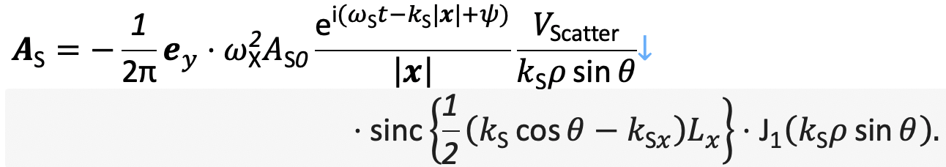
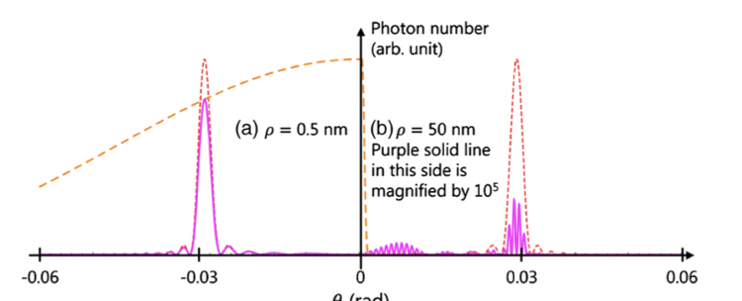
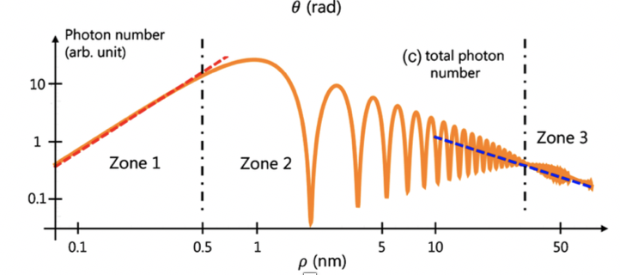
The signal depends on interaction length (Sinc function) and transverse size(Bessel function)

Slide 35
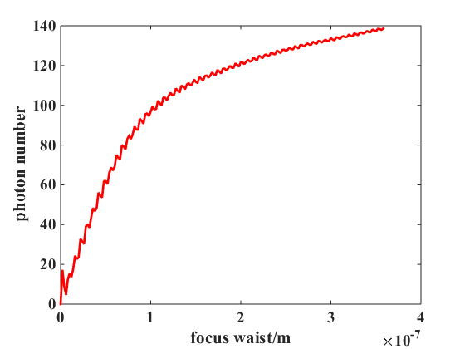
We can use a zone plate to greatly increase the signal photon number.
Here we detect signal photon at different place with different photon energy. The high polarization purity is not required.

Slide 36
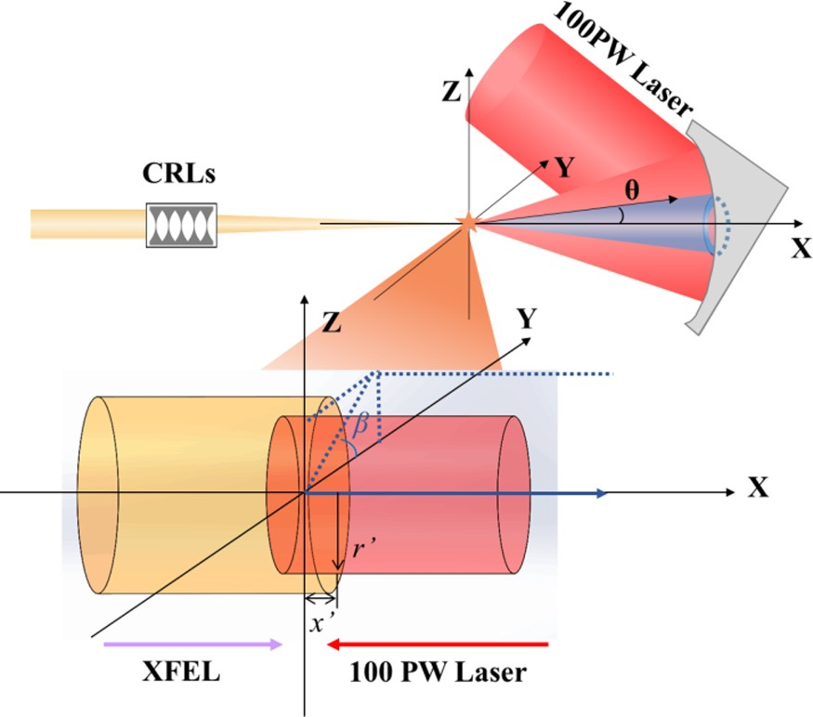
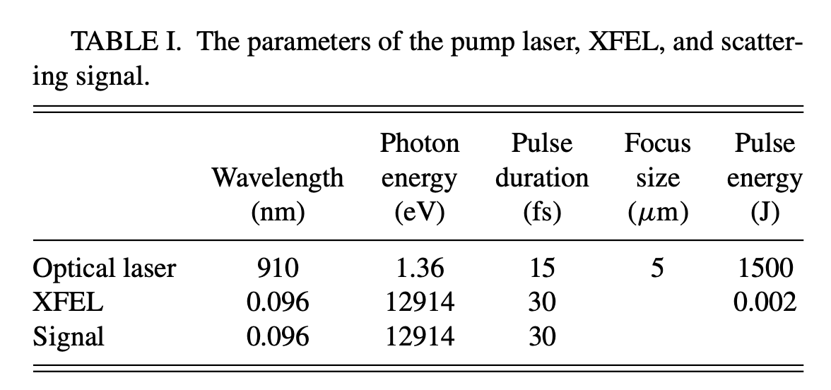
Enhancement of vacuum diffraction by interference of signals produced by a probe x-ray free-electron laser with multiple transverse modes
1. Here the focal size of XFEL is larger that the one of the optical laser. The XFEL is diffracted by the optical laser. The propagation direction or the transverse momentum is changed.
2. When multiple transverse modes are used, the diffraction could be enhanced in some angle.
The transverse momentum is changed.
B. Jin and Baifei Shen, PHYSICAL REVIEW A 106, 013502 (2022)

Slide 37
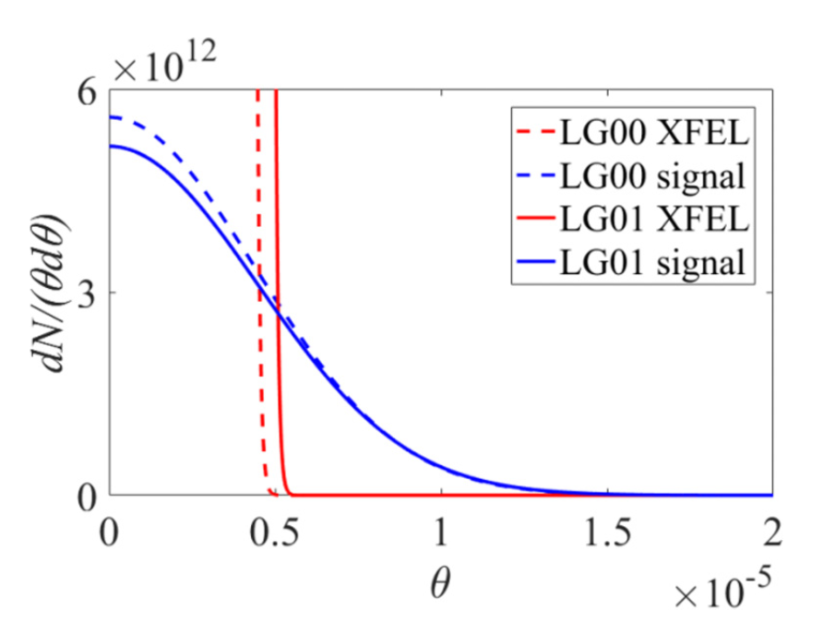
Enhancement of vacuum diffraction by interference of signals produced by a probe x-ray free-electron laser with multiple transverse modes
The angular distribution of scattering photon for LG (0,0) and LG (0,1) mode is different.
By measuring the angular distribution, we can know the photon-photon scattering.
Angular distribution of scattering photon (blue line) and background XFEL (red line) with wX = 25 μm and wL = 5 μm for LG (0,0) mode (dotted line) and LG (0,1) mode (solid line).

Slide 38
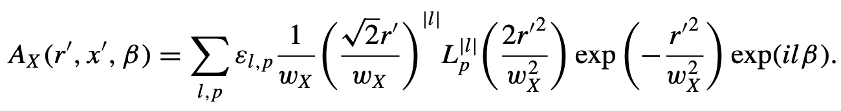
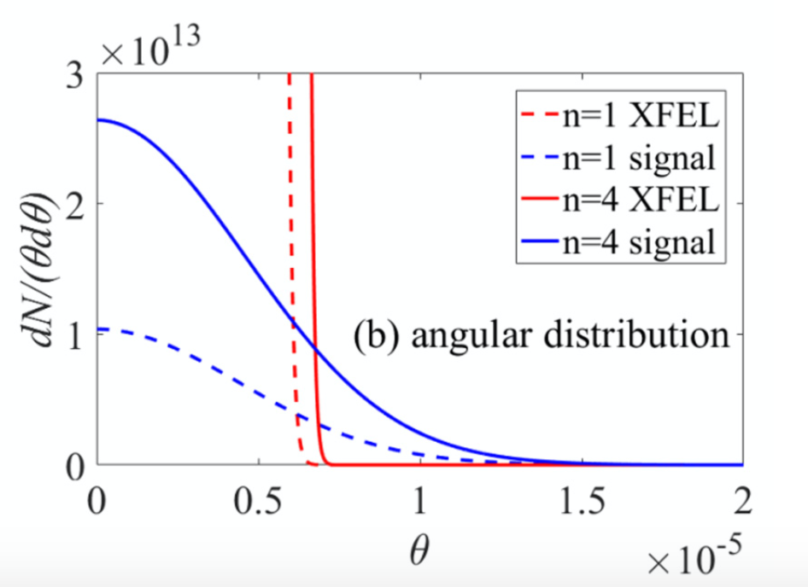
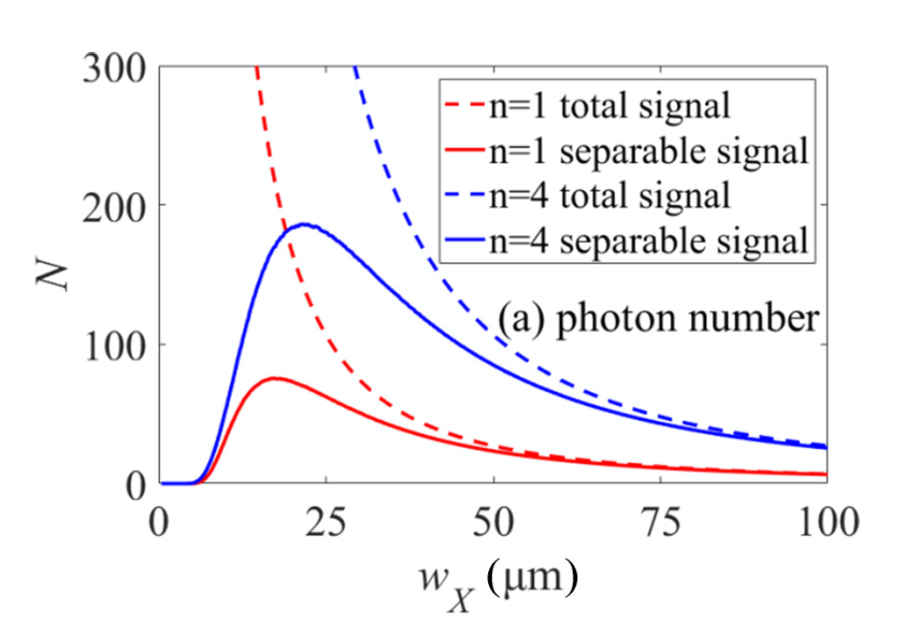
Enhancement of vacuum diffraction by interference of signals produced by a probe x-ray free-electron laser with multiple transverse modes
More X-ray photons are scattered to the larger angle due to the interference between the scattering light from different modes.
Solid lines：detectable photon numbers

Slide 39
Outline
Background
High field Photon-photon scattering
High field axion-like particle generation

Slide 40
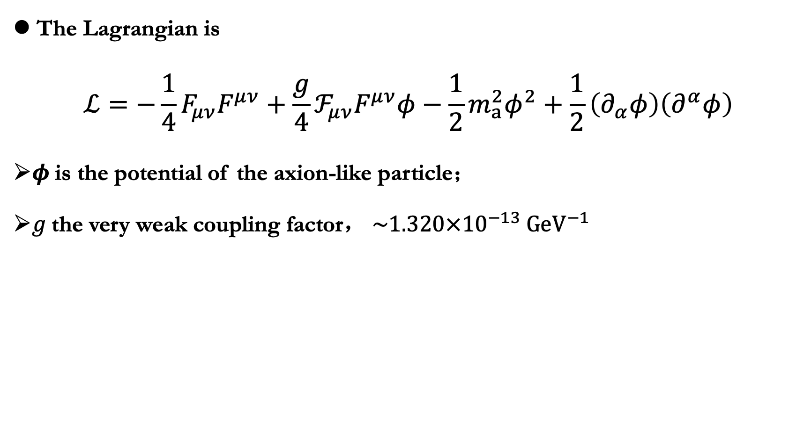
Axion-like particle generation in laser-plasma interaction
In the minimal axion models like the KSVZ model , one axion couples with two photons.
Viewing from a macroscopic perspective, one can treat this axion-diphoton (‘aγγ’) process as a three-wave mixing.
The Lagrangian is
$$ℒ=−\frac{1}{4}F_{μν}F^{μν}+\frac{g}{4}ℱ_{μν}F^{μν}φ−\frac{1}{2}m_{a}^{2}φ^{2}+\frac{1}{2}\left(∂_{α}φ\right)\left(∂^{α}φ\right)$$
$φ$is the potential of the axion-like particle；
$g$the very weak coupling factor，$\sim 1.320×{10}^{−13} {GeV}^{−1}$

Slide 41
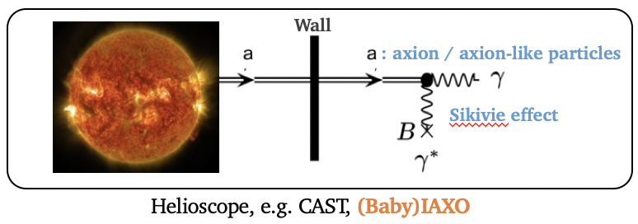
强场类轴子产生和探测
太阳轴子的探测：
轴子和强磁场相互作用产生光子进行测量
CAST 的目的是探测能量为14 keV 的太阳轴子流。若太阳轴子流存在， 一个由长数十米的磁铁提供的强度为数十特斯拉的静磁场可以将一部分轴子转换为 X 射线光子，随后被望远镜尽头的 X 射线探测器发现 。

Slide 42
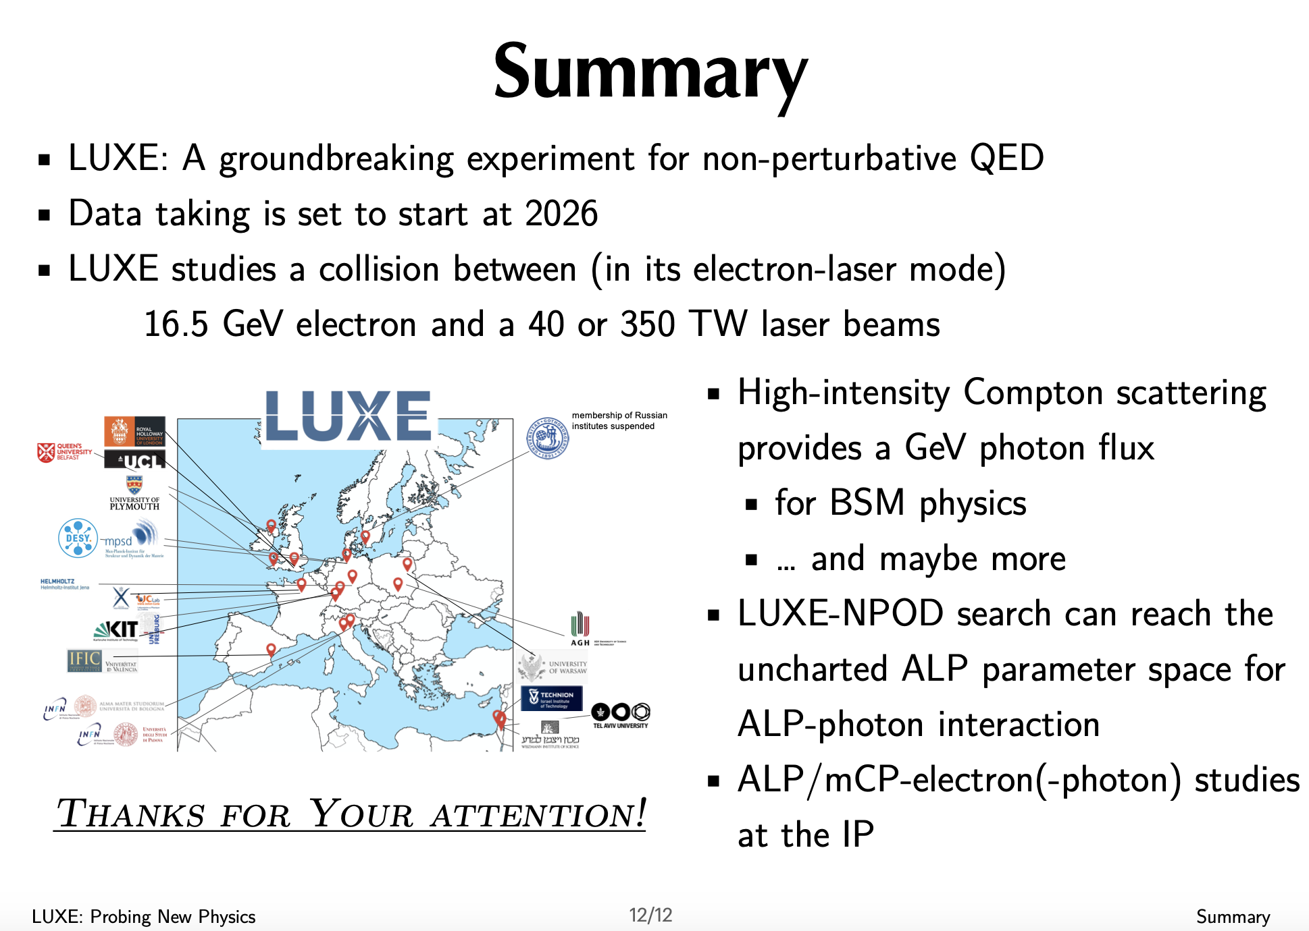
PPT由黄杉提供

Slide 43
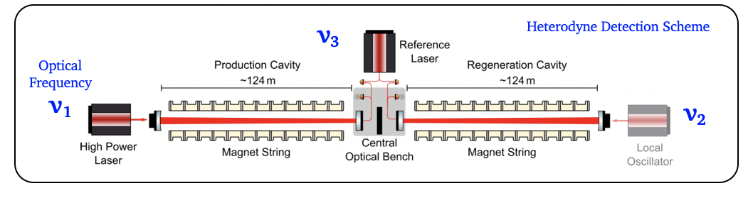
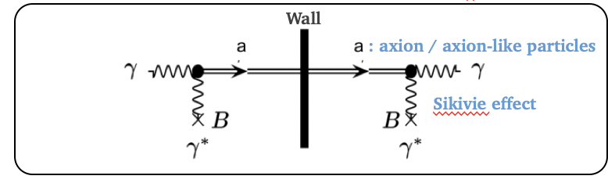
强场类轴子产生和探测
LSW方案 = Light Shining through a Wall
STEP 1: 光在强磁场下产生轴子流．
STEP 2: 光和轴子流一起运动；光被墙阻挡，而轴子穿墙而过．
STEP 3: 轴子在强磁场下被转化为光子．
两步过程的信号是二阶小量

Slide 44
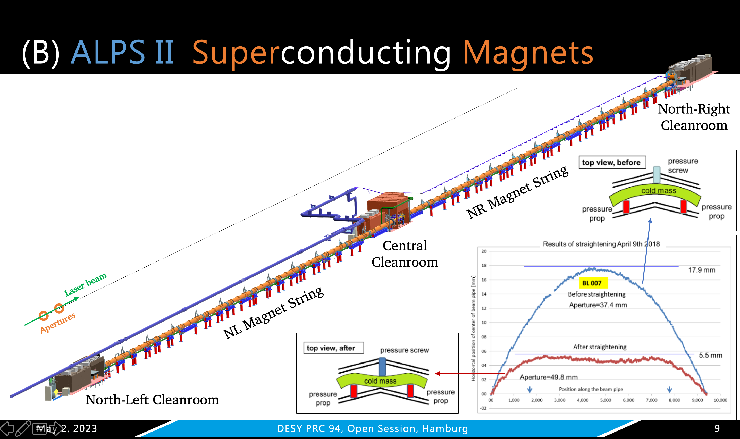

Slide 45


Axion-like particle generation in laser-plasma interaction
Electromagnetic interaction may drive the generation of axion-like particle.
$$\left(∂_{t}^{2}−∇^{2}+m^{2}\right)φ=−gE⋅B$$
At the same time, the production of axion-like particle changes the electromagnetic field.
$$∇⋅E=gB⋅∇φ \\ ∇×B−∂_{t}E=g\left(E×∇φ−B∂_{t}φ\right) \\ ∇⋅B=0 \\ ∇×E+∂_{t}B=0$$

Slide 46

Axion-like particle generation in laser-plasma interaction
$$\left(∂_{t}^{2}−∇^{2}+m^{2}\right)φ=−gE⋅B$$
The intense laser provides much stronger electromagnetic field but much smaller interaction area than static magnetic field.
The laser field of a=100 is 4 orders larger than the static magnetic field of 100T. It means that the interaction length can reduced from 1km to 10 micrometer.
One dimensional three wave mixing:
Ψ1 = 𝜓1 exp {−𝚥(𝜔1𝑡 − 𝑘1𝑥)}
Ψ2 = 𝜓2 exp {−𝚥(𝜔2𝑡 ∓ 𝑘2𝑥)}
(𝜕𝑡2 − ∇2 + 𝑚23)Ψ3 = 𝑔TWMΨ1Ψ2
𝜔32 =𝑘32 +𝑚23, 𝑚3 ≥0.
Phys. Scr. 97 (2022) 105303

Slide 47
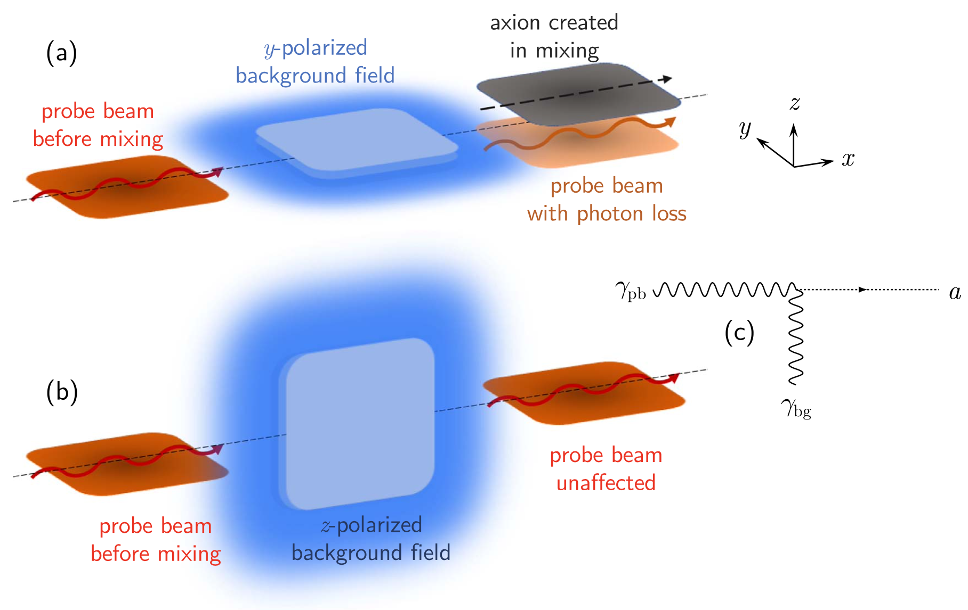
Axion-like particle generation in laser-plasma interaction
We use the B field the probe and the E field of the laser driven plasma to produce the axion-like particles.
If the polarization direction of probe and the E field direction of the plasma has 45 degree. The polarization direction of the probe is changed when axion-like particles are produced.
The probe could be XFEL
Sketches of the interaction between a magnetically y-polarized probe and electrically (a) y-polarized or (b) z-polarized background field..

Slide 48

Axion-like particle generation in laser-plasma interaction
Two cases are discussed.
Phys. Scr. 97 (2022) 105303

Slide 49
Thank you for your attention

Slide 50




XFEL driven wakefield acceleration
Acceleration gradient can be increased greatly by using crystal or nano tube.

Slide 51





Plasma could provide high acceleration gradient
Conventional accelerator
(gradient= 10⁷⁻⁸V/m)
Laser accelerator
(gradient = 10¹¹⁻¹²V/m)‏
气体喷流
驱动激光
Courtesy of W. Mori & L.O. Silva
100 um
(for n_{e}=10¹⁹ cm⁻³)‏
Radiofrequency cavity (1 m-long)‏
3D PIC simulation of a plasma wave (UCLA)‏
51

Slide 52

High-repetition few-attosecond high-quality electron beams generated from crystal driven by intense X-ray laser

Slide 53

The sharp boundary provides good injection control for electron acceleration.

