Slide 1
polarized electron in dual spin directions and hadron polarization maintenance
Minxiang Li
Notes:
大家好，我是李民祥。今天我要讲的题目是通过让平衡极化率达到80%以上来维持对撞环中电子束的极化率在整个对撞时间内都大于80%。

Slide 2
Content:
Overview of Beam Polarization in the EicC
Electron Beam Polarization
Light Ion Beam Polarization

Slide 3
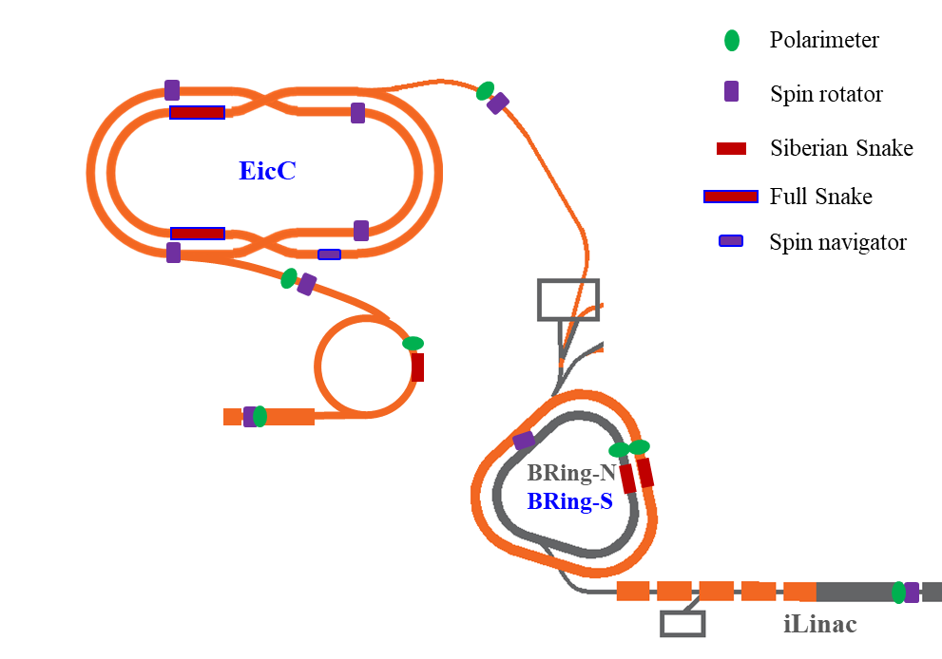
Introduction of polarization design
EicC plans to collide a 19.08GeV, 70% polarization proton beam with a 3.5-5GeV, 80% polarization electron beam in dual spin direction.
Flip frequency
p
192 bunches each injection × 2
0.52 MHz
Electron polarization maintain:
The polarization in dual spin direction
Frequent bunch replacement
e
96 bunches each injection × 4
1.04 MHz
Proton polarization maintain:
the spin resonance in BRing-N
Non-ramping snake
the spin resonance in BRing-S
A Siberian snake
19.08 GeV
67 intrinsic res.
34 imperfect res.
polarized ³He²⁺, ²H⁺
2 GeV
8 intrinsic res.
4 imperfect res.
Loss pol.
200 MeV
Parallel to the main dipole field will loss polarization due to Sokolov-Ternov self-polarization

Slide 4
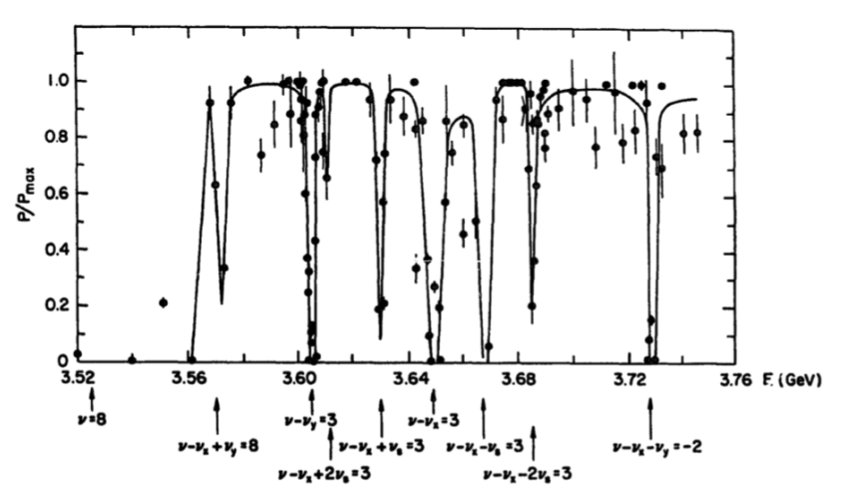
Electron Beam Polarization
The equilibrium polarization anti-parallel to the main field direction can reach 80%;
If only the polarized electron anti-parallel to the main field direction is needed, the polarizability will be maintained and top-up injection can supplement intensity;
For the average polarization parallel to the main field direction, the beam lifetime needs to be very short to reach 80% P_{avg}. However, lifetime is usually longer.
$$P_{avg}=\frac{P_{eq}}{1+τ/{τ_{b}}}+\frac{P_{inj}}{1+{τ_{b}}/τ}$$
E[GeV] | 3.5~5
average radius R [m] | 183.22
bending radius ρ [m] | 25.00
time constant τ [min] | 60.40~359.37
equilibrium polarization | 80%
beam lifetime τ_{b} [min] | 3.75~22.5
Polarization measurements at SPEAR

Slide 5
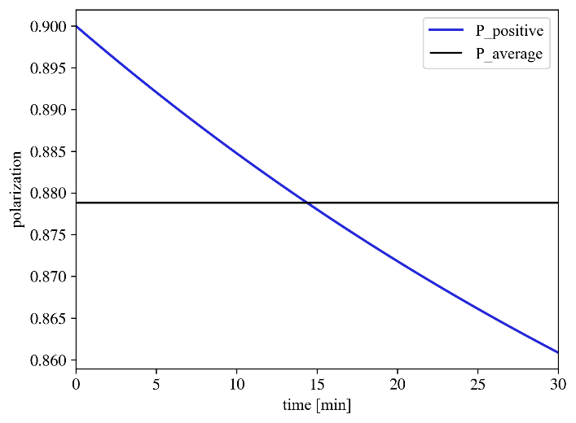
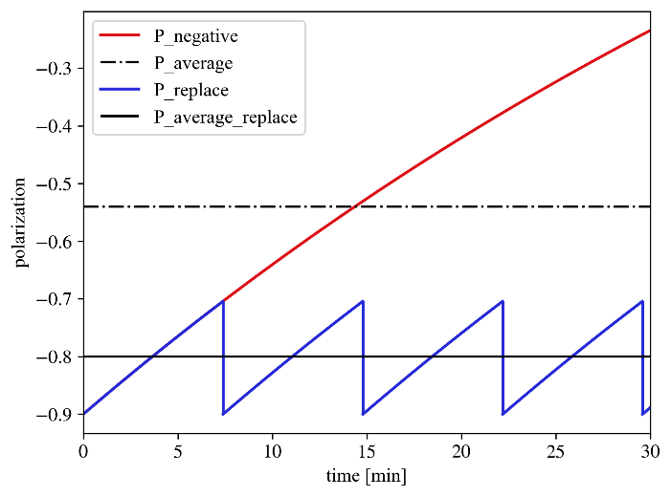
Electron Beam Polarization
If the entire electron beam is directly replaced, the required beam replacement time can be obtained according to the polarization lifetime;
Since the charge of a single beam of the polarized electron gun is only 1/3 to 1/4 of the collision beam, replacing the entire electron beam requires an additional ring to merge 3 to 4 electron beams.
E[GeV] | 3.5~5
average radius R [m] | 183.22
bending radius ρ [m] | 25.00
time constant τ [min] | 60.40~359.37
equilibrium polarization | 80%
time to replace the bunch [min] | 7.40~44.02

Slide 6
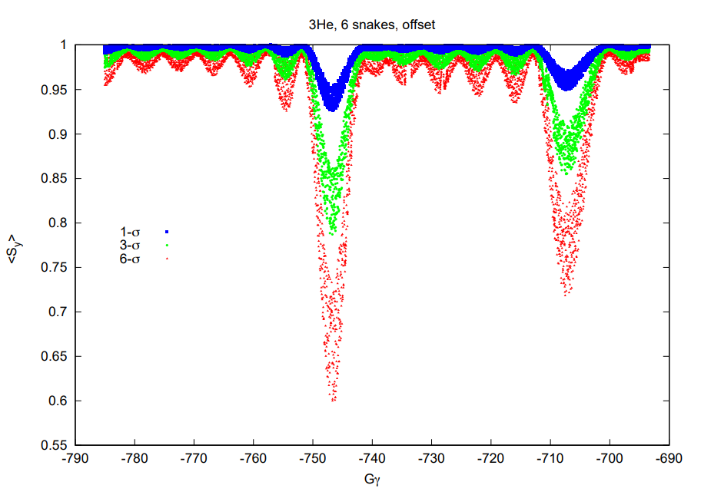
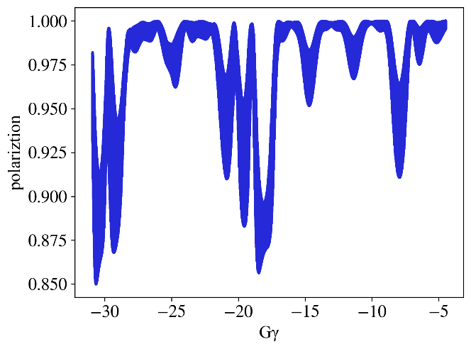
Light Ion Beam Polarization
³He²⁺ is more difficult to maintain polarization than proton;
BNL avoids depolarization by increasing the number of snakes from 2 to 6;
According to simulations, a full snake can control the polarization loss of ³He²⁺ in BRing-N within 10%. More sophisticated snake designs are still in progress.
2 → 6 snakes
acc
Polarization of ³He²⁺ in the RHIC with 6 snakes
 |  | ¹H⁺ | ²H⁺ | ³He²⁺
G |  | 1.79 | -0.14 | -4.18
Ek [GeV] | BRing-N | 0.048~9.23 | 0.048~4.21 | 0.064~5.89
 | BRing-S | 9.23~19.08 | 4.21~11.90 | 5.89~16.19
 | pRing | 19.08 | 11.90 | 16.19
$$v_{spin}$$ | BRing-N | 1.89~19.56 | -0.15~-0.79 | -4.47~-30.65
 | BRing-S | 19.56~38.51 | -0.79~-1.97 | -30.65~-76.91
 | pRing | 38.51 | -1.97 | -76.91
acc
Polarization of ³He²⁺ in the BRing-N with a full snake
G=g/2-1: anomalous g-factor

Slide 7
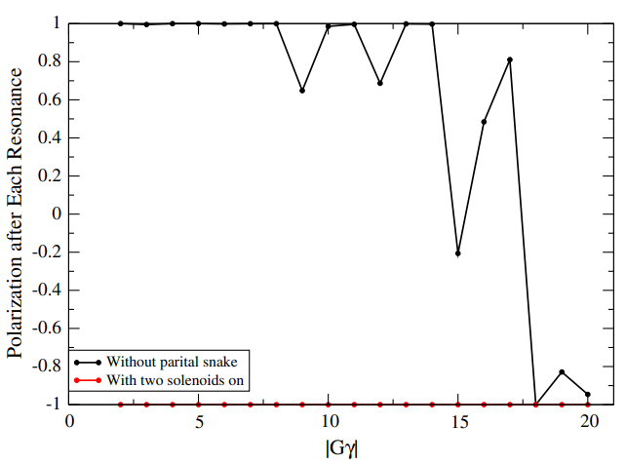
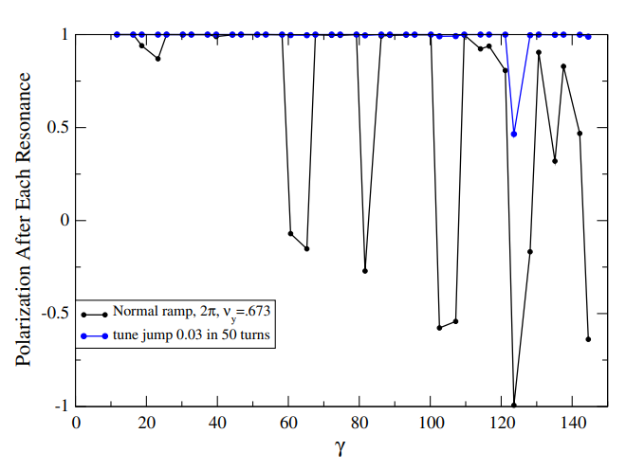
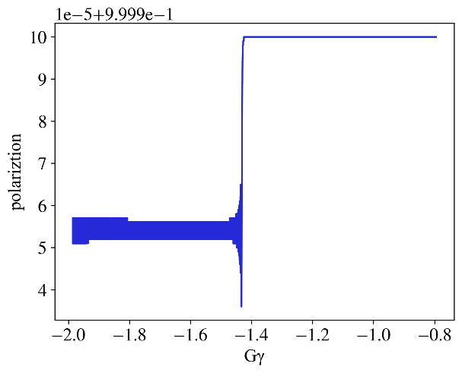
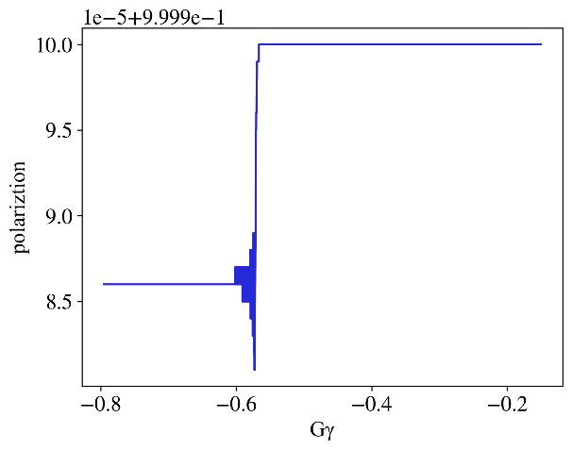
Light Ion Beam Polarization
According to simulations, the polarization of ²H⁺ is not lost in both BRing-N and BRing-S;
In addition, under the collision energy of ²H⁺, the spin tune is close to an integer, which is conducive to spin direction control.
When Gγ is small, RHIC also has no polarization loss.
RHIC avoids imperfect depolarization through two snakes
RHIC avoids intrinsic depolarization through tune jump
acc
acc
Polarization of ²H⁺ in BRing-S
Polarization of ²H⁺ in BRing-N

Slide 8
Summary
The EicC requires to collide a 19.08GeV, 70% polarization proton beam with a 3.5-5GeV, 80% polarization electron beam in dual spin direction.
The electron beams require replacement of the entire beam to obtain high average polarization.
The ²H⁺ beam will not depolarize, and the spin tune is suitable for collision spin direction control.
The snake that maintains ³He²⁺ beam polarization requires more sophisticated design.

