Slide 1
Updates on general design of EicC accelerators for high integral luminosity and spin flip
Jie Liu, liujie115@impcas.ac.cn
Accelerator Physics Group
Institute of Modern Physics, Chinese Academy of Sciences
6th EicC CDR workshop, Huizhou, 21.12.2023

Slide 2
Outline
New EicC general design
Ion accelerator complex
Electron accelerator complex
Polarization
Electron cooling
Accelerator Chapters in the CDR

Slide 3
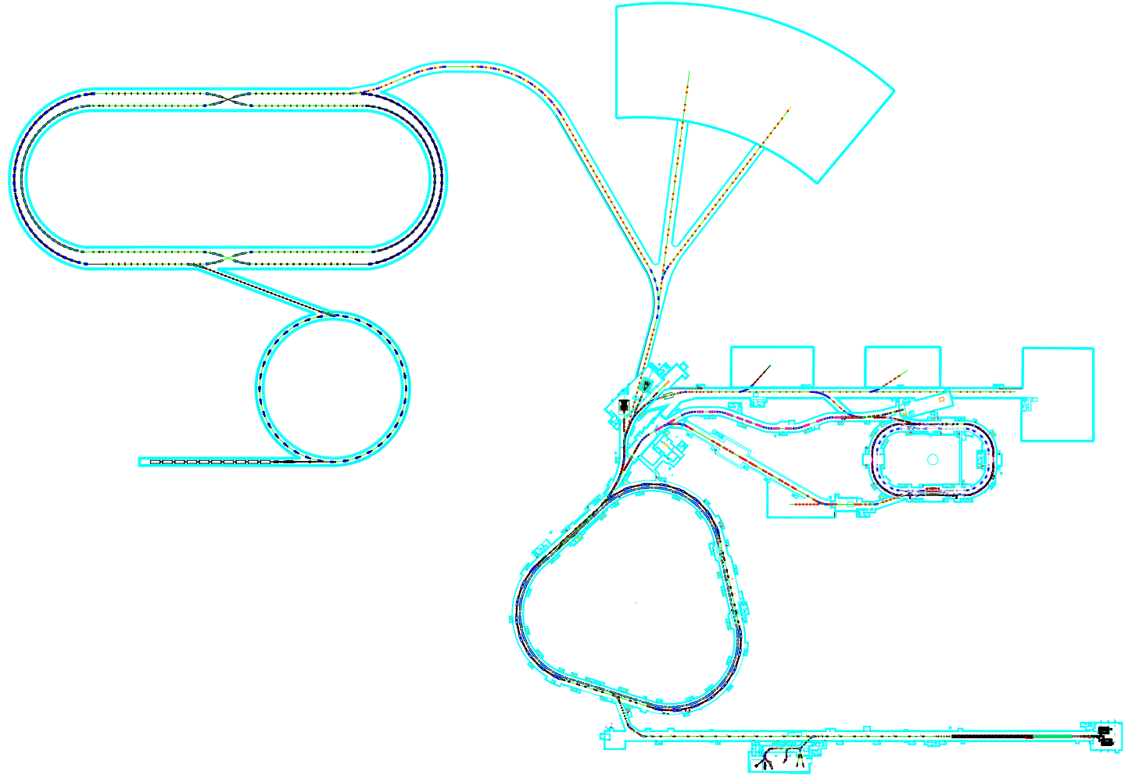
1. New EicC general design – New layout for spin flip
To fulfill the requirements of spin flip, a new electron complex design is proposed.
EicC
HIAF and HIAF-U
pRing ~ 1149.07 m
Full energy injection
eRing ~ 1151.20 m
Based on the HIAF-U
Proton beams can reach the collision energy in the BRing-S
Two available IPs
Accumulation Ring ~ 287.80 m
eLinac
Linac-Ring is replaced with an eLinac and an AR that can accumulate electron bunches (~ 30 nC/bunch while e-gun ~ 7 nC/bunch) and accelerate them to the collision energy.
BRing-N ~ 569.10 m
BRing-S ~ 574.54 m

Slide 4
1. New EicC general design – New layout for spin flip
Four trains of electron bunches with opposite spin directions can exists in the eRing, while two trains of proton bunches are in the pRing.
p
192 bunches each injection × 2
0.52 MHz
1.04 MHz
Flip frequency
e
96 bunches each injection × 4
1.04 MHz
The average polarization of electron bunch trains with different spin direction is 80% and the average polarization of proton trains is 70%.
However, as the spin directions in the eRing cannot match with the spin direction of dipole magnets, electron bunches should be replaced quickly enough due to the self-polarization to keep high average polarization.
More details in the Polarized electron in dual spin directions and hadron polarization maintenance (Minxiang Li)

Slide 5
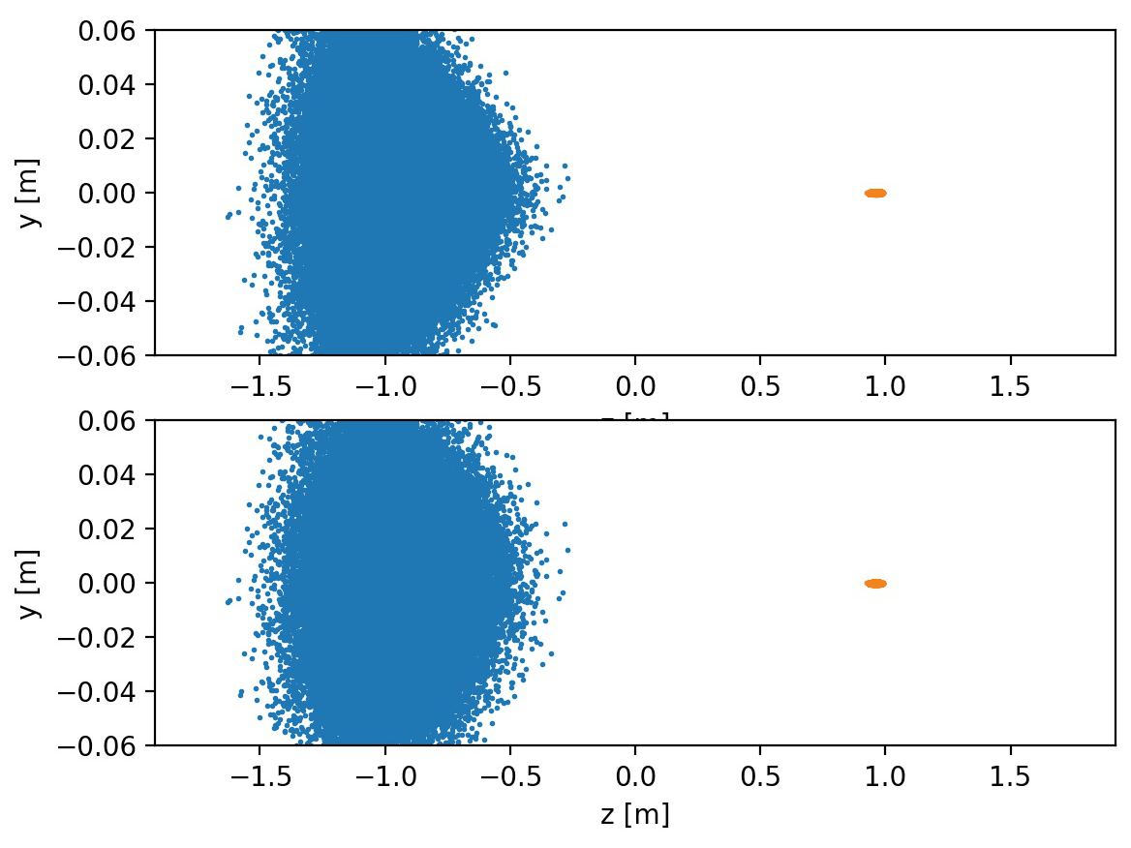
1. New EicC general design – New collision scheme
A new collision scheme called floating-waist is developed to reach the high integral luminosity of 100 fb⁻¹/y while keeping other beam parameters reasonable.
Old scheme
Protons
Electrons
FW scheme
Much higher luminosity
Protons
Electrons
More details in the Updates on ion collider ring optics and collision schemes (Lei Wang)

Slide 6
1. New EicC general design – New collision scheme
New collision scheme compared with the one presented in the 4th workshop
Designs | HIAF | HIAF | HIAF-U-1st | HIAF-U-1st | Floating-waist | Floating-waist
Particle | e | p | e | p | e | p
Circumference(m) | 809.44 | 1341.58 | 1151.20 | 1149.07 | 1151.20 | 1149.07
Kinetic energy (GeV) | 3.5 | 19.08 | 3.5 | 19.08 | 3.5 | 19.08
Momentum (GeV) | 3.5 | 20 | 3.5 | 20 | 3.5 | 20
Total energy (GeV) | 3.5 | 20.02 | 3.5 | 20.02 | 3.5 | 20.02
CM energy (GeV) | 16.76
$f_{collision}$ (MHz) | 100
Polarization | 80% | 70% | 80% | 70% | 80% | 70%
$Bρ$ (T∙m) | 11.7 | 67.2 | 11.7 | 67.2 | 11.7 | 67.2
Particles per bunch (×10¹¹) | 1.7 | 1.25 | 1.7 | 0.76 | 1.7 | 1.05
$ε_{x}/ε_{y}$ (nm∙rad, rms) | 60/60 | 300/180 | 60/60 | 80/40 | 50/15 | 100/50
$β_{x}^{∗}/β_{y}^{∗}$ (cm) | 20/6 | 4/2 | 5.3/1.3 | 4/2 | 10/4 | 5/1.2
Bunch length (cm, rms) | 2 | 4 | 2 | 4 | 0.75 | 8
Beam-beam parameter $ξ_{x}/ξ_{y}$ | 0.09/0.05 | 0.004/0.004 | 0.056/0.028 | 0.017/0.017 | 0.102/0.118 | 0.0144/0.01
Laslett tune shift | - | 0.06/0.09 | - | 0.12/0.19 | - | 0.066/0.105
Energy loss per turn (MeV) | 0.32 | - | 0.32 | - | 0.32 | -
Total SR power (MW) | 0.86 | - | 0.86 | - | 0.86 | -
Average Current (A) | 2.7 | 2 | 2.7 | 1.6 | 2.7 | 1.68
Crossing angle (mrad) | 50
Luminosity (cm⁻²∙s⁻¹) | 2.0×10³³ (50 fb⁻¹/a @ 80%) |  | 4.25×10³³ (105 fb⁻¹/a @ 80%) |  | 4.25×10³³ (H=0.52)

Slide 7
1. New EicC general design – New collision scheme
Compared with other facilities
 | Accelerator | Value | HIAF-U | HIAF-U+FW
Laslett tune shift | ENC | > 0.1 | 0.12/0.19 | 0.066/0.105
 | EIC | ~ 0.06
 | JLEIC | ~ 0.06
 | NICA | < 0.075
Beam-beam parameters for lepton | CESR-B | 0.062 | 0.056/0.028 | 0.102/0.118
 | PEP-II | 0.064/0.055
 | KEKB | 0.12/0.1
 | EIC | ~ 0.1
Beam-beam parameters for hadron | RHIC | 0.015 | 0.017/0.017 | 0.0144/0.01
 | LHC (design) | 0.0034
 | LHC (1 IP / 2 IP) | 0.017 / 0.034
With the new collision scheme, the integral luminosity of the EicC now is twice higher than the one based on HIAF. And the scheme is much more feasible now.

Slide 8
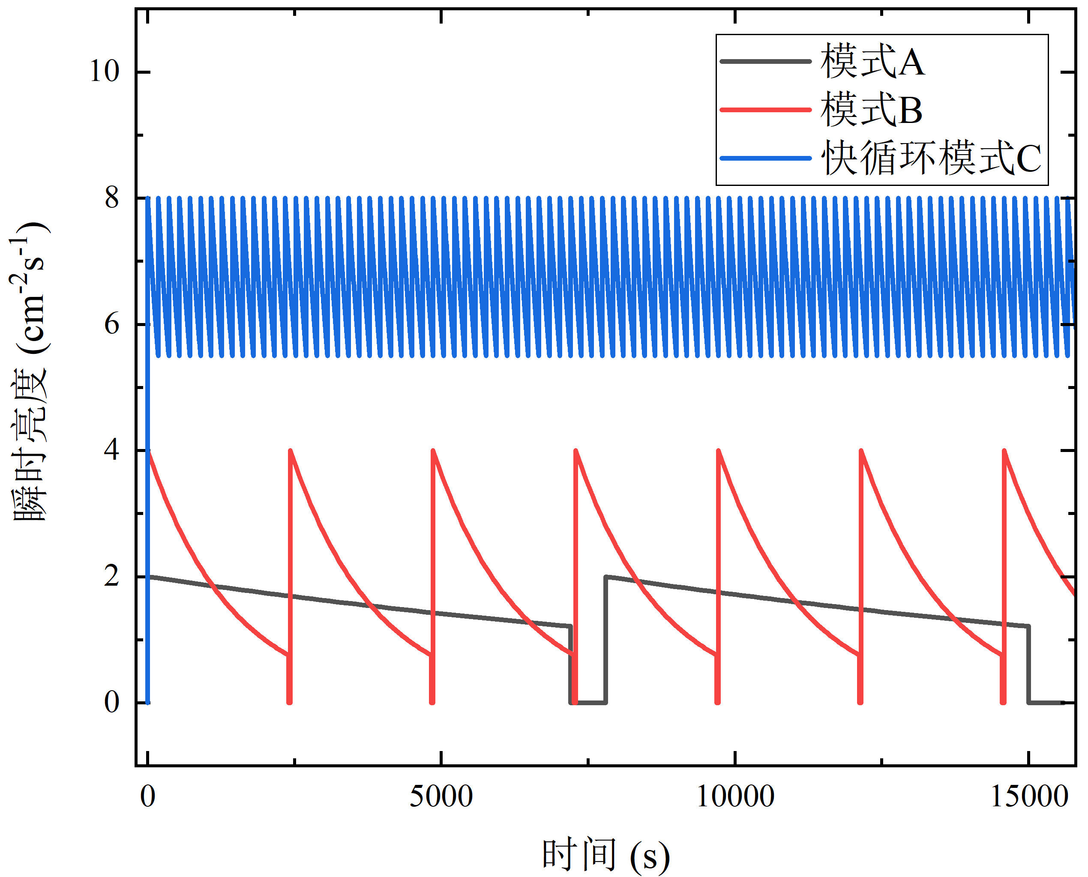
1. New EicC general design – Rapid cycling mode
The high integral luminosity also relies on the special rapid cycling mode supported by the HIAF-U facility.
Replace bunches online in minutes
Old bunches extracted
Beam dump
New bunches injected
In a single turn
High quality, as well as high luminosity, should be kept only in a relatively short time as bunches are replaced quickly.
Luminosity life is not a key problem → higher integral luminosity

Slide 9
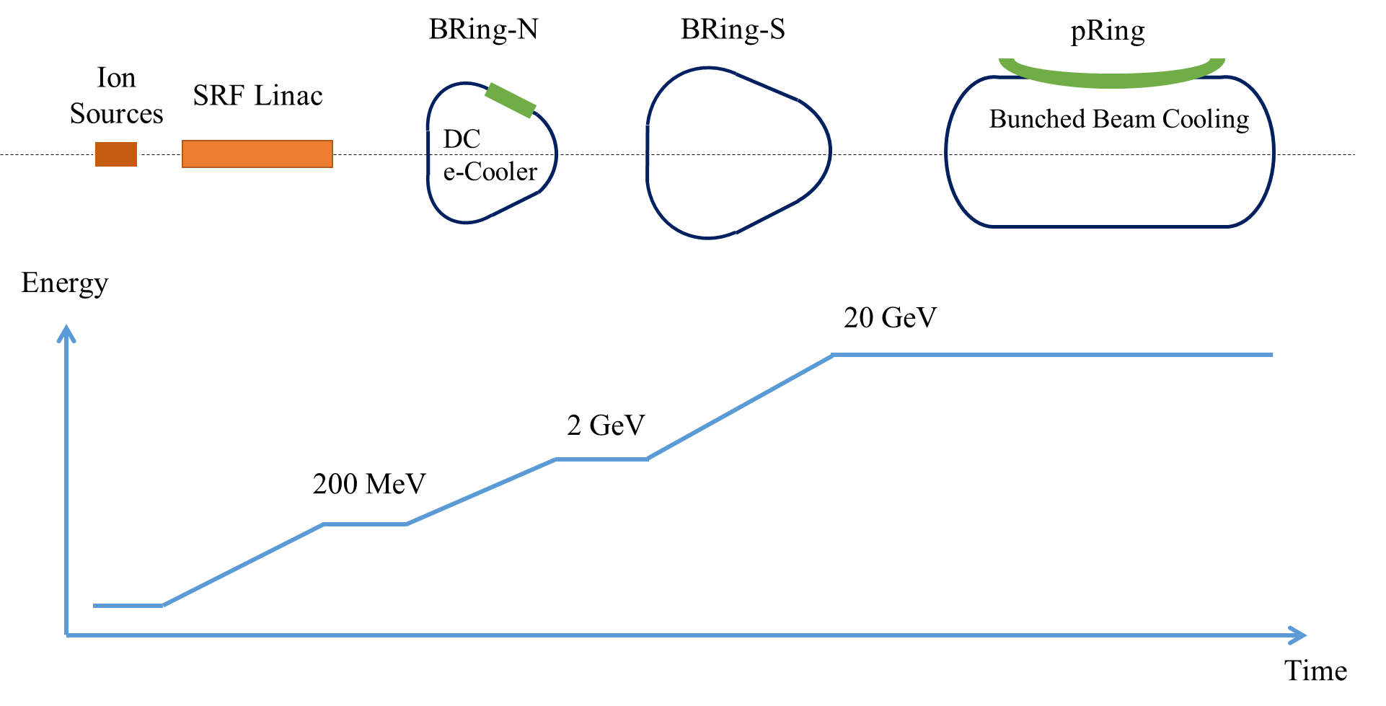
1. New EicC general design – Rapid cycling mode
In the ion accelerator complex, if we use painting injection designed for HIAF and HIAF-U, DC electron cooling in the BRing-N is necessary.
CW
1 bunch
192 bunches
6.77×10¹² ppp injected with the full emittance 74/37 πmm⋅mrad
3 injections: intensity 2.03×10¹³ ppp, rms emittance 200/100 πnm⋅rad
2 injections: 384 bunches, 1.05×10¹¹ ppb，4.05×10¹³ ppp，rms emittance 100/50 πnm⋅rad
Acceleration period ~ 4s, 6x bunch splitting
The replacement time is about 12 min
BRing-N acc. Period ~ 0.1 s, DC electron cooling time ~ 120 s
The cooling time is too long in this design. Maybe new cooling scheme can be applied.

Slide 10
1. New EicC general design – Rapid cycling mode
If we use stripping injection instead of painting injection, electron cooling is unnecessary. The replacement time can be much shorter.
CW
1 bunch
192 bunches
6.77×10¹² ppp injected with the full emittance 18/9 πmm⋅mrad
3 injections: intensity 2.03×10¹³ ppp, rms emittance 200/100 πnm⋅rad
2 injections: 384 bunches, 1.05×10¹¹ ppb，4.05×10¹³ ppp，rms emittance 100/50 πnm⋅rad
Acceleration period ~ 4s, 6x bunch splitting
The replacement time is about 9 s
BRing-N acc. Period ~ 0.1 s
Stripping injection can inject particles continuously in the same phase space regions.

Slide 11
1. New EicC general design – Rapid cycling mode
In the electron complex, the collision bunches will be prepared in the accumulation ring and are separated to 4 trains, in order to provide high average polarization.
7~10 nC in one bunch, and repetition frequency ~ several hundreds of kHz
Electron gun
Also 7~10 nC in one bunch, and increasing energy to match with the injection of AR
Linac
96 bunches in the AR and about 30 nC in each bunch, accumulation, damping, and acceleration to generate collision bunches
AR
eRing
4 injections from AR to replace all bunches completely, opposite spin directions in 4 trains
Linac-ring is not suitable any more for replacing the whole bunch to fulfill spin flip.

Slide 12
1. New EicC general design – Ions
The luminosity of the collisions between ions and electrons are close to 1×10³³ cm⁻²s⁻¹, which means the integral luminosity is close to 25 fb⁻¹/y.
Particle | e | d | ³He⁺⁺ | ⁷Li³⁺ | ¹²C⁶⁺ | ⁴⁰Ca²⁰⁺ | ¹⁹⁷Au⁷⁹⁺ | ²⁰⁸Pb⁸²⁺ | ²³⁸U⁹²⁺
Kinetic energy (GeV/u) | 3.5 | 12.00 | 16.30 | 10.16 | 12.00 | 12.00 | 9.46 | 9.28 | 9.09
Momentum (GeV/u) | 3.5 | 12.90 | 17.21 | 11.05 | 12.90 | 12.90 | 10.35 | 10.17 | 9,98
Total energy (GeV/u) | 3.5 | 12.93 | 17.23 | 11.09 | 12.93 | 12.93 | 10.39 | 10.21 | 10.02
CM energy (GeV/u) | - | 13.48 | 15.55 | 12.48 | 13.48 | 13.48 | 12.09 | 11.98 | 11.87
$f_{collision}$ (MHz) | - | 499.63 | 500.20 | 499.16 | 499.63 | 499.63 | 498.91 | 498.84 | 498.76
Polarization | 80% | Yes | Yes | No | No | No | No | No | No
$Bρ$ (T∙m) | 11.67 | 86.00 | 86.00 | 86.00 | 86.00 | 86.00 | 86.00 | 86.00 | 86.00
Particles per bunch (×10⁹) | 40 | 6.1 | 3.0 | 2.04 | 1.00 | 0.30 | 0.07 | 0.065 | 0.055
$ε_{x}/ε_{y}$ (nm∙rad, rms) | 50/15 | 100/50 | 100/50 | 100/50 | 100/50 | 100/50 | 100/50 | 100/50 | 100/50
$β_{x}^{∗}/β_{y}^{∗}$ (cm) | 10/4 | 5/1.2 | 5/1.2 | 5/1.2 | 5/1.2 | 5/1.2 | 5/1.2 | 5/1.2 | 5/1.2
Bunch length (cm, rms) | 0.75 | 1.5 | 1.5 | 1.5 | 1.5 | 1.5 | 1.5 | 1.5 | 1.5
Beam-beam parameter $ξ_{x}/ξ_{y}$ (10⁻³) | 6/7 | 3/2 | 3/2 | 3/2 | 3/2 | 3/2 | 3/2 | 3/2 | 3/2
Laslett tune shift (10⁻²) | - | 3.7/5.9 | 2.1/3.3 | 5.1/8.1 | 3.7/5.8 | 3.7/5.8 | 5.2/8.3 | 5.2/8.3 | 5.1/8.2
Average Current (A) | 3.3 | 0.42 | 0.48 | 0.49 | 0.48 | 0.48 | 0.44 | 0.43 | 0.40
Crossing angle (mrad) | - | 50 | 50 | 50 | 50 | 50 | 50 | 50 | 50
Hourglass | - | 0.9 | 0.9 | 0.9 | 0.9 | 0.9 | 0.9 | 0.9 | 0.9
Luminosity at nucleon level (cm⁻²∙s⁻¹) | - | 10.09 ×10³² | 7.44 ×10³² | 11.81 ×10³² | 9.92 ×10³² | 9.92 ×10³² | 11.40 ×10³² | 11.18 ×10³² | 10.82 ×10³²

Slide 13
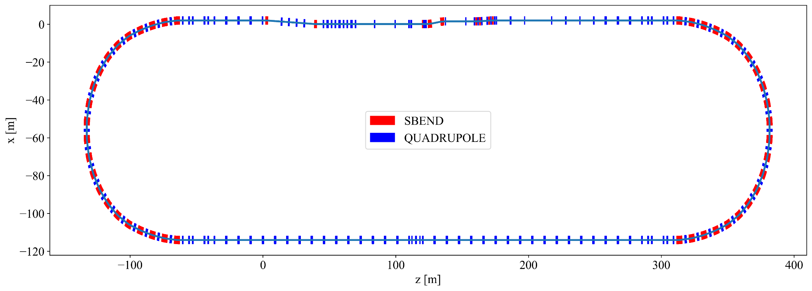
2. Ion accelerator complex
The lattice is preliminarily designed, in which one interaction region will be ready in the first stage, and another interaction region can be installed in the future.
IR
Inj. /Ext.
IP
Chromaticity correction
/Collimation
Reserved IR
Cooling section
RF gymnastics
Racetrack shape, longer linear sections to install other necessary devices
One interaction region is ready in the first stage, another one reserved
Lower chromaticity, correcting the chromaticity while keeping large dynamic apertures
Less requirements for magnet apertures and gradients
Compared with old 8-figure pRing

Slide 14
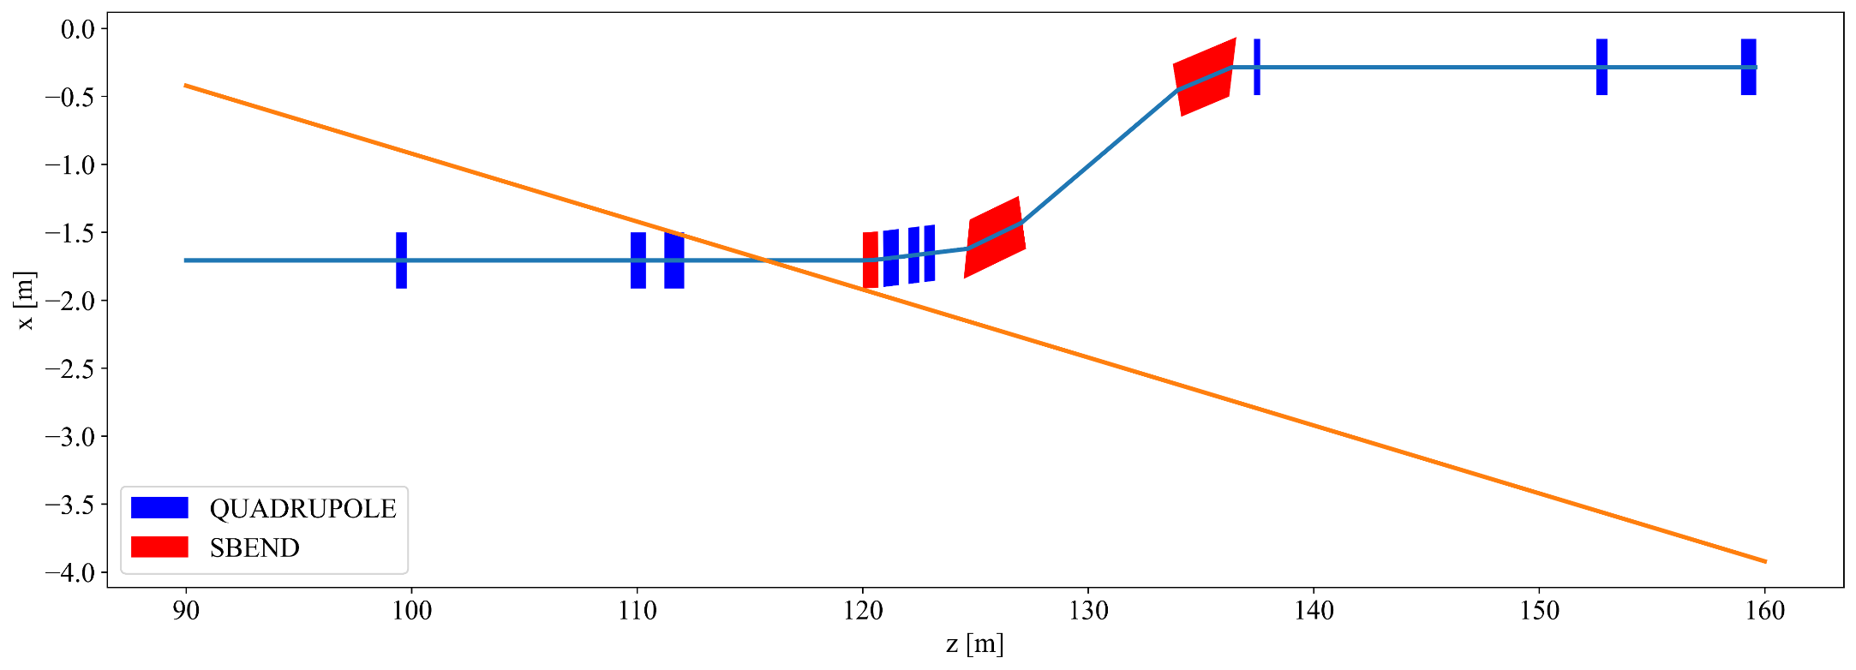
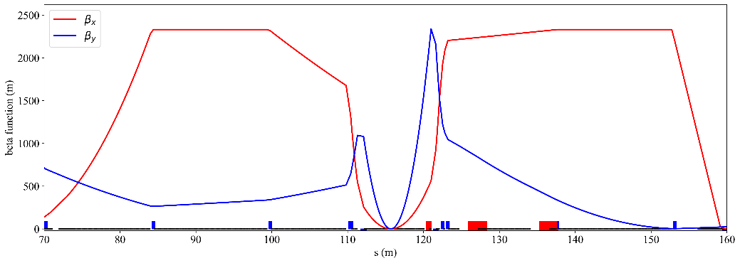
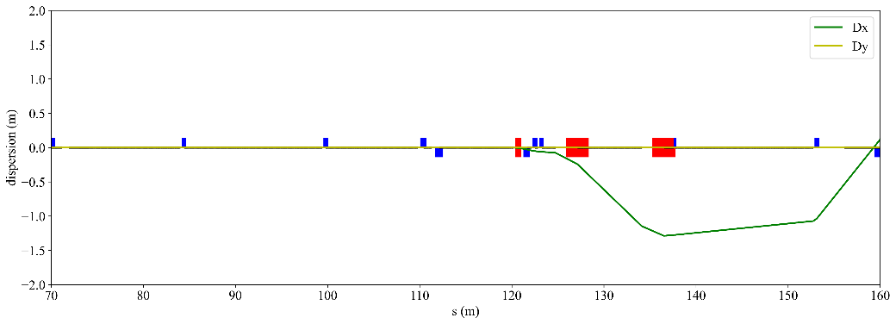
2. Ion accelerator complex
The lattice design also comes with an interaction region design
FDT
Electron beam
crab cavities
BpF2,
-120 mrad
EDT
+/- 25 mrad
BpF1,
-20 mrad
ZDC
Proton beam
+4.4 m/-3.6 m free space for central detectors, and better for magnet designs
Large enough space for ZDC detector with a +/- 25 mrad neutron cone
~15 m for crab cavities with a β up to 2300 m, making it more feasible
~ 1 m dispersion and lower beam angular divergence at the FDT position
Betatron functions
Dispersion functions
More details in the Updates on ion collider ring optics and collision schemes (Lei Wang)

Slide 15
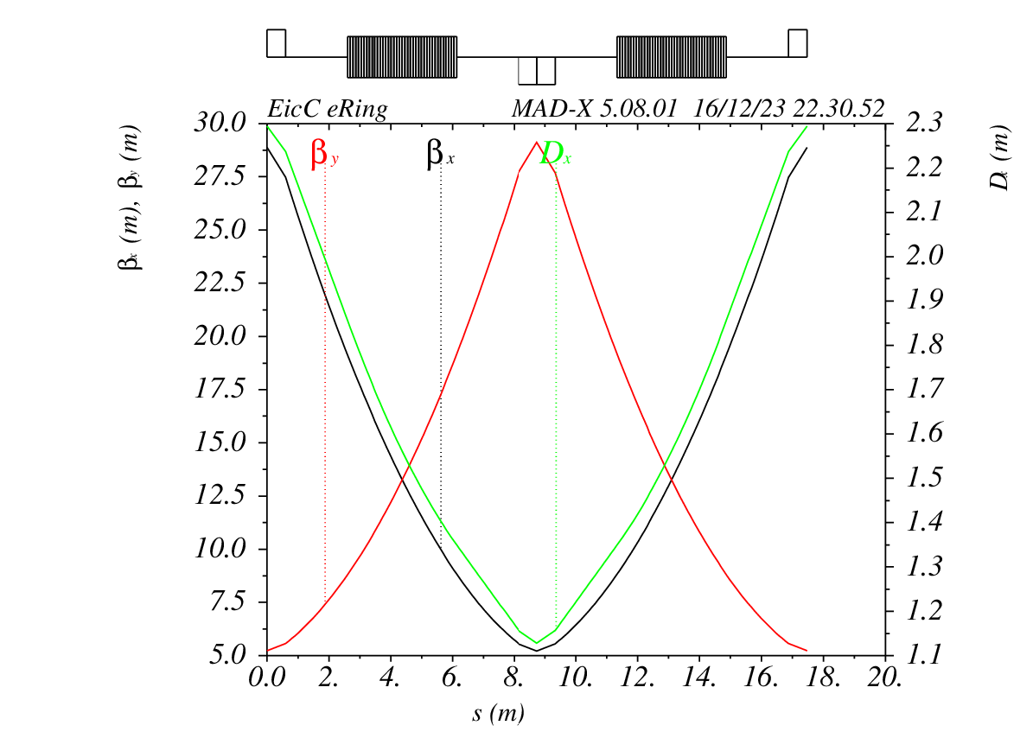
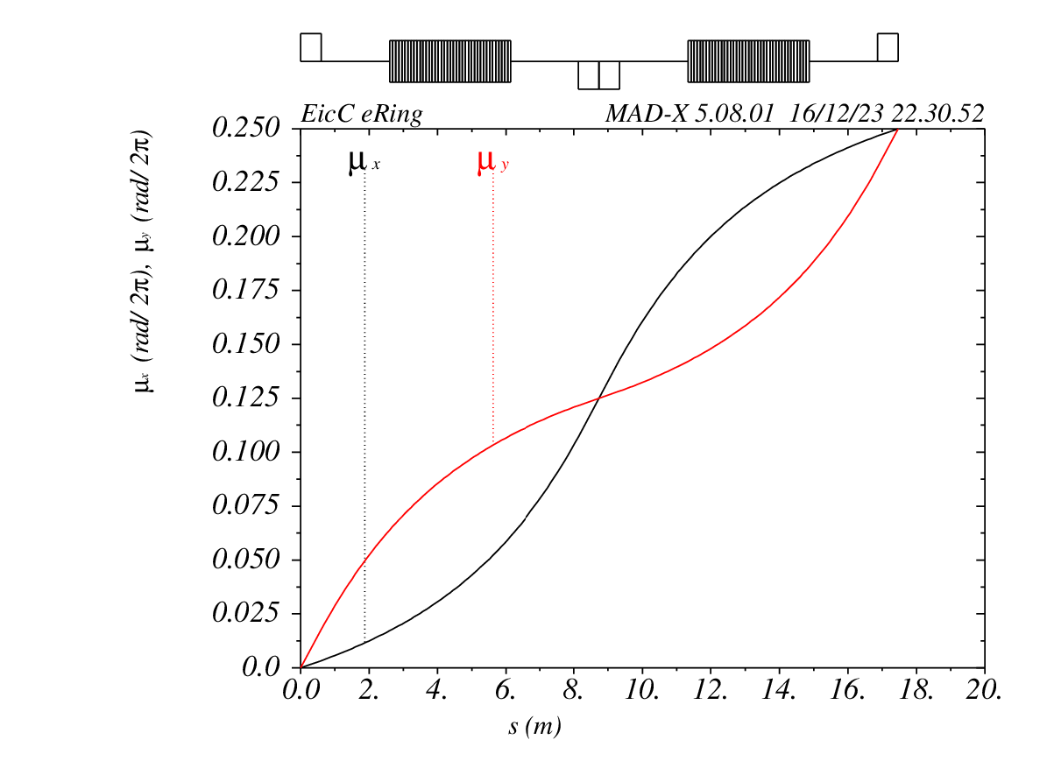
3. Electron accelerator complex
For the electron collision ring, synchrotron radiation is within acceptable limits: 0.72MW, 2.3kW/m @ 3.5 GeV and 3MW, 9.5kW/m @ 5GeV.
Optic design is very important to equilibrium emittance. We choose 90 degree phase advance per FODO cell.
Due to the radiation damping time is too long (13316/26632 turns), the wiggler is needed.
Synchrotron radiation needs to be avoided before entering the IR, which can damage detection equipment and affect detector data acquisition.

Slide 16
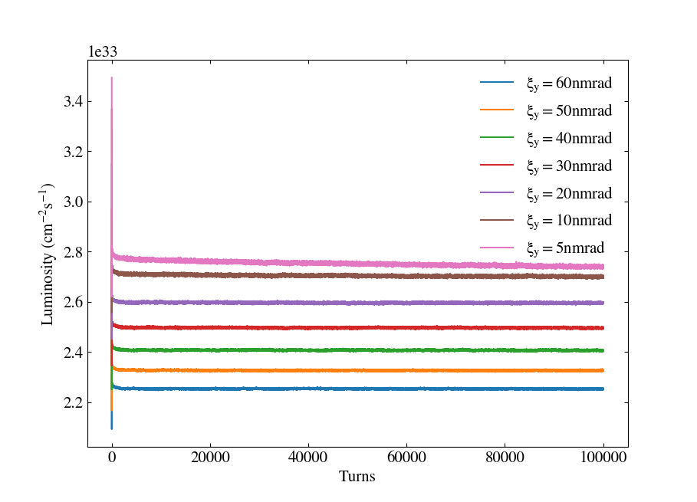
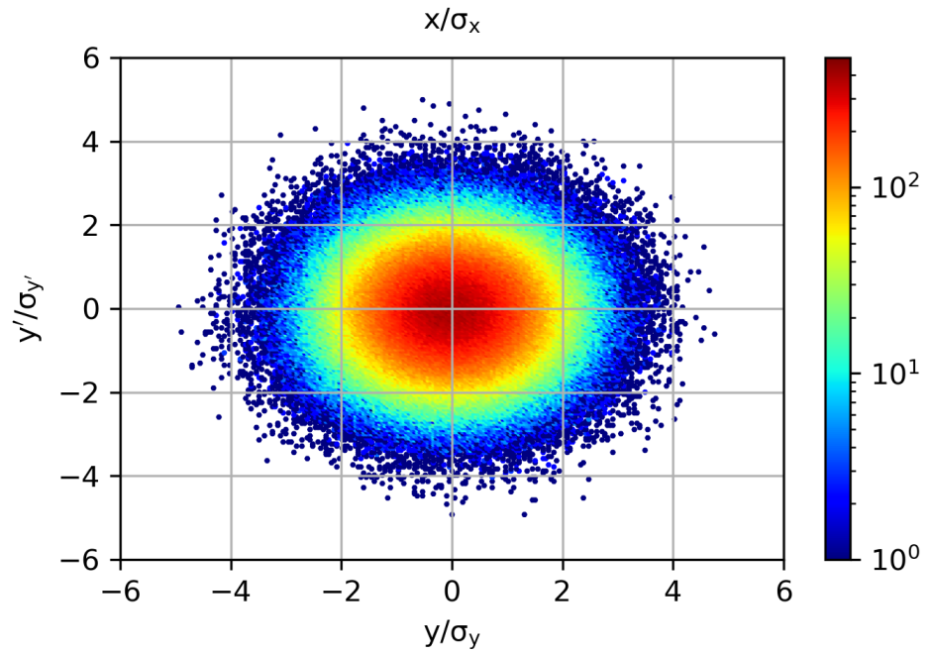
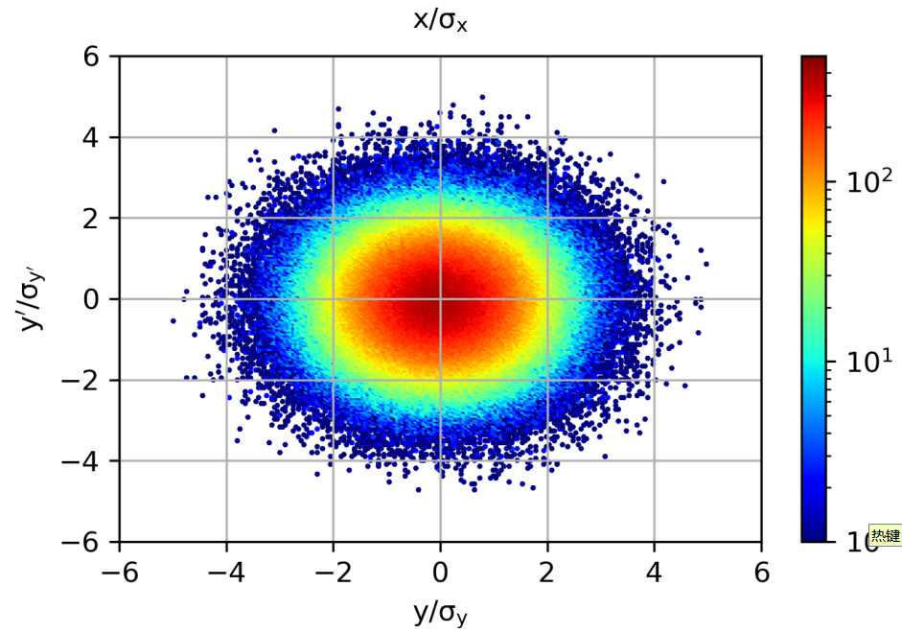
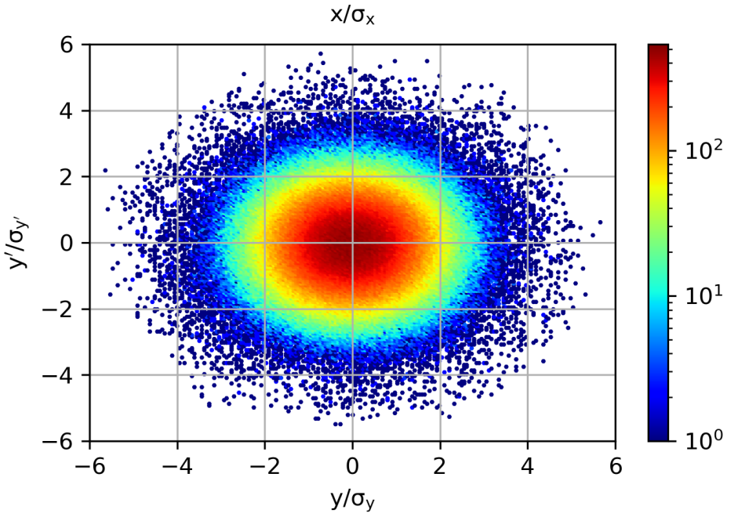
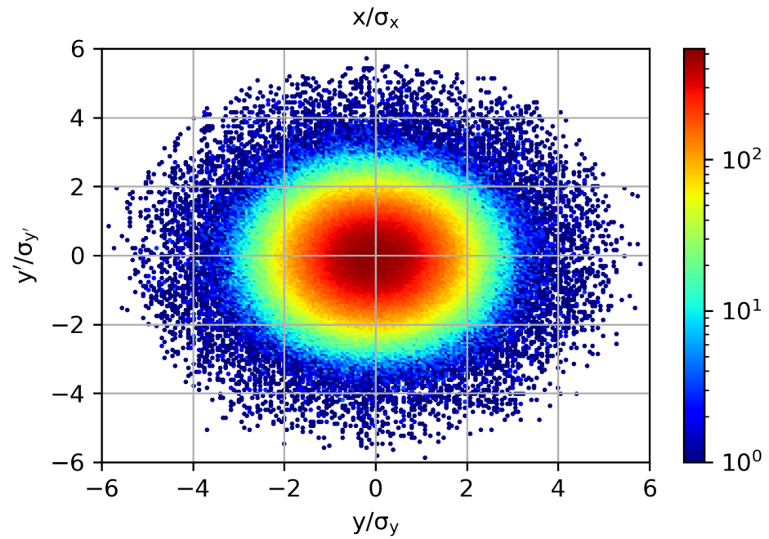
3. Electron accelerator complex
Electron storage rings naturally have a very small vertical emittance, wigglers/ betatron coupling may be used to arrange that value.
Usually, the bunch sizes of electrons and protons at the IP are approximately the same, but if there is still room to reduce the bunch size of electron bunch, the luminosity can be further increased.
Proton y-y’ distribution
εy= 60 nmrad
εy= 40 nmrad
Reduce εy from 60 to 10 nmrad, 1.2x luminosity gain
εy= 10 nmrad
εy= 5 nmrad
The proton beam halo appears to grow and needs to be balanced with electron cooling.
More details in the Research on the electron collision ring of EicC (Mingxuan Chang)

Slide 17
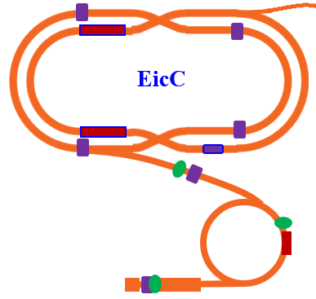
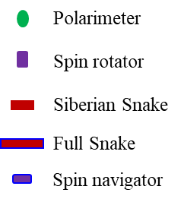
4. Polarization – Electrons
The electron beam will tend to be polarized in the inverse dipole field direction due to the Sokolov-Ternov self-polarization effect. The bunches with opposite spin direction will lose polarization and should be replaced within 7.4 min.
Loss pol.
In the accumulation ring, electron beams will always be accelerated with a spin direction matched to self-polarization. Then spin will be rotated in the opposite direction before the injection of eRing.
The spin direction matched with AR is set right after the e-gun.

Slide 18
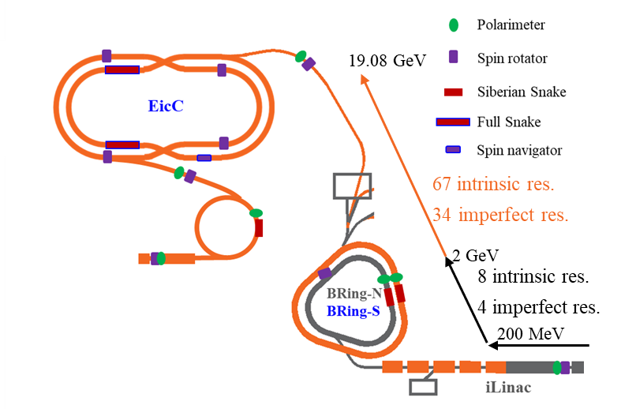
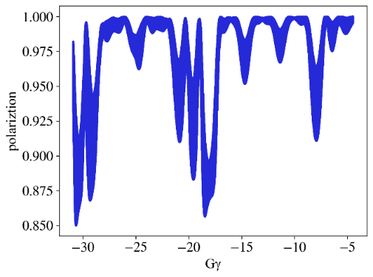
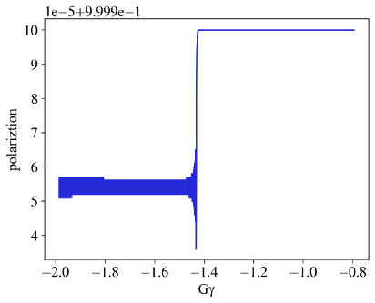
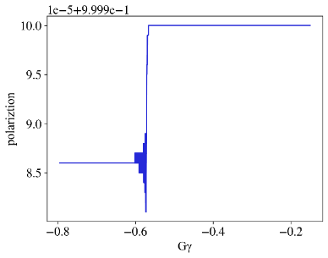
4. Polarization – Ions
The polarized ion beams come out of the ion source and are rotated to one of two spin directions matched with dipole magnet fields by the spin rotator. Then, they are accelerated in these directions.
A fixed field Siberian snake is designed for ¹H⁺ in BRing-N.
Before injecting into pRing, the spin directions will be rotated to required directions
²H⁺,
BRing-S
²H⁺,
BRing-N
A full Siberian snake
³He²⁺, BRing-N
Polarization doesn’t lose.
More details in the Polarized electron in dual spin directions and hadron polarization maintenance (Minxiang Li)

Slide 19
5. Electron cooling
Intrabeam scattering (IBS) leads to a reduction in integral luminosity, beam cooling is needed to suppress the emittance growth during collision.
Electron cooling is more efficient for low energy and low emittance beams.
Two-stage beam cooling：
Pre-cooling for emittance reduction @BRing
Conventional DC e-cooler (<2MeV)
High energy cooling for emit. maintenance @pRing
ERL-based cooler (10MeV)
20 GeV IBS@pRing

Slide 20
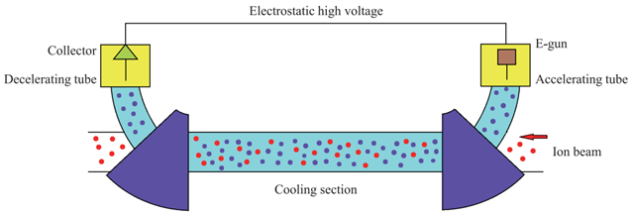
5. Electron cooling
Two-stage beam cooling：
Pre-cooling for emittance reduction @BRing
Conventional DC e-cooler (<2MeV)
The cooling time is about 2 mins for 2GeV p (from 10/5 to 6.4/3.8 π mm.mrad).
Particle | proton
Ion energy | 2 GeV
Particle number in BRing | 4e12
Initial normalized emittance H/V (RMS) | 10/5 π.mm.mrad
Initial momentum spread (RMS) | 0.0003
Electron current | 3 A
Electron beam radius | 15 mm
Effective cooling length | 20 m
Longitudinal magnetic field at the cooling section | 1 T
Beta function at cooler | 25m
Electron beam temperature (transverse/longitudinal) | 0.1/1.0e-5 eV
Much more difficult!
Now, we need to cool the proton beams from 8.4/4.2 πmm mrad to 2.2/1.1 πmm mrad.

Slide 21
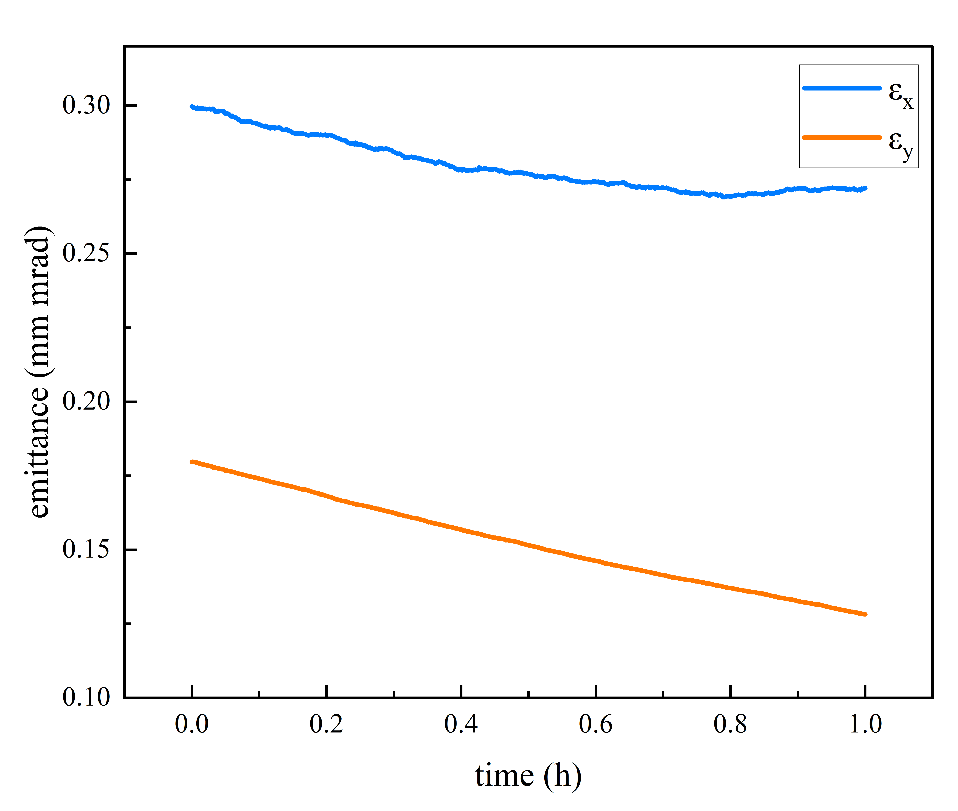
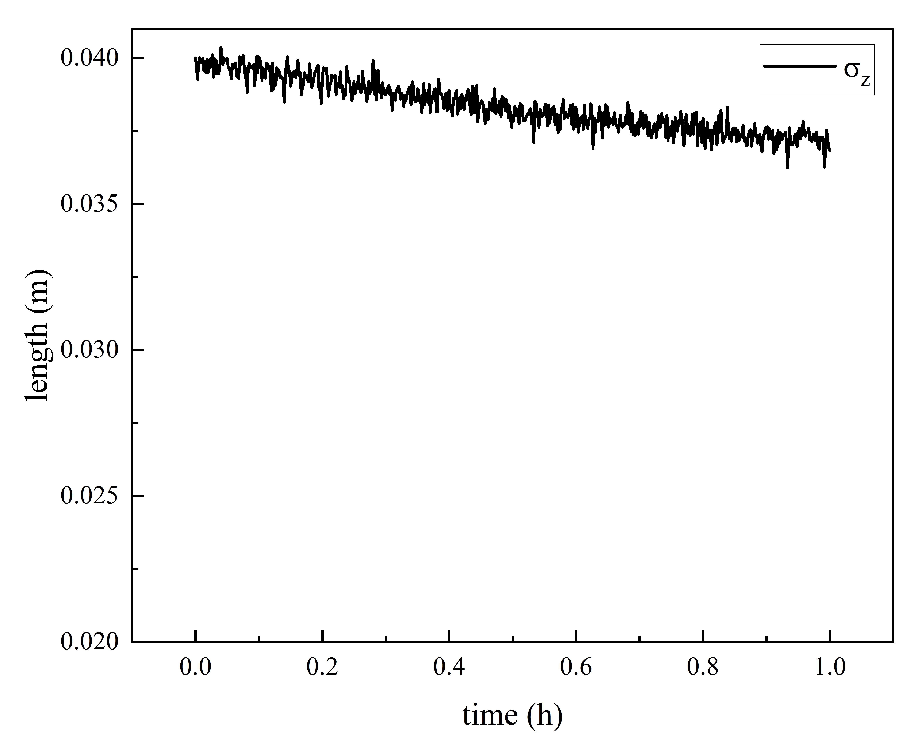
5. Electron cooling
Two-stage beam cooling：
High energy cooling for emit. maintenance @pRing
ERL-based cooler (10MeV)
The emittance of the 20 GeV proton beam could be effectively maintained using the ERL cooler.
Electrons per bunch | 6.25×10⁹
Beam size (x/y/z) | 3/3/40 mm
Emittance | 5 π mm mrad
Momentum spread | 5×10⁻⁴
Beta function | 30 m
Dispersion | 2 m
Effective cooling length | 2×25 m
pRing
Cooling section-1
Cooling section-2
Kicker
Ring
Kicker
ERL
SRF e-gun
Dump
SRF cavity

Slide 22
6. Accelerator Chapters in the CDR
Improvements after 5th EicC CDR workshop:
To perform spin flip, the linac-ring in the electron accelerator complex is replaced with an eLinac and an accumulation ring (AR), which can produce four trains of electron bunches in the collision ring eRing.
New luminosity designs in which the luminosity is about 4.25×10³³ cm⁻²s⁻¹ and the integral luminosity is about 105 fb⁻¹ per year.
Lattice and operation mode designs of eRing and pRing along with interaction region designs are being performed now, which will be written into the CDR.
The polarization of ²H⁺ and ³He²⁺ can be maintained and controlled in the BRing-N, BRing-S, and pRing, which is tested by simulations (³He²⁺ simulation results in the BRing-S are coming soon).

Slide 23
6. Accelerator Chapters in the CDR
Plans:
General designs (Jie Liu)
Introduction; Luminosities; Polarization
Ion Accelerator Complex (Lei Wang)
Operation mode; Lattice; Beam dynamics
Electron Accelerator Complex (Mingxuan Chang)
Operation mode; Lattice; Beam dynamics
Interaction Region (Lei Wang & Mingxuan Chang)
Requirements and general design; Ion side; Electron side
Polarization (Minxiang Li)
Proton Polarization; Ion Polarization; Electron Polarization
Electron Cooling (He Zhao)
Scheme; DC electron cooler; Bunched beam electron cooler
2024.04 ~ full version

Slide 24
Thanks!

