Slide 1
Quark matter under extreme conditions
QCD transition in the early universe
曹高清
中山大学物理与天文学院
1. GC, L. He and P. Zhang, 104, 054007 (2021).
2. GC, Phys. Rev. D 107, 014021 (2023).
2023.9.16@USTC

Slide 2
outline
Little bang and big bang
QCD epoch of the early universe
Lepton flavor densities and pion superfluidity
Primordial magnetic field
Phase diagram within three-flavor PNJL model
Bubble dynamics and gravitational wave
Summary and prospective

Slide 3
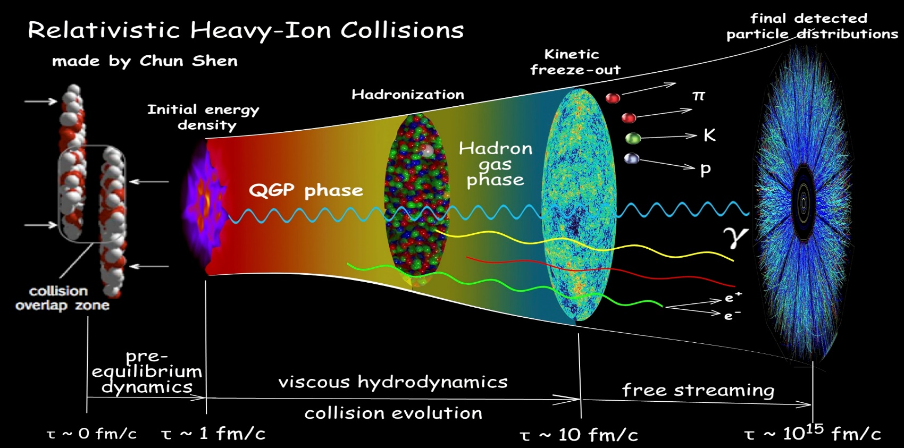
Little bang
Fireball with initial temperature $0.1\sim 1 GeV$
Expand, cool and freeze out
Probe of QGP: heavy flavors, photon, leptons, jets

Slide 4
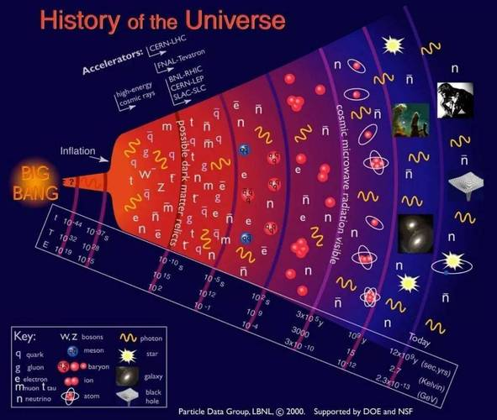
Big bang
Formation of atoms: photons escape and produce cosmic microwave background (CMB) of $2.73K$
——one of the strongest proof of Big Bang
QCD dominant epoch：$t={10}^{−6}\sim {10}^{2}s$

Slide 5
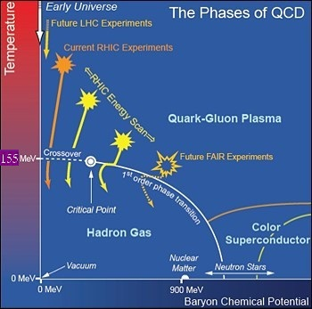
QCD epoch of the early universe
The probe to the QCD epoch?
Candidates: gluons, neutrinos, gravitational wave
$1s$ decouple (CNB $1.96K$)
Direct generation: first-order transition
$μ_{B}≈0$，
E. Witten, Phys. Rev. D 30 (1984) 272-285.
crossover
How about the cases with nozero $μ_{I}, B…$?
$$μ_{5}$$
J. Shao and M. Huang (2023)

Slide 6
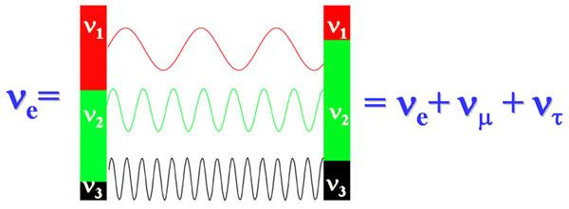
Lepton flavor densities
$$b=\frac{n_{B}}{s}=8.6×{10}^{−11}$$
Current constraints
$$l=\frac{n_{l}}{s}≤−0.012$$
$$l=l_{e}+l_{μ}+l_{τ}$$
Neutrino oscillation
flexibility
Hard to trace back the lepton flavor density $l_{l}$

Slide 7
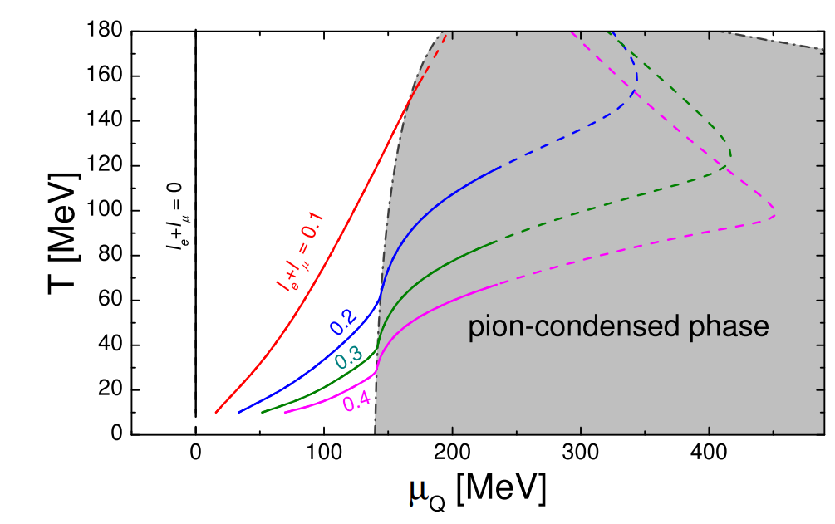
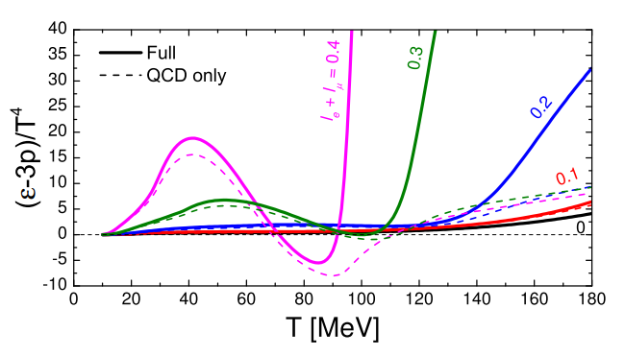
Lepton flavor densities and pion superfluidity
$$l=0, l_{e}=l_{μ}$$
Pion superfluidity for large $l_{e}+l_{μ}$
Equation of state changes much for large $l_{e}+l_{μ}$
V. Vovchenko, B. B. Brandt, F. Cuteri, G. Endrodi, F. Hajkarim and J. Schaffner-Bielich, Phys. Rev. Lett. 126, 012701 (2021)

Slide 8
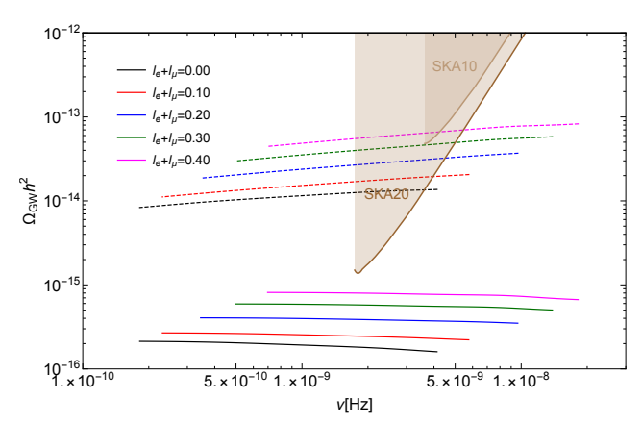
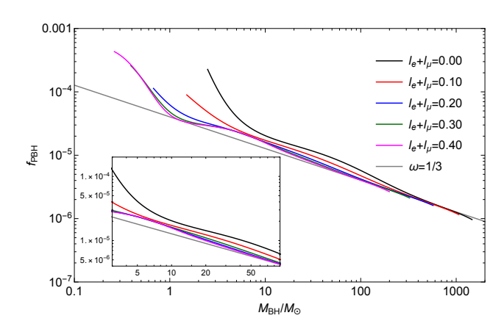
Influence on primordial physics
Primordial gravitational wave
Primordial black hole
PGW relic density is enhanced by $l_{e}+l_{μ}$
Fraction of small mass PBH reduces with $l_{e}+l_{μ}$

Slide 9
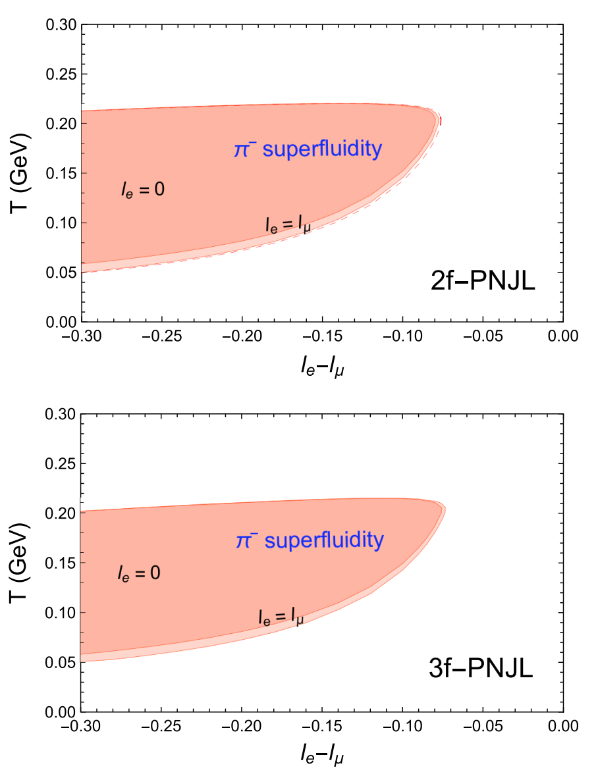
Confirmation by PNJL model
GC, L. He and P. Zhang, 104, 054007 (2021).
Advantages:
no sign problem,
more analytic,
more self-consistent
Discoveries:
1. insensitive to $l_{e}/l_{μ}$, $s$ quark
2. the upper boundary is
almost a constant

Slide 10
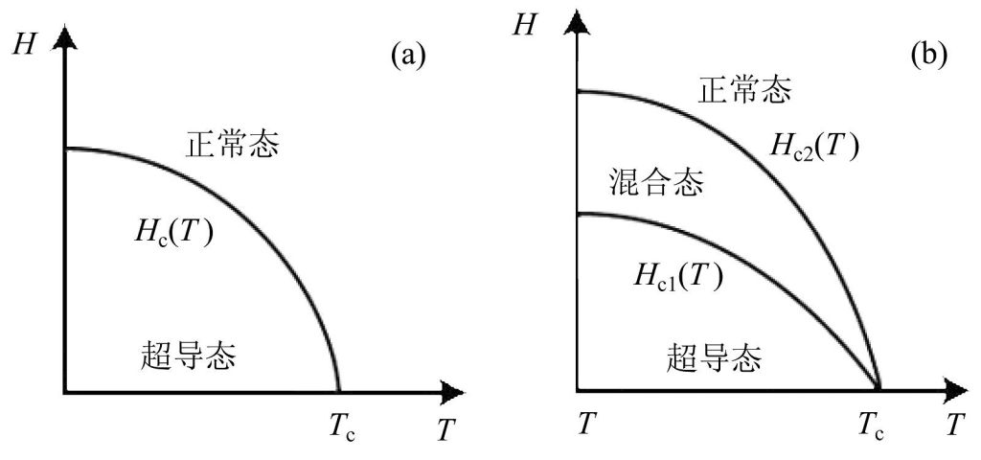
Superconductor in an external magnetic field
pion superfluid is also electric superconductor
(a) Type-I: Meissner effect in the bulk, homogeneous
phases, first-order transition
(b) Type-II: magnetic vortices, second-order transition

Slide 11
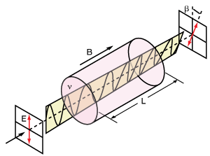
Primordial magnetic field
Milkyway magnetic field
$$m=1$$
$$S=1$$
$$m=0$$
$$m=−1$$
21 cm
$$S=0$$
$$H=0$$
$$H≠0$$
A. Faraday rotation
B. Zeeman effect
celestial 21 cm-hydrogen line
galactic background radio radiation、polarization of star light…
$$H={10}^{−6}−{10}^{−5}Gs$$
scaling factor $a={10}^{12}−{10}^{12.5}$
PMF $eH={10}^{−2}−1 GeV$

Slide 12
Study within the three-flavor PNJL model
Lagrangian
‘t Hooft interaction
Gluon potential
Polyakov loop

Slide 13
Normal chiral phase
$$σ_{i}=\left\langle {\overline{ψ}}_{i}ψ_{i}\right\rangle , i=u,d,s$$
Gap equation
Quark propagator in B
Thermodynamic potential
GC and J. Li, Phys. Rev. D 107, 094020 (2023) .

Slide 14
Free energy
Helmholtz free energy
$H=\frac{∂Ω_{H}^{M}}{∂B}$ is the true variable
$$≈B$$
A. L. Fetter and J. D. Walecka, Quantum theory of many-particle systems, Chapter 13 (McGraw-Hill Book Company, New York, 1971).
Gibbs free energy
External magnetic field reduces Gibbs free energy

Slide 15
Pion superfluidity
Meissner effect: $H≠0$, but $B=0$
bilinear contribution

Slide 16
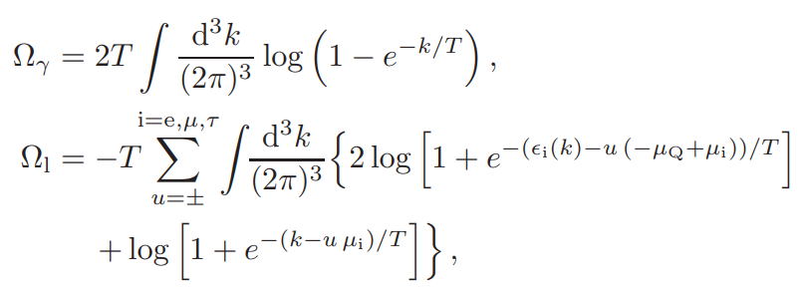
The electroweak sector
photons $γ$, leptons $l$ (charged $τ$ not important)
Free gas approximation
$$+$$
consistent magnetic effect
pion superfluidity
Total thermodynamic potential
$$Ω=Ω^{M}+Ω_{γ}+Ω_{l}$$

Slide 17
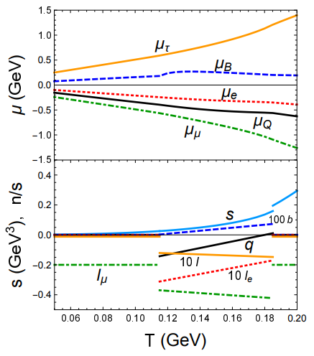
cosmic trajectory
unknown chemical potentials (5): $μ_{Q},μ_{B},μ_{e},μ_{μ},μ_{τ}$
known constraints (3): $n_{Q}=0,b=8.6×{10}^{−11},$
$$l=−0.012$$
2 flexible constraints
$l_{e}+l_{μ}=−0.2$,
$$eH=0.01 GeV^{2}$$
$$l_{e}=0$$
setup
varying $l_{e}+l_{μ}$

Slide 18
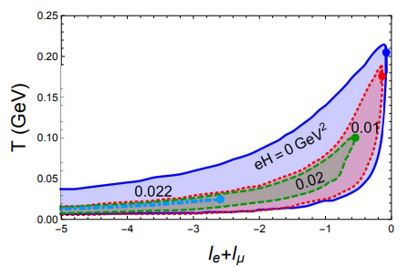
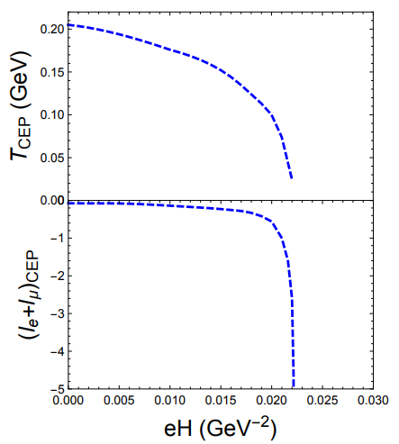
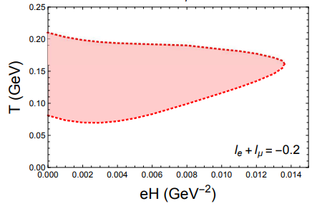
phase diagram
pion superfluid phase shrinks quickly with $eH$
de Haas-van Alphen oscillation

Slide 19
Bubble dynamics
complete for boson theory
a. S. R. Coleman, “The Fate of the False Vacuum. 1. Semiclassical Theory,”
Phys. Rev. D 15, 2929 (1977), Erratum: [Phys. Rev. D 16, 1248 (1977)].
b. C. G. Callan, Jr. and S. R. Coleman, “The Fate of the False Vacuum. 2.
First Quantum Corrections,” Phys. Rev. D 16, 1762 (1977).
unclear with fermion theory
Two-flavor Polyakov-quark-meson model for illustration

Slide 20
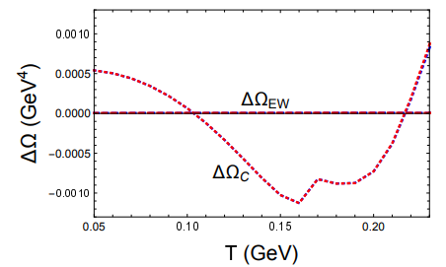
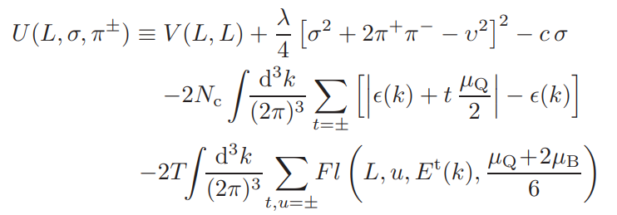
Simplification
$l_{e}+l_{μ}=−0.2$,
$$eH=0.01 GeV^{2}$$
The QCD part dominates the change
$$σ=0$$
local approximation

Slide 21
Equations of state
$$L(\tilde{π})$$
Coulomb gauge
Rotational symmetry
Boundary condition

Slide 22
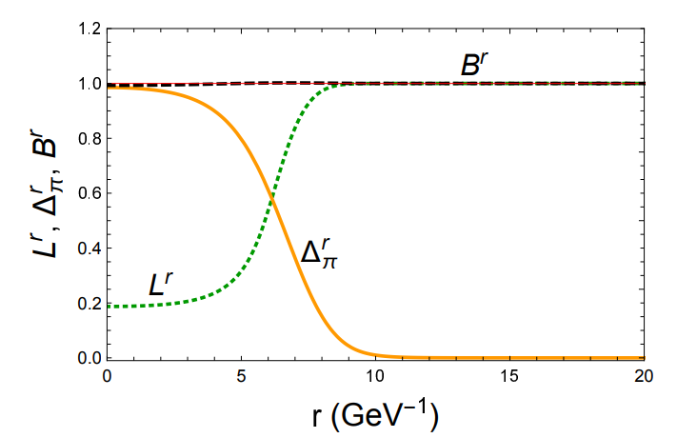
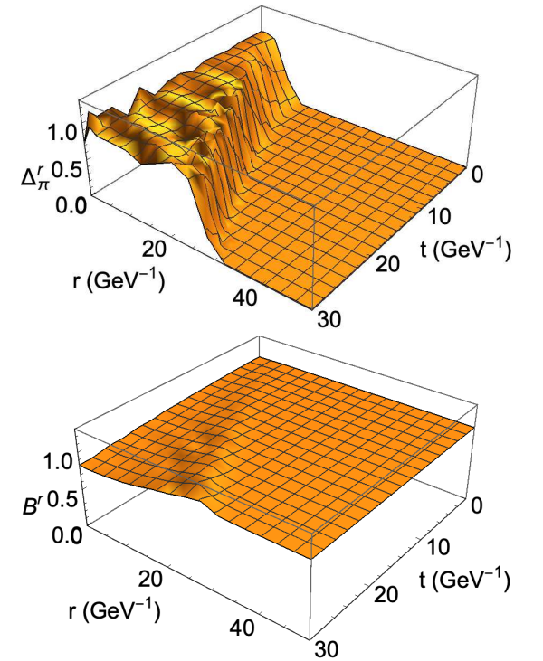
Bubble evolution
Initial bubble structure
Expanding velocity $\sim 0.5 c$

Slide 23
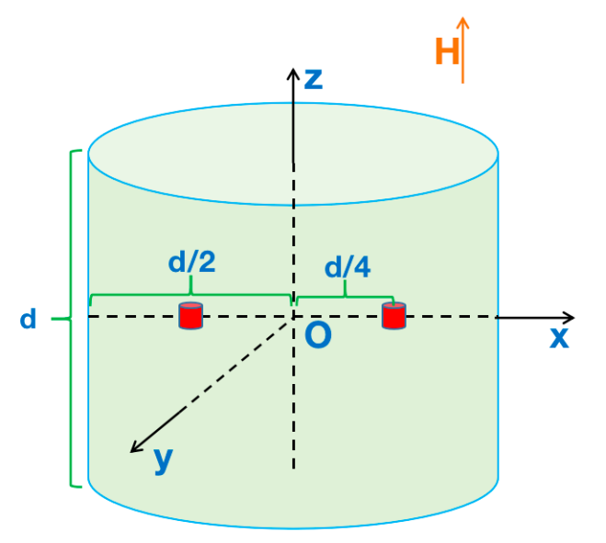
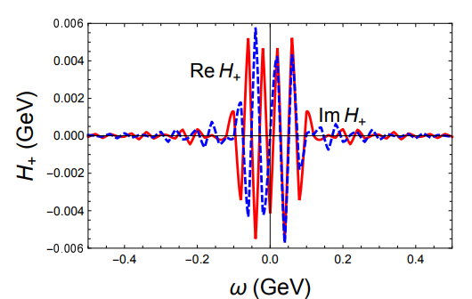
Estimation of gravitational wave
$$d=1 pm$$
Current: $1−10 m$
$$0$$
$$∝\sin{2}θ$$
Fourier transformation
$ω_{c}\sim 0.1 GeV$, consistent with $Λ_{QCD}$
Relic GW: $f_{c}\sim 10^{9}−10^{10} Hz$
or $0.1−1 K$

Slide 24
Summary and prospective
Gibbs free energy has to be adopted for the study of Type-I superconductor
First-order transition to pion superfluidity can happen when proper magnitude of primordial magnetic field was present
The pion superfluidity phase shrinks quickly with $eH$
The characteristic frequency of relic GW is $f_{c}\sim 10^{9}−10^{10} Hz$ or $0.1−1 K$
Thanks!
Future: the possibility of Type-II superconductor, $K^{±}, ρ^{±}$ condensation?

Slide 25
Backup

