Slide 1

Precision studies of the DVCS process at JLab
Award #2209199
Julie Roche
Generalized Parton Distributions (GPD) are accessible through many exclusive processes. So far, the most studied channels are Deeply Virtual Compton Scattering (DVCS) and Deep Virtual Meson production (DVMP).
Our JLab Hall A/C collaboration measures DVCS and DVMP-π0 absolute cross-section using a “simple” dedicated apparatus since 2006.
Our precise (5%) measurements are essential to interpret the data.
We just completed a new set of measurements in Hall C/JLab using a new PbWO₄ calorimeter and expanding our kinematic reach.

Slide 2
Generalized Parton Distribution Function :
3-D imaging of the nucleon with access to correlations between
transverse spatial distribution and longitudinal momentum distributions.

Slide 3
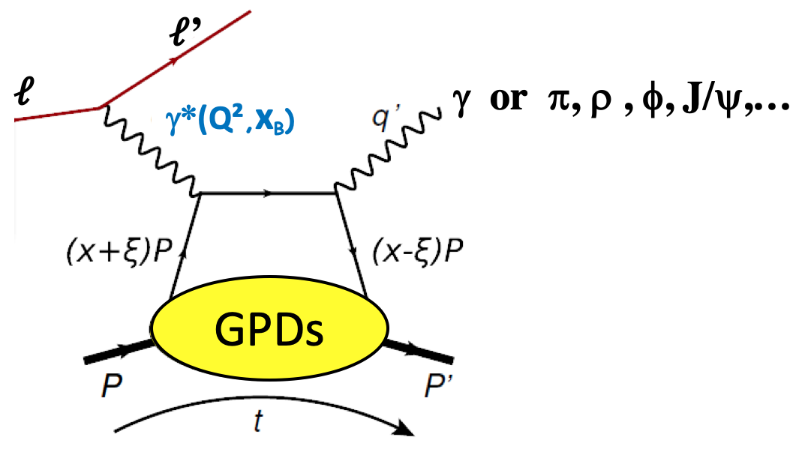
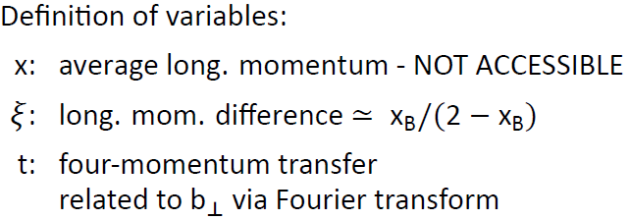
Exclusive reactions: handbag diagram
DVCS : golden channel
DVMP

Slide 4
GPDs and factorization
In the Bjorken limit:
Hard process
LO: QED
NLO: QCD perturbative
D. Mueller et al, Fortsch. Phys. 42 (1994)
X.D. Ji, PRL 78 (1997), PRD 55 (1997)
A. V. Radyushkin, PLB 385 (1996), PRD 56 (1997)
Soft process
Non perturbative QCD
described by GPD(x,ξ,t)
x is not accessible, one measures CFF(ξ,t)=CFF(x_{B},t)

Slide 5
Generalized Parton Distributions
DIS
Elastic
~
No relation for the GPD E and E
RPP 76(2013) 066202
Notes:
What is the meaning of the comma in the PDF definition?

Slide 6
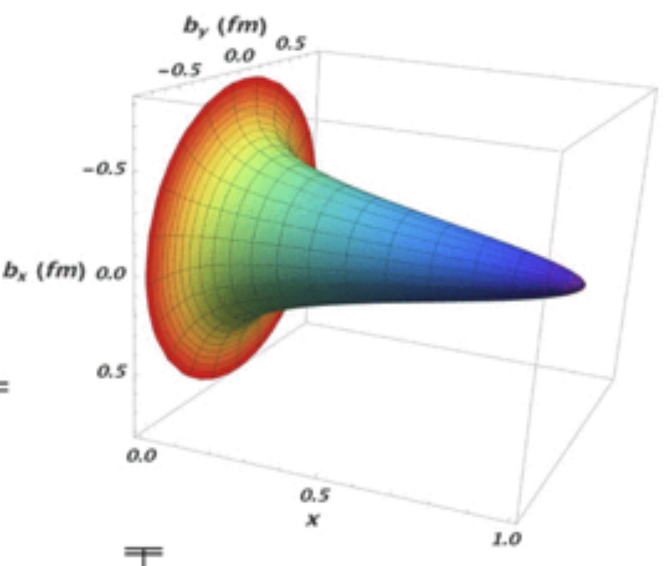
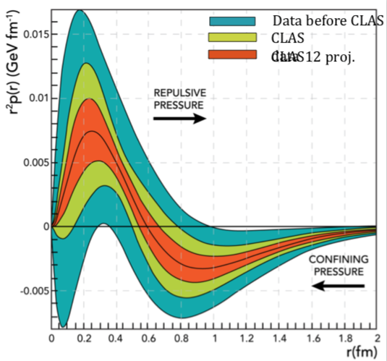
GPDs and hadronic physics issues
Contribution of the angular momentum of quark
to the proton spin (Ji’s sum rule: PRL 78(4):610-613, 1997)
Nucleon tomography
R. Dupré et al. PRD95 (2017)
Local fits from Hermes, CLAS & Hall A data
Assume H contribution only
Model dependent assumptions for x_{B} dependence
~30%
~20%
??
??
Access to the mechanical properties/gravitational form factors of the proton
V. Burkert,
L. Elouadrhiri,
F.X. Girod
Nature 557
(2018, 7705, 396-399)

Slide 7
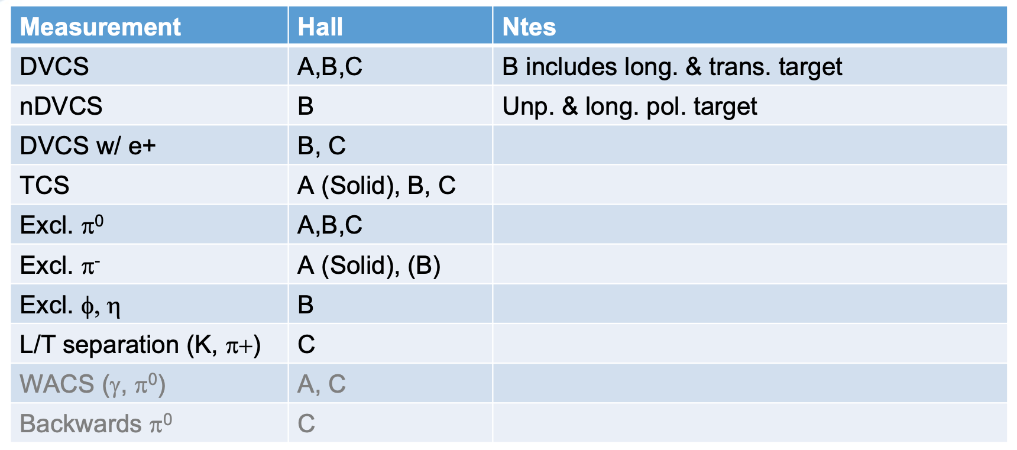
JLab Exclusive reactions for GPDs program
Tables by C. Munoz-Camacho
Polarized beam and/or target
Deuterium/He3
,C, A(Solid)
In the valence region (JLab 6 and JLab 12)
Partially complimentary, overlapping
Hall A/C: Test the validity of the formalism
  high accuracy (~5%)
  limited kinematic
Hall B: Map the GPDS
  limited accuracy (15+%)
  wide kinematic range

Slide 8
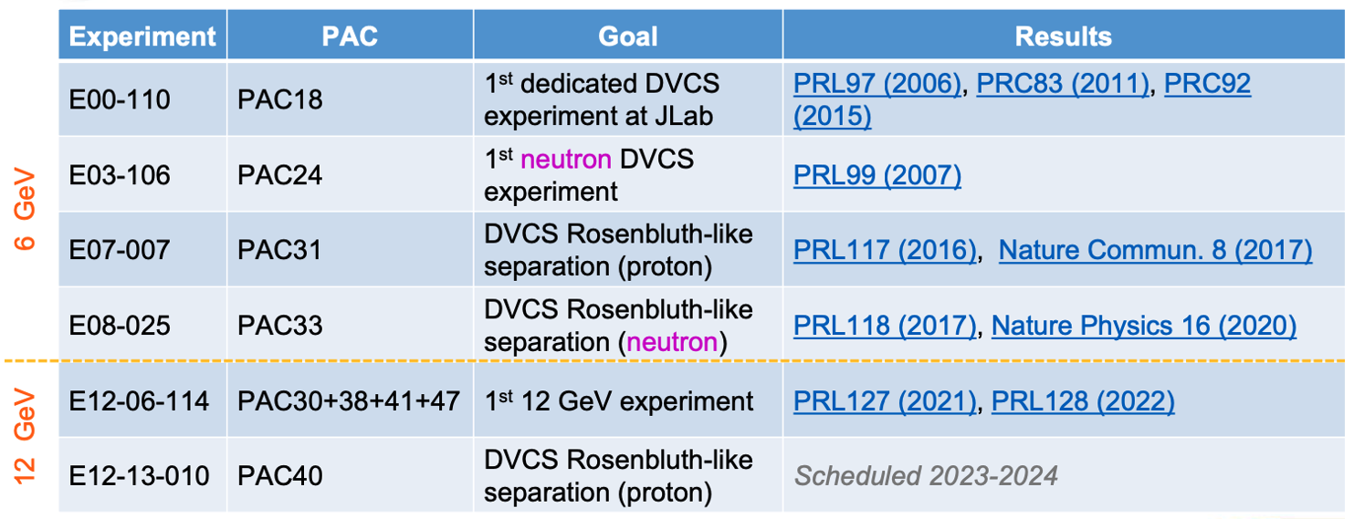
JLab Exclusive reactions for GPDs program
This talk focuses on
recent
DVCS and DVMP- π⁰ using the Hall A/C scheme
and the future of this niche technique.

Slide 9
Precision studies of the DVCS process at JLab
Julie Roche
GPDs are accessible through many exclusive processes. So far, the most studied channels are Deeply Virtual Compton Scattering (DVCS) and Deep Virtual Meson production (DVMP).
Our JLab Hall A/C collaboration measures DVCS and DVMP-π0 absolute cross-section using a “simple” dedicated apparatus since 2006.
Our precise (5%) measurements are essential to interpret the data.
We just completed a new set of measurements in Hall C/JLab using a new PbWO₄ calorimeter and expanding our kinematic reach.

Slide 10
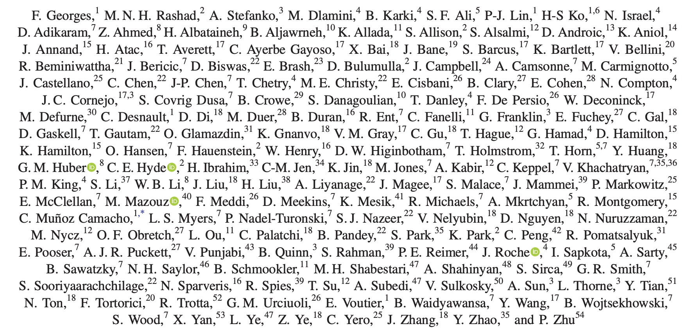
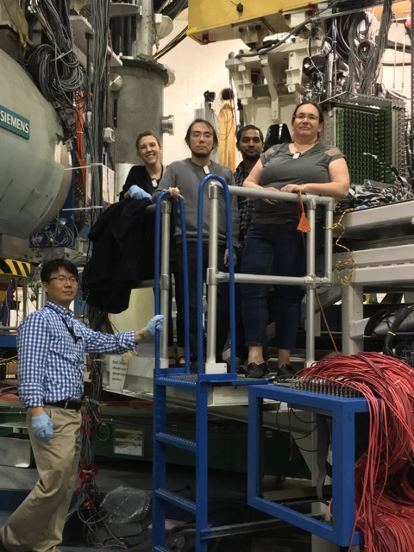
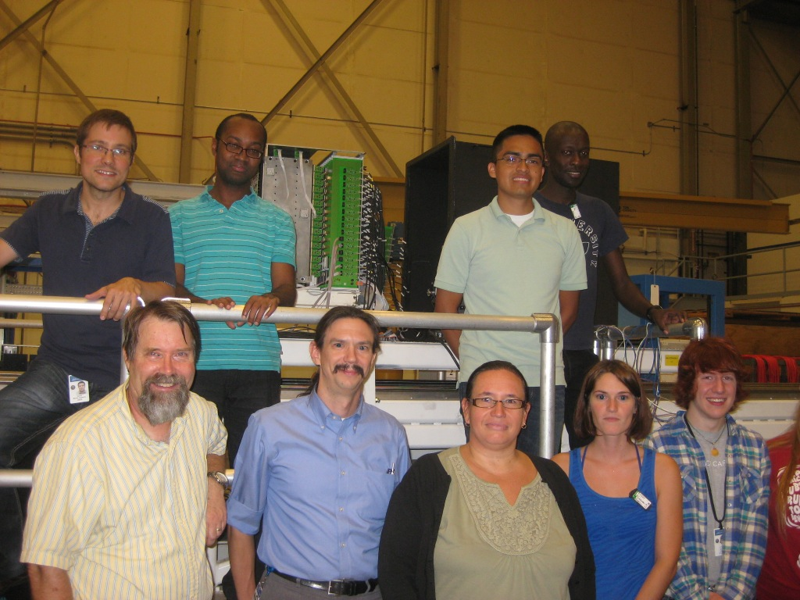
Author’s list from our most recent DVCS paper (June 2022)
Students/Postdocs Spoke-persons
The Jefferson Lab Hall A/C technical staff
The Jefferson Lab Accelerator staff

Slide 11
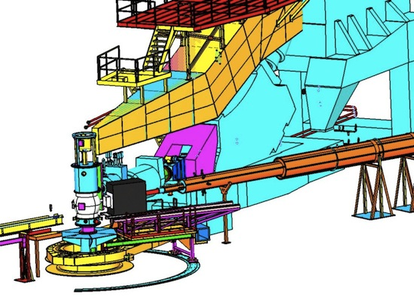
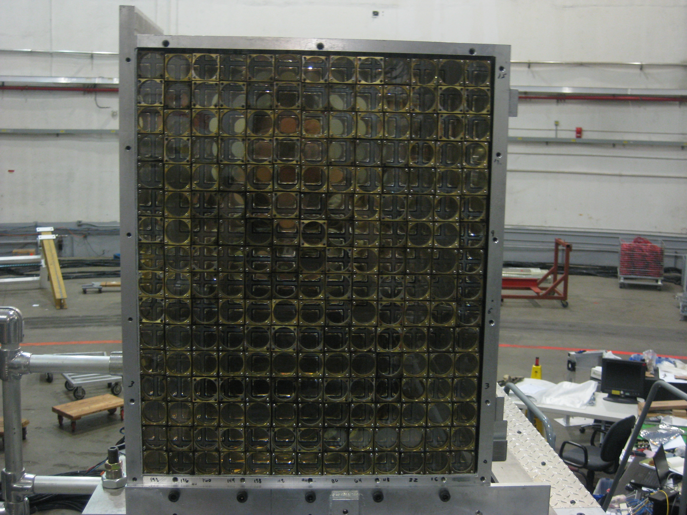
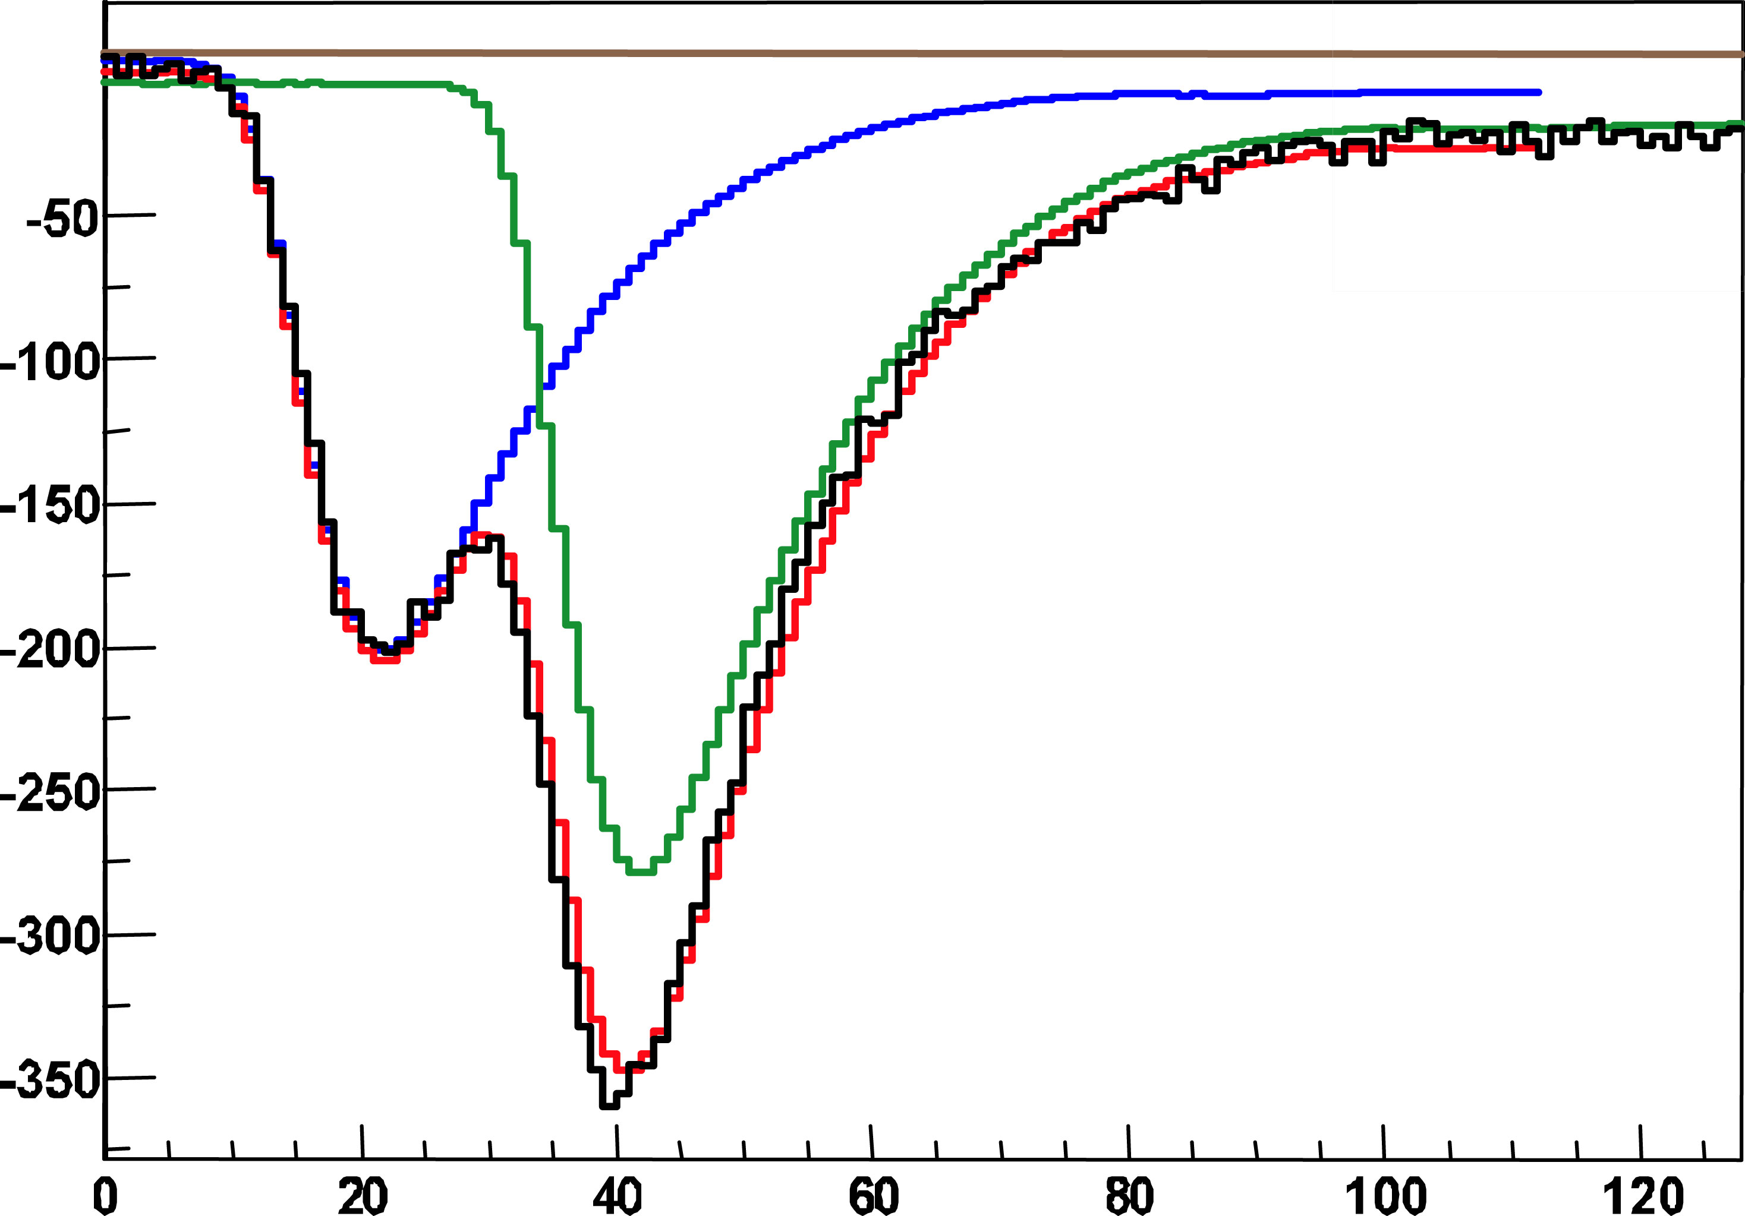
Dedicated apparatus e.g. the Hall A scheme
208 PbF2 blocks
Luminosity of ~5. 10³⁷ Hz/cm²
1 GHz digitizer
t (ns)

Slide 12
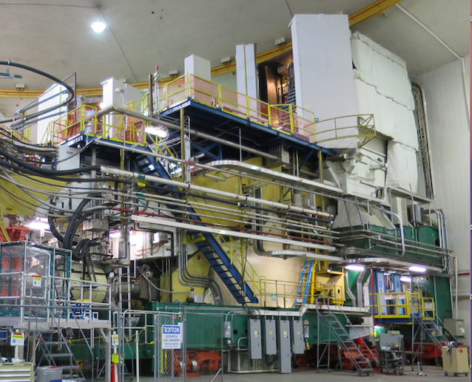
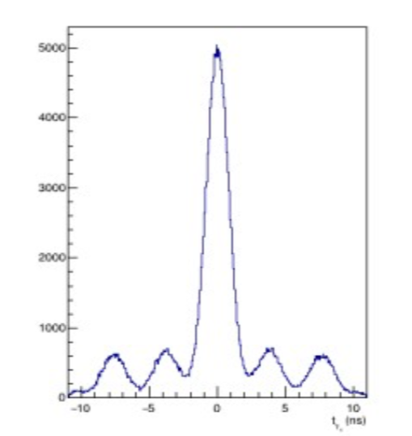
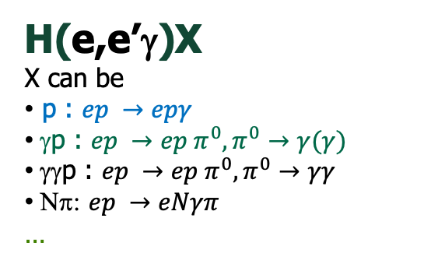
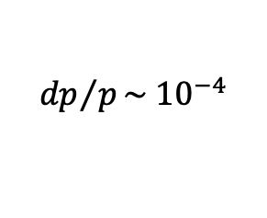
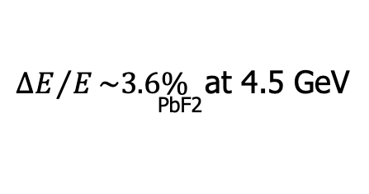

Exclusivity : the DVCS@Hall A scheme
Coincidence time (e-γ)
scattered electron
85% polarized beam
$${dp}/p\sim {10}^{−4}$$
LH2/LD2
$$σ \sim 1 ns$$
γ
${ΔE}/E\sim 3.6\%$ at 4.5 GeV
^{PbF2}
H(e,e’γ)X
X can be
p : $ep →epγ$
γp : $ep →ep π^{0}, π^{0}→γ(γ)$
γγp : $ep →ep π^{0}, π^{0}→γγ$
Νπ: $ep →eNγπ$
…

Slide 13
Precision studies of the DVCS process at JLab
Julie Roche
GPDs are accessible through many exclusive processes. So far, the most studied channels are Deeply Virtual Compton Scattering (DVCS) and Deep Virtual Meson production (DVMP).
Our JLab Hall A/C collaboration measures DVCS and DVMP-π0 absolute cross-section using a “simple” dedicated apparatus since 2006.
Our precise (5%) measurements are essential to interpret the data.
We just completed a new set of measurements in Hall C/JLab using a new PbWO₄ calorimeter and expanding our kinematic reach.

Slide 14
Measuring DVCS to access GPDs information
GPDs
D
Known if
Nucleon FFs are known
Linear combinations
of GPD/CFFs and FFs
Bilinear combinations
of GPD/CFFs
P_{l} : polarization target or beam
e_{l} : charge of the lepton beam

Slide 15
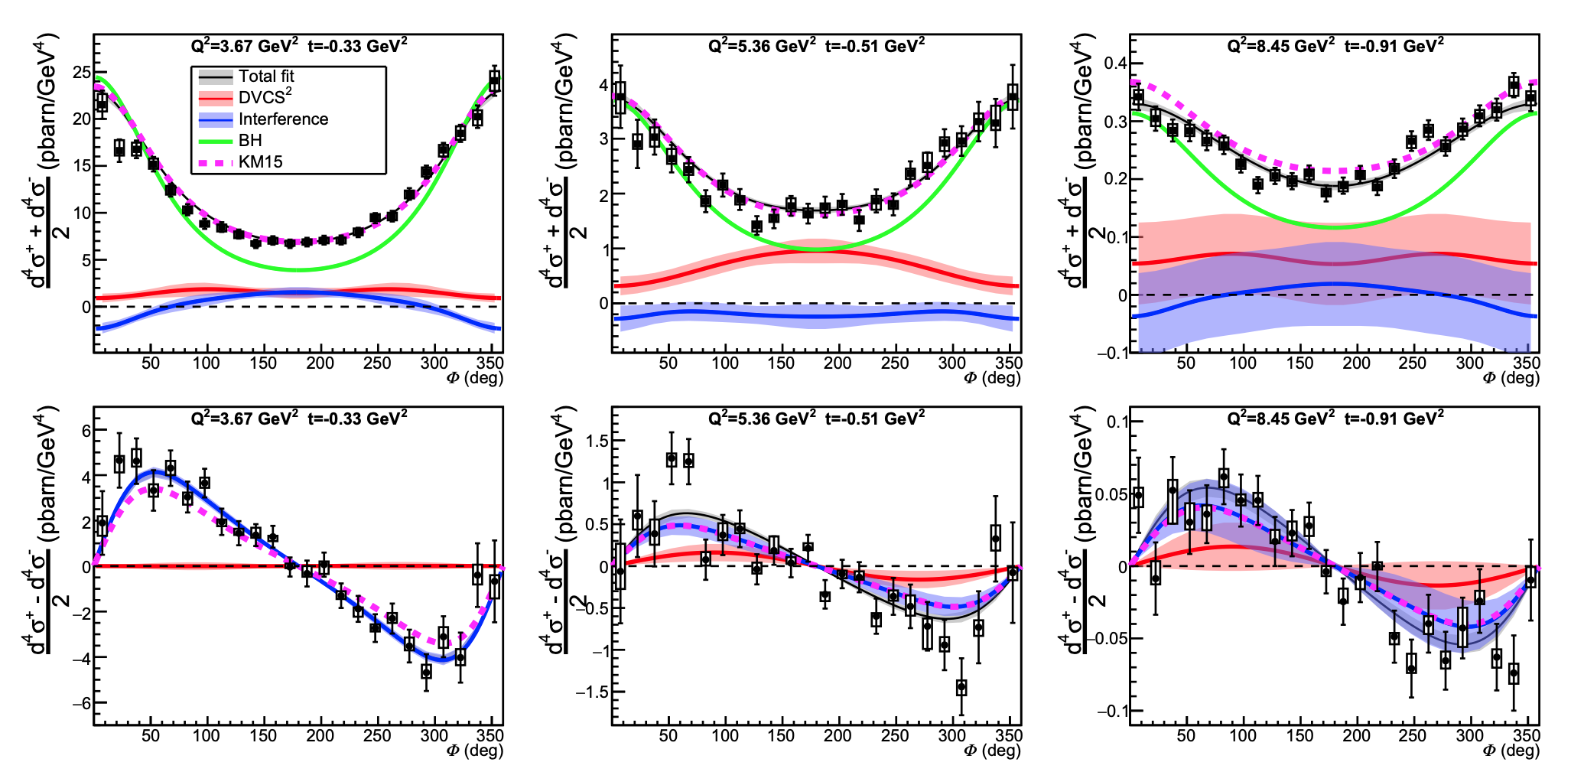



DVCS in Hall A: 12 GeV result
F. Georges et al., Phys.Rev.Lett. 128 (2022) 25, 252002
BH
DVCS²
Interference
φ
[KM15] K. Kumericki and D. Mueller,
EPJ Web Conf. 112 (2016) 01012
Braun-Manashov-Müller-Pirnay formalism,
Phys. Rev. D 89, 074022 (2014).
$$x_{B}=0.36$$
$$x_{B}=0.48$$
$$x_{B}=0.60$$

Slide 16
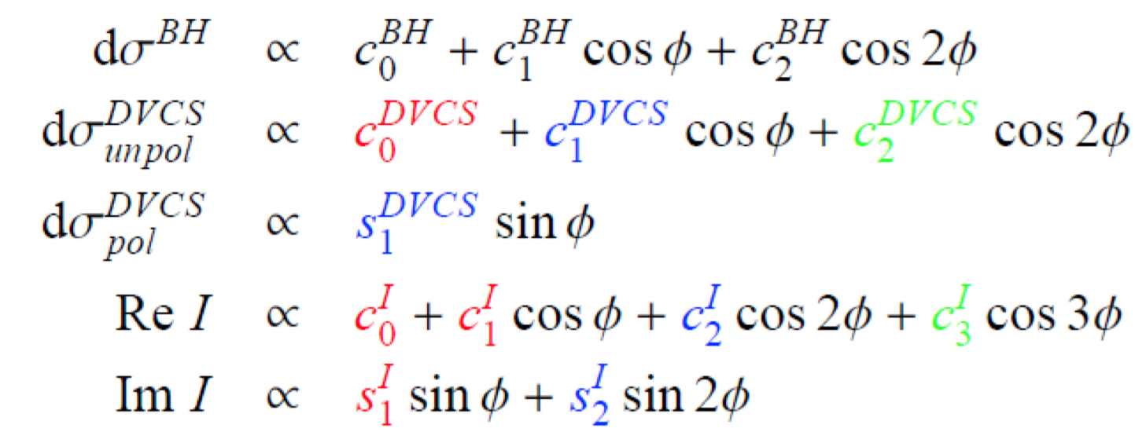
How to parametrize the DVCS cross-sections?
φ
LT/LO
HT
NLO
World-wide GPDs analysis include more or less terms:
both in terms of harmonics (c_{i}’s and s_{i}’s) and
in term of GPD/CFFs.

Slide 17
DVCS in Hall A@Jlab program
1st Generation (2004)
Q² dependence study (of red terms)
2nd Generation (2010)
Beam energy dependence study at fixed x_{B} and Q²
Separate C₀^{DVCS} from C₀^{I}
Separate HT and NLO from LT/LO coefficients
3rd Generation (2014-2016)
Multiple x_{B} and Q² measurements
Experimental extraction of the CFFs as a function of x_{B}
Importance of considering all CFFs when extracting CFFs
LT/LO
HT
φ
Results:
off LH2 and LD2 (neutron)
on DVCS and DVMP- π⁰
NLO

Slide 18
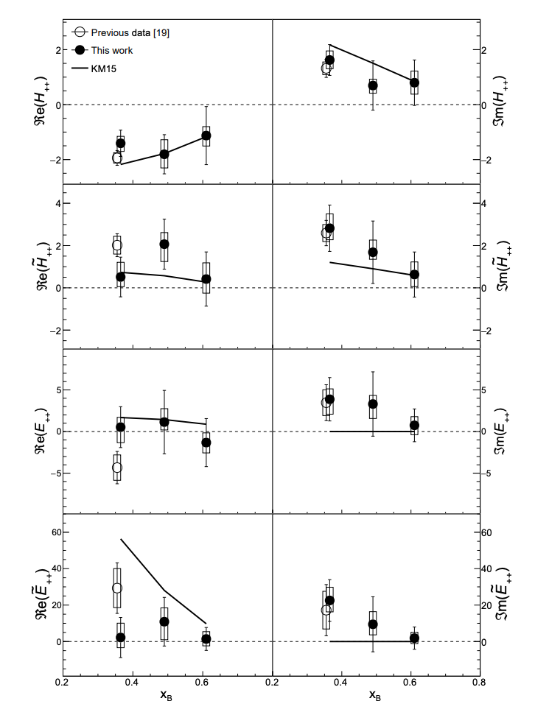
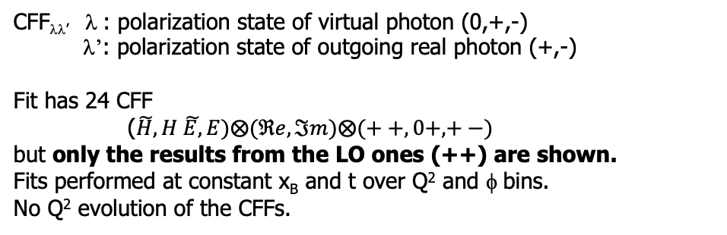
DVCS in Hall A: 12 GeV results
[This work] F. Georges, Phys.Rev.Lett. 128 (2022) 25, 252002
Error bars: statistical
Error boxes: systematic
[19] M. Defurne et al., Phys. Rev. C92, 055202 (2015)
[KM15] K. Kumericki and D. Mueller, EPJ Web Conf. 112 (2016) 01012
The precise measurement of cross-sections at the same
x_{B}-Q² bin but multiple beam energies is essential for this extraction.
Also demonstrated in
  M. Defurne et al., Nat. Commun. 8, 1408 (2017).
  B. Kriesten et al., Phys. Rev. D 101, 054021 (2020).
  M. Čuić et al., Phys. Rev. Lett. 125, 232005 (2020).
CFF_{λλ’} λ : polarization state of virtual photon (0,+,-)
λ’: polarization state of outgoing real photon (+,-)
Fit has 24 CFF
($\tilde{H}, H \tilde{E,}E)⨂(ℜe,ℑm)⨂(++,0+,+−)$
but only the results from the LO ones (++) are shown.
Fits performed at constant x_{B} and t over Q² and φ bins.
No Q² evolution of the CFFs.
The average 𝑡 values are −0.281 GeV² for [19] and
−0.345, −0.702, −1.050 GeV² at 𝑥𝐵=0.36, 0.48, 0.60, respectively for this work..

Slide 19
DVCS@Hall A neutron data
A combined neutron and proton targets data allows for flavor separation of the GPDs.
Neutron data are uniquely sensitive to the elusive GPD E (no connection to PDFs).
Below the two pions threshold:
LD2
LH2
LD2-LH2
d(e,e’π⁰)d
n(e,e’π⁰)n
separated by
Computed for n(e,e’π⁰)X
Figure from M. Mazouz PRL 118 (2017) 22, 222002

Slide 20
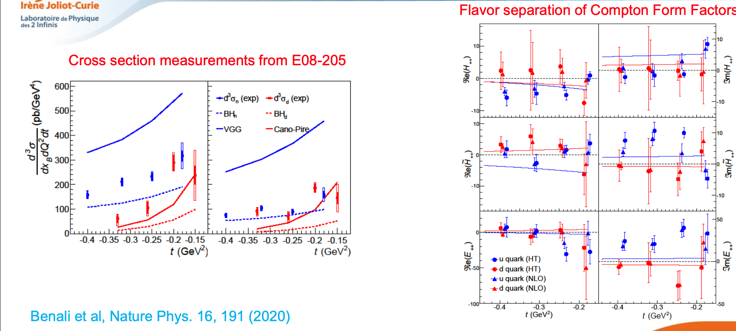
DVCS2@Hall A neutron data
Q²=1.9 GeV², x_{B}=0.36

Slide 21
L/T pion production separation: E07-007
M. Defurne et al. PRL 117, 26 (2015)
4 chiral-even GPDs
4 chiral-odd GPDS (not seen in DVCS)
Leading twist , leading order factorization is only proven for dσ_{L}/dt (Collins et al. 1997)
Q²=1.5 GeV²
Dominance of dσ_{T}/dt observed (directly or not) also at
  Hermes & Hall C π⁺
  Hall B, Hall A π⁰
1.75 GeV²
2 GeV²

Slide 22

GPDs through DVMP-π⁰
Factorization is only exact for longitudinal photons
(Collins et al., 1997).
DA
$$σ_{L}→ Q^{2} σ_{T}$$
At large Q², QCD predicts that
Effective transverse factorization schemes exploit and explain the observed σ_{T} > σ_{L} for existing high x data.
S. Goloskokov and P. Kroll (Eur.Phys.J A47, 112(2011))
  S. Liuti and G. Golstein (Phys.Rev.D79, 054014 (2009))
Twist 3 Distribution Amplitudes (DA) couple with transversity GPDs.
The dominant contribution is not the leading twist contribution
Notes:
What is the meaning of the comma in the PDF definition?

Slide 23
E07-007: π⁰ fully separated contributions
M. Defurne et al. PRL 117, 26 (2015)
Models with dσ_{T} factorization scheme
We observed:
Small dσ_{L}, large dσ_{T}: models ok with these
Wrong sign and t dependence for dσ_{TL} and dσ_{TT}
sizeable dσ_{TL} => dσ_{L} is small but not null
G-H-L ( JPG:NPP39 ‘12)
G-K (EPJA47 ‘11)

Slide 24
Precision studies of the DVCS process at JLab
Julie Roche
GPDs are accessible through many exclusive processes. So far, the most studied channels are Deeply Virtual Compton Scattering (DVCS) and Deep Virtual Meson production (DVMP).
Our JLab Hall A/C collaboration measures DVCS and DVMP-π0 absolute cross-section using a “simple” dedicated apparatus since 2006.
Our precise (5%) measurements are essential to interpret the data.
We just completed a new set of measurements in Hall C/JLab using a new PbW0₄ calorimeter and expanding our kinematic reach.

Slide 25
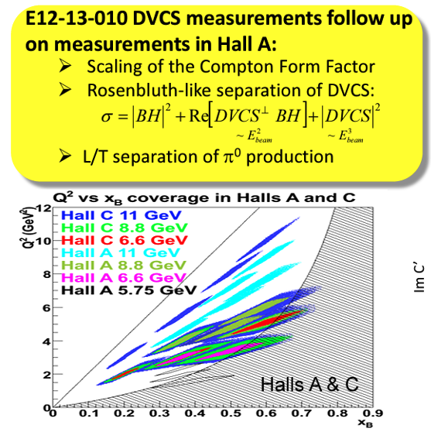
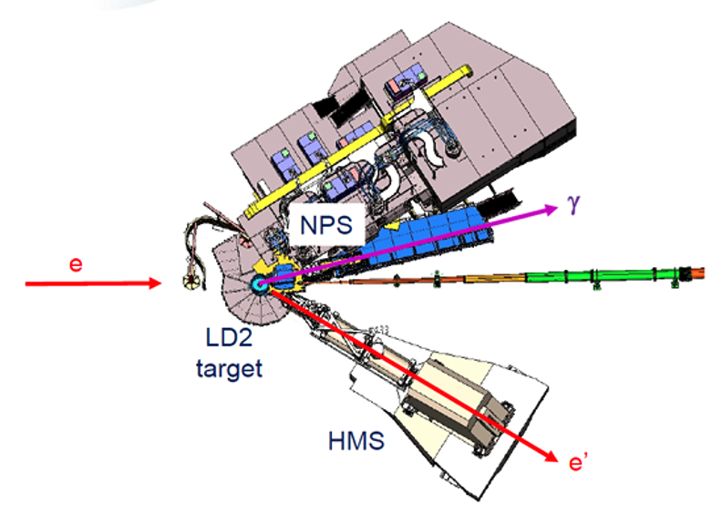
Neutral Particle Spectrometer (Hall C/JLab)
The NPS calorimeter consists of 1080 PbWO₄ crystals, the preferred material for high-resolution calorimetry, also at EIC – NPS has the largest set of PbWO4 crystals in an operating calorimeter in the US
The NPS Science Program consists of ten approved experiments. 4 experiments have been running in parallel from Sept ‘23 to May ‘24.

Slide 26
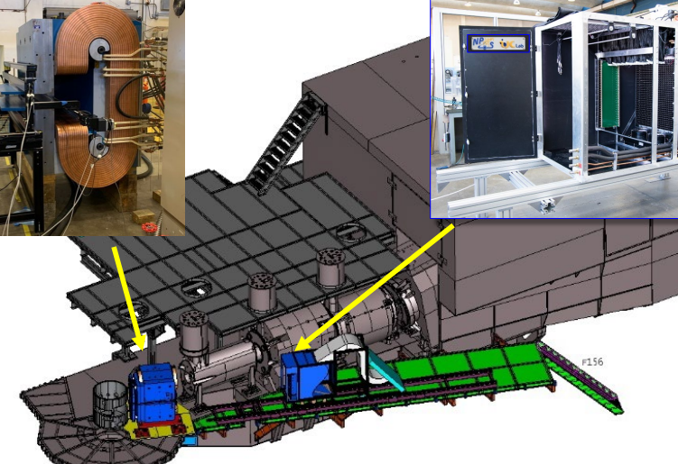
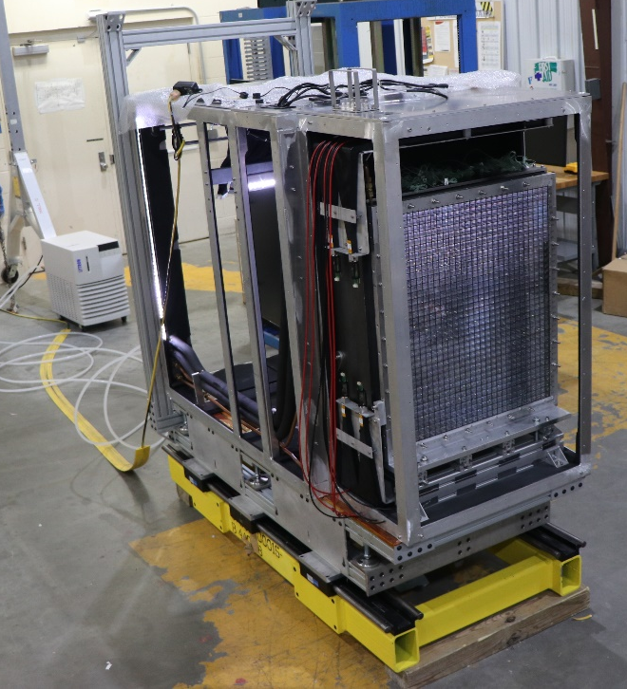
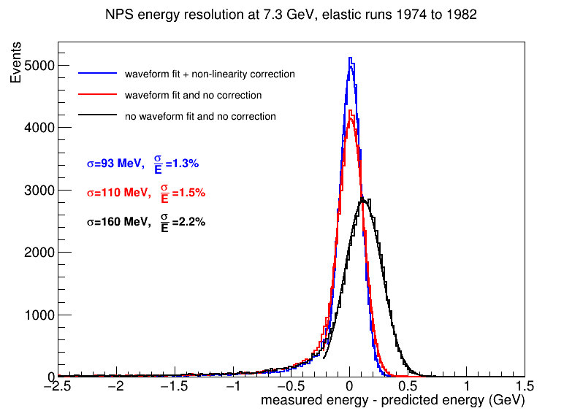
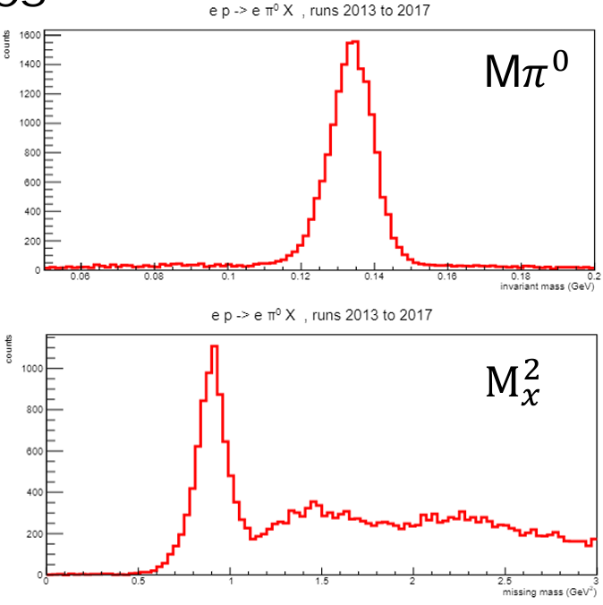
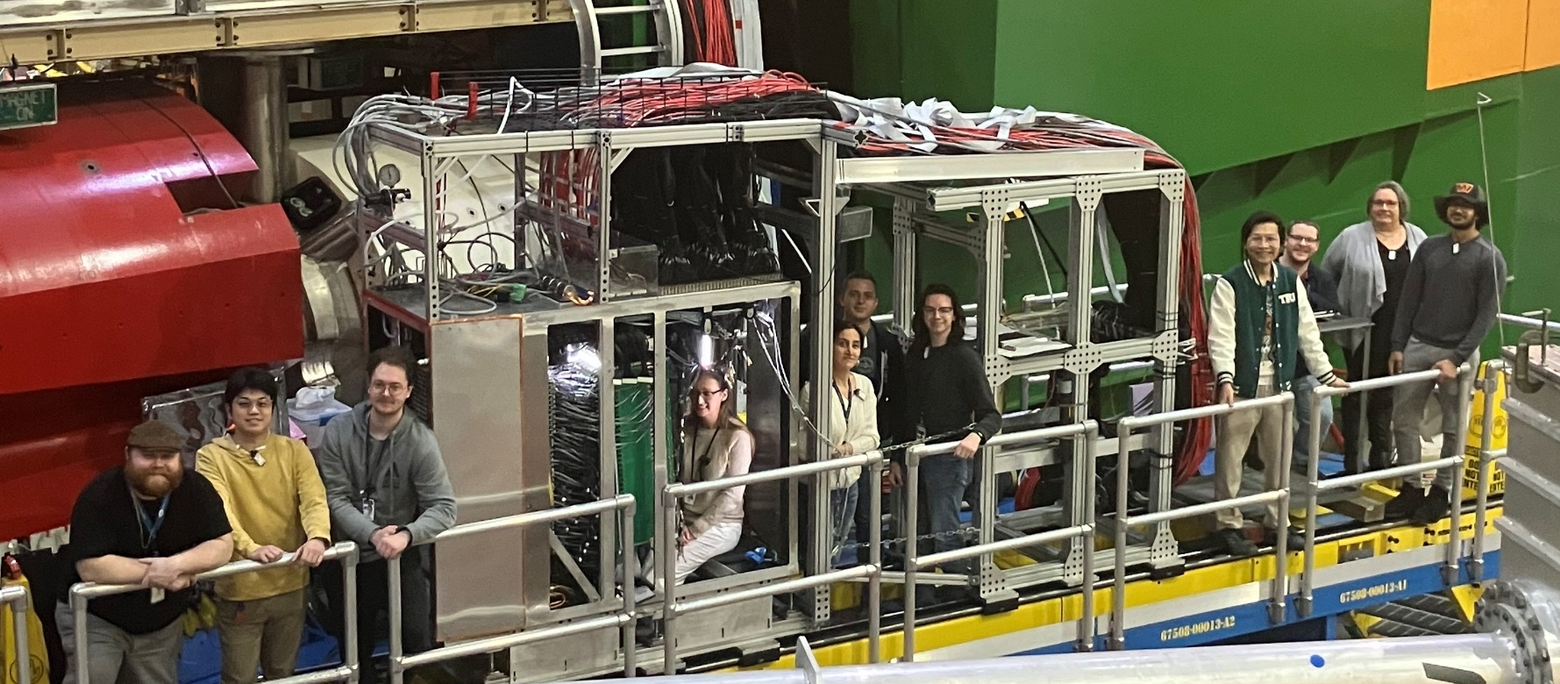


Neutral Particle Spectrometer (Hall C/JLab)
Elastic NPS Energy Resolution
π⁰ Resolution
$$π^{0}⟶ γγ$$
sweeping magnet
PbWO₄ electromagnetic calorimeter
$${p(e,π}^{0})X$$
1080 PbWO₄ crystals
0.6 Tm sweeping magnet
F250ADC sampling electronics
NPS students in Hall C
All channels perform well at very high luminosity on LH2 and LD2(≈ 8x10³⁷ cm²/s).
The expected resolution energy resolution was achieved (1.3% at 7.3 GeV).

Slide 27
Precision studies of the DVCS process at JLab
Our JLab Hall A/C collaboration measures DVCS and DVMP-π⁰ absolute cross-section using a “simple” dedicated apparatus since 2006.
Our precise (5%) measurements are essential to interpret the data.
  proton, neutron and exclusive pi-zero absolute cross section measurement
  total and beam helicity correlated cross section measurement
  cover the valence region (x_{B}=0.2 to 0.6) with Q² in the 1-10 GeV² range
  repeated (x_{B}-Q²) measurement at different beam energies
We just completed a new set of measurements in Hall C/JLab using a new PbWO₄ calorimeter and expanding our kinematic reach.
Thank you for your attention!

Slide 28
Thank you for your attention!

Slide 29
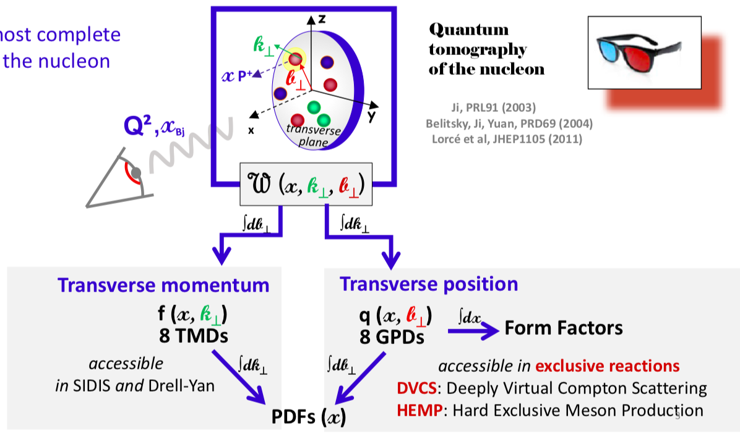
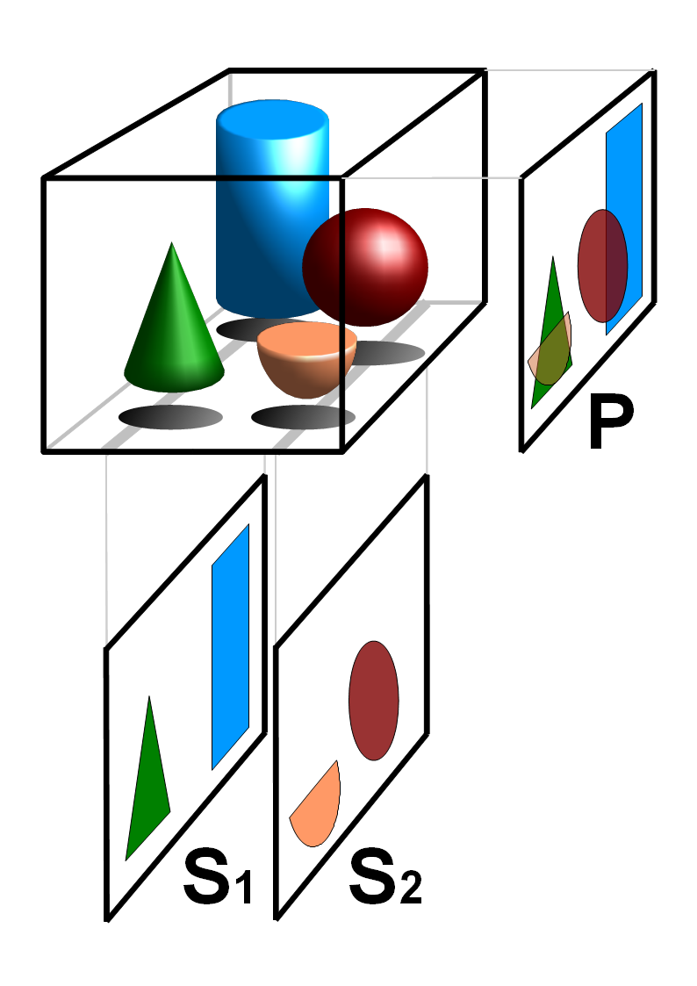
Toward a more complete description of the nucleon
Slide from N. d’Hose, APS-April meeting 2019.

Slide 30
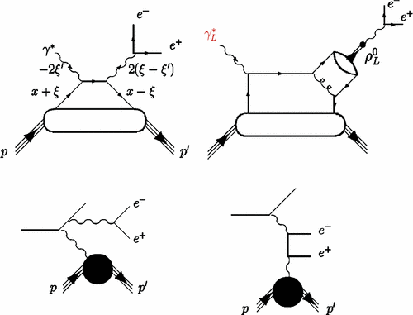
Universality of GPDs
(γ)
DVCS
Quark GPDs
Gluon GPDs
Quark GPDs
(TCS), DDVCS
DVMP
Quark GPDs
Gluon GPDs
Notes:
Depending on the reaction and on the kinematics one can sample different kinds of GPDs

Slide 31
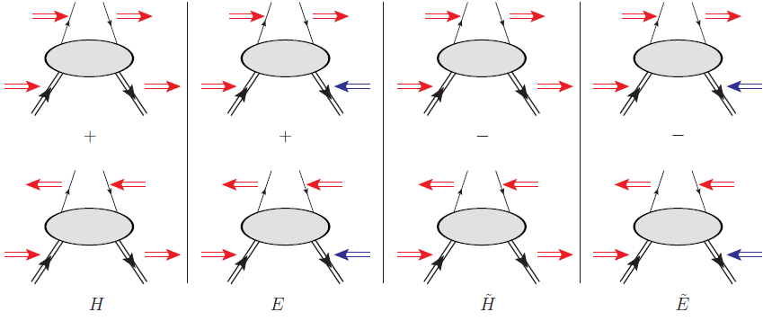
DVCS/DVMP : same GPDs??
Chiral even GPDs:
(helicity of the parton is conserved)
Chiral even GPDs
+
Chiral-odd GPDs:
(helicity of the parton can flip)
conserve nucleon spin
flip nucleon spin
parton helicity sensitive

Slide 32
Sensitivity to different GPDs (at leading order and twist)
Slide from M. Vanderhaeghen

Slide 33
The DVCS program worldwide
Experimental timeline
Pioneering results from non-dedicated experiments (Hall B and Hermes): ~2001
First round of dedicated experiments (Hall A/B, Hermes, H1&ZEUS): ~ 2005
Second round of dedicated experiments (Halls A/B): ~2010
Compelling DVCS program at JLab-12 GeV and Compass: 2015 and later
EIC program…
In the valence region (JLab 6 and JLab 12)
Partially complimentary, overlapping
Hall A/C: Test the validity of the formalism
  high accuracy (~5%)
  limited kinematic
Hall B: Map the GPDS
  limited accuracy (15+%)
  wide kinematic range

Slide 34
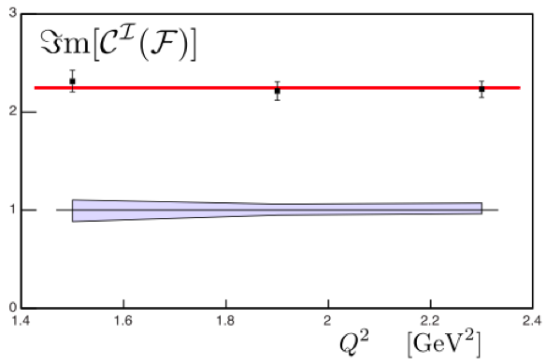
DVCS Hall A@Jlab 1rst generation
PRC C92, Nov ‘15
LT/LO
HT
NLO
S₁ ^{I}
No Q² dependence within this limited range => leading twist dominance
Needs to be checked over a larger Q² bite

Slide 35
Hall A E00-110: cross section Q² dependence
PRC C92, Nov ‘15
No Q² dependence within this limited range => leading twist dominance
Need to be checked over a larger Q² bite

Slide 36
Hall A E00-110 cross sections: higher twist corrections
PRC C92, Nov ‘15
Higher twist corrections might be necessary to fully explain experimental data
Confirmation of the significant deviation from BH => Need to measure T²_{DVCS}

Slide 37
Hall A E07-007 (JLab 6 GeV)
Goal: To separate the BH.DVCS interference contribution from the DVCS² contribution.
Nature Commun. 8 (2017) no.1, 1408
OR
LT/LO
NLO
HT
Q²=1.75 GeV², t=-0.30 GeV²
d⁴σ
Δ⁴σ
Fit HT or NLO
E_{beam}=4.455 GeV
E_{beam}=5.55 GeV

Slide 38
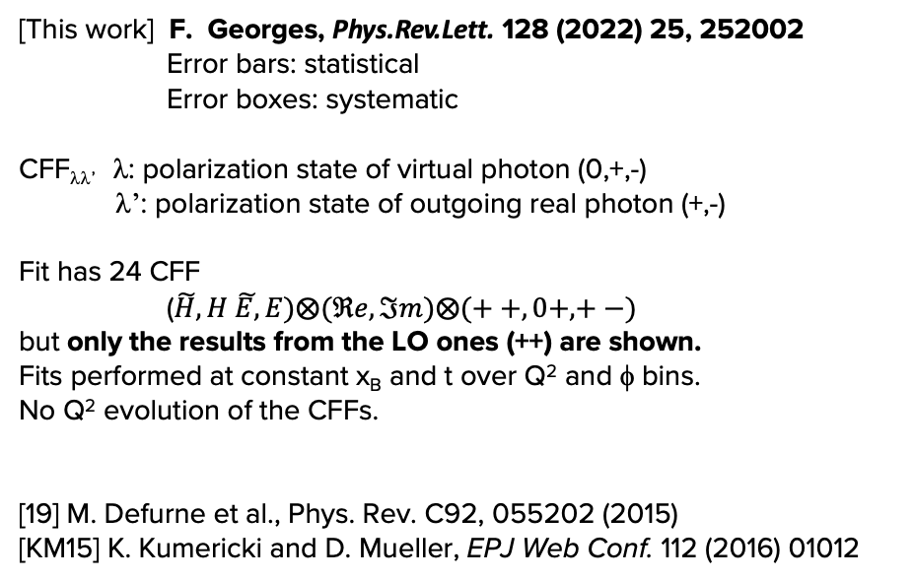
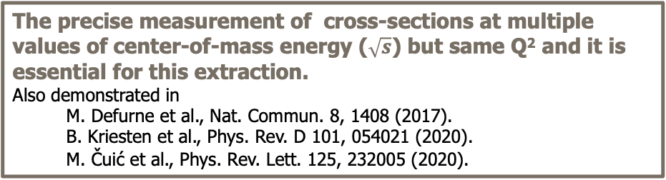
DVCS in Hall A: 12 GeV results
[This work] F. Georges, Phys.Rev.Lett. 128 (2022) 25, 252002
Error bars: statistical
Error boxes: systematic
CFF_{λλ’} λ: polarization state of virtual photon (0,+,-)
λ’: polarization state of outgoing real photon (+,-)
Fit has 24 CFF
($\tilde{H}, H \tilde{E,}E)⨂(ℜe,ℑm)⨂(++,0+,+−)$
but only the results from the LO ones (++) are shown.
Fits performed at constant x_{B} and t over Q² and φ bins.
No Q² evolution of the CFFs.
[19] M. Defurne et al., Phys. Rev. C92, 055202 (2015)
[KM15] K. Kumericki and D. Mueller, EPJ Web Conf. 112 (2016) 01012
The precise measurement of cross-sections at multiple values of center-of-mass energy ($\sqrt{s}$) but same Q² and it is essential for this extraction.
Also demonstrated in
  M. Defurne et al., Nat. Commun. 8, 1408 (2017).
  B. Kriesten et al., Phys. Rev. D 101, 054021 (2020).
  M. Čuić et al., Phys. Rev. Lett. 125, 232005 (2020).

Slide 39
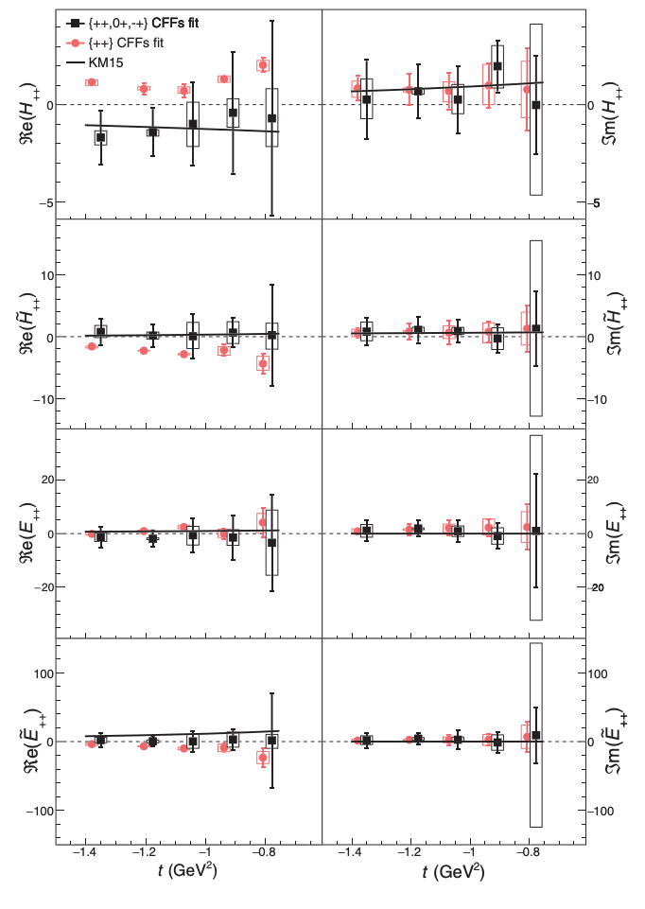
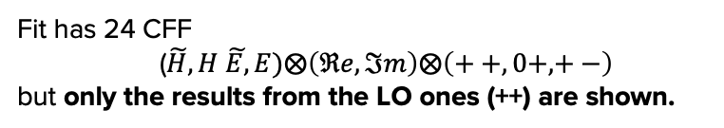

DVCS in Hall A: 12 GeV results
F. Georges, Phys.Rev.Lett. 128 (2022) 25, 252002
Results shown at x_{B}=0.60
Fits performed at constant x_{B} and t over Q² and φ bins.
No Q² evolution of the CFFs.
Fit has 24 CFF
($\tilde{H}, H \tilde{E,}E)⨂\left(ℜe,ℑm\right)⨂\left(++,0+,+−\right)$
but only the results from the LO ones (++) are shown.
Fit has only 8 CFF
($\tilde{H}, H \tilde{E,}E)⨂\left(ℜe,ℑm\right)⨂\left(++\right)$
Fitting all CFFs is essential
to get realistic estimates
of their uncertainties.

Slide 40
π⁰ DVCS2n results: fully separated contributions
M. Mazouz PRL 118 (2017) 22, 222002
Q²=1.75 GeV² and x_{B}=0.36
Goloskokov and Kroll
Eur Phys J A47 (2012)

Slide 41
π⁰ DVCS2n results: flavor separation
M. Mazouz PRL 118 (2017) 22, 222002
Q²=1.75 GeV² , x_{B}=0.36
account for the unknown phase variation between u and the d amplitude γ*q -> q’π⁰ convoluted with (H,E)_{T}
Goloskokov and Kroll
Eur Phys J A47 (2012)
u quark
d quark

Slide 42
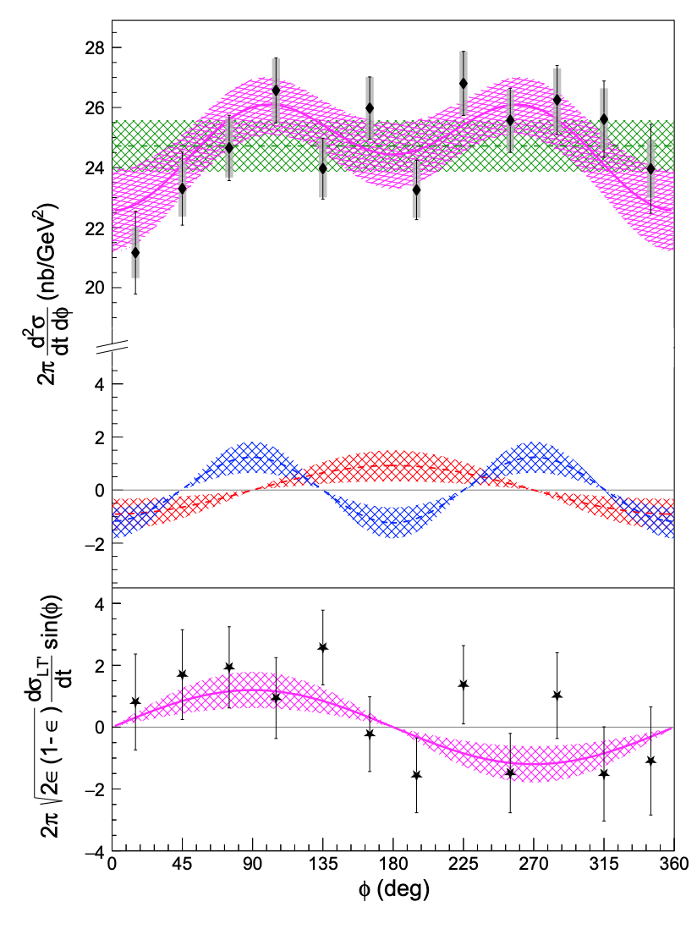
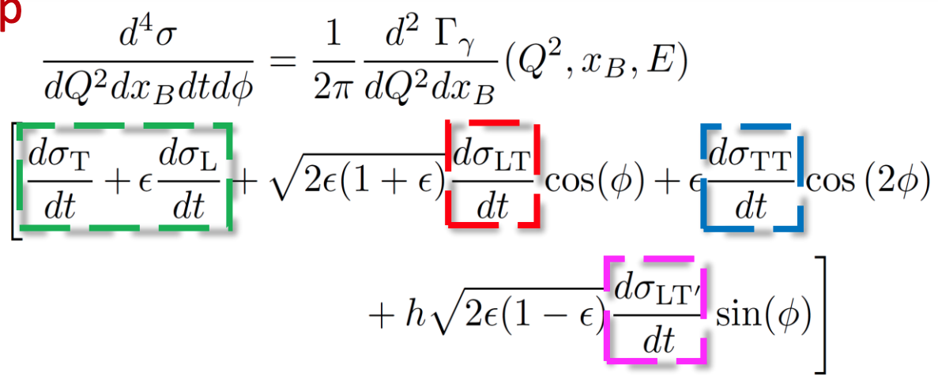

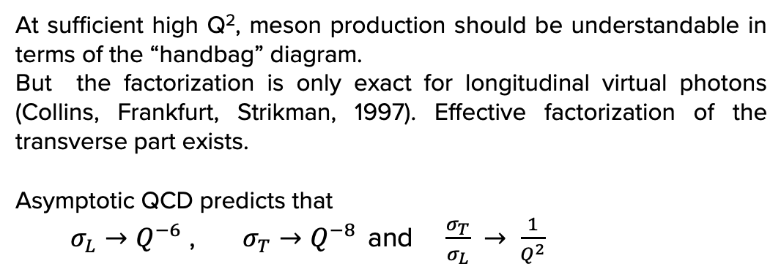
$ep→epπ^{0}$in Hall A : 12 GeV result
Q²=8.31 GeV², t’=0.15 GeV², x_{B}=0.60
At sufficient high Q², meson production should be understandable in terms of the “handbag” diagram.
But the factorization is only exact for longitudinal virtual photons (Collins, Frankfurt, Strikman, 1997). Effective factorization of the transverse part exists.
Asymptotic QCD predicts that
  $σ_{L}→Q^{−6}$ , $σ_{T}→Q^{−8 }$ and $\frac{σ_{T}}{σ_{L}} → \frac{1}{Q^{2}}$
dσ_{U}=dσ_{T}+ ε dσ_{L}

Slide 43
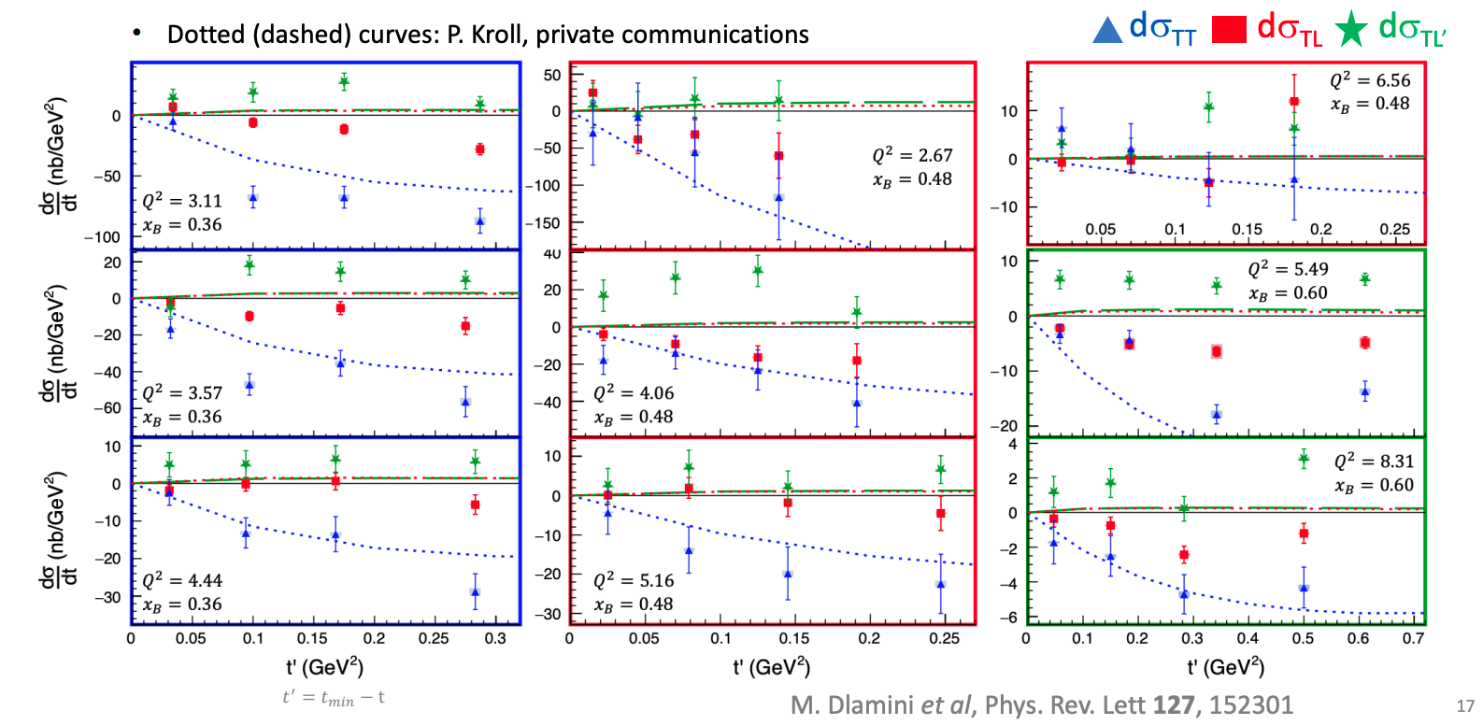
$ep→epπ^{0}$in Hall A : 12 GeV result
σ_{TT} larger than σ_{TL} and σ_{TL’} : hint of dominance of the transverse amplitude as suggested by the GK model
σ_{TL} and σ_{TL’} underestimated by the GK model: larger contribution of the longitudinal amplitude than the one expected by GK
sign difference between GK and σ_{TL} (Hall B & COMPASS results agree with GK)

Slide 44
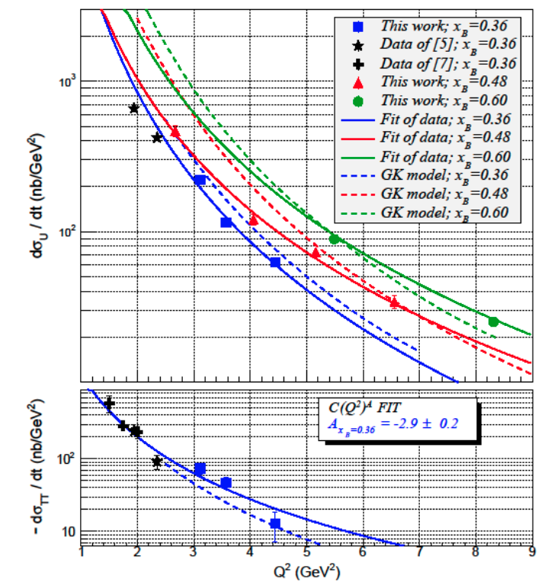
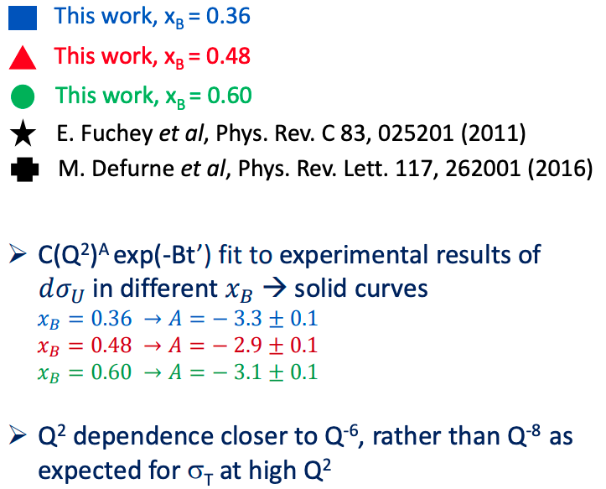

$ep→epπ^{0}$in Hall A : 12 GeV result
<t’> = 0.1 GeV²
dashed lines: P. Kroll private communication
$$\frac{dσ_{u}}{dt}=\frac{dσ_{T}}{dt}+ ε\frac{dσ_{L}}{dt}$$

Slide 45
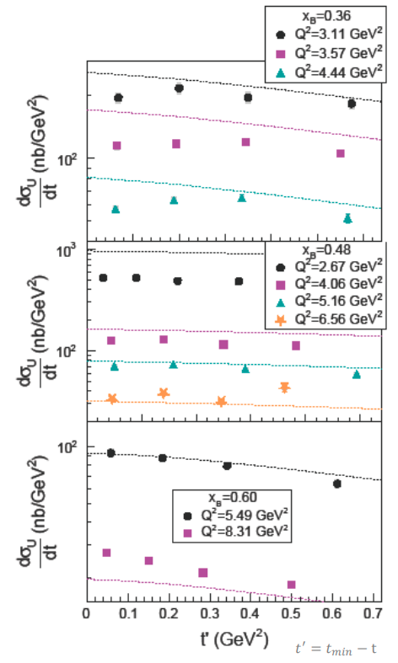
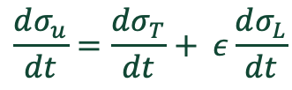
$$\frac{dσ_{u}}{dt}=\frac{dσ_{T}}{dt}+ ε\frac{dσ_{L}}{dt}$$
dashed lines: P. Kroll private communication

Slide 46
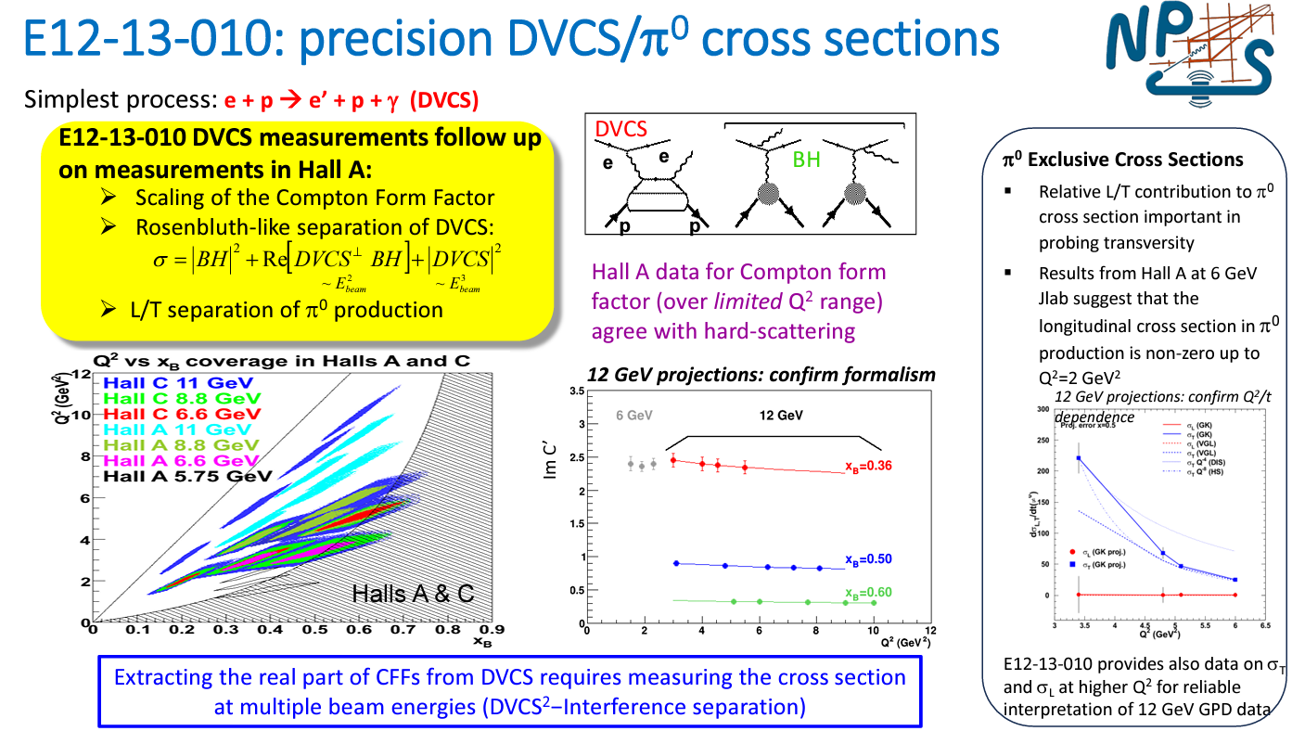

Slide 47
