Slide 1
Parton distribution function on Lattice QCD
The 12th Circum-Pan-Pacific Symposium on High Energy Spin Physics
Peng Sun
Institute of Modern Physics,
Chinese Academy of Sciences
Lattice Parton collaboration
2024/11/12

Slide 2
Outline
How to calculate PDF on Lattice QCD
Results from Lattice Parton collaboration (LPC)
summary

Slide 3
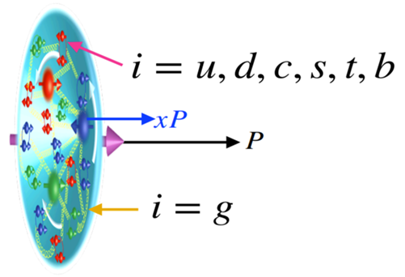
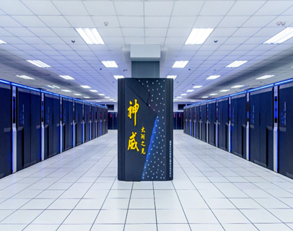
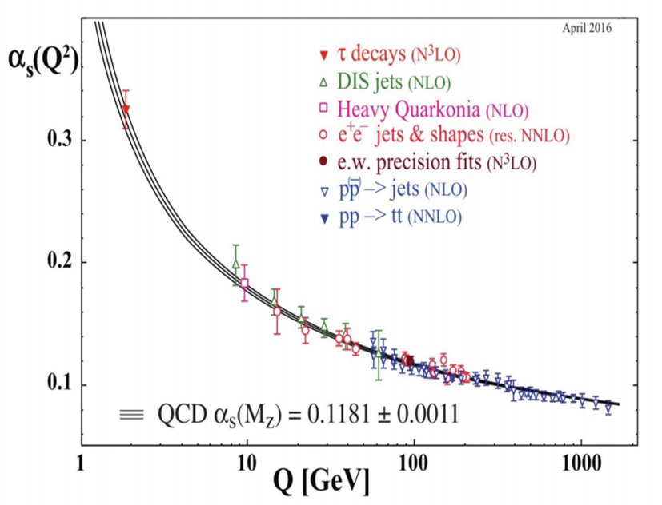
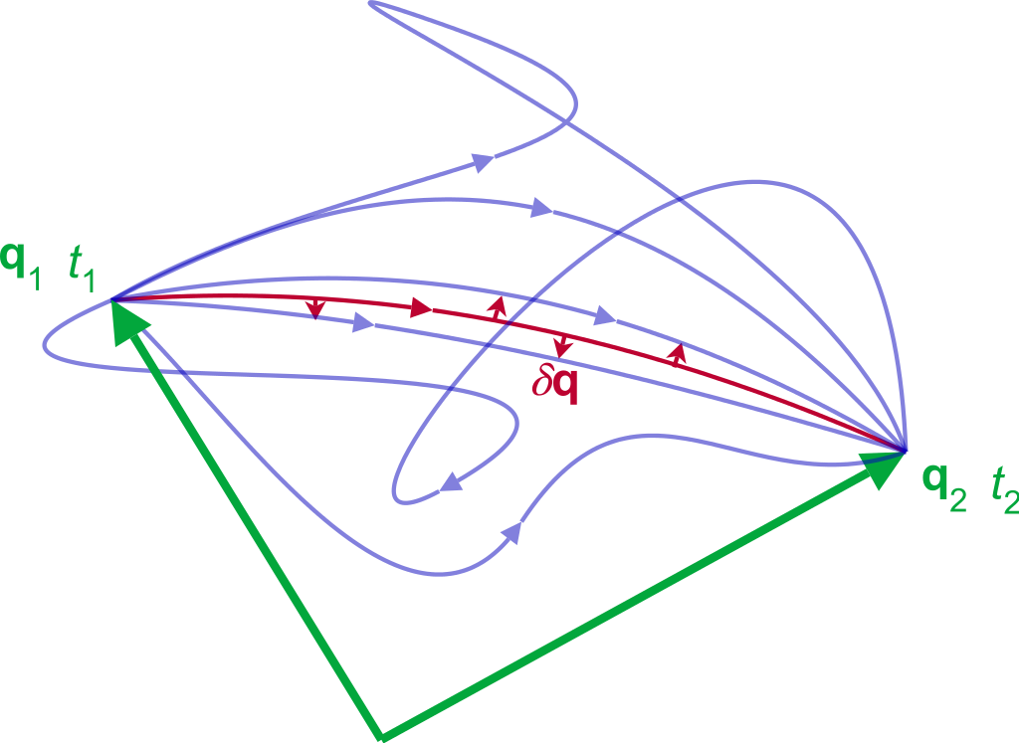
Lattice QCD & PDF

Slide 4
Reconstruct the PDF from Lattice QCD
The direct calculation of the hadronic tensor on the lattice which can be used to reconstruct the structure functions through the Laplace transform
K. Liu, S. Dong, Phys.Rev.Lett. 72 1790 (1994)
J. Liang, et.al, Phys. Rev. D 101, 114503 (2020)
The quasi-PDF proposed by Ji: Reconstruct the PDF through Fourier transform
X.D. Ji, Phys.Rev.Lett 110 262002 (2013)
X. Xiong, et.al, Phys.Rev. D 90 014051 (2014)
Lattice cross section: the hadronic matrix elements which are calculable in lattice QCD and factorizable in terms of PDFs
Y.Q. Ma and J.-W. Qiu, Phys.Rev.Lett 120 022003 (2018)
The pseudo-PDF is similar as quasi-PDF, and it is renormalized by hadron matrix elements
A. V. Radyushkin, Phys.Rev. D 96, 034025 (2017)

Slide 5
Large-Momentum Effective Theory (LaMET)
X. D. Ji, Phys.Rev.Lett 110 (2013) 262002
X. Ji, Y.-S. Liu, Y. Liu, J.-H. Zhang and Y Zhao , Rev. Mod. Phys. 93, 35005 (2021).
Light-cone PDF : Cannot be
calculated on the lattice
Quasi-PDF : Directly
calculable on the lattice

Slide 6
Matching between Qausi-PDF and LC-PDF
Factorization formula rigorously proven in the momentum space in MS scheme
*The qausi-PDF and LC-PDF share the same IR physics in x,y=[0, 1]
Then we can build the matching relationship:
Y.-Q. Ma and J. Qiu, Phys.Rev. D 98 (2018)
X. Ji, Y.-S. Liu, Y. Liu, J.-H. Zhang and YZ, arXiv: 2004.03543 (2020)

Slide 7
Picture of Qausi-PDF on Lattice
Propagate
Z-direction
gauge link
u
u
d
u
u
d
u
u
d
u
u
d

Slide 8
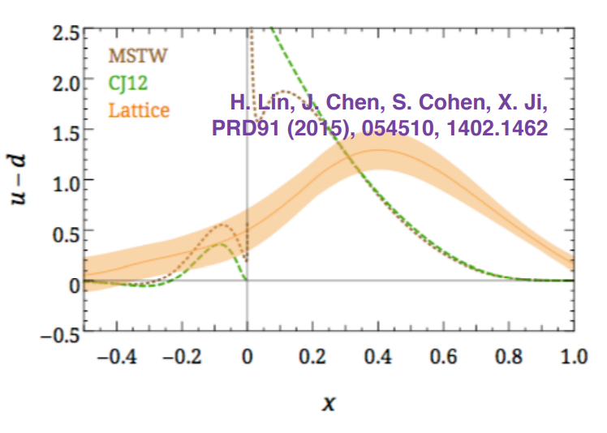
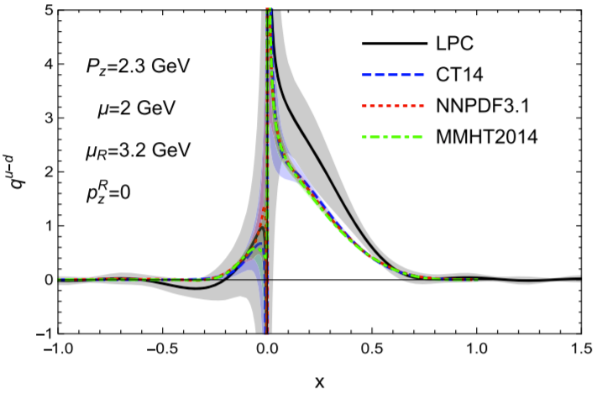
Unpolarized PDF on Lattice from 2015 to now
Y. Liu, et.al., LPC, PRD101(2020)034020
• Improved operator definition;
• RI/MOM renormalization;
• Complete 1-loop matching;
• Larger momentum and lighter pion mass.

Slide 9
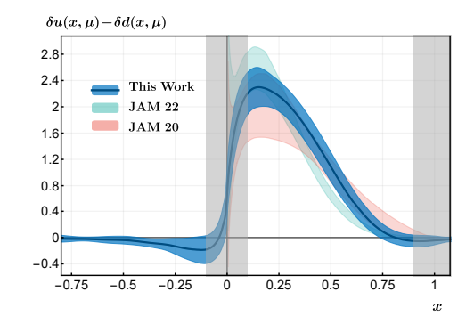
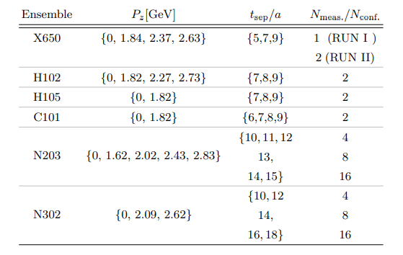
Transversity PDF on Lattice
Pion mass = {354, 281, 222} MeV
F Yao et al LPC Phys. Rev. Lett. 131, 261901

Slide 10
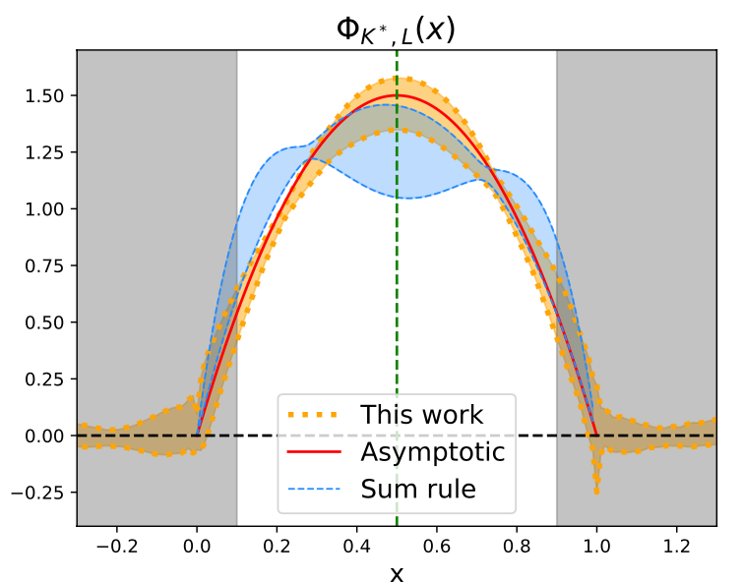
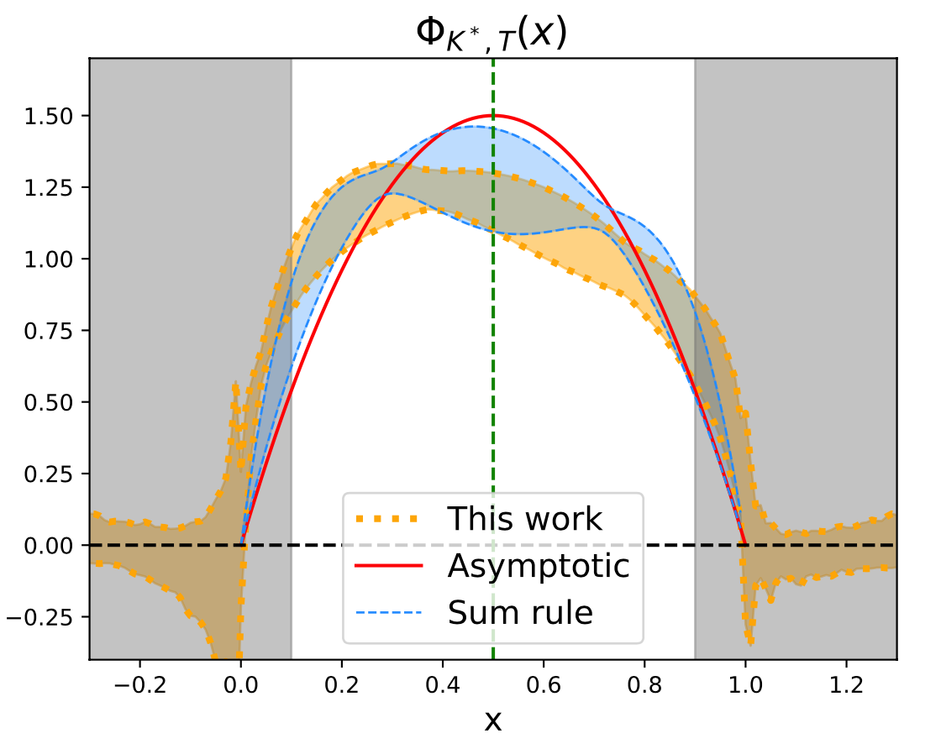
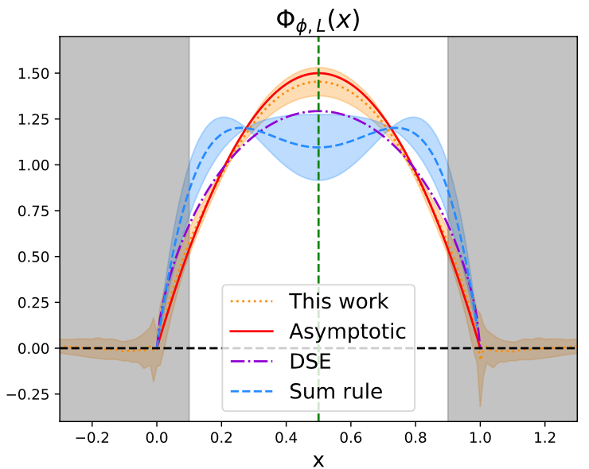
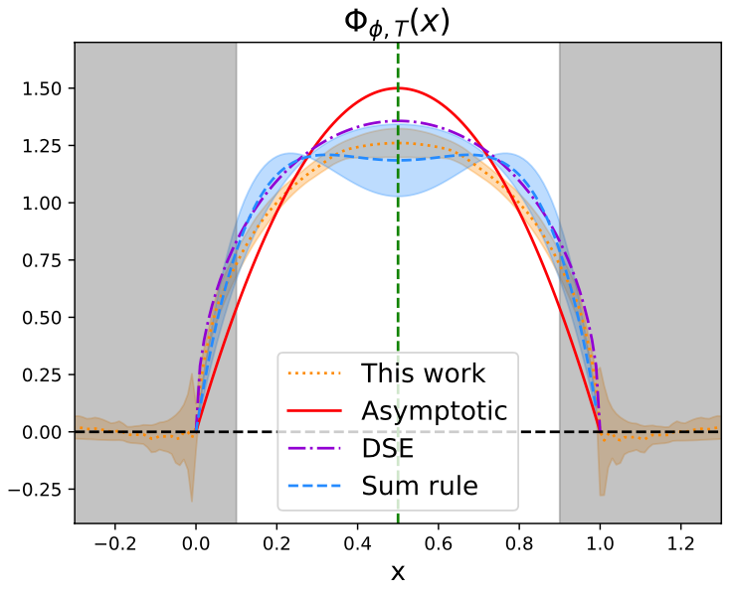
Pseudoscalar and vector meson LCDAs
$K^{∗}$ LCDA
3 lattice spacings：
(0.12,0.09,0.06)fm,
largest volume(96³×192)
3 momentum：
(1.29, 1.72, 2.15)GeV
mass:
$$K^{∗}:0.89GeV, φ:1.02GeV$$
Hybrid scheme (based on RI/MOM)
$φ$ LCDA
J.Hua et.al. LPC PRL127. 062002(2021)

Slide 11
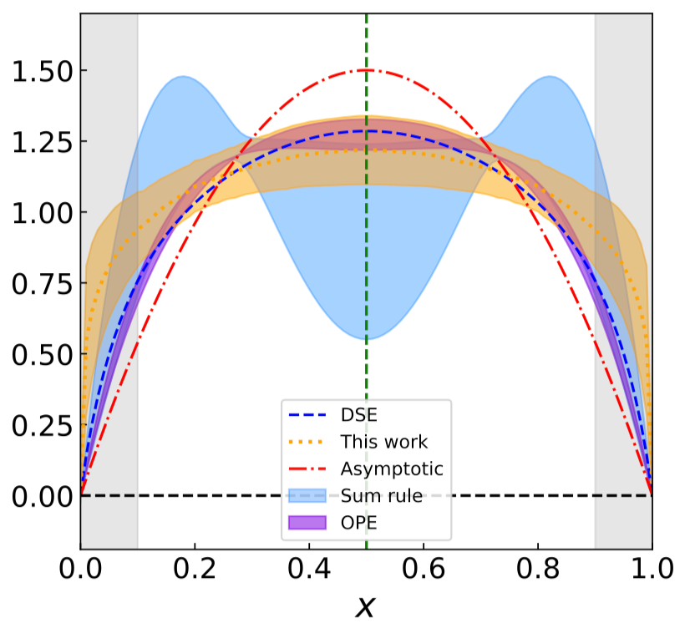
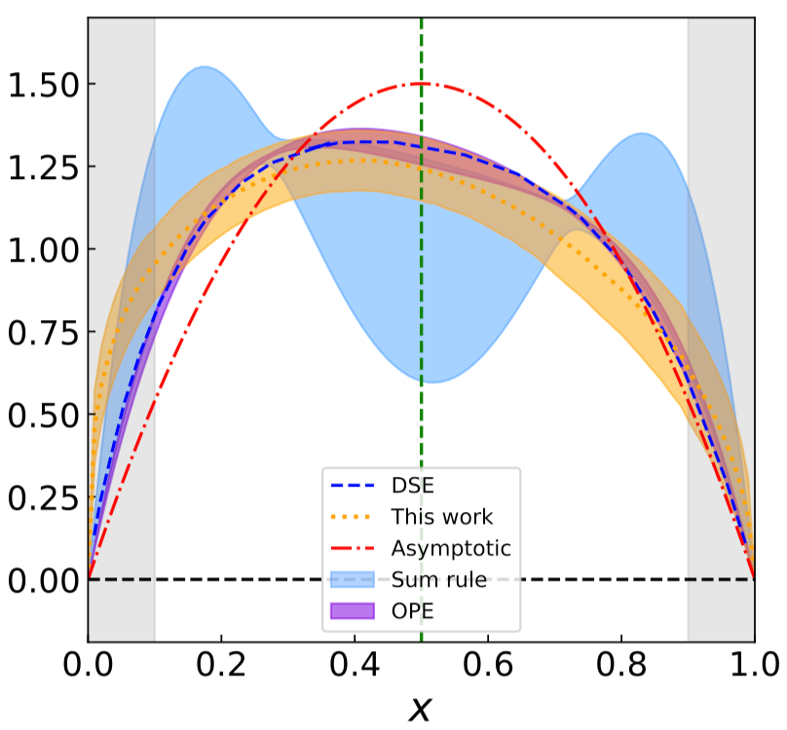
Pseudoscalar and vector meson LCDAs
$π$ LCDA:
$K$ LCDA:
3 lattice spacings：
(0.12,0.09,0.06)fm,
largest volume(96³×192)
3 momentum：
(1.29, 1.72, 2.15)GeV
mass:
$π:0.13GeV, K:0.49GeV$
Hybrid scheme(Self renormalization)
J.Hua et.al. LPC PRL129. 132001(2022)
There are uncontrolled systematic uncertainty in the endpoint region

Slide 12
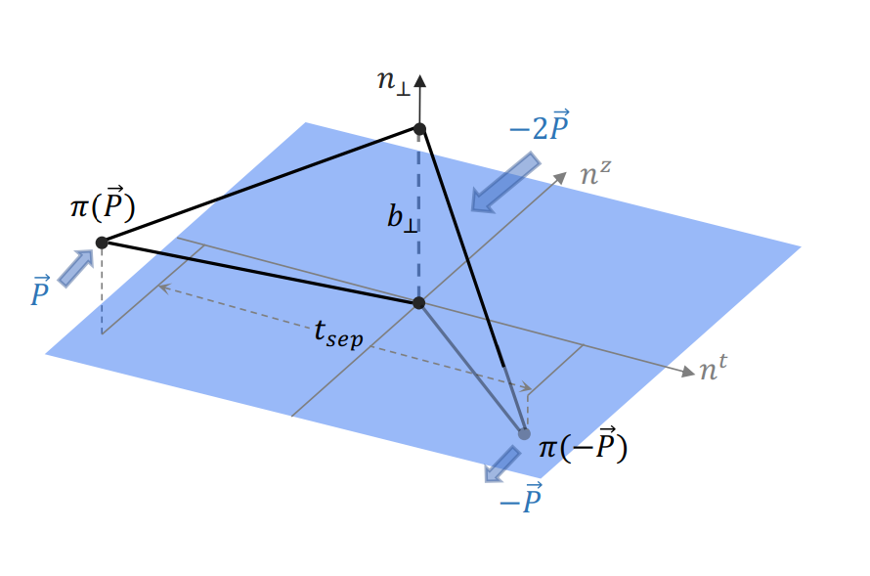
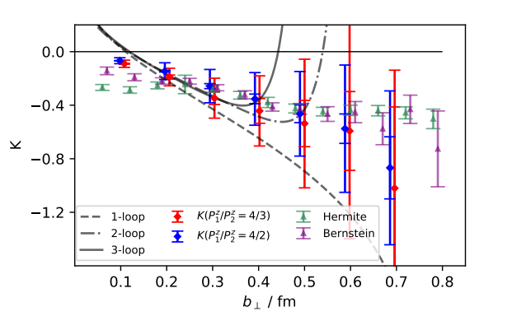
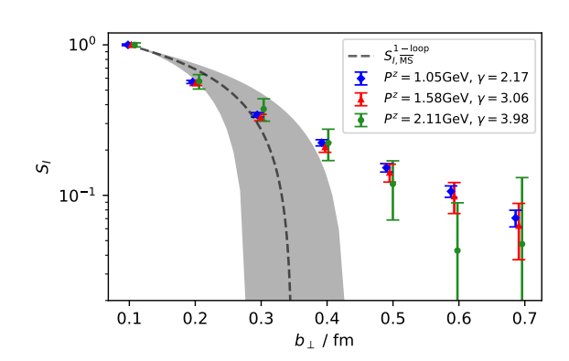
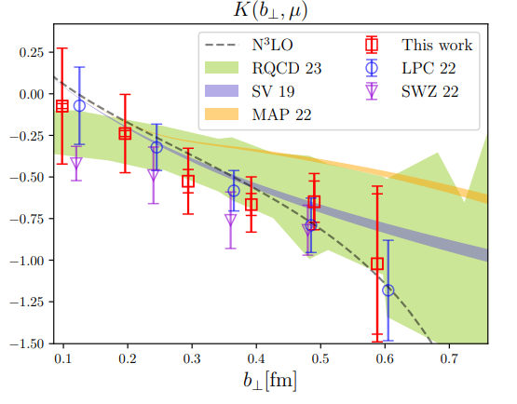
Soft Factor on Lattice QCD
Q.-A. Zhang. et.al., LPC, PRL125(2020)192001
M.H. Chu. et.al., LPC, JHEP 08 (2023) 172

Slide 13
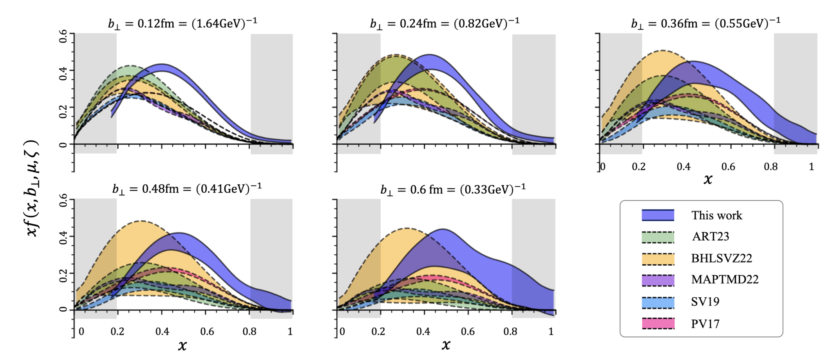
Unpolarized TMD PDF on Lattice QCD
Moos, JHEP2024
Bury, JHEP2022
Bacchetta, JHEP2022
Scimemi, JHEP2020
Bacchetta, JHEP2019
J.S. He. et.al., LPC, PRD109(2024)114513

Slide 14
Unpolarized TMD PDF on Lattice QCD
Compare the $b_{⊥}$-dependence of lattice and phenomenological results:
J.S. He. et.al., LPC, PRD109(2024)114513

Slide 15
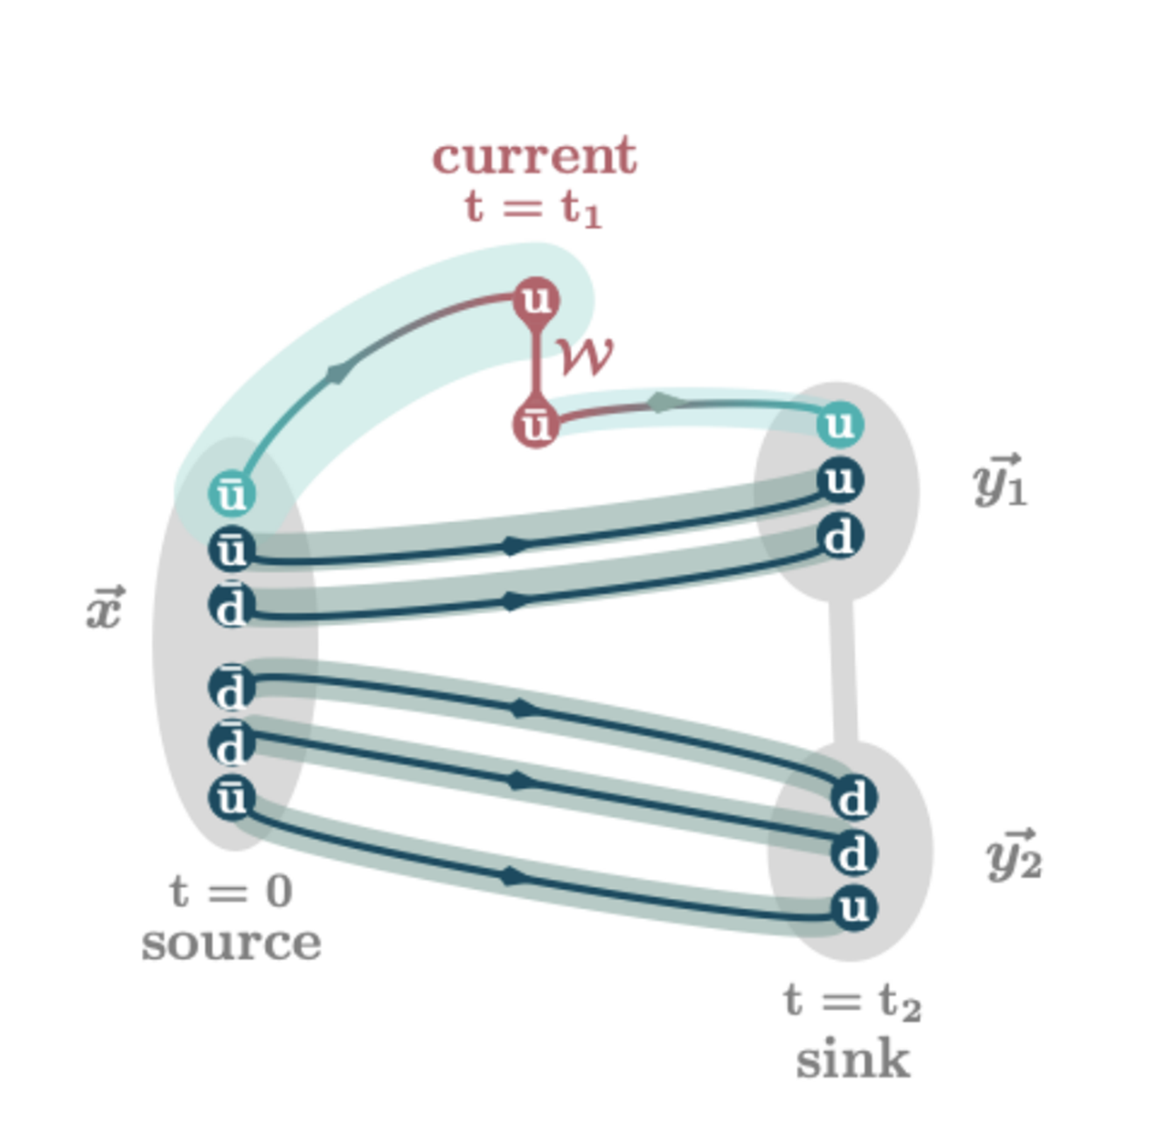
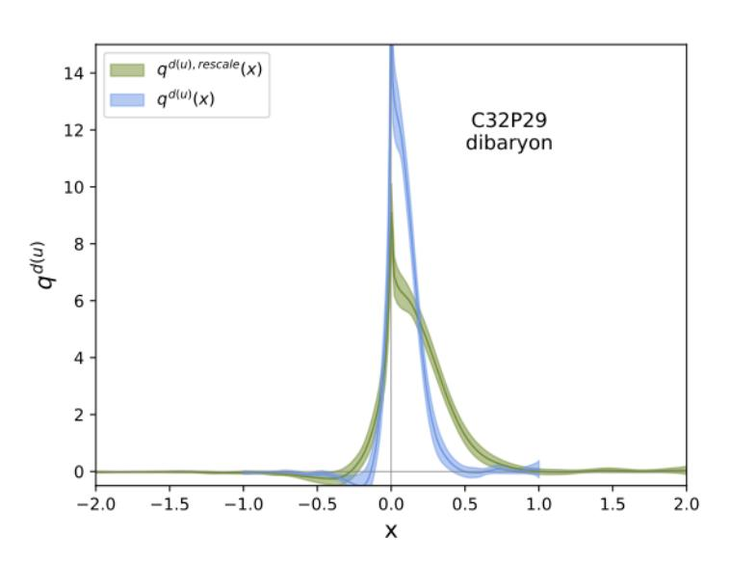
Dibaryon PDF on the lattice
C. Chen, et.al.,LPC 2408.12819
m_{π} = 290 MeV, L = 3.3 fm m_{π} = 290 MeV, L = 2.5 fm m_{π} = 900 MeV, L = 2.5 fm
15

Slide 16
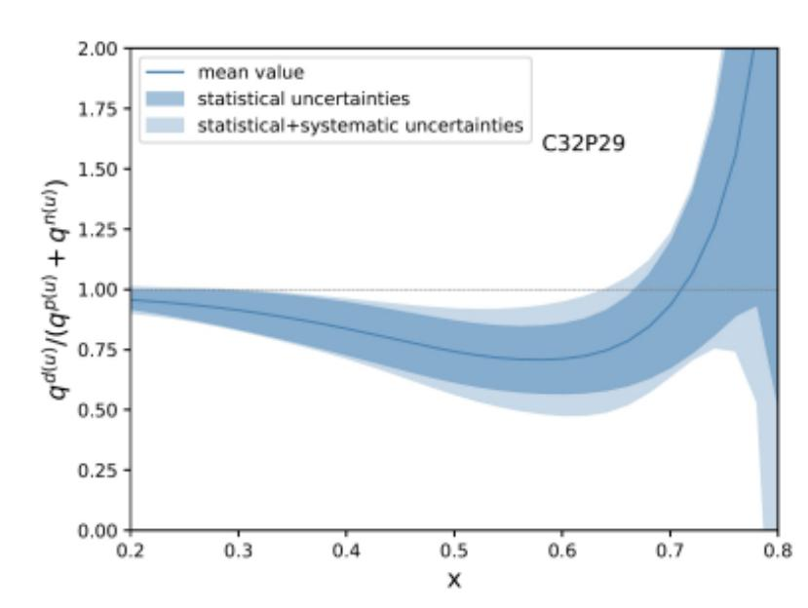
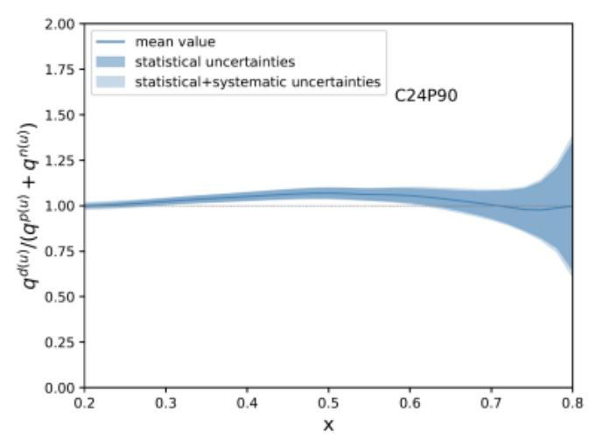
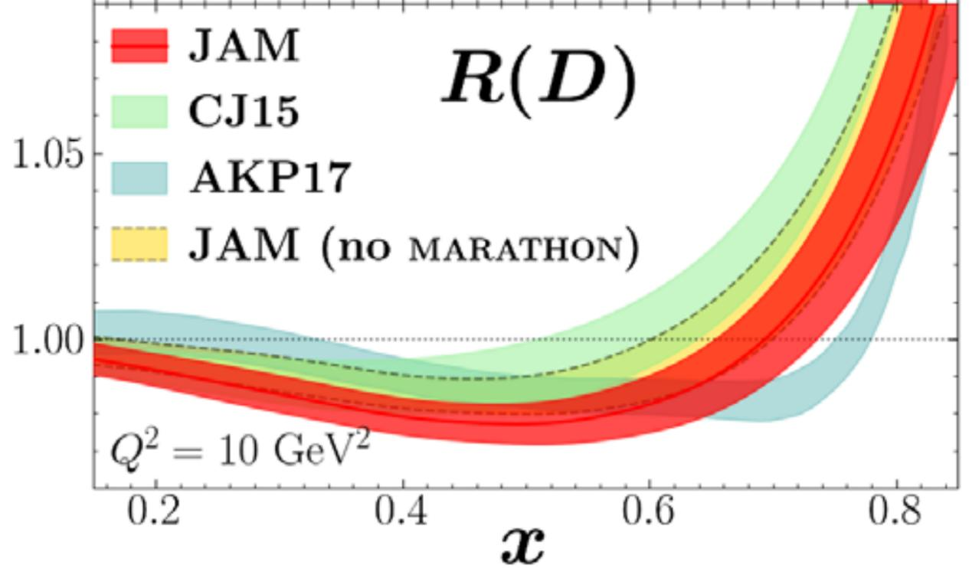
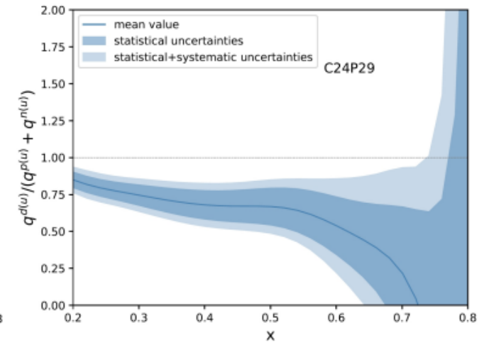
Dibaryon PDF on the lattice
C. Chen, et.al.,LPC 2408.12819
m_{π} = 290 MeV, L = 3.3 fm
m_{π} = 900 MeV, L = 2.5 fm
m_{π} = 290 MeV, L = 2.5 fm
After we take the ratio f_{D}(2x)/(2f_{N}(x)):
• Deviation from 1 is still tiny with m_{π} ~ 900 MeV;
• But much more larger at m_{π} ~ 290 MeV with large uncertainty,
and show similar tendency as that in the experiment.
16

Slide 17
Summary
We have completed many works on the lattice calculation of PDFs.
However, current works only focus on PDFs of u-d without gluon and sea quark contribution.
We are working on the gluon PDF and PDFs with sea quark PDFs
To obtain precise PDFs via lattice QCD, it is still a long way to go.

