Slide 1
Constraining the collision terms
in spin kinetic theory
Jian-Hua Gao
Shandong University at Weihai
Based on: Shi-Yuan Wu, JHG arXiv: 2409.00457
The 12th Circum-Pan-Pacific Symposium on High Energy Spin Physics, Nov. 8 -12, 2024, Hefei, Anhui

Slide 2
Contents
Introduction
Wigner function formalism
Self-consistent constraints on collision terms in spin kinetic theory
Self-consistent relaxation time approximation
Summary and outlook

Slide 3
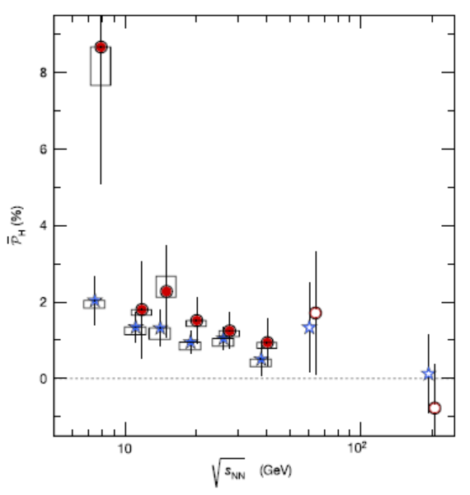
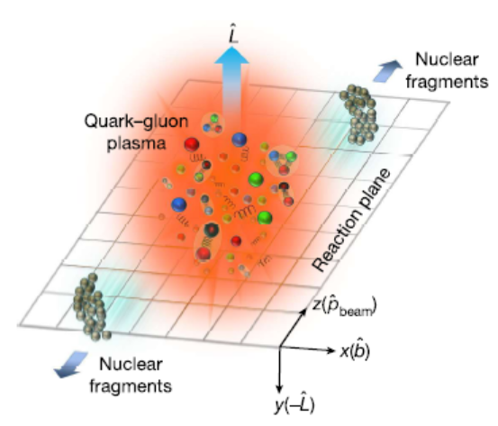
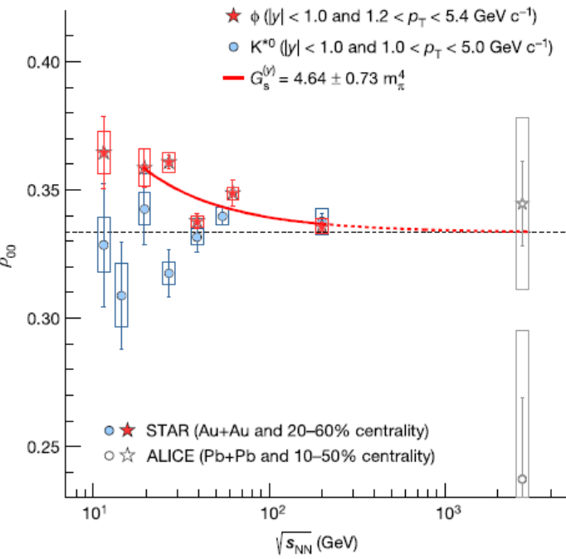
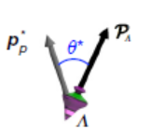
Introduction
STAR Nature 2017
STAR Nature 2023

Slide 4
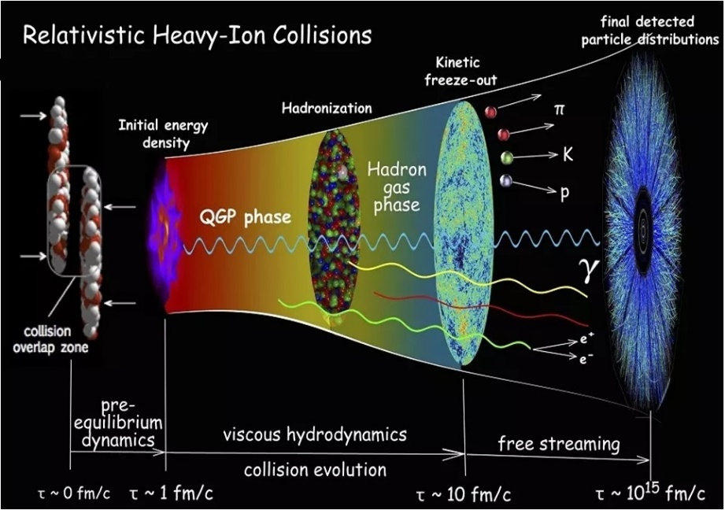
Introduction
Made by Chun Shen
by Chun Shen
Non-equilibrium Effect
Spin polarization effect
Spin hydrodynamics
Spin kinetic theory
Plenary talk by Shu Lin (Nov. 9); Plenary talk by Xu-Guang Huang (Nov. 10)
Parallel talk by Dong-Lin Wang (Nov. 11)； Parallel talk by Shuo Fang (Nov. 11)

Slide 5
Introduction
Made by Chun Shen
Recent developments in spin kinetic theory：
J. H. Gao, Z. T. Liang, S. Pu, Q. Wang and X. N. Wang, Phys. Rev. Lett. 109, 232301 (2012)2012
M. A. Stephanov and Y. Yin, Phys. Rev. Lett. 109, 162001 (2012)
J. W. Chen, S. Pu, Q. Wang and X. N. Wang, Phys. Rev. Lett. 110, no. 26, 262301 (2013).
J. Y. Chen, D. T. Son and M. A. Stephanov, Phys. Rev. Lett. 115, no. 2, 021601 (2015).
Y. Hidaka, S. Pu and D. L. Yang, Phys. Rev. D 95, no. 9, 091901 (2017).
A. Huang, S. Shi, Y. Jiang, J. Liao and P. Zhuang, Phys. Rev. D 98, no. 3, 036010 (2018).
J. H. Gao, Z. T. Liang, Q. Wang and X. N. Wang, Phys. Rev. D 98, no. 3, 036019 (2018).
Y. C. Liu, L. L. Gao, K. Mameda and X. G. Huang, Phys. Rev. D 99, no.8, 085014 (2019)
J. H. Gao and Z. T. Liang, Phys. Rev. D 100, 056021 (2019).
N. Weickgenannt, X. L. Sheng, E. Speranza, Q. Wang and D. H. Rischke, Phys. Rev. D 100,056018 (2019).
K. Hattori, Y. Hidaka and D. L. Yang, Phys. Rev. D 100, 096011 (2019).
Z. Wang, X. Guo, S. Shi and P. Zhuang, Phys. Rev. D 100, 014015 (2019).
S. Lin and L. Yang, Phys. Rev. D 101, no.3, 034006 (2020)
S. Li and H. U. Yee, Phys. Rev. D 100, no. 5, 056022 (2019)
N. Weickgenannt, E. Speranza, X. l. Sheng, Q. Wang and D. H. Rischke, Phys. Rev. Lett.127, no.5, 052301 (2021)
T. Hayata, Y. Hidaka and K. Mameda, JHEP 05, 023 (2021)
X. L. Luo and J. H. Gao, JHEP 11, 115 (2021)
S. Lin, Phys. Rev. D 105, no.7, 076017 (2022)
S. Fang, S. Pu and D. L. Yang, Phys. Rev. D 106, no.1, 016002 (2022)
……
from massless to massive
from first to second order
from Abelian to non-Abelian
from flat to curved spacetime
from collisionless to collisional
Collision terms play a central role in describing the generation and diffusion of global spin polarization!

Slide 6
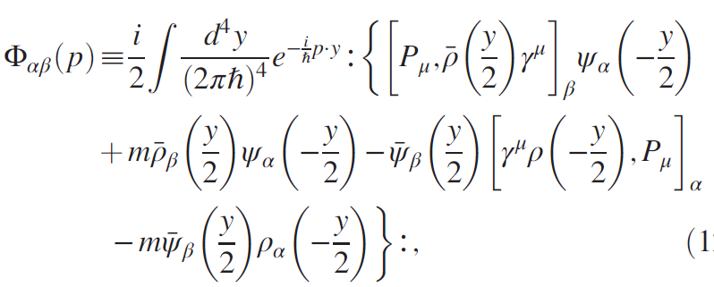
Introduction
Made by Chun Shen
Derive the collision terms from quantum field theory:
J. Y. Chen, D. T. Son and M. A. Stephanov, Phys. Rev. Lett. 115, 021601 (2015).
S. Li and H. U. Yee, Phys. Rev. D 100, 056022 (2019)
S. Carignano, C. Manuel and J. M. Torres-Rincon, Phys. Rev. D 102,016003 (2020)
D. L. Yang, K. Hattori and Y. Hidaka, JHEP 07,070 (2020)
N. Weickgenannt, E. Speranza, X. l. Sheng, Q. Wang and D. H. Rischke, Phys. Rev. Lett.127, 052301 (2021)
N. Weigckgenannt, E.Speranza, X.L. Sheng, Q. Wang and D.H. Rischke, Phys. Rev. D 104,016022
X.L. Sheng, N.Weigckgenannt, E.Speranza, D.H. Rischke and Q. Wang , Phys. Rev. D 104,016029
G. Fauth, J. Berges, A. Di Piazza Phys. Rev. D 104.036007
T. Hayata, Y. Hidaka and K. Mameda, JHEP 05, 023 (2021)
S. Lin, Phys. Rev. D 105 076017 (2022)
Z. Wang Phys. Rev. D 106, 076011 (2022)
S. Fang, S. Pu and D. L. Yang, Phys. Rev. D 106, no.1, 016002 (2022)
W. B. Dong, Y. L. Yin and Q. Wang, Phys. Rev. C 106.054909(2022)
D.Wagner, N. Weichgenant and D. H. Rischke, Phys. Rev. D 106,116021
……
The collision terms in spin kinetic theory are very complex ! Need further simplification and approximation !

Slide 7
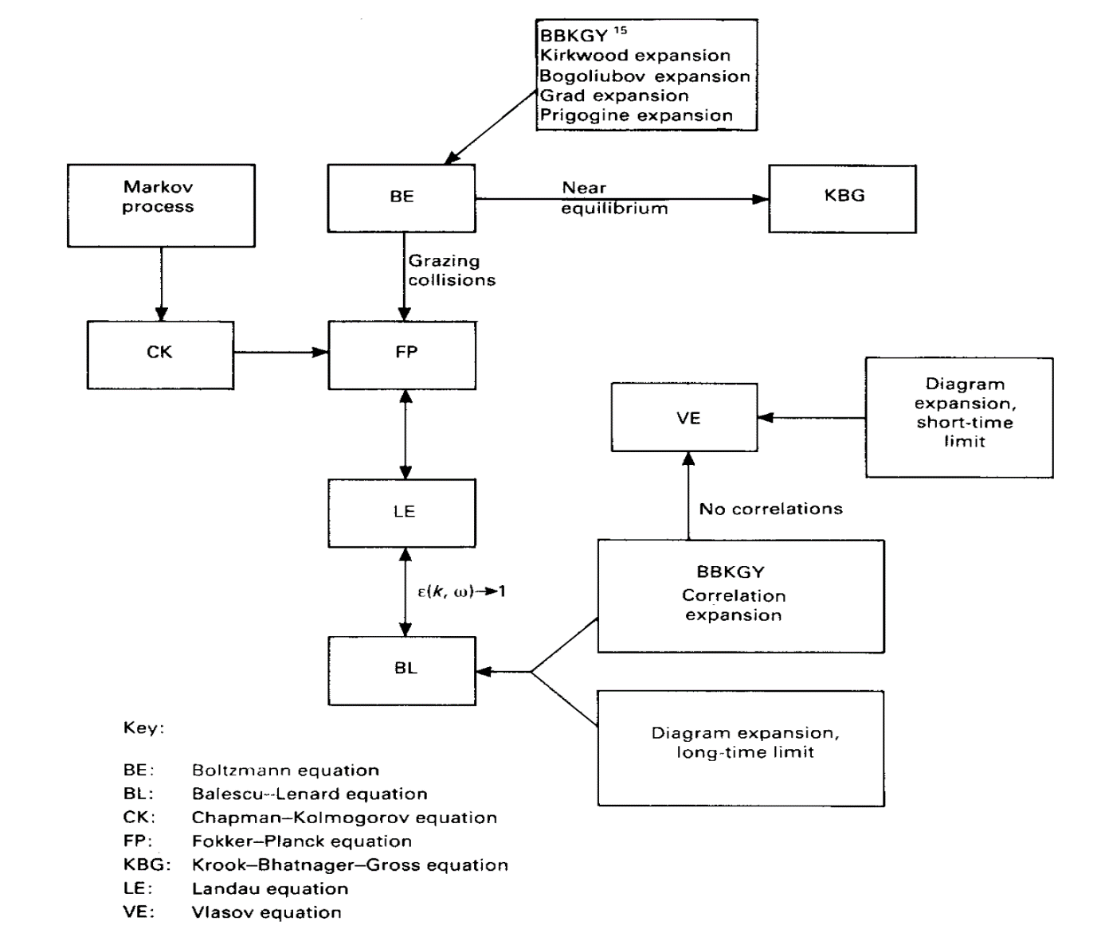
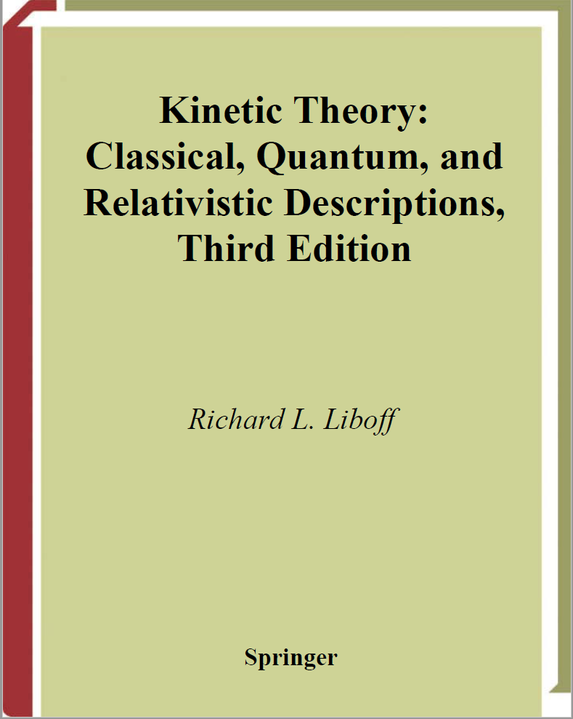
Introduction
Made by Chun Shen
Can we have any constraints on the collision terms in spin kinetic theory?

Slide 8
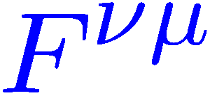
Wigner function formalism
Made by Chun Shen
Wigner function from quantum field theory ：
Gauge invariant density operator in QED ：
Wigner equation in QED：
General collision terms：
Space-time derivative acts only on
under mean field approximation

Slide 9
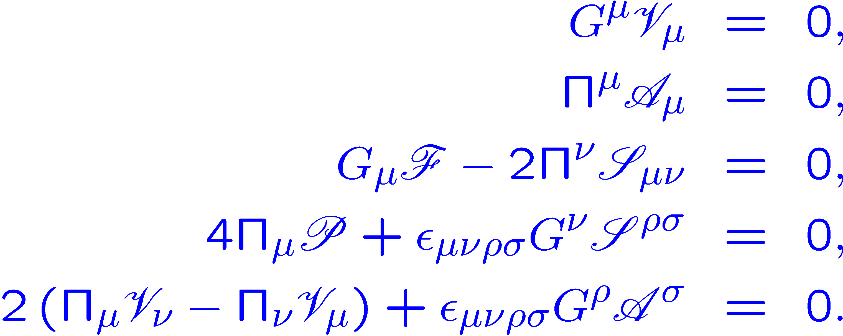
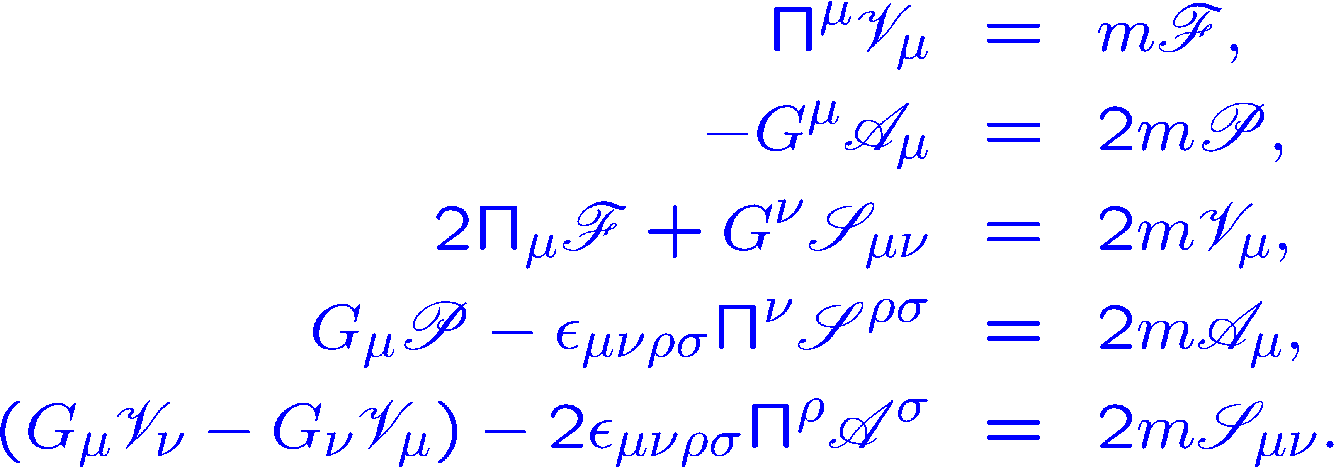
Wigner function formalism
Made by Chun Shen
Quantum Vlasov equation：
16 Wigner functions in Clifford algebra :
scalar pseudo vector axial tensor
32 closed Wigner equations in mean field approximation :

Slide 10
Self-consistent constraints on collision terms in spin kinetic theory
Under mean field approximation!
12 Wigner equations are satisfied automatically and redundant!
J. H. Gao, Z. T. Liang, Q. Wang and X. N. Wang, Phys. Rev. D 98, 036019 (2018).
J. H. Gao and Z. T. Liang, Phys. Rev. D 100, 056021 (2019).
S. X. Ma and J. H. Gao, Phys. Lett. B 844 (2023)
Beyond mean field approximation?
12 of Wigner equations lead to self-consistent constraints on collision terms!
Notes:
10
10

Slide 11
Self-consistent constraints on collision terms in spin kinetic theory
Wigner equations:
Decomposition in Clifford algebra:
Chirality basis (s= ±1)
Wigner equations after decomposition in Clifford algebra:
Notes:
11
11

Slide 12
Self-consistent constraints on collision terms in spin kinetic theory
Semi-classical $ℏ$expansion :
Up to the second order of $ℏ$:
Introduce an auxiliary time-like 4-vector $n^{μ}$ with normalization $n^{2}=1$:
Vector:
Antisymmetric tensor:
We will assume $n^{μ}$can depend on the space-time coordinates $x^{μ}$
Notes:
12
12

Slide 13
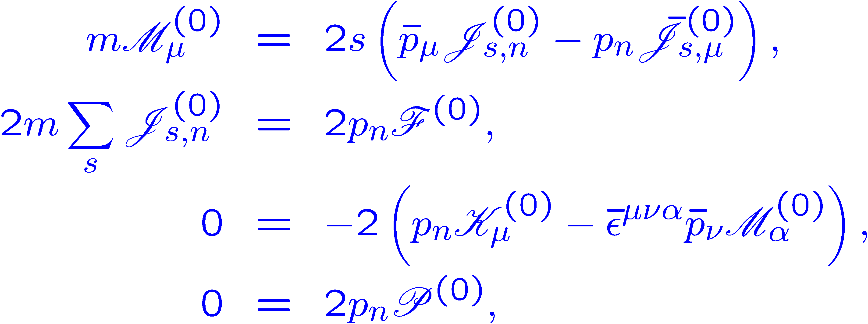
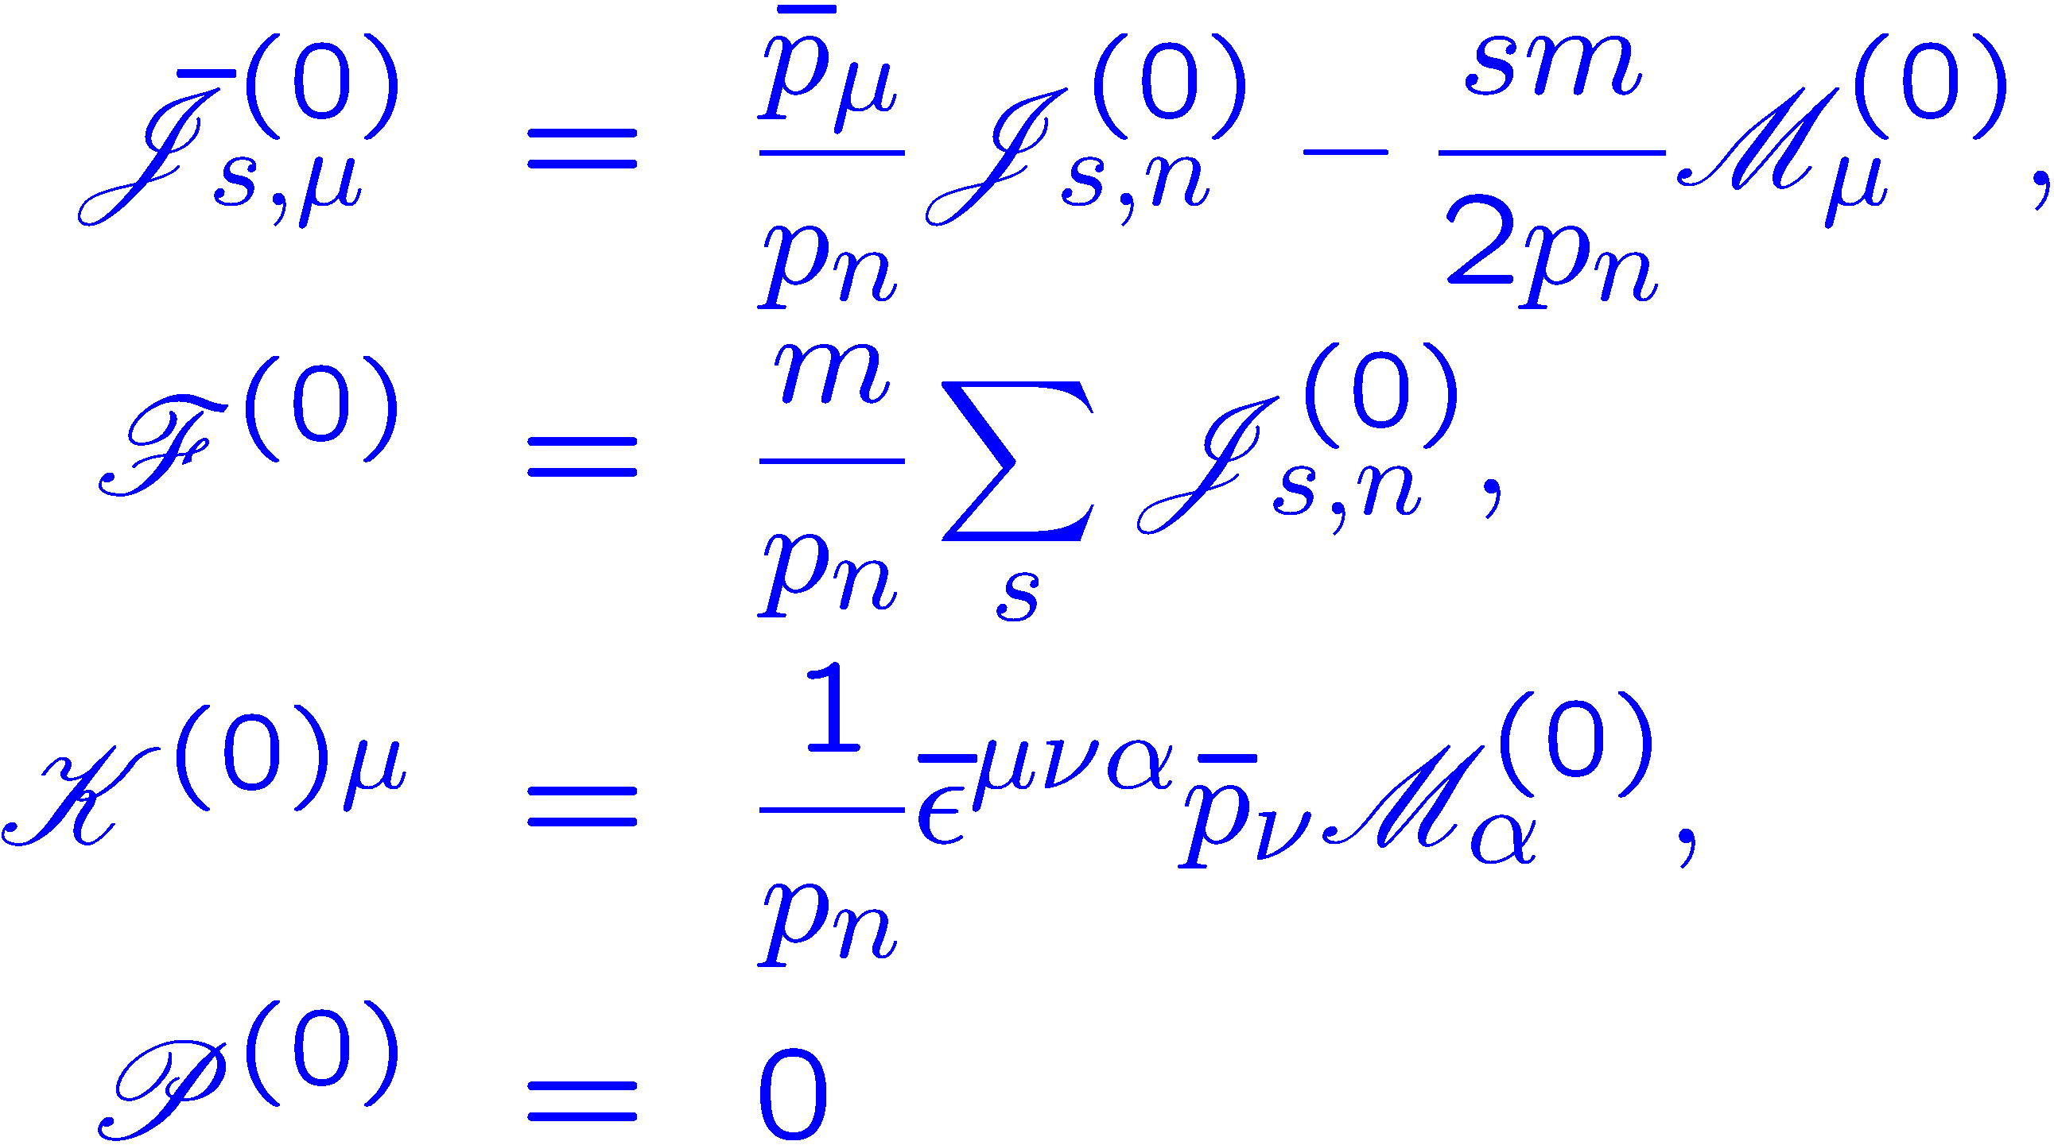
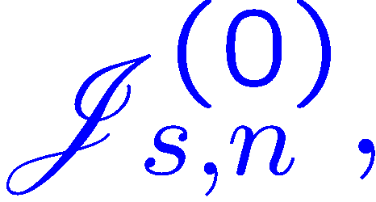
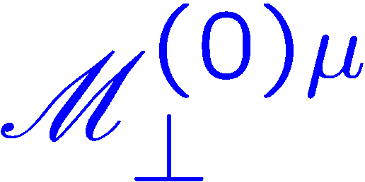
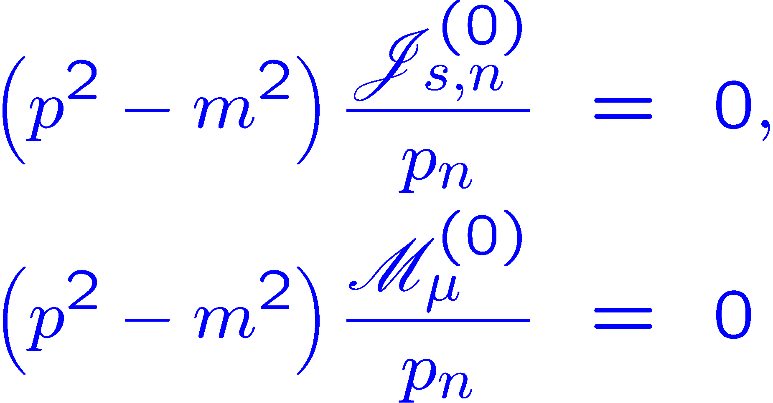
Self-consistent constraints on collision terms in spin kinetic theory
Wigner equations at zeroth order:
Constitutive
relations:
independent
functions
Longitudinal
constraint :
Longitudinal spin distribution:
Transverse spin distribution:
On-shell
conditions:
Notes:
13
13

Slide 14
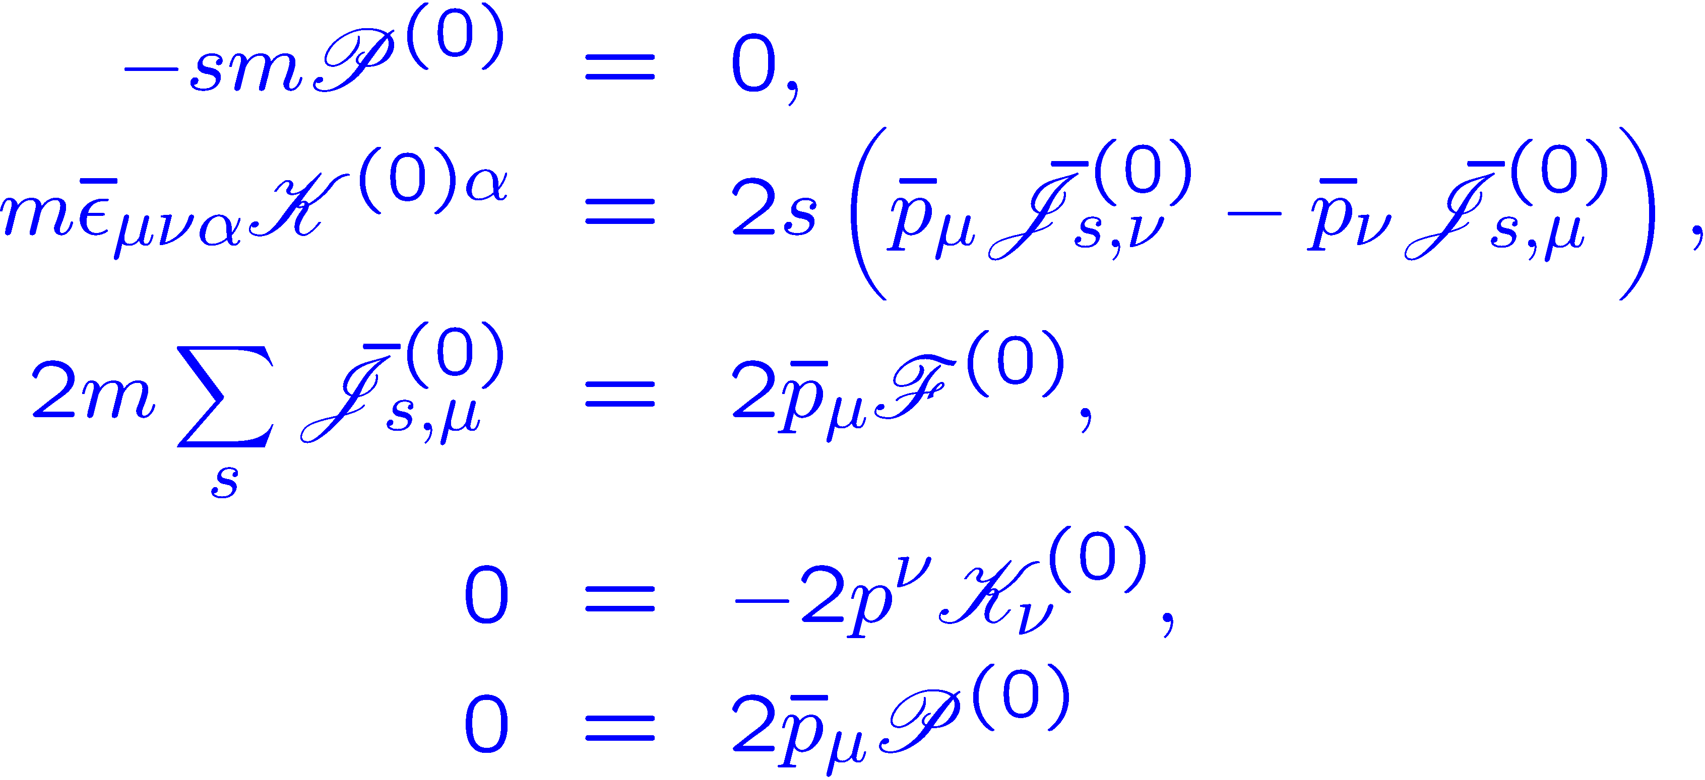
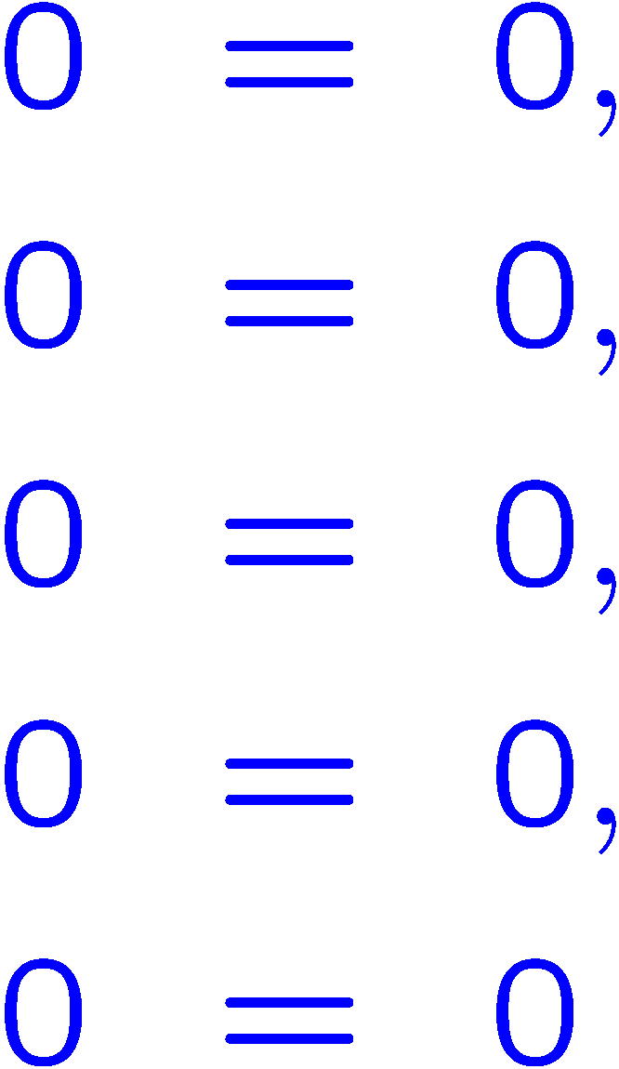
Self-consistent constraints on collision terms in spin kinetic theory
Wigner equations at zeroth order:
These Wigner equations are satisfied automatically and redundant!
No collision terms or kinetic equations from Wigner equations at zeroth order!
Notes:
14
14

Slide 15
Self-consistent constraints on collision terms in spin kinetic theory
Wigner equations at first order:
Zeroth-order collision terms appear in Wigner equations at first order !
Notes:
15
15

Slide 16
Self-consistent constraints on collision terms in spin kinetic theory
Wigner equations at first order:
Require all the equations self-consistent:
Constraints on zeroth-order collision terms and zeroth-order kinetic equations !
Notes:
16
16

Slide 17
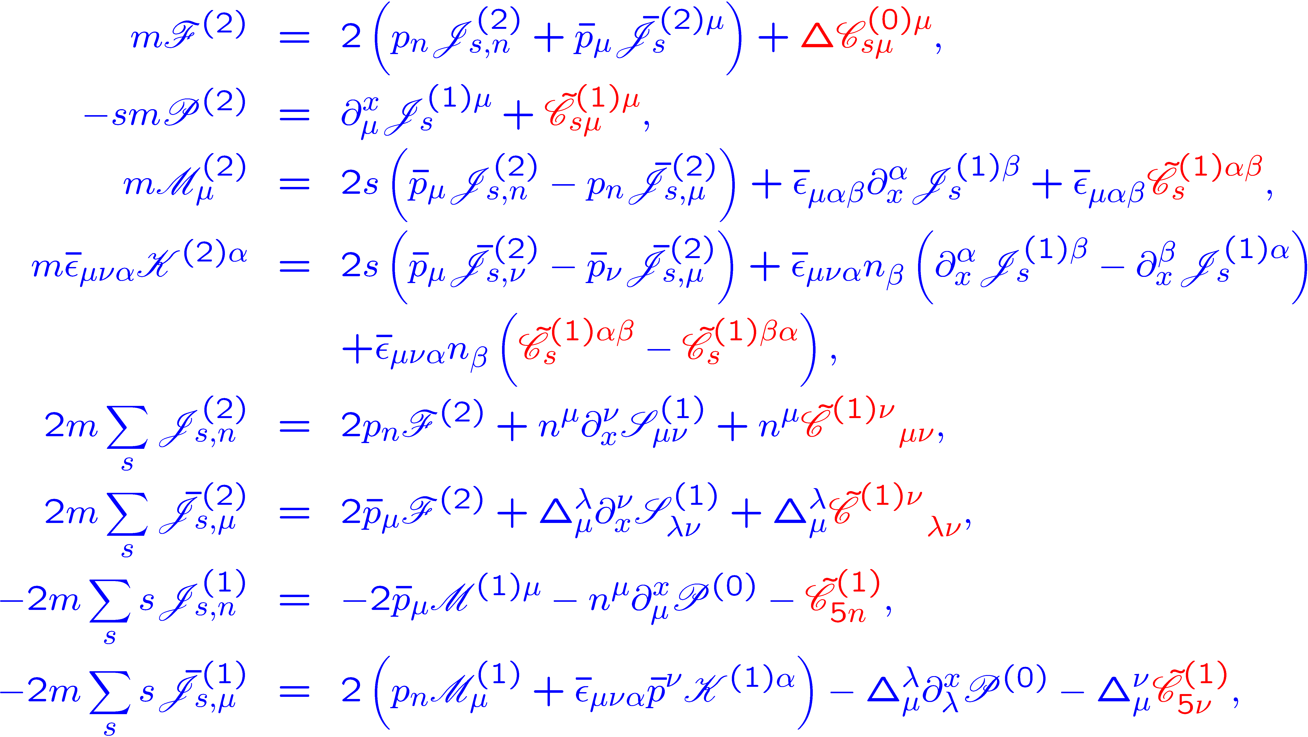
Self-consistent constraints on collision terms in spin kinetic theory
Second-order result:
Independent collision terms:
Notes:
17
17

Slide 18
Self-consistent constraints on collision terms in spin kinetic theory
On-shell conditions for second-order Wigner functions:
Kinetic equations for first-order Wigner equations:
Notes:
18
18

Slide 19
Self-consistent constraints on collision terms in spin kinetic theory
Self-consistent constraints on first-order collision terms:
Notes:
19
19

Slide 20
Self-consistent constraints on collision terms in spin kinetic theory
Some other constraint conditions from the antisymmetry of $F^{νλ}$:
$$F^{νλ}=−F^{λν}$$
Notes:
20
20

Slide 21
Self-consistent relaxation time approximation
A specific solution with only three vector functions involved:
The collision terms which can smoothly approach the chiral limit:
Chiral limit $m=0$:
Notes:
21
21

Slide 22
Self-consistent relaxation time approximation
With zeroth order expressions for collision terms, first-order Wigner functions are given by
Spin kinetic equations for zeroth-order distribution functions:
Notes:
22
22

Slide 23
Self-consistent relaxation time approximation
Given zeroth-order collision terms , first-order collision terms can be obtained :
First-order spin kinetic equations are given by:
Notes:
23
23

Slide 24
Self-consistent relaxation time approximation
Conventional forms at relaxation-time approximation:
Relaxation time parameters:
Deviation of the distribution off equilibrium:
The distributions are defined by fluid velocity $u^{μ}$:
Notes:
24
24

Slide 25
Self-consistent relaxation time approximation
Let the arbitrary vector $n^{μ}$ coincides with the fluid velocity $u^{μ}$ :
$$n^{μ}=u^{μ}$$
Summing the zeroth- and first-order contributions:
Notes:
25
25

Slide 26
Self-consistent relaxation time approximation
$$?$$
Electric charge separation
$$?$$
Spin polarization effect
Notes:
26
26

Slide 27
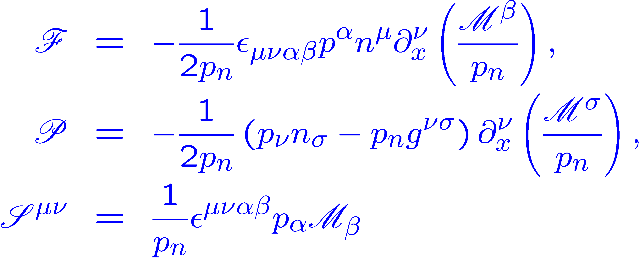
Self-consistent relaxation time approximation
Spin kinetic equations at chiral limit $m=0$
All the Wigner functions at chiral limit $m=0$ :
All the Wigner functions has no explicit collision terms at chiral limit $m=0$ !
Notes:
27
27

Slide 28
Summary and outlook
Self-consistent constraints on collision terms in SKT are derived!
The SKT within self-consistent relaxation time approximation is obtained.
Some constitutive relations exhibit simple dependence on collision terms
in a fluid comoving frame at relaxation time approximation.
Analytical and numerical calculation with SKT at relaxation time approximation?
Similar constraints for hadron’s Wigner or distribution functions?
Thanks for your attention !

