Slide 1
COMPASS SIDIS

Slide 2

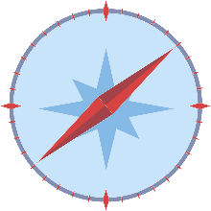
What does “COMPASS” stand for?
COMPASS: NA58, EHN2, building 888:
COmmon
Muon
Proton
Apparatus for
Structure and
Spectroscopy
COMPASS was the largest surface experiment at CERN

Slide 3













COMPASS Collaboration
Дубна (LPP and LNP), Москва (INR, LPI, State University), . Протвино
Bochum, Bonn (ISKP & PI), Erlangen, Freiburg, Mainz, München TU
CERN
Warsawa (NCBJ),
Warsawa (TU)
Warsawa (U)
UIUC
Yamagata
Praha
Saclay
Lisboa
Torino
(University,INFN),
Trieste
(University,INFN)
Burden, Calcutta
Tel Aviv
  about 220 members
  from 13 different countries
  involving 24 universities and research institutes
Taipei (AS)

Slide 4
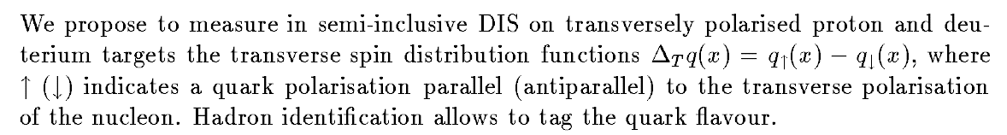
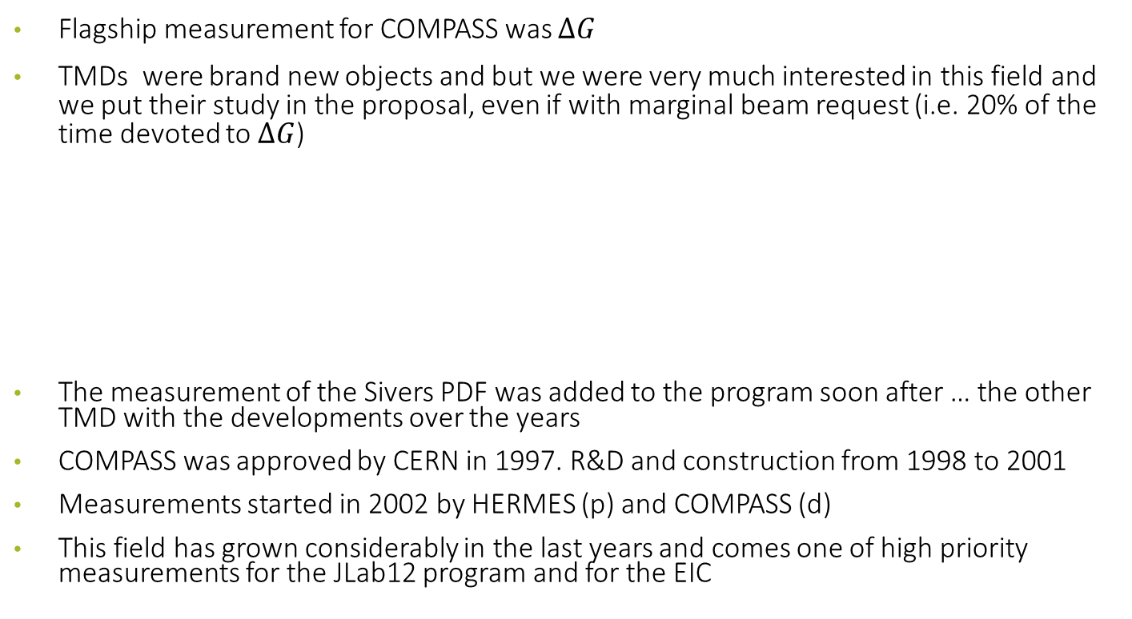
COMPASS, few facts
Flagship measurement for COMPASS was $ΔG$
TMDs were brand new objects and but we were very much interested in this field and we put their study in the proposal, even if with marginal beam request (i.e. 20% of the time devoted to $ΔG$)
The measurement of the Sivers PDF was added to the program soon after … the other TMD with the developments over the years
COMPASS was approved by CERN in 1997. R&D and construction from 1998 to 2001
Measurements started in 2002 by HERMES (p) and COMPASS (d)
This field has grown considerably in the last years and comes one of high priority measurements for the JLab12 program and for the EIC

Slide 5
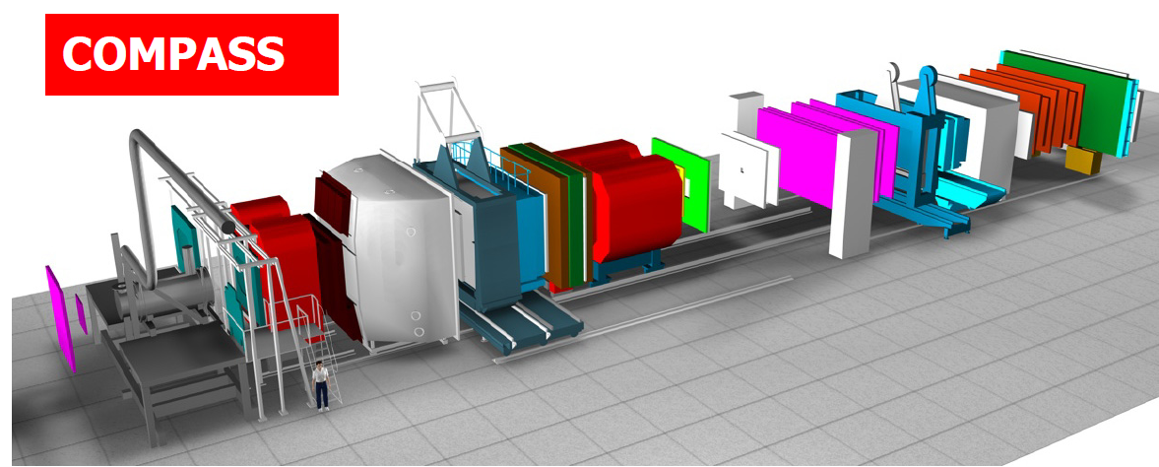
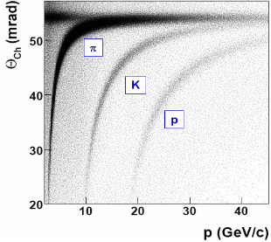
Muon beam: SIDIS setup
high energy beam
large angular acceptance
broad kinematical range
two stages spectrometer
  Large Angle Spectrometer (SM1)
  Small Angle Spectrometer (SM2)
radiator C₄F₁₀
threshold: π ~2 GeV/c
K ~ 10 GeV/c
SM2
MuonWall
E/HCAL
SM1
RICH
MuonWall
Target
E/HCAL
variety of tracking detectors to cope with different particle flux from θ = 0 to θ ≈ 200 mrad
Notes:
5

Slide 6
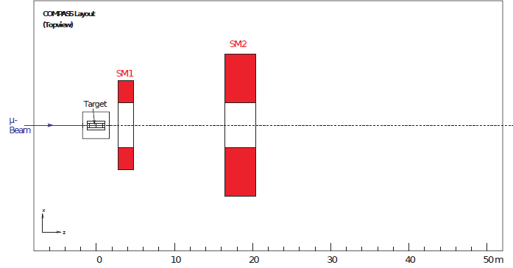
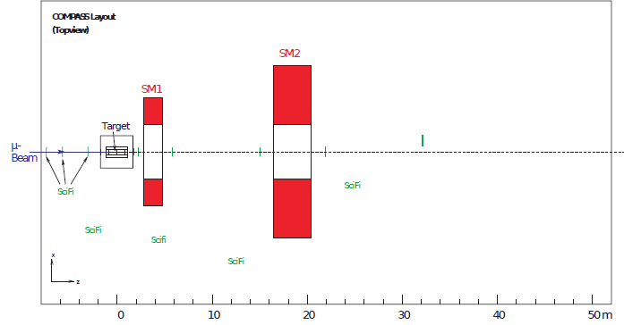
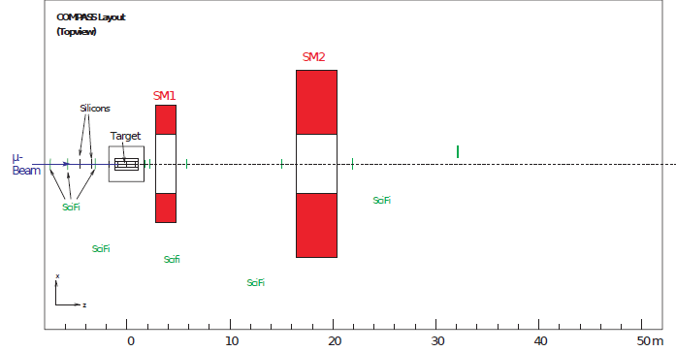
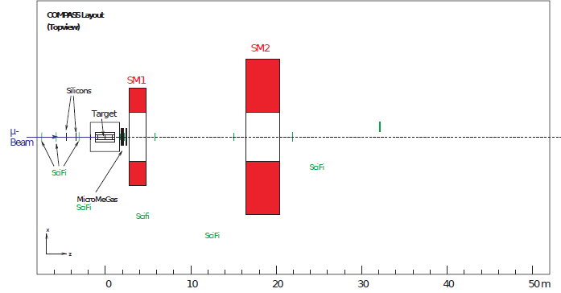
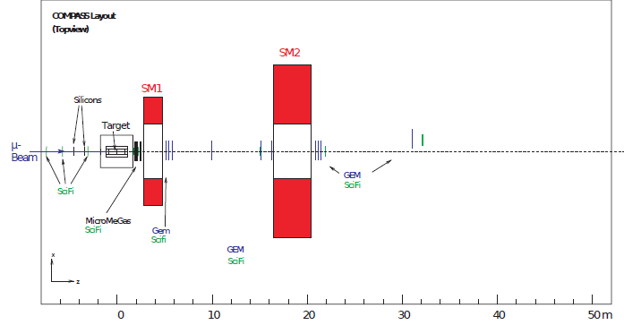
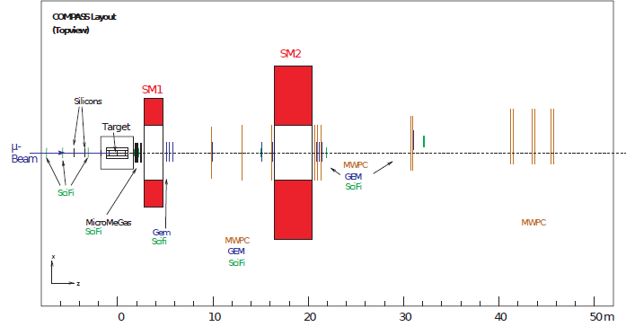
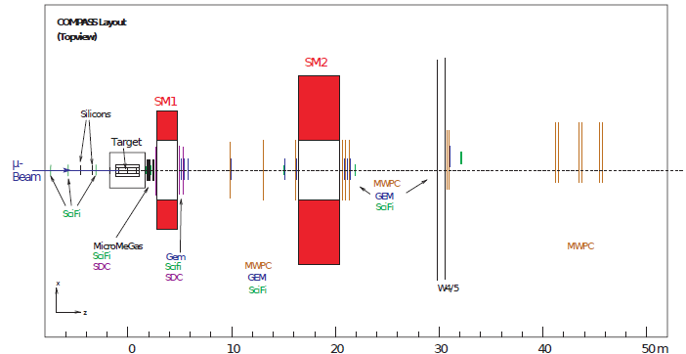

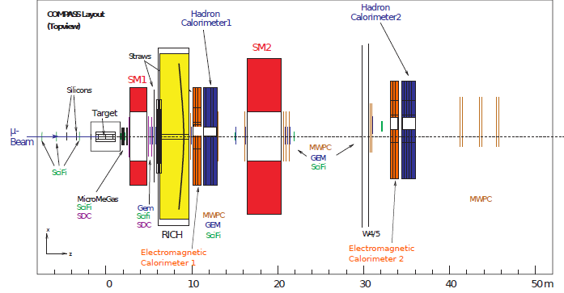
Spectrometer elements

Slide 7
Spectrometer: 2021 event

Slide 8
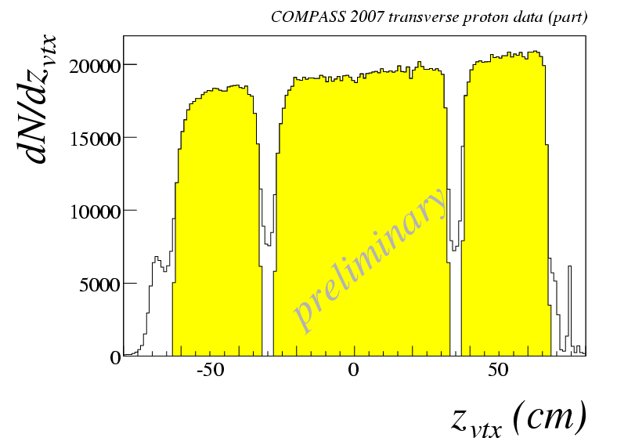
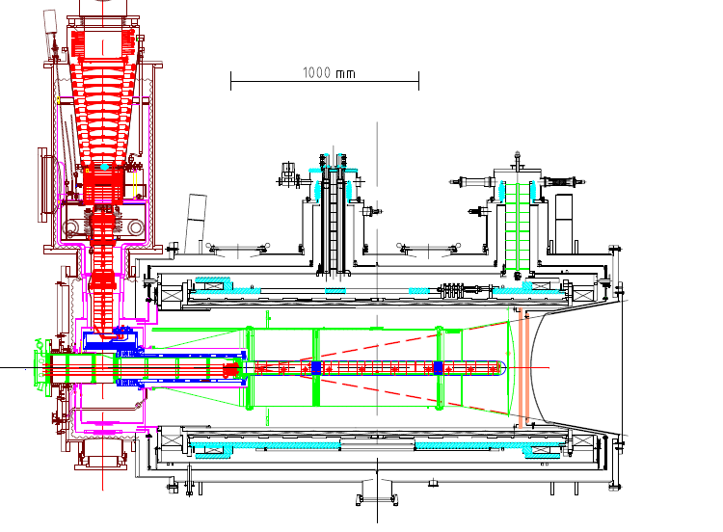
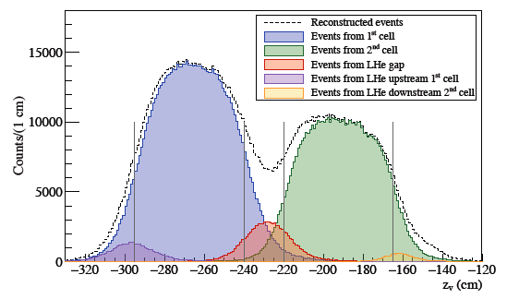
the polarized target system (>2005)
³He – ⁴He dilution refrigerator (T~50mK)
acceptance > ± 180 mrad
3 target cells
30, 60, and 30 cm long
μ
opposite polarisation
d (⁶LiD) p (NH₃)
polarization 50% 90%
dilution factor 40% 16%
solenoid 2.5T
dipole magnet 0.6T
no evidence for relevant
nuclear effects (160 GeV)

Slide 9
Polarized target
1.2 m long, 40 mm diameter, 5-6 l
Temperature 60mK (-273.09 °C) with a record of 30 mK
⁶LiD, deuterated lithium – deuterium acts as target
NH₃ ammonia – hydrogen acts as target
Polarization is obtained by Dynamic Nuclear Polarization
Three things are needed: high magnetic field to align the spins, a very low temperature to reduce thermal energy and microwaves to transfer spin from the electrons to the nucleons
A 2.5 T solenoid field is applied by a superconducting magnet with a 10⁻⁴ homogeneity over the target volume

Slide 10
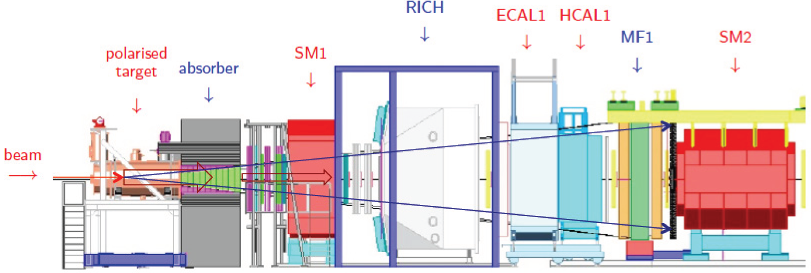
Hadron beam: Drell-Yan setup

Slide 11
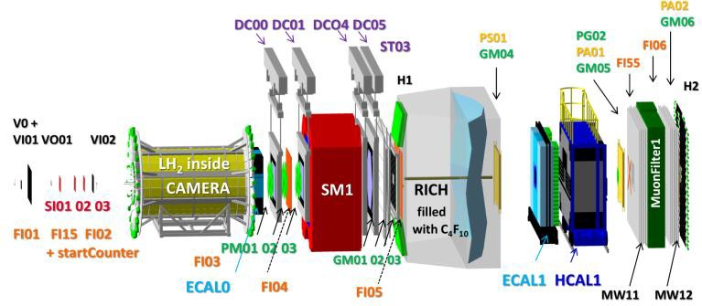
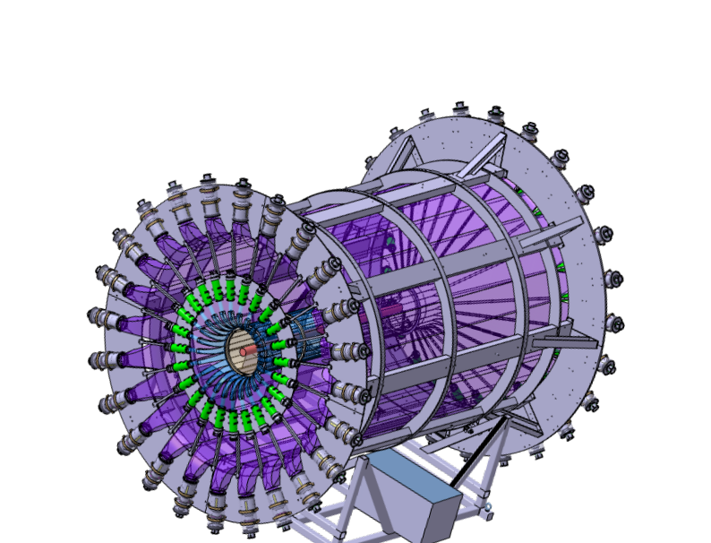
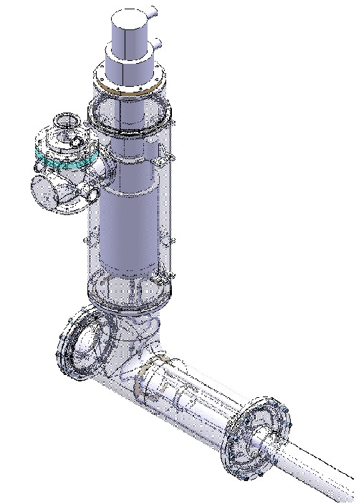
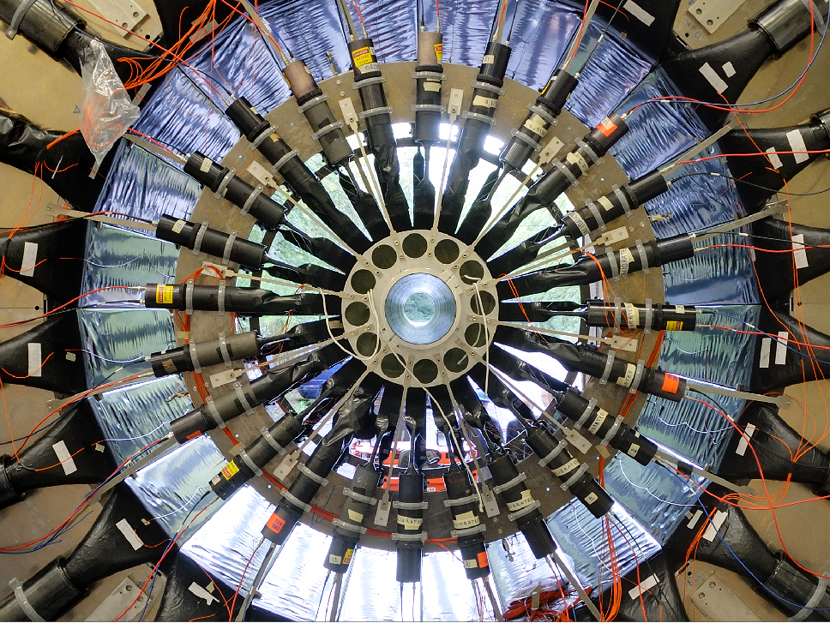
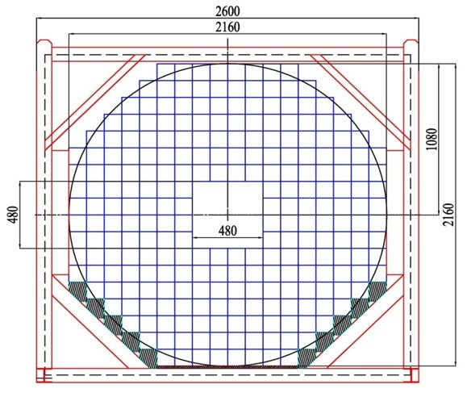
Muon beam – DVCS setup

Slide 12
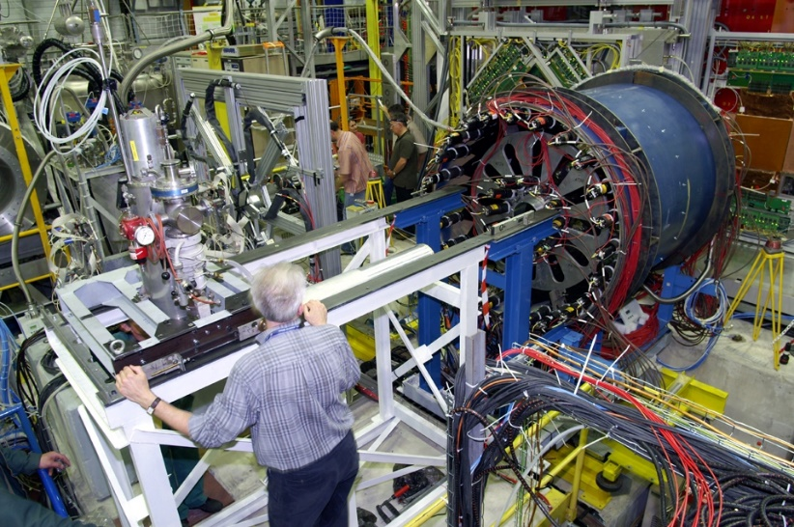
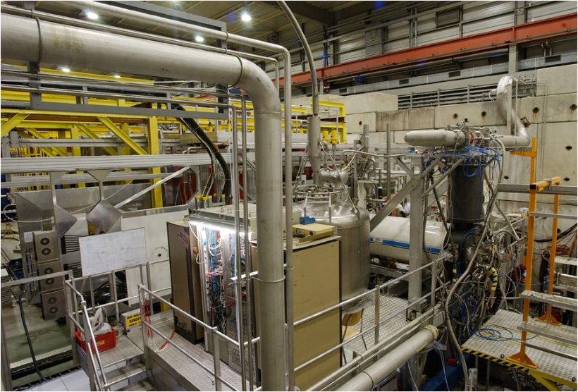
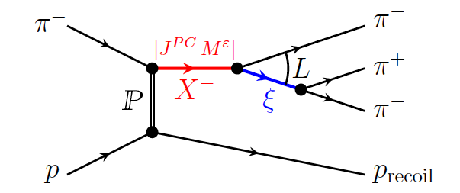
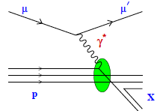
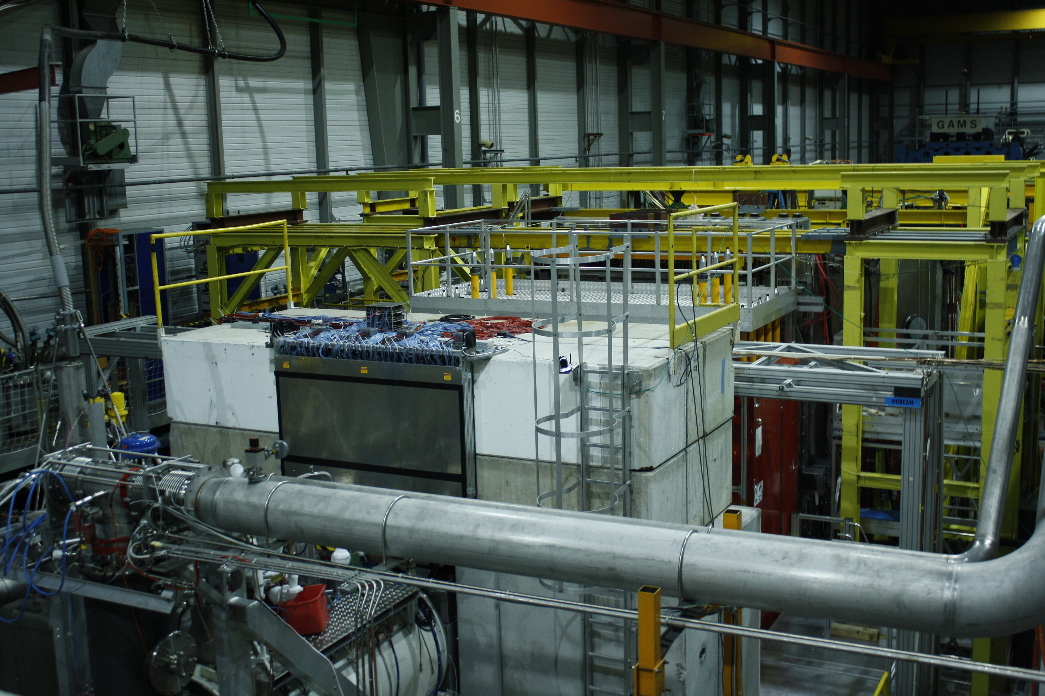
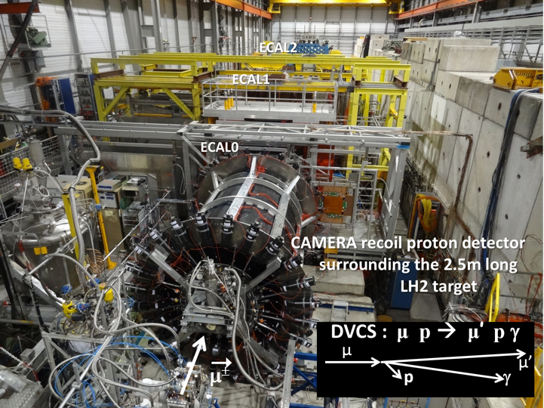
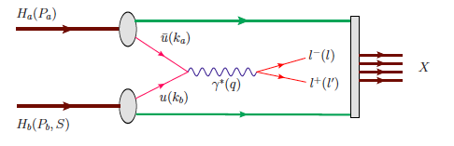
COMPASS target area
Hadron Spectroscopy
Polarised SIDIS
COMPASS-I
1997-2011
and back in
2022
Polarised Drell-Yan
DVCS (GPDs) + unp. SIDIS
COMPASS-II
2012-2020

Slide 13
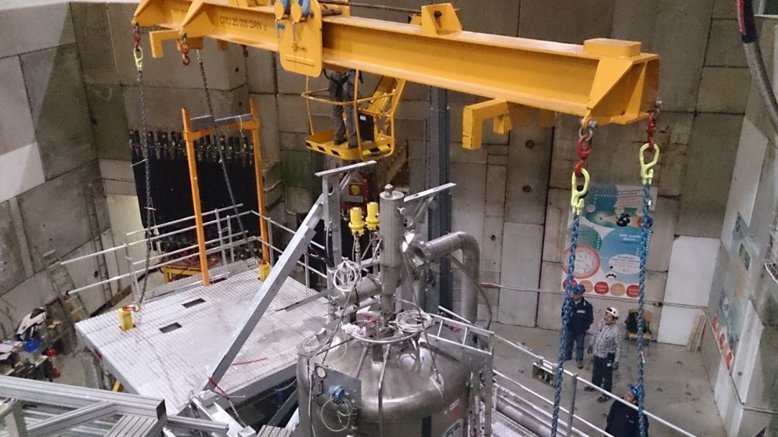
Operations on the target area

Slide 14
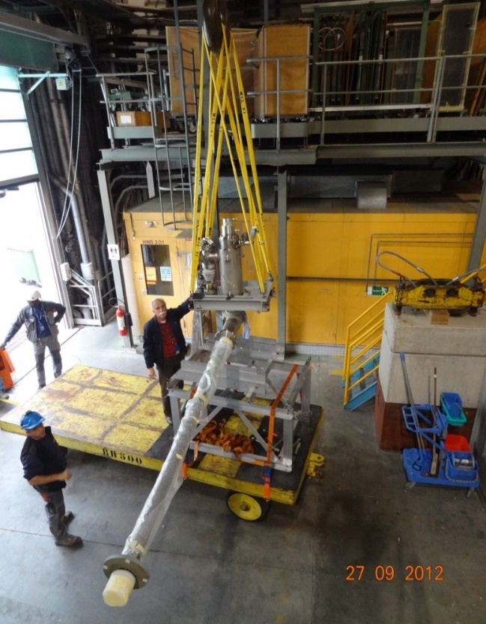
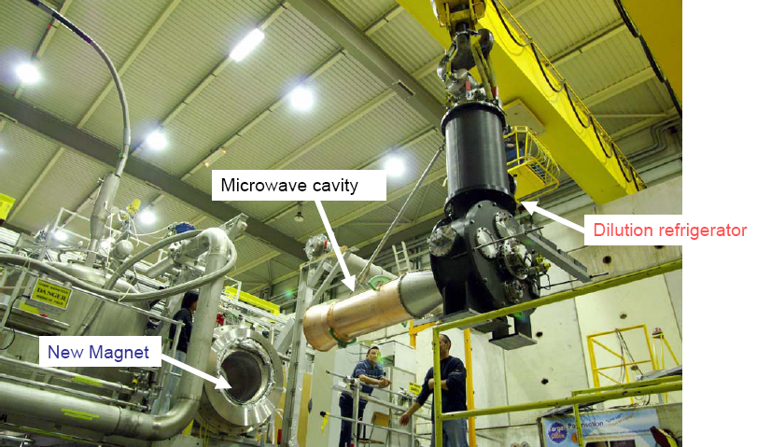
Targets

Slide 15
COMPASS data taking
muon beam | deuteron (⁶LiD) PT | 2002 2003 2004 | 80% L/20% T target polarisation
 |  | 2006 | L target polarisation
 | proton (NH₃) PT | 2007 | 50% L /50% T target polarisation
Hadron | LH target | 2008 2009
muon beam | proton (NH₃) PT | 2010 | T target polarisation
 |  | 2011 | L target polarisation
Hadron | Ni target | 2012 | Primakoff
muon beam | LH2 target | 2012 | Pilot DVCS & unpol. SIDIS
Hadron | Proton (NH3) DT PT | 2014 2015 2018 | Pilot DY run DY run DY run
muon beam | LH2 target | 2016 2017 | DVCS & unpol. SIDIS
muon beam | deuteron (⁶LiD) PT | 2022 | T target polarisation

Slide 16
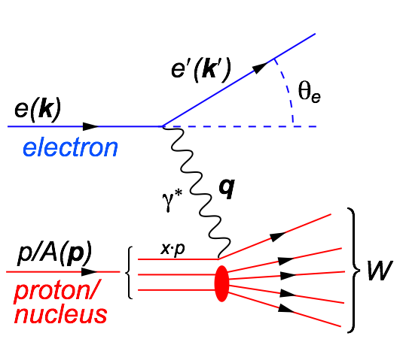
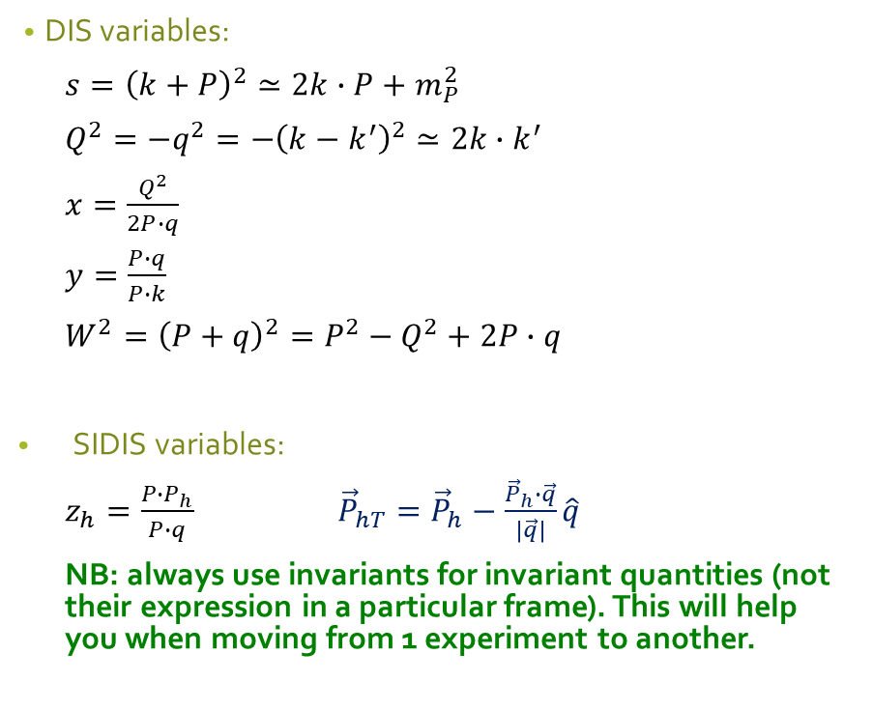
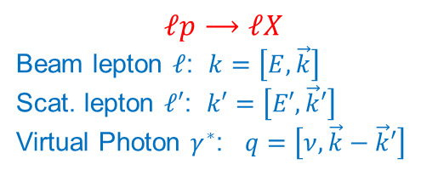
Kinematics of Deep Inelastic Scattering
DIS variables:
$s={\left(k+P\right)}^{2}≃2k∙P+m_{P}^{2}$
$Q^{2}=−q^{2}=−{\left(k−k^{′}\right)}^{2}≃2k∙k^{′}$
$x=\frac{Q^{2}}{2P∙q}$
$y=\frac{P∙q}{P∙k}$
$W^{2}={\left(P+q\right)}^{2}=P^{2}−Q^{2}+2P∙q$
SIDIS variables:
$z_{h}=\frac{P∙P_{h}}{P∙q}$ ${\vec{P}}_{hT}={\vec{P}}_{h}−\frac{{\vec{P}}_{h}∙\vec{q}}{\left|\vec{q}\right|}\hat{q}$
NB: always use invariants for invariant quantities (not their expression in a particular frame). This will help you when moving from 1 experiment to another.
$$ℓp⟶ℓX$$
Beam lepton $ℓ$: $k=\left[E,\vec{k}\right]$
Scat. lepton $ℓ′$: $k′=\left[E′,\vec{k}′\right]$
Virtual Photon $γ^{∗}$: $q=\left[ν,\vec{k}−\vec{k}′\right]$

Slide 17
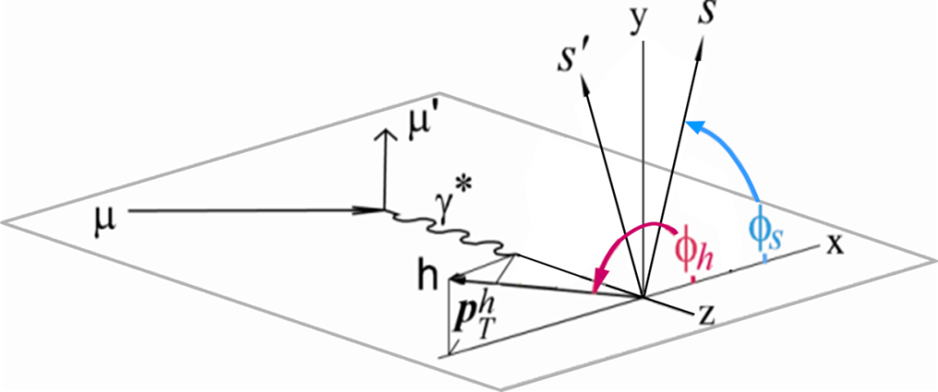
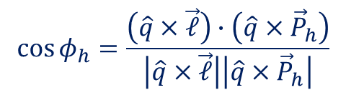
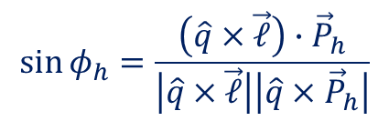
Azimuthal angles in the GNS or Breit
$$\sin{φ_{h}}=\frac{\left(\hat{q}×\vec{ℓ}\right)∙{\vec{P}}_{h}}{\left|\hat{q}×\vec{ℓ}\right|\left|\hat{q}×{\vec{P}}_{h}\right|}$$
$$\cos{φ_{h}}=\frac{\left(\hat{q}×\vec{ℓ}\right)∙\left(\hat{q}×{\vec{P}}_{h}\right)}{\left|\hat{q}×\vec{ℓ}\right|\left|\hat{q}×{\vec{P}}_{h}\right|}$$
We look at our events in the Gamma Nucleon System (GNS) or Breit Frame, i.e. we need a perfectly reconstructed lepton kinematic.

Slide 18
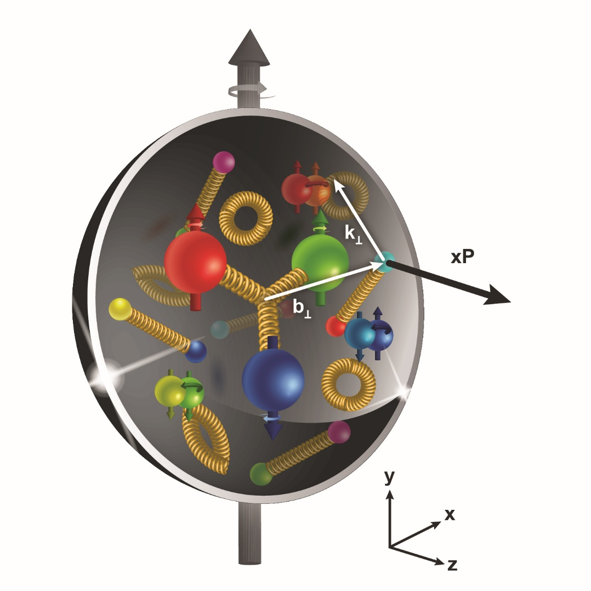
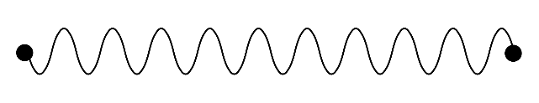
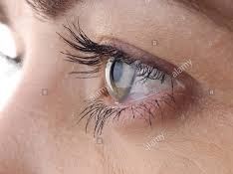

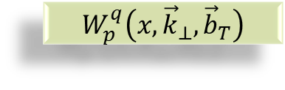

Transverse structure of the Nucleon
Confinement Scale
$$W_{p}^{q}\left(x,{\vec{k}}_{⊥},{\vec{b}}_{T}\right)$$
Transverse momentum
Longitudinal momentum
Transverse position
$$ℓ′$$
Photon Virtuality Q²
$$ℓ$$
Hard Scale
High Energy Probe

Slide 19
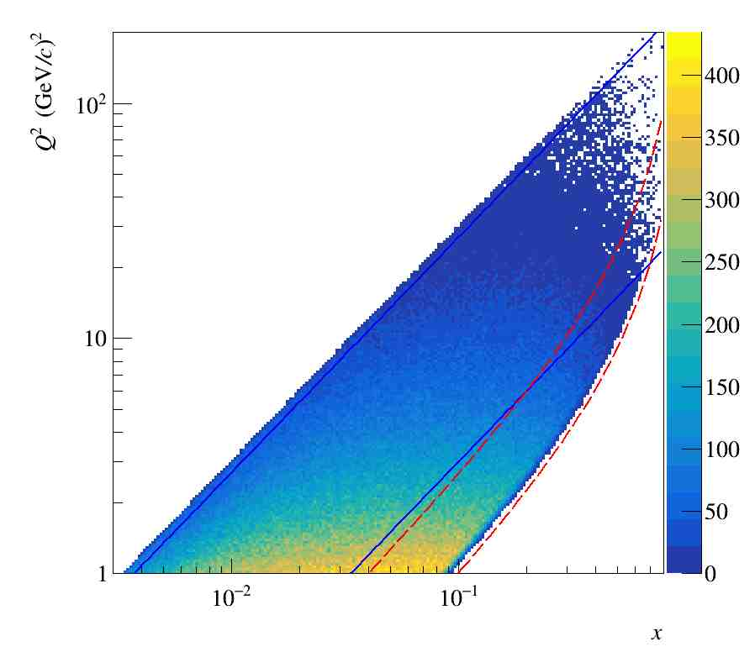
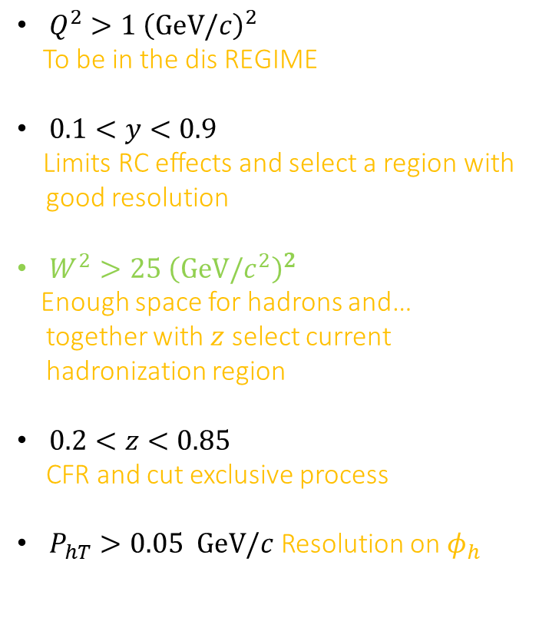





Standard Cuts @ $\sqrt{s}\sim 17$ GeV
$Q^{2}>1 {\left(GeV/c\right)}^{2}$
To be in the dis REGIME
$0.1<y<0.9$
Limits RC effects and select a region with good resolution
$W^{2}>25 {\left(GeV/c^{2}\right)}^{2}$
Enough space for hadrons and… together with $z$ select current hadronization region
$0.2<z<0.85$
CFR and cut exclusive process
$P_{hT}>0.05 GeV/c$ Resolution on $φ_{h}$
$$W^{2}=25 {\left(GeV/c^{2}\right)}^{2}$$
$$W^{2}=10 {\left(GeV/c^{2}\right)}^{2}$$
$$y=0.9$$
$$y=0.1$$

Slide 20
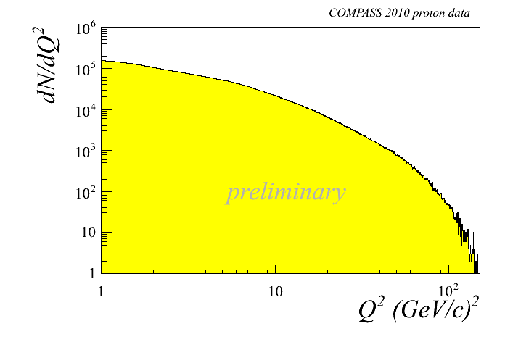
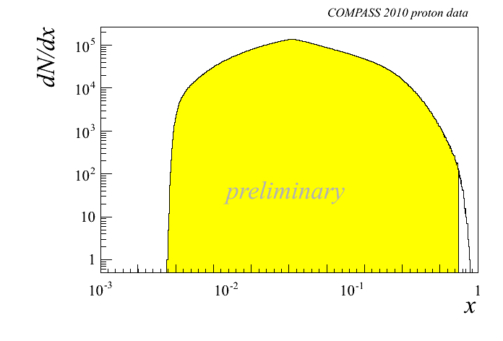
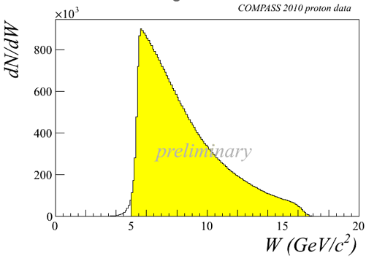
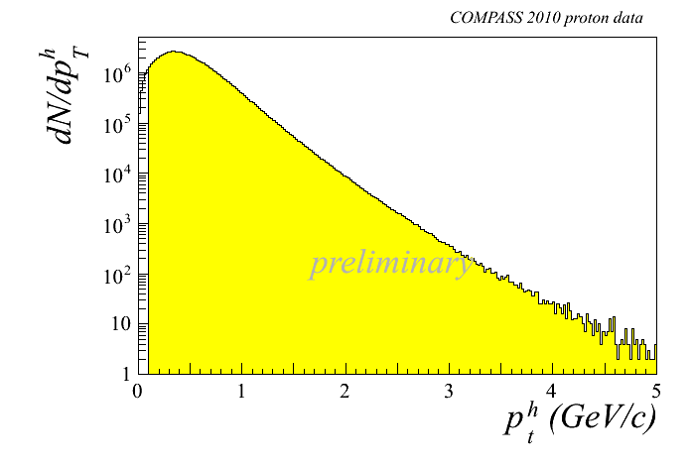
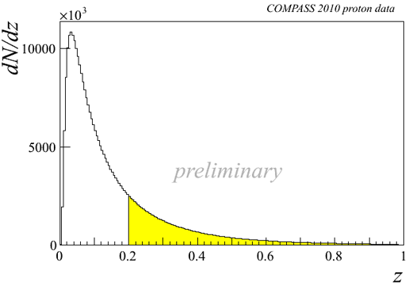
Kinematic distributions
Notes:
20

Slide 21
Kinematic coverage
Notes:
21

Slide 22

Results with the longitudinally polarized target
Year | Obs.
2006 | $$A_{LL}^{2h}\left(Q^{2}<0\right)$$ | $$Δg/g$$
2007 | $$g_{1}^{d}\left(x\right),$$ | $$Γ_{1}^{d}, ∆Σ$$
2008 | $$A_{1,d}^{h^{+}−h^{−}}$$ | $$Δu_{v}+Δd_{v}$$
2009 | $$A_{1,d}^{},{ A}_{1,d}^{π^{±}},A_{1,d}^{K^{±}}$$ | $$Δu_{v}+Δd_{v},Δ\overline{u}+Δ\overline{d}, Δs\left(=Δ\overline{s}\right)$$
2010 | $$g_{1}^{p}\left(x\right),$$ | $$Γ_{1}^{NS}, \left|{g_{A}}/{g_{V}}\right|$$
2010 | $$A_{1,d}^{},{ A}_{1,d}^{π^{±}},A_{1,d}^{K^{±}},A_{1,p}^{},{ A}_{1,p}^{π^{±}},A_{1,p}^{K^{±}}$$ | $$Δu, Δd,Δ\overline{u}, Δ\overline{d},Δ\overline{d}, Δs,Δ\overline{s}$$
2010 | $\sin{φ}, \sin{2φ}, \sin{3φ}$, $\cos{φ}$ asyms | $h_{L}$, $f_{L}^{⊥}$,$h_{1}$, $f_{1T}^{⊥}$, $h_{1L}^{⊥}, h_{1T}^{⊥}$, $h_{1L}^{⊥}$, $g_{L}^{⊥}$,$g_{1T}$
2013 | $$A_{LL}^{2h}$$ | $$Δg/g$$
2013 | $$A_{D}^{γN}$$ | $Δg/g$ in LO and NLO
2015 | $$g_{1}^{p}\left(x\right)$$ | $$Γ_{1}^{NS}, ΔΣ,Δu+Δ\overline{u}⋯$$
2015 | $$A_{LL}^{p}$$ | NLO QCD fits for $Δg/g$
2016 | Final COMPASS results on $g_{1}^{d}\left(x\right)$ | $$Γ_{1}^{d}, ∆Σ$$
2017 | $A_{1,p}^{}$ and $g_{1}^{p}$ at small $x$ and $Q^{2}$

Slide 23

Results for the transversely polarized target
Year | Obs
2005 | $$A_{Siv, d}^{h}, A_{Col, d}^{h}$$ | First ⁶LiD data
2006 | $$A_{Siv, d}^{h}, A_{Col, d}^{h}$$ | 2002-2004 ⁶LiD statistics
2009 | $$A_{Siv, d}^{π^{±},{ K}^{±}, K_{s}^{0}}, A_{Col, d}^{π^{±},{ K}^{±}, K_{s}^{0}}$$ | 2002-2004 ⁶LiD statistics
2010 | $$A_{Siv, p}^{h}, A_{Col, p}^{h}$$ | 2007 NH₃ data
2012 | $$A_{UT,d}^{sinφ_{RS}},A_{UT,p}^{sinφ_{RS}}$$ | 2002-2004$\text{6}\text{LiD}$
2012 | $$A_{Siv, p}^{h}, A_{Col, p}^{h}$$ | $$\text{Full} \text{NH}\text{3}\text{statistics}$$
2012 | $A_{UT,d}^{sin\left(φ_{ρ}−φ_{S}\right)}$, $A_{UT,p }^{sin\left(φ_{ρ}−φ_{S}\right)}$ | Exclusive${ ρ}^{0}$
2013 | $$A_{UT,d}^{\left(φ_{ρ},φ_{S}\right)}\text{, }A_{UT,p }^{\left(φ_{ρ},φ_{S}\right)}$$ | Exclusive${ ρ}^{0}$, all asyms.
2014 | $$A_{UT,d}^{sinφ_{RS}},A_{UT,p}^{sinφ_{RS}}$$ | $\text{Full} \text{6}\text{LiD}$and NH₃
2014 | $$A_{Siv, d}^{π^{±},{ K}^{±}, K_{s}^{0}}, A_{Col, d}^{π^{±},{ K}^{±}, K_{s}^{0}}$$ | Full NH₃ statistics
2015 | Interplay $A_{UT,p}^{sinφ_{RS}}$ vs $A_{Col, p}^{h}$ | Full NH₃ statistics
2016 | $A_{Siv, h}^{h}$ in SIDIS at the hard scale of the Drell-Yan | Full NH₃ statistics
2018 | $P_{hT}$-weighted Sivers asymmetries | Full NH₃ statistics
2019 | transversity-induced polarisation of $Λ$and $\overline{Λ}$ | Full NH₃ statistics
2022 | Collins and Sivers for $ρ^{0}$ | Full NH₃ statistics
2022 | TSAs for $π$ and K | Full NH₃ statistics, 2002-2004 ⁶LiD
2023 | $$A_{Siv, d}^{h}, A_{Col, d}^{h}$$ | 70% of 2022 ⁶LiD data

Slide 24

Measurements with unpolarised targets:
Year | Obs
2013 | $${{dn}^{h}}/{\left({dN}^{μ}dz dp_{T}^{2}\right)}$$ | multiplicities on d, 2004
2014 | $A_{UU,d}^{\cos{φ_{h}}},A_{UU,d}^{\cos{{2φ}_{h}}}$, $A_{LU,d}^{\sin{φ_{h}}}$ | 2004, part
2016 | $${{dn}^{π}}/{\left({dN}^{μ}dz\right)}$$ | multiplicities on d, 2006
2016 | $${{dn}^{h}}/{\left({dN}^{μ}dz dp_{T}^{2}\right)}$$ | multiplicities on d, 2006
2016 | $${{dn}^{K}}/{\left({dN}^{μ}dz\right)}$$ | multiplicities on d, 2006
2017 | $${{dn}^{h}}/{\left(dxdQ^{2}dz dp_{T}^{2}\right)}$$ | multiplicities on d, 2006
2018 | (${{dn}^{K^{−}}{/dn}^{K^{+}})/}/{\left({dN}^{μ}dz\right)}$ | Multiplicity ratios for Kaons, 2006
2019 | Contribution of exclusive diffractive processes to $A_{UU,d}^{\cos{φ_{h}}},A_{UU,d}^{\cos{{2φ}_{h}}}$, $A_{LU,d}^{\sin{φ_{h}}}$ | $$ρ^{0}, φ, ω$$
2020 | (${dn}^{p\overline{p}}{/dn}^{p}) and$(${{dn}^{K^{−}}{/dn}^{K^{+}})/}/{\left({dN}^{μ}dz\right)}$ | Hight $z$

Slide 25




Accessing TMD PDFs and FFs
TMD factorization works in the domain where there are two observed momenta in the process, such as SIDIS, DY, $e^{+}e^{−}$. $Q≫q_{T}$: $Q$ is large to ensure the use of pQCD, $q_{T}$ is much smaller such that it is sensitive to parton’s transverse momentum
SIDIS off (un)polarized p, d, n targets
(un)polarised Drell-Yan
$e^{+}e^{−}→h_{1}h_{2}$
HERMES
COMPASS
JLab12
future: EIC
$$σ^{ℓp→ℓ^{′}hX}\sim q\left(x\right)⊗{\hat{σ}}^{γq→q}⊗D_{q}^{h}\left(z\right)$$
COMPASS
RHIC
FNAL
future: FAIR, JPark, NICA
$$σ^{hp→μμ}\sim {\overline{q}}_{h}\left(x_{1}\right)⊗q_{p}\left(x_{2}\right)⊗{\hat{σ}}^{\overline{q}q→μμ}\left(\hat{s}\right)$$
BaBar
Belle
Bes III
$$σ^{e^{+}e^{−}→h_{1}h_{2}}\sim {\hat{σ}}^{ℓℓ→\overline{q}q}\left(\hat{s}\right)⊗D_{q}^{h_{1}}\left(z_{1}\right)⊗D_{q}^{h_{2}}\left(z_{2}\right)$$

Slide 26

TMD Distribution Functions

Slide 27
Single spin asymmetries

Slide 28




Transversity PDF
$h_{1}^{q}(x)=q^{↑↑}(x)−q^{↑↓}(x)$
$q=u_{v},d_{v}, q_{sea}$
quark with spin parallel to the nucleon spin in a transversely polarised nucleon
probes the relativistic nature of quark dynamics
no contribution from the gluons  simple $Q^{2}$ evolution
Positivity: Soffer bound…………….. $2\left|h_{1}^{q}\right|≤f_{1}^{q}+g_{1}^{q}$
first moments: tensor charge………. $δq\left(Q^{2}\right)=\int_{0}^{1}{dx\left[h_{1}^{q}\left(x\right)−h_{1}^{\overline{q}}\left(x\right)\right]}$
is chiral-odd: decouples from inclusive DIS
Soffer, PRL 74 (1995)
Bakker, Leader, Trueman, PRD 70 (04)

Slide 29

Transversity
is chiral-odd:
observable effects are given only by the
product of $h_{1}^{q}$ (x) and an other chiral-odd function
can be measured in SIDIS on a transversely polarised target
via “quark polarimetry”
“Collins” asymmetry “Collins” Fragmentation Function
“two-hadron” asymmetry “Interference” Fragmentation Function
Λ polarisation Fragmentation Function of q↑Λ

Slide 30



From Collins asymmetries to transversity
Following Physical Review D 91, 014034 (2015), in the valence region
$$\begin{matrix}xh_{1}^{u}=\frac{1}{5}\frac{1}{{\tilde{a}}_{P}^{h}\left(1−\tilde{α}\right)}\left[\left(xf_{p}^{+}A_{p}^{+}−xf_{p}^{−}A_{p}^{−}\right)+\frac{1}{3}\left(xf_{d}^{+}A_{d}^{+}−xf_{d}^{−}A_{d}^{−}\right)\right] \\ \\ xh_{1}^{d}=\frac{1}{5}\frac{1}{{\tilde{a}}_{P}^{h}\left(1−\tilde{α}\right)}\left[\frac{4}{3}\left(xf_{d}^{+}A_{d}^{+}−xf_{d}^{−}A_{d}^{−}\right)−\left(xf_{p}^{+}A_{p}^{+}−xf_{p}^{−}A_{p}^{−}\right)\right]\end{matrix}$$
With ${\tilde{a}}_{P}^{h}$ and $\tilde{α}$ constants
$$A_{p}^{±}=\frac{\sum_{q}{e_{q}^{2}}h_{1}^{q}\left(k_{⊥}\right)⨂H_{1}^{⊥q→h}\left(p_{⊥}\right)}{\sum_{q}{e_{q}^{2}}f_{1}^{q}⨂D_{1}^{q→h}}$$
$$A_{UT}^{\sin\left(φ_{R}+φ_{S}−π\right)}=\frac{\sum_{q}{e_{q}^{2}h_{1}^{q}\left(x\right)H_{q→h_{1}h_{2}}^{∡}\left(z, ℳ_{h_{1}h_{2}}^{2}\right)}}{\sum_{q}{e_{q}^{2}q\left(x\right)D_{q}^{h_{1}h_{2}}\left(z, ℳ_{h_{1}h_{2}}^{2}\right)}}$$

Slide 31


2022 Deuteron run
Benchmark: $h_{1}$ extraction from Collins asymmetries
Transversity extracted as in PRD 91(2015) 014034

Slide 32
Transversity from our data
Point-to-point extraction [Physical Review D 91, 014034 (2015)]
Only COMPASS measured TSA on deuteron
Open points/squares ─ from dihadron
Closed points/squares ─ from Collins
ERRORS ON $h_{1}^{d}$ ARE A FACTOR 4 LARGER THAT THE ONES ON $h_{1}^{u}$

Slide 33

2022 Deuteron Run
COMPASS proposed to CERN to run a full year with the transversely polarized deuteron target and this proposal has been approved

Slide 34

First results from 2022 deuteron run
PRL 133, 101903 (2024)

Slide 35

First results from 2022 deuteron run
PRL 133, 101903 (2024)

Slide 36


Sivers Asymmetry
Sivers: correlates nucleon spin & quark transverse momentum k_{T} /T-ODD
at LO:
$$μp^{↑}→μXh^{±}$$
The Sivers PDF
1992 | Sivers proposes $f_{1T}^{⊥}$
1993 | J. Collins proofs $f_{1T}^{⊥}=0$ for T invariance
2002 | S. Brodsky, Hwang and Schmidt demonstrate that $f_{1Tq}^{⊥}$ may be $≠0$ due to FSI
2002 | J. Collins shows that${\left(f_{1T}^{⊥}\right)}_{DY}=−{\left(f_{1T}^{⊥}\right)}_{SIDIS}$
2004 | HERMES on p: $A_{Siv}^{π^{+}}≠0$ and $A_{Siv}^{π^{−}}=0$
2004 | COMPASS on d: $A_{Siv}^{π^{+}}=0$ and $A_{Siv}^{π^{−}}=0$
2008 | COMPASS on p: $A_{Siv}^{π^{+}}≠0$ and $A_{Siv}^{π^{−}}=0$

Slide 37

Sivers Asymmetry
$$A_{Siv}\left(x,z\right)=\frac{F_{UT}^{sinΦ_{Siv}}(x,z) }{F_{UU}(x,z)}= \frac{\sum_{q}{e_{q}^{2}xf_{1T}^{⊥q}\left(x,{ k}_{⊥}^{2}\right)⨂D_{1q}^{h}(z, p_{⊥}^{2})}}{\sum_{q}{e_{q}^{2}xf_{1}^{q}\left(x, k_{⊥}^{2}\right)⨂D_{1q}^{h}(z, p_{⊥}^{2})}}$$
To evaluate it we need to solve the convolutions (i.e. make hypothesis on the transverse momenta dependences of the TMDs)
Gaussian ansatz: $f_{1T}^{⊥q}\left(x\right)\frac{e^{−k_{⊥}^{2}/{\left\langle k_{⊥}^{2}\right\rangle }_{S}}}{π{\left\langle k_{⊥}^{2}\right\rangle }_{S}} D_{1q}^{h}\left(z\right)\frac{e^{−p_{⊥}^{2}/\left\langle p_{⊥}^{2}\right\rangle }}{π\left\langle p_{⊥}^{2}\right\rangle }$
Leading to:$A_{Siv,G}\left(x,z\right)=\frac{\sqrt{π}M}{\sqrt{{z^{2}\left\langle k_{T}^{2}\right\rangle }_{S}+\left\langle p_{T}^{2}\right\rangle }}\frac{\sum_{q}{e_{q}^{2} xf_{1T}^{⊥\left(1\right)q}\left(x\right)zD_{1q}^{h}\left(z\right)}}{\sum_{q}{e_{q}^{2}{xf}_{1}^{q}\left(x\right)D_{1q}^{h}}\left(z\right)}$ with $f_{1T}^{⊥\left(1\right)q}(x)=\int{d^{2}{\vec{k}}_{T}}\frac{k_{T}^{2}}{2M^{2}}f_{1T}^{⊥q}(x,k_{T}^{2})$

Slide 38



Sivers asymmetry on p
charged pions (and kaons), HERMES and COMPASS

Slide 39


First results from 2022 deuteron run
PRL 133, 101903 (2024)

Slide 40
Unpolarized distribution/asymmetries

Slide 41

Semi Inclusive unpolarised DIS Cross Section
The account of the transverse motion of the quark result in the following general form of the unpolarised semi-inclusive deep inelastic cross-section
$$\begin{matrix}\frac{d^{5}σ}{dxdydzdP_{hT}^{2}dφ_{h}} & = & \frac{2πα^{2}}{xyQ^{2}}\frac{y^{2}}{2\left(1−ε\right)}\left(1+\frac{2xM^{2}}{Q^{2}}\right)\left[\left(1−y\right)+\frac{y^{2}}{2}\right] \\ & & \left\{F_{UU,T}^{h}+εF_{UU,L}^{h}+\sqrt{2ε\left(1+ε\right)}F_{UU}^{\cos{φ_{h}}}cos{φ_{h}}+εF_{UU}^{\cos{{2φ}_{h}}}cos{{2φ}_{h}}+…\right\}\end{matrix}$$
We can then introduce amplitude of the azimuthal asymmetries as
$$A_{UU}^{\cos{{Xφ}_{h}}}\left(x,z,P_{hT}^{2};Q^{2}\right)=\frac{F_{UU}^{\cos{{Xφ}_{h}}}\left(x,z,P_{hT}^{2};Q^{2}\right)}{F_{UU}^{h}\left(x,z,P_{hT}^{2};Q^{2}\right)}$$
An the angular independent ratio
$$M_{UU}^{h}\left(x,z,P_{hT}^{2};Q^{2}\right)=\frac{F_{UU}^{h}\left(x,z,P_{hT}^{2};Q^{2}\right)}{F_{2}\left(x,Q^{2}\right)}$$
Experimentally these are more difficult measurements than spin asymmetries, since we have to correct for the apparatus acceptance

Slide 42



Unpolarised Azimuthal Modulation
When looking at the content of the structure functions/modulations in terms of TMD PDFs for the $\cos{φ_{h}}$ and $\cos{{2φ}_{h}}$ we can write:
In the $\cos{{2φ}_{h}}$ Cahn effects enters only at twist4
$$F_{UU}^{\cos{φ_{h}}}=−\frac{2M}{Q}C\left[\frac{\hat{h}∙{\vec{k}}_{⊥}}{M}f_{1}D_{1}−\frac{p_{⊥}k_{⊥}}{M}\frac{{\vec{P}}_{hT}−z\left(\hat{h}∙{\vec{k}}_{⊥}\right)}{zM_{h}M}h_{1}^{⊥}H_{1}^{⊥}\right]+twists>3$$
$$F_{UU}^{\cos{{2φ}_{h}}}=C\left[\frac{\left(\hat{h}∙{\vec{k}}_{⊥}\right)\left(\hat{h}∙{\vec{p}}_{⊥}\right)−{\vec{p}}_{⊥}∙{\vec{k}}_{⊥}}{MM_{h}}h_{1}^{⊥}H_{1}^{⊥}\right]+twists>3$$
$$F_{Cahn}^{\cos{{2φ}_{h}}}≈\frac{2}{Q^{2}}C\left[\left\{2{\left(\hat{h}∙{\vec{k}}_{⊥}\right)}^{2}−k_{⊥}^{2}\right\}f_{1}D_{1}\right]$$

Slide 43

Experimentally
In the case of unpolarized SIDIS the measured rates need to be corrected for the effect of the apparatus (acceptance corrections, including geometrical acceptance, detector efficiencies …)
Events from processes different from SIDIS may be present in the final sample, and we know that charged hadron SIDIS sample at large $z$ and at small $P_{hT}$ contains a non-negligible contribution of hadrons from the decay of vector mesons (VM) produced in exclusive processes
Radiative effects change both the LO cross section and the reconstructed event kinematics
With the COMPASS data sample increasing over the years we were able to address with improved precision these effects

Slide 44



Background from exclusive VMs
Exclusive VMs can be removed from the sample when both final hadrons detected (VISIBLE PART). EVM cut:
$$z_{t}=z_{h^{+}}+z_{h^{−}}<0.95$$
If one hadron is miss, this is no longer true (INVISIBLE PART).
Strategy:
  have a MC for exclusive VMs with Spin Density Matrix Elements.
  Compare MC with our exclusive data normalize MCs
  Use this normalization to subtract the invisible fraction from our data. EVM subtraction
Contributions from $ρ^{0}, ω$ and $φ$
Exclusive $ρ^{0}$ leptoproduction can be viewed as a virtual photon fluctuation into a $q\overline{q}$-pair followed by the scattering of this pair off the nucleon and formation of the final state.
These are spin-1 objects, i.e. $J=1$. Decay particles have spin $0$, so $L=1$ for the decay. In words when the VM decays, its spin-state will be reflected in the orbital momentum of the decay particles.
Due to the nature of the process we can reject some/most, not all, of these hadrons from our sample

Slide 45



LEPTONIC RADIATION
Feynman diagrams for leptonic radiation
The radiative leptonic tensor $S\left(ℓ, ℓ^{′},k\right)$, include Born + loops at $ℴ\left(α_{em}^{2}\right)$:
  Gauge invariant
  Infrared finite
  Universal (for $1γ$ exchange)
  The kinematic is shifted ${\tilde{q}}^{μ}=q^{μ}−k^{μ}$

Slide 46

$P_{hT}$-dependent multiplicities

Slide 47






Positive vs Negative charged hadrons (${LH}_{2}$)

Slide 48
Azimuthal Modulations

Slide 49






An old story
QCD alone
QCD + quark transverse motion
EMC experiment [1987]
Fit: Konig-Kroll model [1982] + Lund String
Cross section for SIDIS process expected to be
$$dσ∼σ_{0}[1+A\cos{φ_{h}}+B\cos{2φ_{h}}]$$
Georgi and Politzer [1978]: azimuthal modulations of hadrons around the jet axis due to gluon radiation. Effect regarded as a clean QCD test [Phys.Rev.Lett. 40 (1978) 3].
R.N. Cahn [1978]: same modulations can arise due to the quark intrinsic motion ($k_{⊥})$ [ Phys.Lett.B 78 (1978) 269]

Slide 50


Effect of Exclusive VM subtraction

Slide 51


Radiative effects

Slide 52

Corrected results
MultiD on LH2, corrected for both VM and RC is coming

Slide 53
Outlook
Deuteron data by COMPASS 2022 run will remain a unique data set for the next decade and beyond, before EIC operation with D beams.
It allows a precise and valuable extraction of “d” quarks TMD PDFs
In the study of unpolarized multiplicities and azimuthal asymmetries we are able already today to obtain precise multidimensional results
This should allow the start for the transition from “exploratory/consolidation” to the “maturity” era that will arrive with the EIC
But also offers us the glimpse on the challenges that this “precision” will bring for both the experimentalist and the theoreticians

Slide 54
Thank you

Slide 55





Contamination on (${LH}_{2}$) – 1D
Determined from $z_{1}+z_{2}>0.95$
Selecting $ρ^{0}, ω$ and $φ$

Slide 56







Unpolarised Transverse Momentum dependent PDFs
When we consider the transverse momentum of the quark in the calculation of the cross section Transverse Momentum Dependent parton distribution (TMDs)
The unpolarised number density of the quarks gains a dependence from the intrinsic transverse momentum $k_{⊥}$
$$f_{1}^{q}\left(x,k_{⊥}\right)$$
New parton densities arise: the Boer-Mulders functions $h_{1}^{⊥,q}\left(x,k_{⊥}\right)$, describing the correlation between the intrinsic quark transverse momentum and the spin of the quark in an unpolarised nucleon
$$f_{q↑}\left(x,k_{⊥}, \vec{s}\right)=f_{1}^{q}\left(x,k_{⊥}\right)−\frac{1}{M}h_{1}^{⊥,q}\left(x,k_{⊥}\right)\vec{s}∙\left(\hat{p}×{\vec{k}}_{⊥}\right)$$
$$k_{⊥}$$
$$p_{q}≈xP$$
$$f\left(x\right)$$
$$f\left(x,k_{⊥}\right)$$
Longitudinal motion only
Longitudinal + transverse motion

Slide 57




Unpolarised Azimuthal Modulation
The cross-section is $dσ^{ℓp→ℓ^{′}hX}=\sum_{q}{f_{q}\left(x,Q^{2}\right)}⊗dσ^{ℓq→ℓ^{′}q}⊗D_{q}^{h}\left(z,Q^{2}\right)$ with the partonic process is given by $dσ^{ℓq→ℓ^{′}q}={\hat{s}}^{2}+{\hat{u}}^{2}$
In collinear PM $dσ^{ℓq→ℓ^{′}q}={\hat{s}}^{2}+{\hat{u}}^{2}=x\left[1+{\left(1−y\right)}^{2}\right]$, i.e. no $φ_{h}$ dependence.
$$\hat{s}≔{\left(ℓ+k\right)}^{2}\sim 2ℓ∙k$$
$$\hat{u}≔{\left(ℓ−k\right)}^{2}\sim −2ℓ∙k$$
$$k=xP+k_{⊥}$$

Slide 58


Unpolarised Azimuthal Modulation
When $k_{⊥}$is taken into account:
$\hat{s}=sx\left[1−\frac{2k_{⊥}}{Q}\sqrt{1−y}\cos{φ}\right]+ℴ\left(\frac{k_{⊥}^{2}}{Q}\right) \hat{u}=sx\left(1−y\right)\left[1−\frac{2k_{⊥}}{Q\sqrt{1−y}}\cos{φ}\right]+ℴ\left(\frac{k_{⊥}^{2}}{Q}\right)$ and
$dσ^{ℓq→ℓ^{′}q}∝{\hat{s}}^{2}+{\hat{u}}^{2}∝{\left[1−\frac{2k_{⊥}}{Q}\sqrt{1−y}\cos{φ}\right]}^{2}+{\left(1−y\right)}^{2}{\left[1−\frac{2k_{⊥}}{Q\sqrt{1−y}}\cos{φ}\right]}^{2}$ ,
Resulting in the $\cos{φ_{h}}$and $\cos{2φ_{h}}$ modulations observed in the azimuthal distributions
$$k≅\left(xP,k_{⊥}\cos{φ},k_{⊥}\sin{φ}, xP\right)$$
$$k_{⊥}≅\left(0,k_{⊥}\cos{φ},k_{⊥}\sin{φ}, 0\right)$$

Slide 59



$q_{T}$ distributions

Slide 60




Phenomenological fits
arXiv:2206.07598v1 [hep-ph] 15 Jun 2022

Slide 61



Azimuthal modulations on (${LH}_{2}$) – 3D

Slide 62




Contamination on (${LH}_{2}$) – 3D

Slide 63



$Q^{2}$ behavior

Slide 64


2h Multiplicities (>10 years ago)

Slide 65






1st publication on $P_{hT}$ distributions (2013);

Slide 66




Slope dependence
  A Gaussian ansatz for $k_{⊥}$ and $p_{⊥}$ leads to $\left\langle P_{hT}^{2}\right\rangle =z^{2}\left\langle k_{⊥}^{2}\right\rangle +\left\langle p_{⊥}^{2}\right\rangle$

Slide 67


P vs D

Slide 68



Contamination of hadrons from $ρ^{0}$and $φ$

Slide 69


Kinematic distributions
DIS Cuts
$$Q^{2}>1 {\left({GeV}/c\right)}^{2}$$
$$0.1<y<0.9$$
$$W>5 GeV/c^{2}$$
Notes:
69

Slide 70

Kinematic distributions - 2
DIS Cuts | Hadron Cuts
$$Q^{2}>1 {\left({GeV}/c\right)}^{2}$$ | $$z>0.2$$
$$0.1<y<0.9$$ | $$P_{hT}>0.1 GeV/c$$
$$W>5 GeV/c^{2}$$
Notes:
70
70

Slide 71


VM subtraction from ${}_{}^{6}{Li}D$ results
NPB 956 (2020) 115039

Slide 72


2nd publication on $P_{hT}$ distributions (2018);
Improved binning
Subtraction of Diffractive Vector Mesons

Slide 73


2nd publication on $P_{hT}$ distributions;

Slide 74



2nd publication on $P_{hT}$ distributions;

Slide 75



Positive vs Negative charged hadrons (${}_{}^{6}{LiD}$)
$$F_{UU}^{h}\left(x, z, P_{hT}^{2}; Q^{2}\right)=x\sum_{q}{e_{q}^{2}\int{d^{2}{\vec{k}}_{⊥}d^{2}{\vec{p}}_{⊥}δ\left({\vec{p}}_{⊥}−z{\vec{k}}_{⊥}−{\vec{P}}_{hT}\right) f_{1}^{q}\left(x, k_{⊥}^{2};Q^{2}\right)D_{1}^{q→h}\left(z,p_{⊥}^{2};Q^{2}\right)}}$$
$\left\langle Q^{2}\right\rangle =9.78 {\left(GeV/c\right)}^{2}$and $\left\langle x\right\rangle =0.149$

Slide 76



Study of VM contamination $LH_{2}$
Normalization of HEPGEN

