Slide 1
How difficulty is it to test proton spin sum rules experimentally ?
Xiangdong Ji
U. Maryland

Slide 2
Outline
Frame-dependence of hadron wave functions
Jaffe-Manohar spin sum rule
  Quark helicity
  Gluon helicity
  Orbital angular momentum
Frame-independent sum rule and its IMF interpretation as twist-2 transverse-spin sum rule
Twist-3 transverse-spin case: a rotation of Jaffe-Manohar sum rule
Conclusions
Ref: Ji, Zhao, and Yuan, What we know and what we don’t know about the proton spin after 30 years Nature Reviews Physics 3, 65 (2021)

Slide 3
Frame-dependence of hadron wave functions
Wave functions of hadrons (hence their structure) are frame-dependent!
  True for any quantum systems, but usually ignored.
  H-atom will have a photon component when it starts to move.
Hadron wave functions in the rest frame are very different from those moving with velocity v
Hadrons moving at the speed of light (or infinite momentum frame) have “light-cone (light-front) wave functions”

Slide 4
Relationship between wave functions in different frames
Connected by Lorentz boost, which is a dynamical process, interaction-dependent!
  In particular, the simple Lorentz transformations of coordinates will not be the right answer.
  When discussing hadron structures, frame specification is a must.
  Decompositions of proton spin are usually frame-dependent.
Only Lorentz scalars, such as charges, are frame-independent.

Slide 5
Jaffe-Manohar spin sum rule: An IMF sum rule

Slide 6
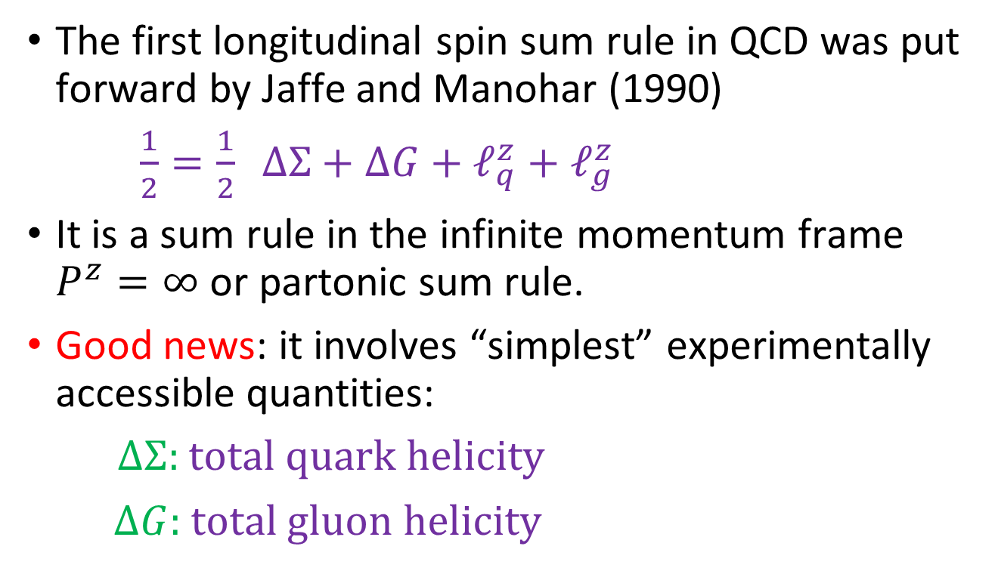
Longitudinal spin sum rule
The first longitudinal spin sum rule in QCD was put forward by Jaffe and Manohar (1990)
$\frac{1}{2}=\frac{1}{2} ΔΣ+ΔG+ℓ_{q}^{z}+ℓ_{g}^{z}$
It is a sum rule in the infinite momentum frame $P^{z}=∞$ or partonic sum rule.
Good news: it involves “simplest” experimentally accessible quantities:
$ΔΣ:$ total quark helicity
$ΔG:$total gluon helicity

Slide 7

Progress in measuring $ΔG$

Slide 8
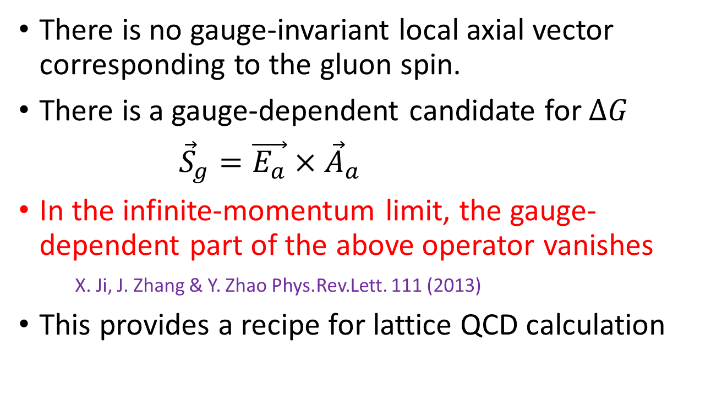
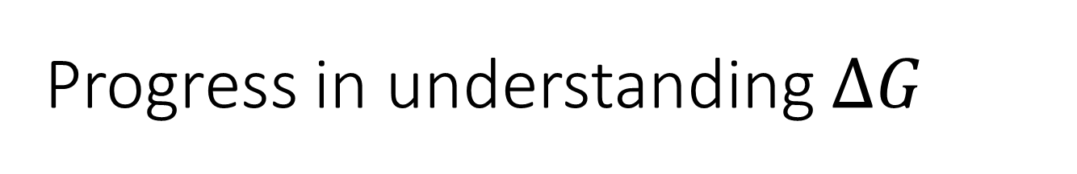
Progress in understanding $ΔG$
There is no gauge-invariant local axial vector corresponding to the gluon spin.
There is a gauge-dependent candidate for $ΔG$
${\vec{S}}_{g}=\vec{E_{a}}×{\vec{A}}_{a}$
In the infinite-momentum limit, the gauge-dependent part of the above operator vanishes
X. Ji, J. Zhang & Y. Zhao Phys.Rev.Lett. 111 (2013)
This provides a recipe for lattice QCD calculation

Slide 9
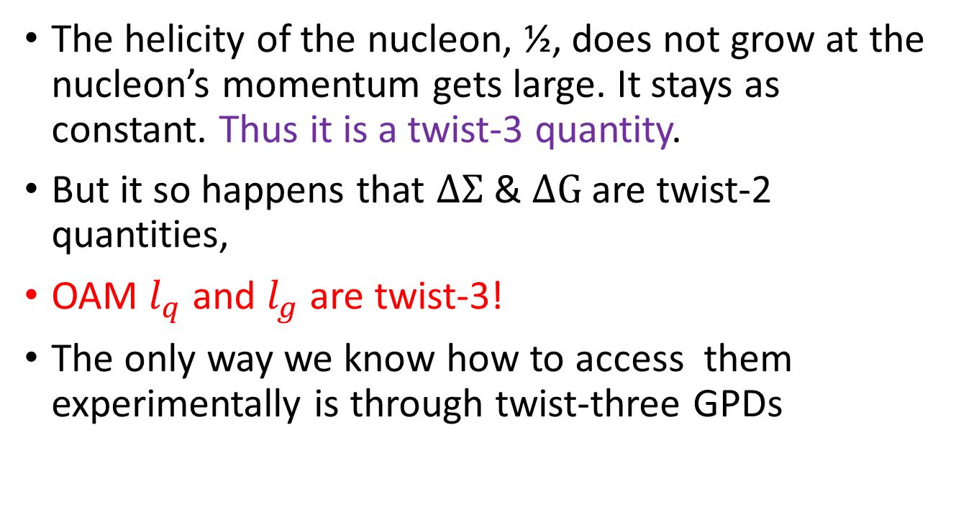
“Bad news”
The helicity of the nucleon, ½, does not grow at the nucleon’s momentum gets large. It stays as constant. Thus it is a twist-3 quantity.
But it so happens that $ΔΣ$ & $ΔG$ are twist-2 quantities,
OAM $l_{q}$ and $l_{g}$ are twist-3!
The only way we know how to access them experimentally is through twist-three GPDs

Slide 10
Parton OAM & twist-3 GPD
Very very challenging! It will be a while before we learn how to measure twist-3 GPDs

Slide 11
Frame-independent sum rule

Slide 12
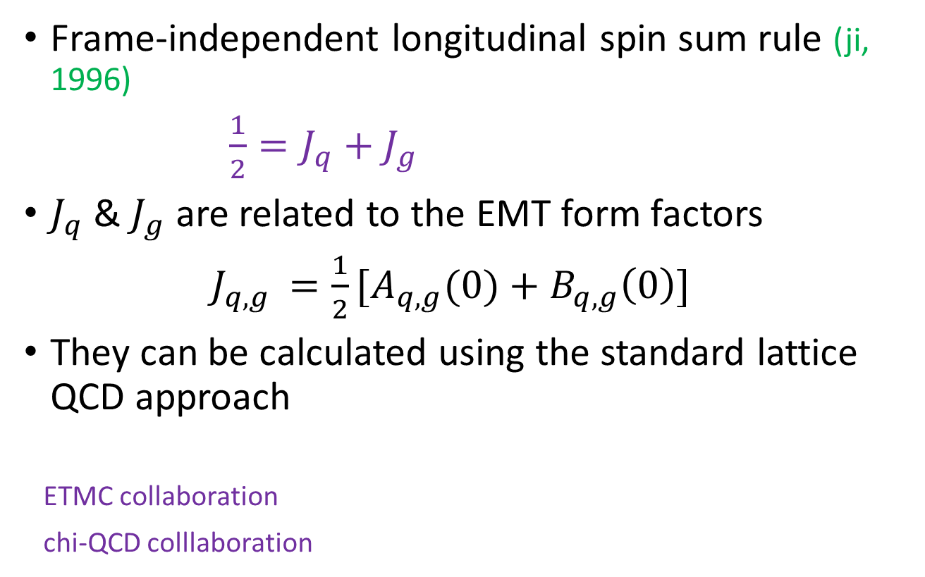
A frame-independent sum rule
Frame-independent longitudinal spin sum rule (ji, 1996)
$\frac{1}{2}=J_{q}+J_{g}$
$J_{q}$ & $J_{g}$ are related to the EMT form factors
$J_{q,g }=\frac{1}{2}[A_{q,g}(0)+B_{q,g}\left(0\right)]$
They can be calculated using the standard lattice QCD approach
ETMC collaboration
chi-QCD colllaboration

Slide 13


Experiment through DVCS etc
GPDs were introduced to extract the form factors of EMT through the sum rules
To extract H & E from DVCS and similar processes model-independently are somewhat challenging

Slide 14
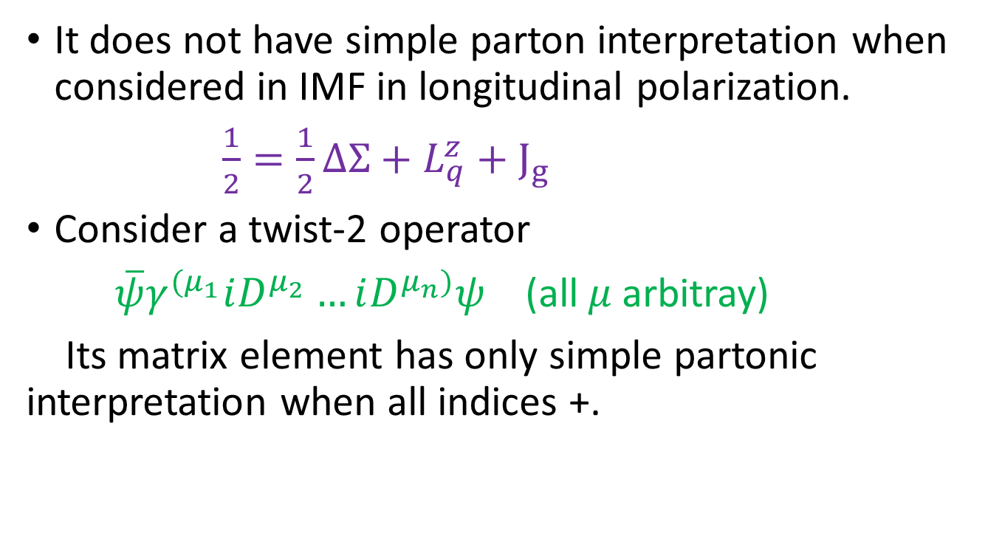
Interpretation in IMF
It does not have simple parton interpretation when considered in IMF in longitudinal polarization.
$\frac{1}{2}=\frac{1}{2}ΔΣ+L_{q}^{z}+J_{g}$
Consider a twist-2 operator
$\overline{ψ}γ^{{(μ}_{1}}iD^{μ_{2}}…iD^{μ_{n})}ψ$ (all $μ$arbitray)
Its matrix element has only simple partonic interpretation when all indices +.

Slide 15
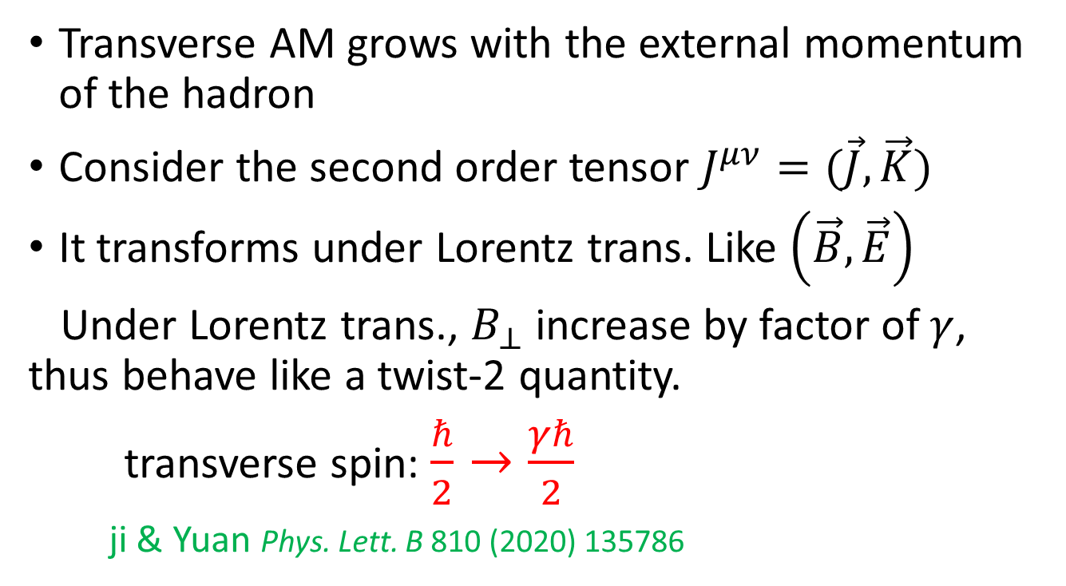
Transverse spin as twist-2 quantity
Transverse AM grows with the external momentum of the hadron
Consider the second order tensor $J^{μν}=(\vec{J},\vec{K})$
It transforms under Lorentz trans. Like $\left(\vec{B},\vec{E}\right)$
Under Lorentz trans., $B_{⊥}$ increase by factor of $γ$, thus behave like a twist-2 quantity.
transverse spin: $\frac{ℏ}{2}→\frac{γℏ}{2}$
ji & Yuan Phys. Lett. B 810 (2020) 135786

Slide 16


Slide 18

Simple parton sum rule for transverse spin
Spin sum rule as an infinite momentum frame simple parton sum rule for transverse spin
Complete twist-2 partonic sum rule!

Slide 19
Transverse spin sum rules: twist-3 case

Slide 20

Twist-3 transverse spin sum rule
$Δq_{T}$ is related to g₂ structure function
$ΔG_{T}$ is a twist-three, spin-dependent gluon distribution
Twist-3 OAM are a challenge to measure

Slide 21
g₂ structure function
Can be measured with a transversely polarized target.
Jlab 6 GeV, 12 GeV
Moments have been calculated on lattice in the past
X-dependent distribution can be calculated using large momentum effective theory

Slide 22
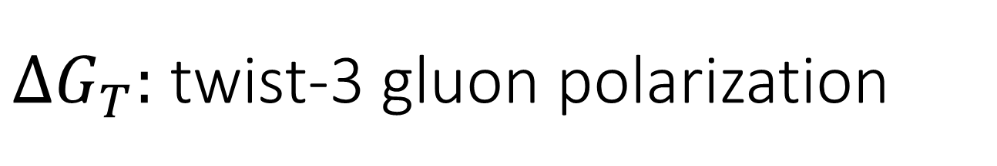


$ΔG_{T}:$ twist-3 gluon polarization
When the target is transversely polarized, there is
a twsit-3 gluon density.
This mixes with g_2 in factorization formula.
No experimental data.
Can be calculated on lattice.

Slide 24
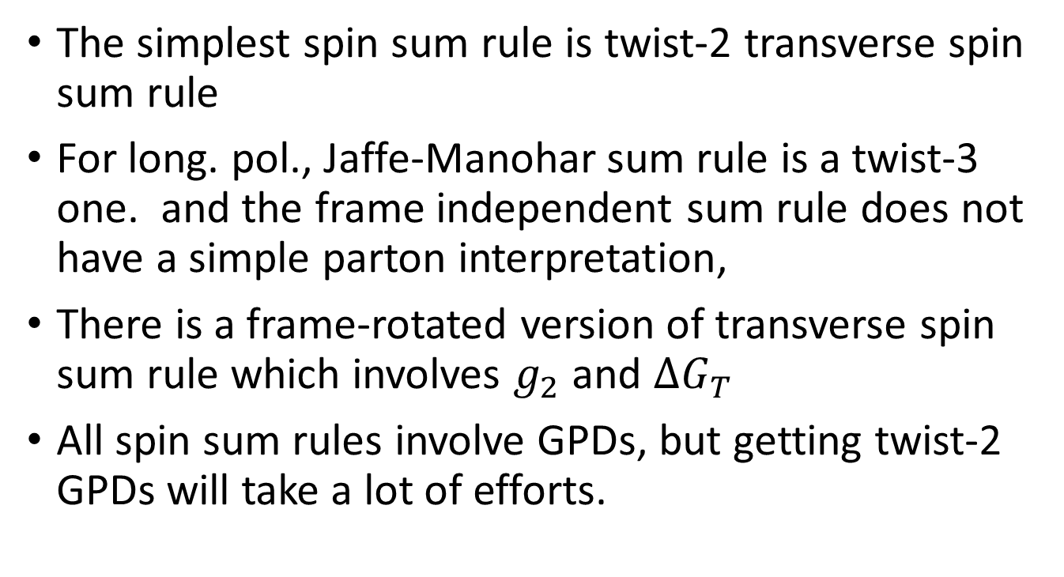
Conclusions
The simplest spin sum rule is twist-2 transverse spin sum rule
For long. pol., Jaffe-Manohar sum rule is a twist-3 one. and the frame independent sum rule does not have a simple parton interpretation,
There is a frame-rotated version of transverse spin sum rule which involves $g_{2}$ and ${ΔG}_{T}$
All spin sum rules involve GPDs, but getting twist-2 GPDs will take a lot of efforts.

