Slide 1

GPDs of nucleon and meson in a light-cone model
Zhun Lu (吕准)
Southeast University
talk ased on recently works: arxiv: 2302.11278;
2404.13962;
2406.19376
Pacificspin 2024, 9-12 Nov; Hefei

Slide 2
Outline
Overview of generalized parton distributions (GPDs)
The leading-twist GPDs of sea quarks in light-cone model
Higher-twist GPDs of pion and kaon
Phenomenology in DVCS probing transversity gluon GPDs
Summary

Slide 3
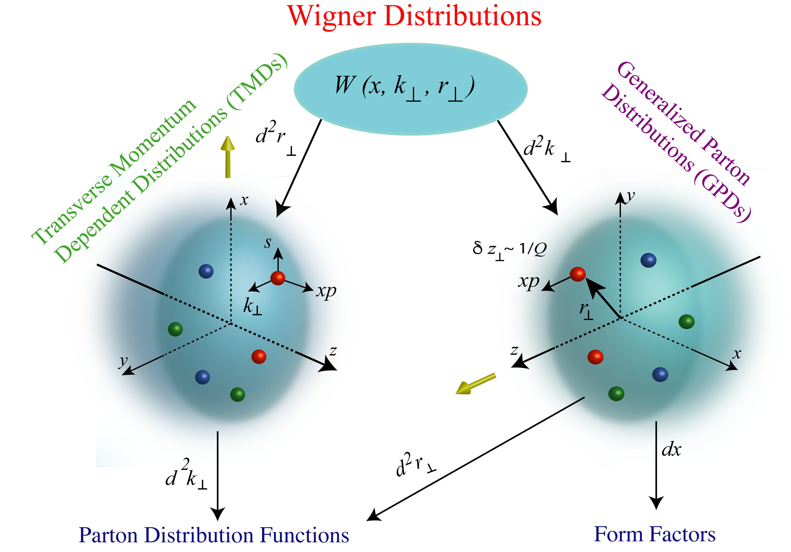
General description of nucleon structure
Multidimensional parton distributions:
F.T. of GTMD
Ji 1997；
Müller et al. 1994;
Radyushkin 1997
semi-inclusive:
SIDIS
Drell-Yan
e⁺e⁻ annihilation
exclusive:
DVCS
HEMP
(Model dependent) relations between GPDs and TMDs
Meissner, Metz, Goeke, 2007

Slide 4
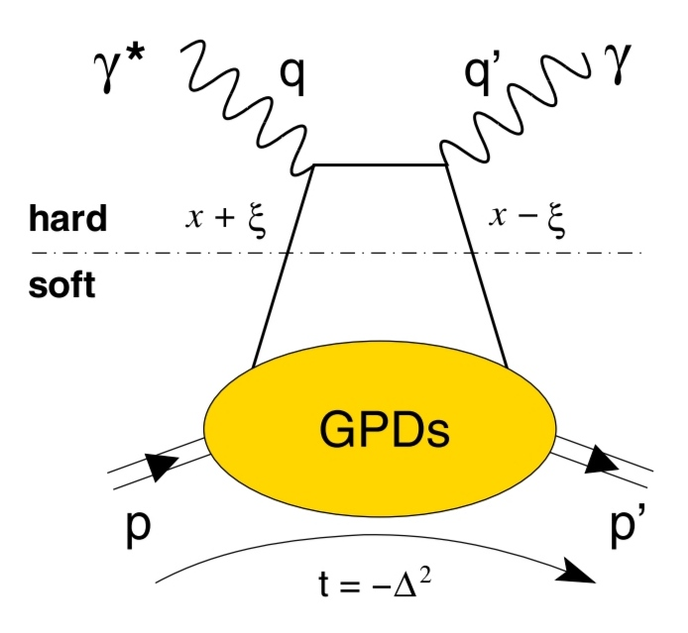
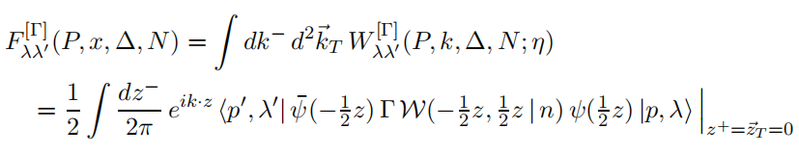
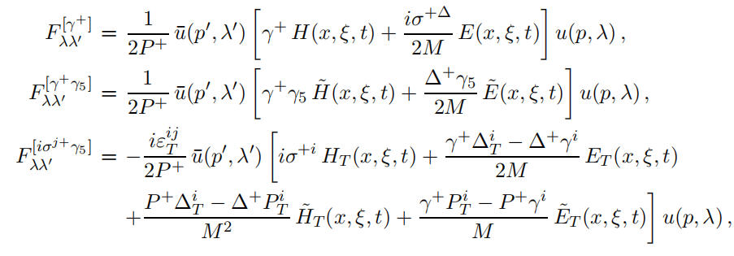
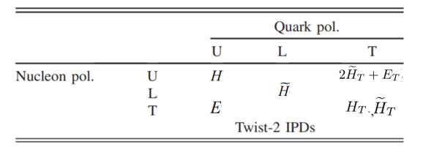
GPDs for spin-1/2 hardon
GPD-limit (spin-1/2 hardon)
GPD correlator (spin-1/2 hardon)
Leading-twist parameterization (spin-1/2 hardon)
4 chiral-even GPDs
4 chiral-odd GPDs

Slide 5
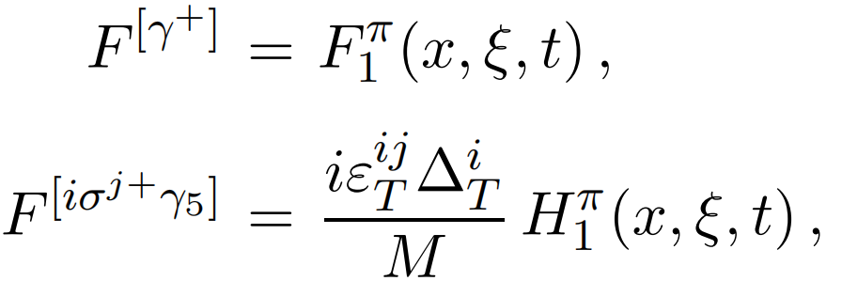
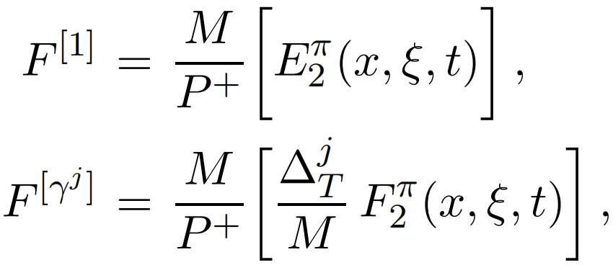
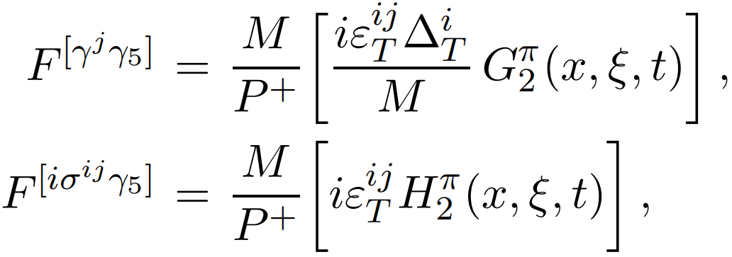
GPDs for spin-0 hadrons
GPD-limit (spin-0 hardon)
GPD correlator
leading-twist GPDs
twist-3 GPDs

Slide 6
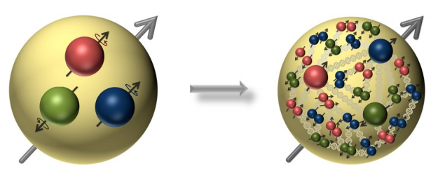
sea quark degree of freedom
Sea quarks
constituent quark model
NLO ...
...
meson-baryon fluctuation model
Brodsky, Ma, 1996
in our model
other opproaches: chiral quark model, meson cloud model ...

Slide 7

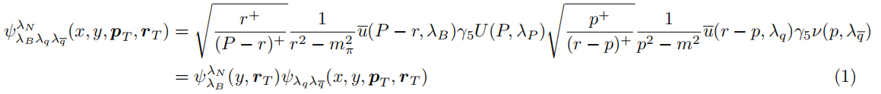





The leading-twist GPDs of sea quarks
Light-cone wave functions of q-qbar-baryon system
LCWFs For
$$(x. p_{T})$$
$$\overline{q}$$
$$q$$
$$(1−x. −p_{T})$$
$$(y. r_{T})$$
$$M$$
$$(1−y. −r_{T})$$
B
P

Slide 8


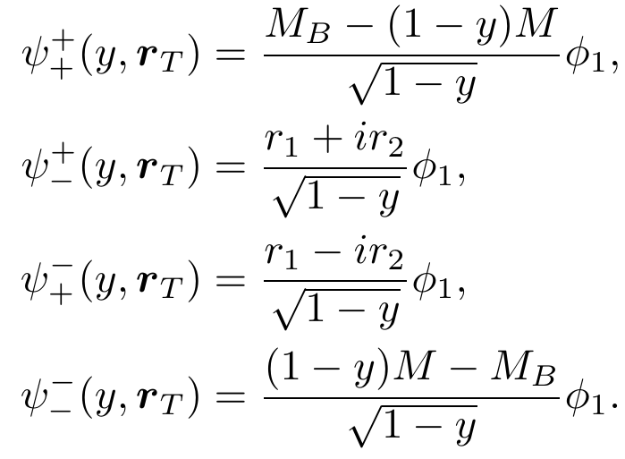
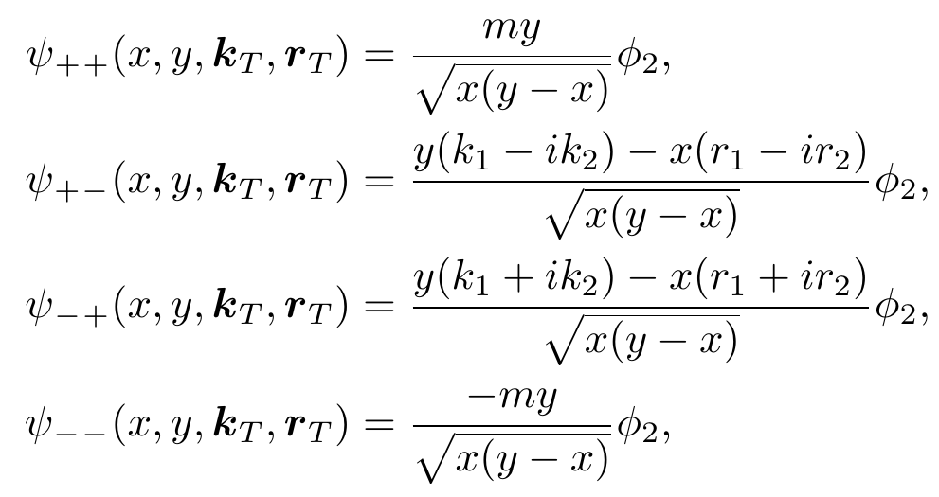
The leading-twist GPDs of sea quarks
Light-cone wave functions
For , the LCWFs can be defined as
Luan and ZL, 2022
: LCWFs of the nucleon in terms of
: LCWFs of meson inside nucleon in terms of

Slide 9
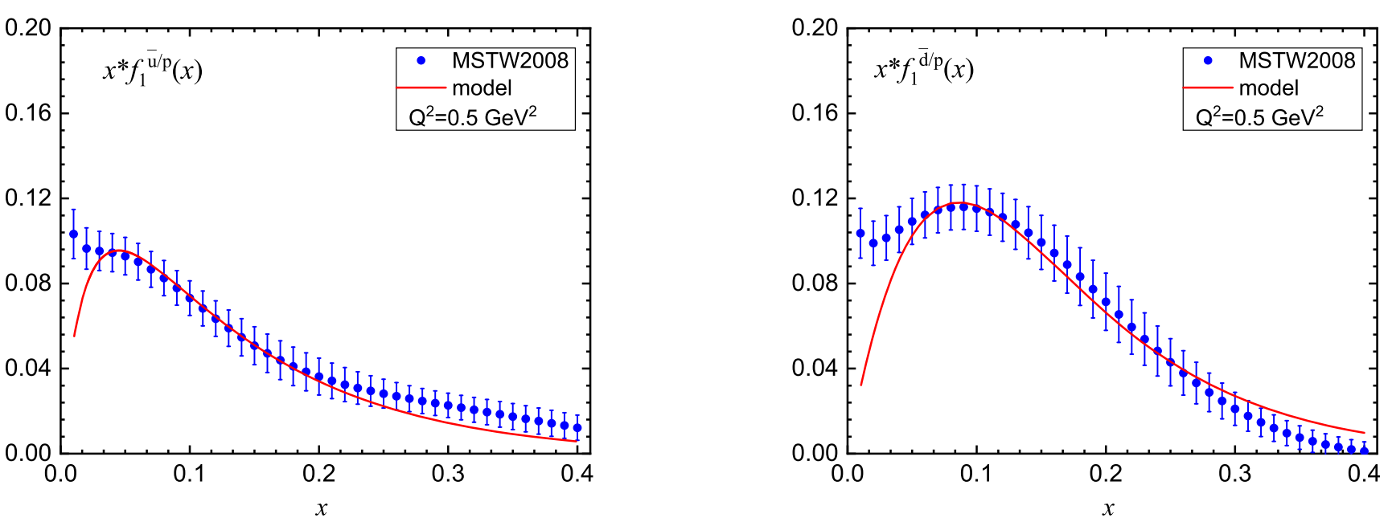
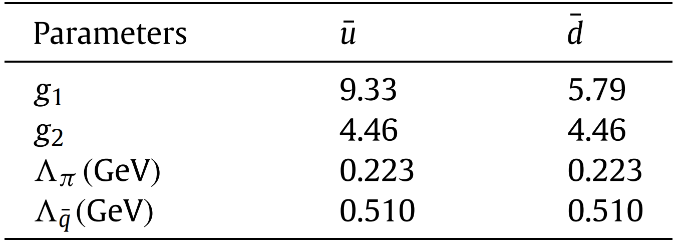


The leading-twist GPDs of sea quarks
Model parameters
Values of the parameters obtained from fitting
the model to the GRV LO (second and fourth row) and MSTW2008 (first and third row).

Slide 10
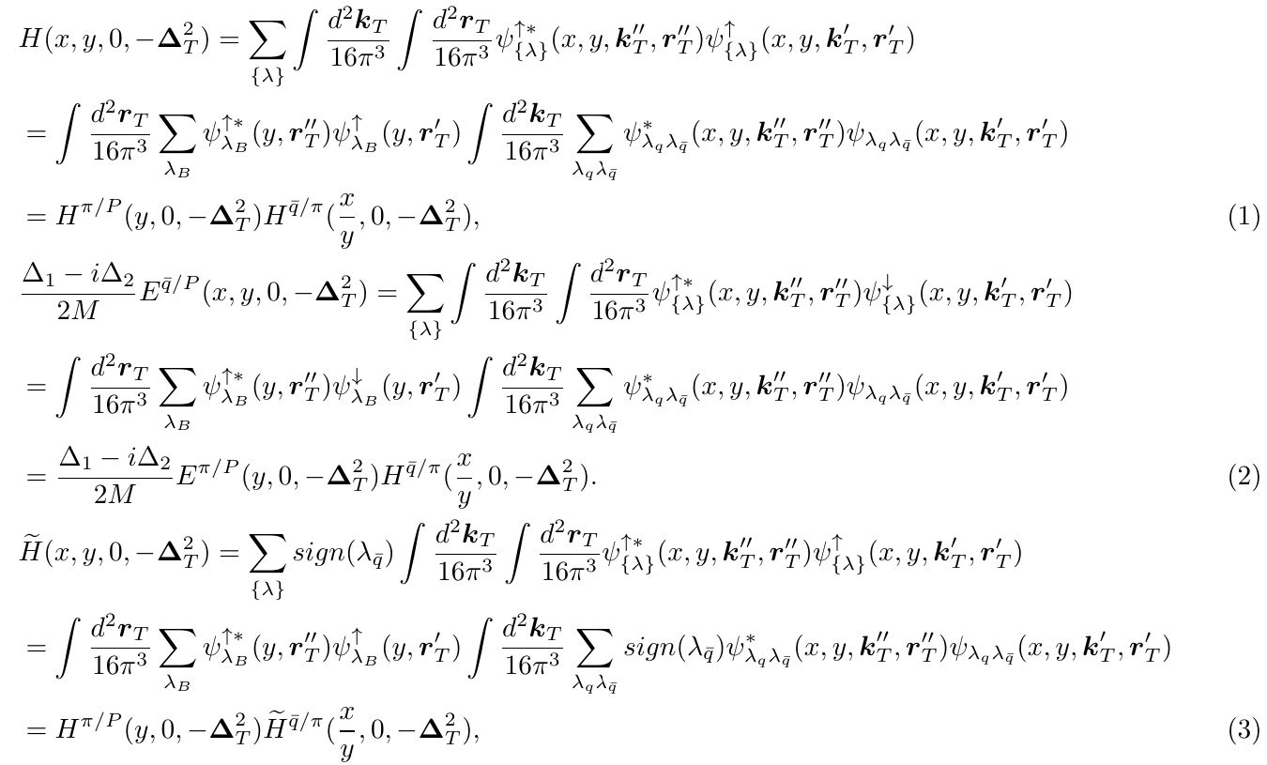
The leading-twist GPDs of sea quarks
overlap representation of GPDs at ξ = 0 in terms of LCWFs

Slide 11
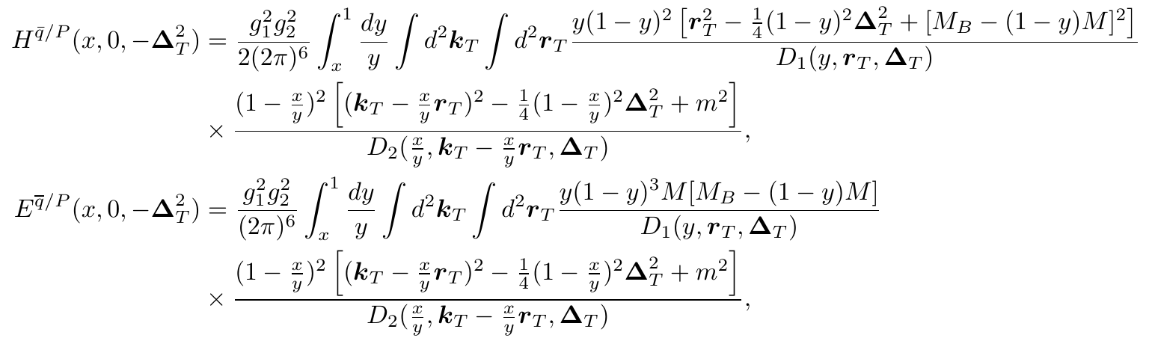
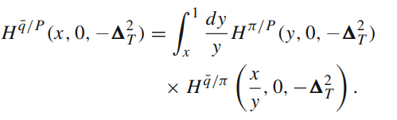
The leading-twist GPDs of sea quarks
Chiral-even GPDs for proton
A convoluted form:

Slide 12

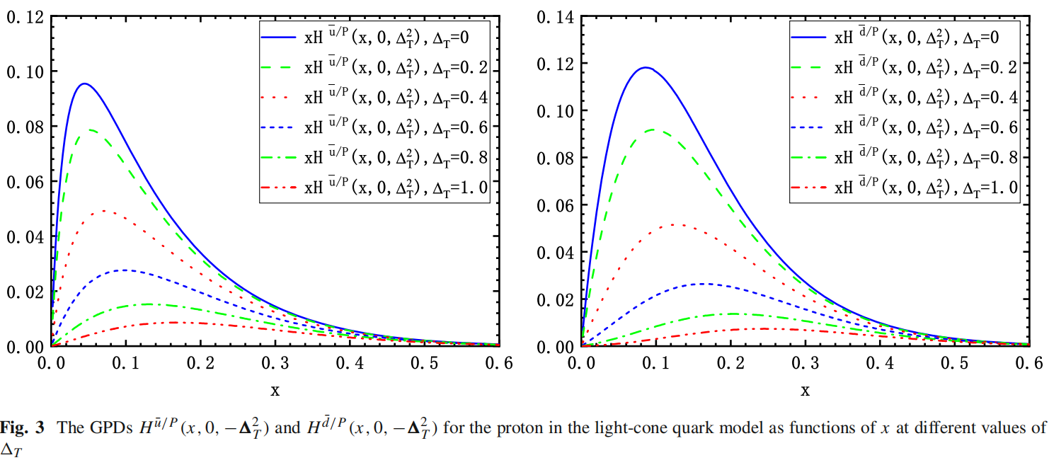
Results for
Luan and ZL, 2023

Slide 13

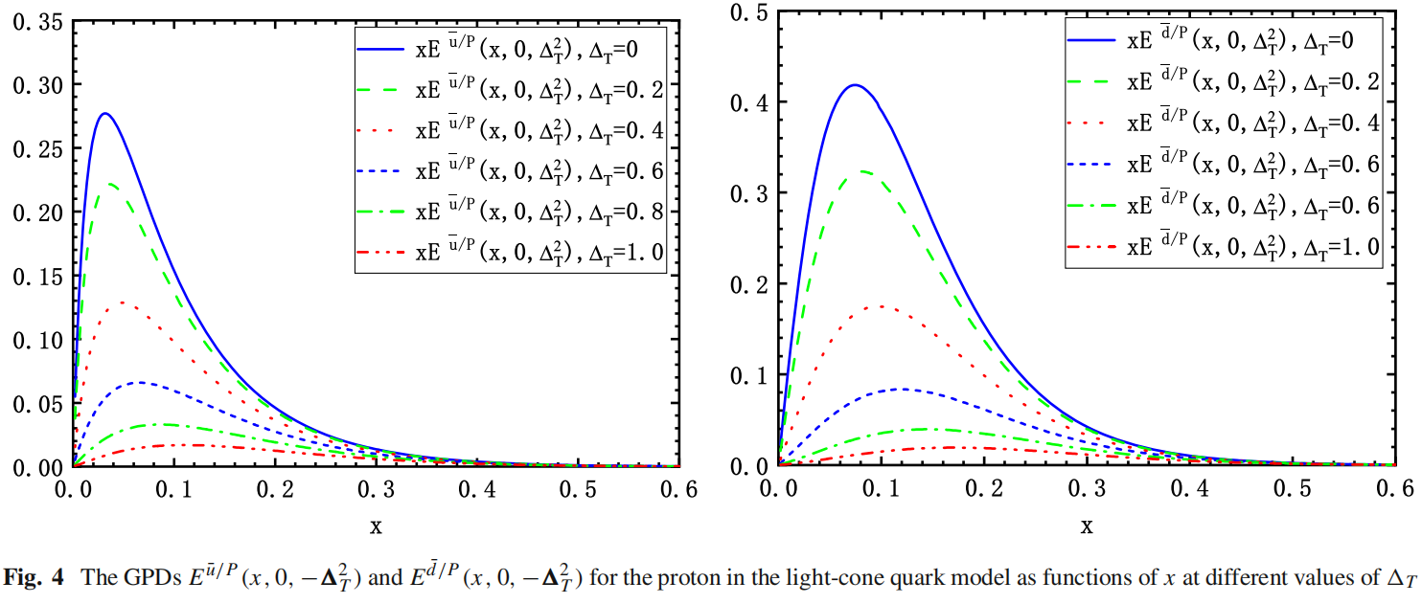
Results for

Slide 14
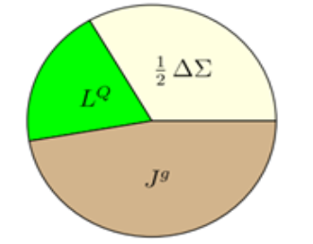

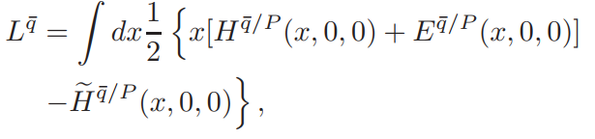
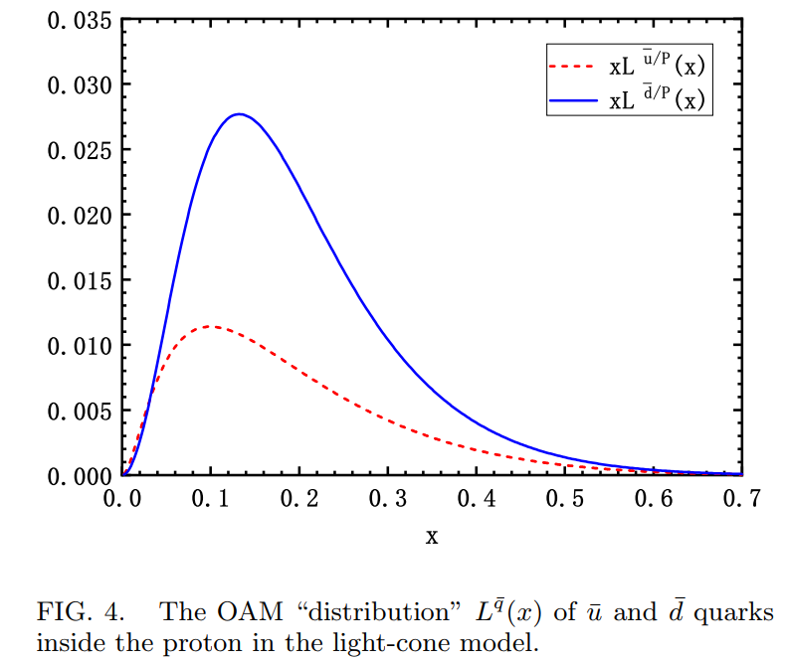

Orbital angular momentum of sea quarks
Ji 1997

Slide 15
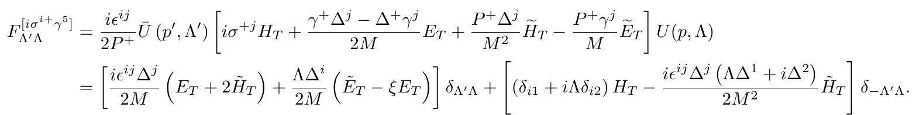
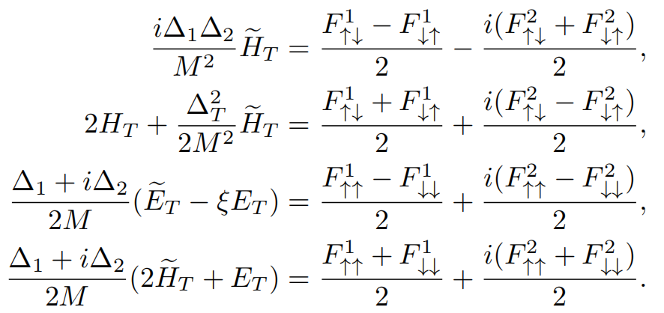
Chiral-odd GPDs of sea quarks
Γ = iσ^{i+}γ₅
quark proton helicity amplitudes for Chiral-odd GPDs
Rajan, Engelhardt, Liuti 2017
obtaining Chiral-odd GPDs from combinations of helicity amplitudes:

Slide 16
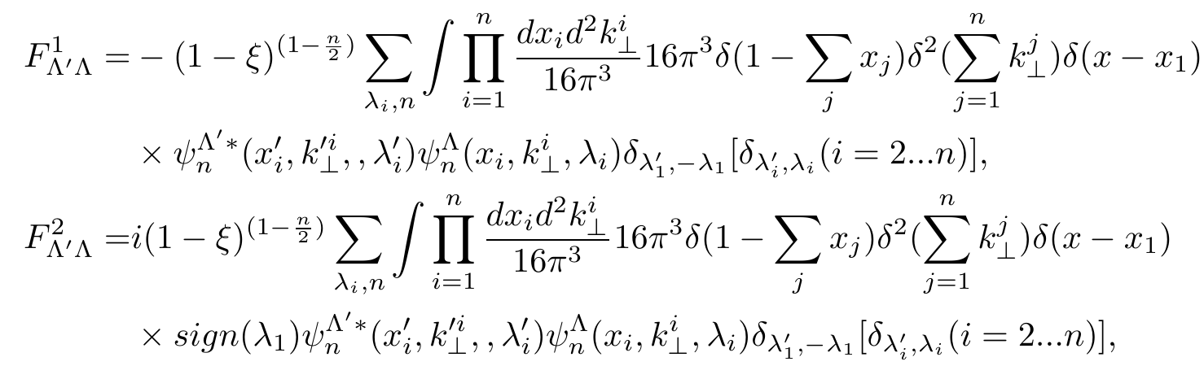
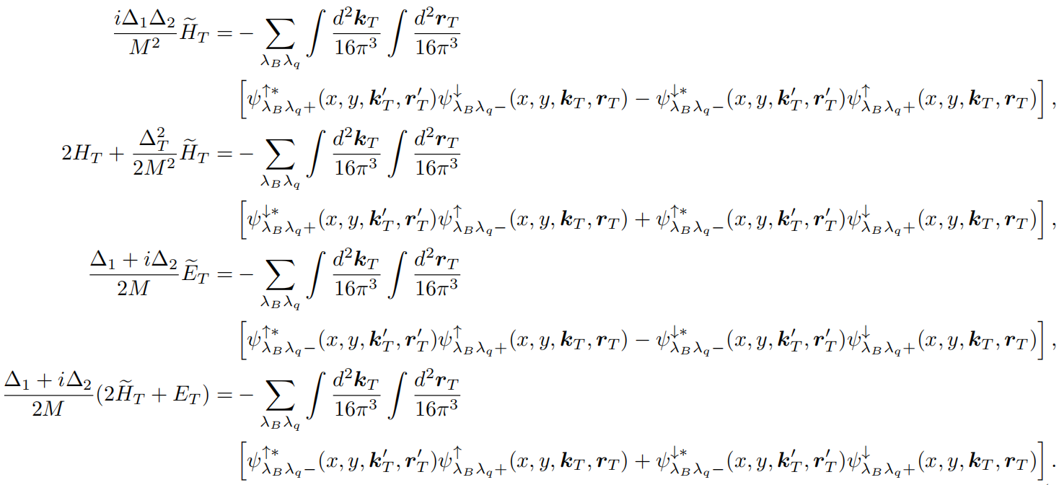
Chiral-odd GPDs in overlap representation
overlap representation for helicity amplitudes:
Chakrabarti, Manohar, Mukherjee 2008
Chiral-odd GPDs of sea quarks in terms of LCWFs:

Slide 17
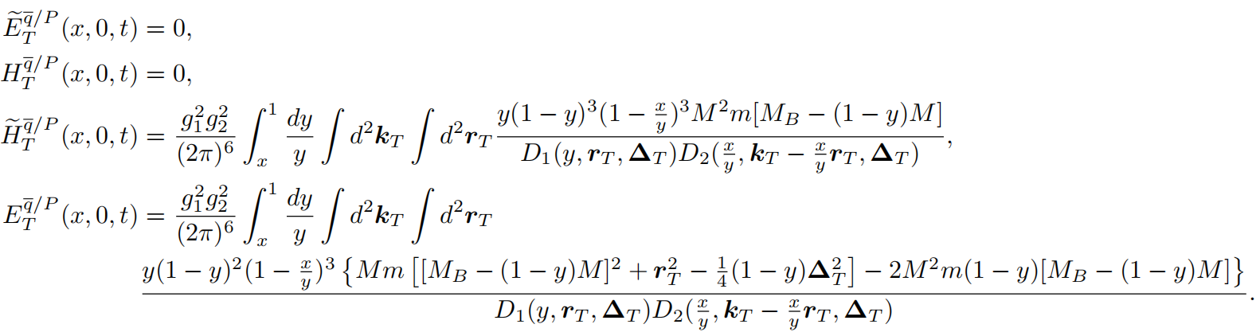
Chiral-odd GPDs of sea quarks at zero skewness
expression for the chiral-odd GPDs of the sea quarks
cannot written in a convoluted form

Slide 18
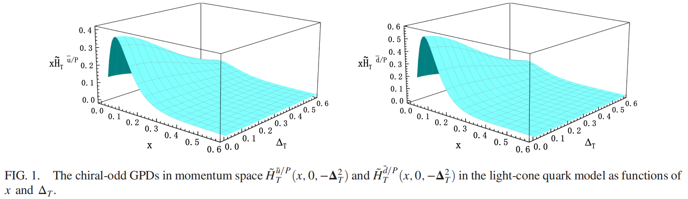
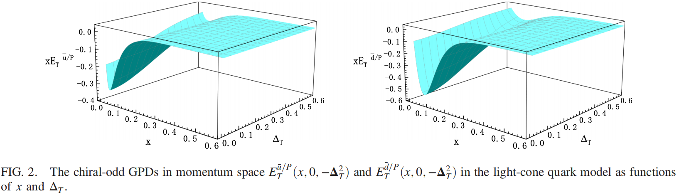
Chiral-odd GPDs of sea quarks

Slide 19



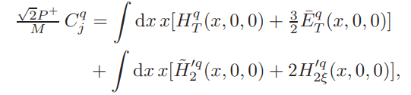
Higher-twist GPDs
Why to study higher twist GPDs?
  provide access to the quark OAM
or
Penttinen et al. 2000 Lorcé, Pasquini, 2012
transverse color Lorentz force acting on quark
Aslan, Burkardt, Schlegel, 2019
spin-orbit correlation
Lorcé, 2014
Bhoonoh, Lorcé, 2017

Slide 20
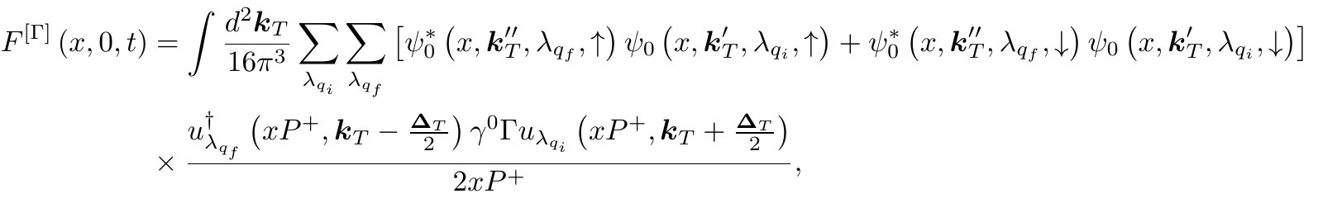
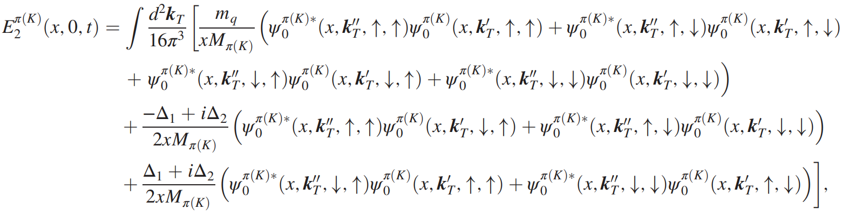
Overlap representation for higher-twist GPD
Sharma, Dahiya, 2024
twist-3 GPDs
Luan and ZL, 2024

Slide 21
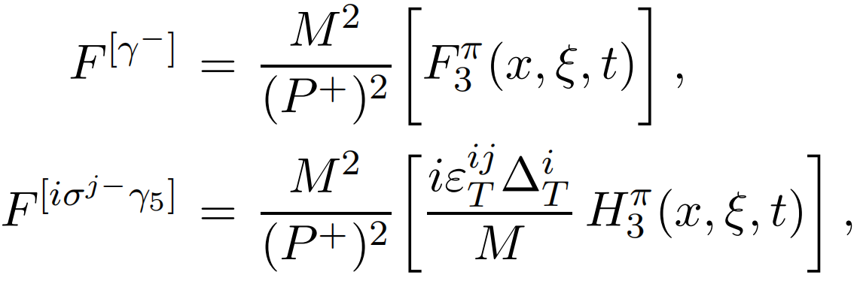
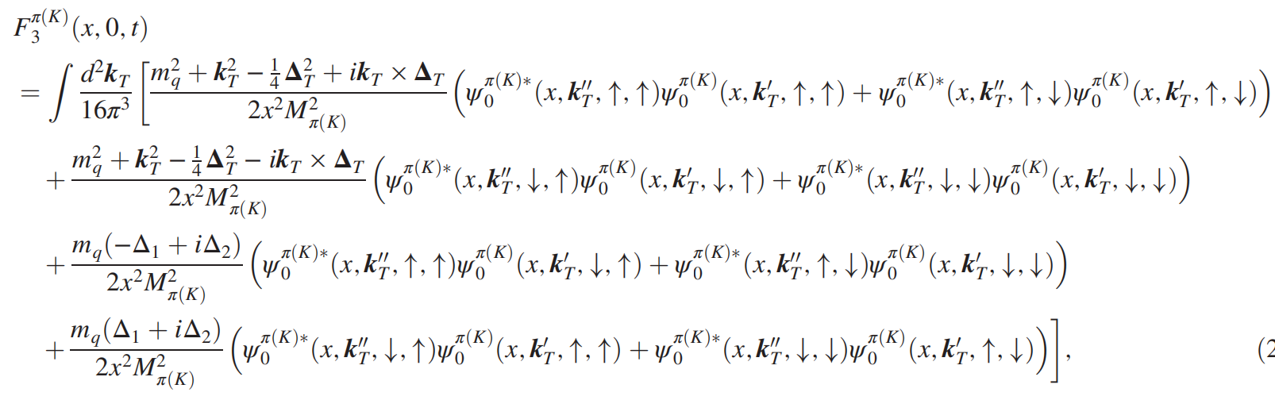
twist-4 GPDs of pion and kaon
twist-4 GPDs

Slide 22
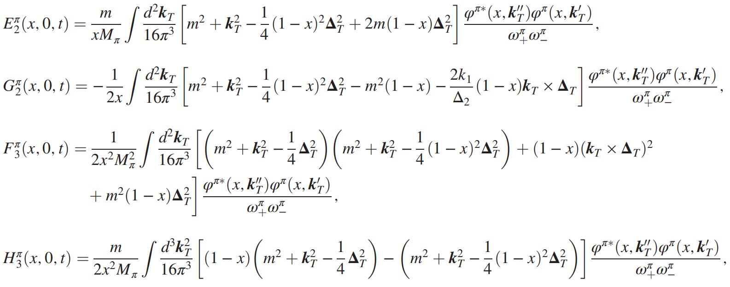
The twist-3 and twist-4 GPDs of the pion
twist-3
twist-4

Slide 23
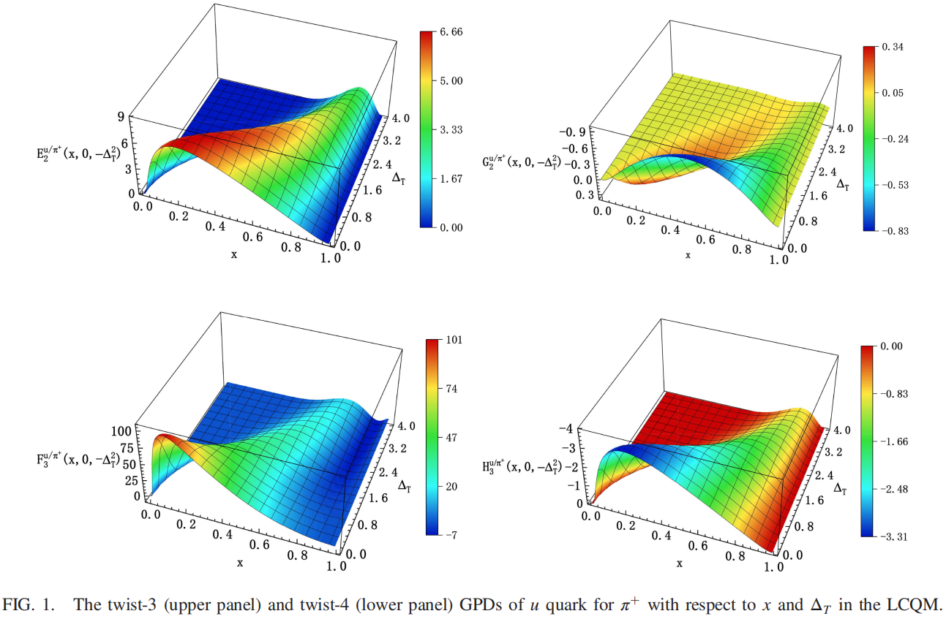
The twist-3 and twist-4 GPDs of the pion
10/17/2024 第二届核子三维结构研讨会暨第二届高扭度核子结构研讨会 26/30

Slide 24
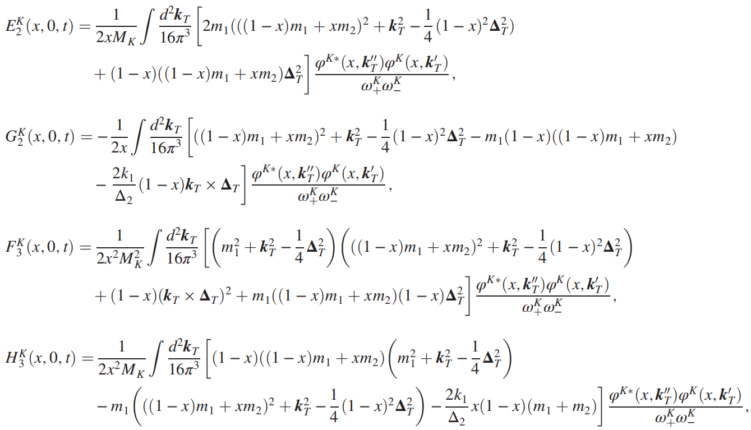
The twist-3 and twist-4 GPDs of the kaon
twist-3
twist-4

Slide 25
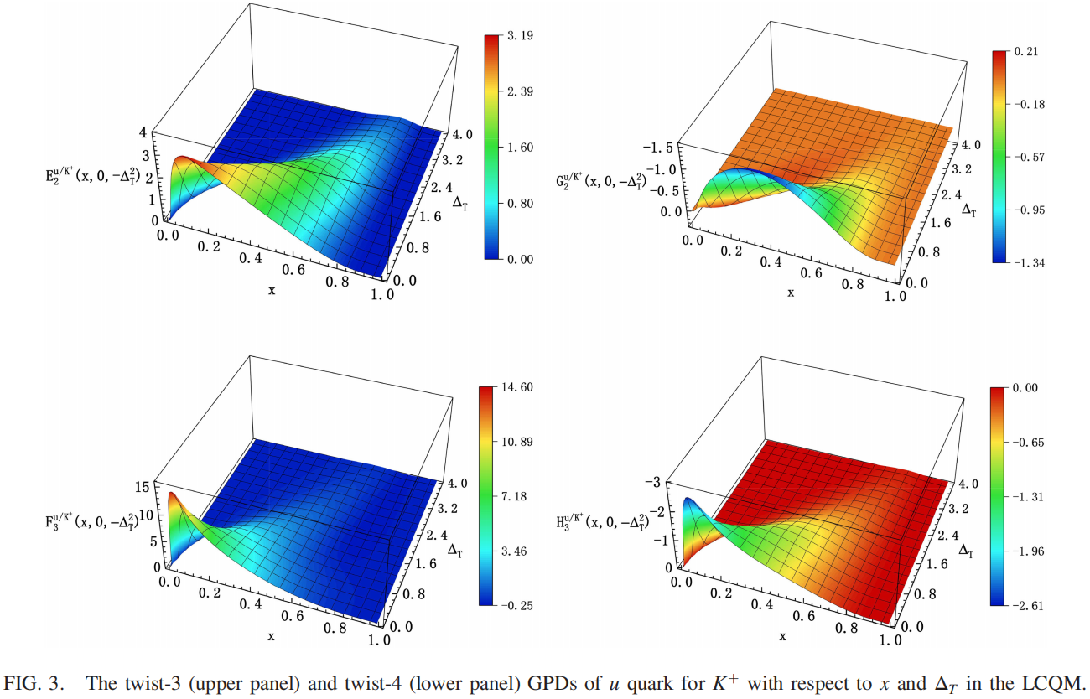
The twist-3 and twist-4 GPDs of the kaon

Slide 26
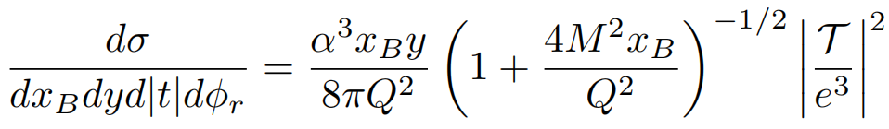
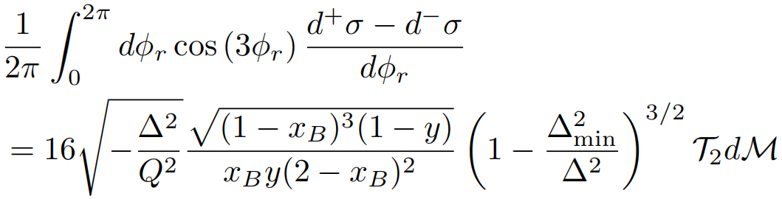


DVCS cross section with transversity gluon GPDs
The transversity gluon GPDs can be access via ep → epγ:
using cos(3φ) weighted cross section to extract gluon GPD contribution
Belitsky, Mueller, 2000
，
gluon Compton form factors (CCFs)

Slide 27
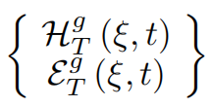
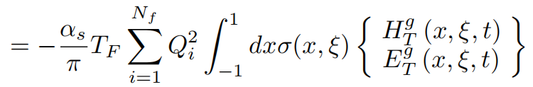

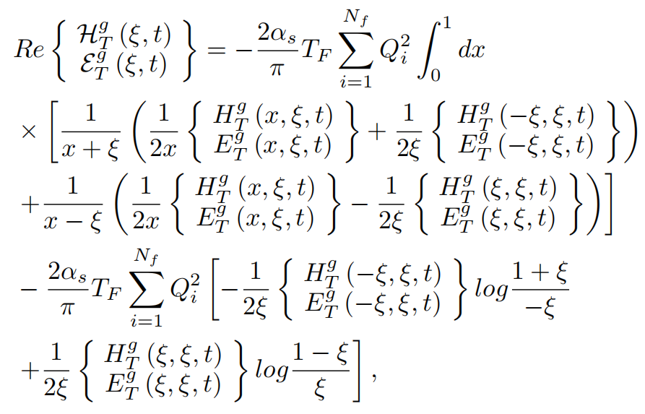
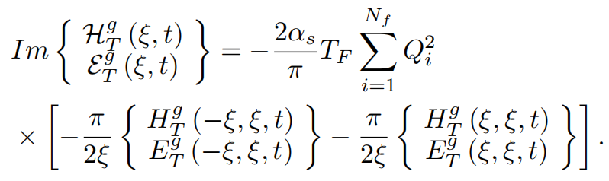
DVCS cross section with transversity gluon GPDs
The gluonic CFFs
For phenomenological estimate, transvetsity Gluon GPDs at nonzero skewness is need

Slide 28
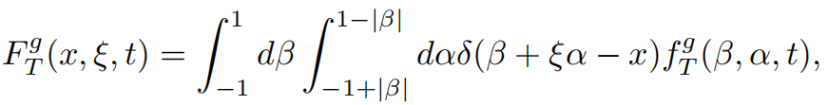




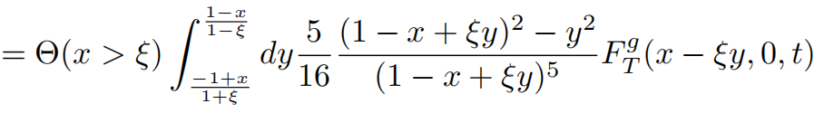
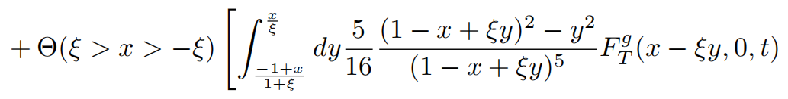

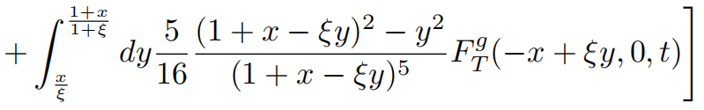
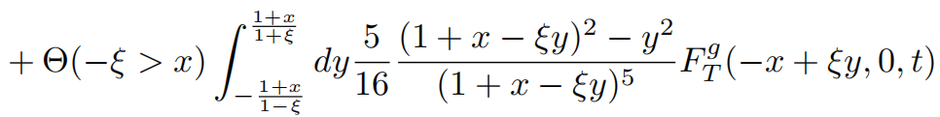

DVCS cross section with transversity gluon GPDs
transversity gluon GPDs at $ξ≠0$ constructed from the double distribution (DD) ansatz
Musatov, Radyushkin 2000
: double distribution
zero-skewness GPD for β > 0.
profile function to generates the skewness dependence,
transversity gluon GPDs at $ξ≠0:$

Slide 29
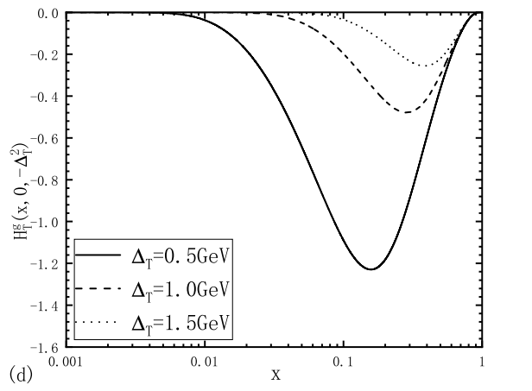

DVCS cross section with transversity gluon GPDs
adopt gluon GPDs at zero skewness from LC spectator model result as input
Tan, ZL, 2023

Slide 30




DVCS cross section with transversity gluon GPDs
Numerical estimates for real and imaginative parts of CCFs
$$t=−0.25{GeV}^{2}$$
dominate over

Slide 31



DVCS cross section with transversity gluon GPDs
weighted cross section at (CLAS12)
work in preparation

Slide 32
Summary
Leading-twist GPDs of sea quarks in the proton as well as the higher-twist GPDs of light mesons at zero skewness are studied a light-cone quark model
Numerical result for OAM of sea quarks privided:
cos3phi-weighted cross section of the DVCS are estimated, it may provide access to the transversity gluon GPDs.

Slide 33

THANK YOU!

Slide 34



parton distribution functions
quark-quark correlation function parameterization
collinear parton distribution functions(PDFs)
(Unpolarized)
(Longitudinally polarized)
Longitudinal motion only
(Transversely polarized)
transverse momentum distributions(TMDs, 3dpdf)
Bacchetta et al 06
Longitudinal + transverse motion

Slide 35





The twist-3 and twist-4 GPDs of light mesons
Light-cone wave fuctions of the pion and kaon
B. W. Xiao and B. Q. Ma, Phys. Rev. D 68, 034020 (2003).
W. Qian and B. Q. Ma, Phys. Rev. D 78, 074002 (2008).
S. Kaur and H. Dahiya, Phys. Rev. D 100, 074008 (2019).

Slide 36


DVCS cross section with transversity gluon GPDs
The gluonic CFFs are obtained as convolution
0 < a < 1 , P denotes Cauchys principal integral
10/17/2024 第二届核子三维结构研讨会暨第二届高扭度核子结构研讨会 3136

