Slide 1
change MC geometry
diao hongbin
State key laboratory of particle detection and electronics
USTC

Slide 2
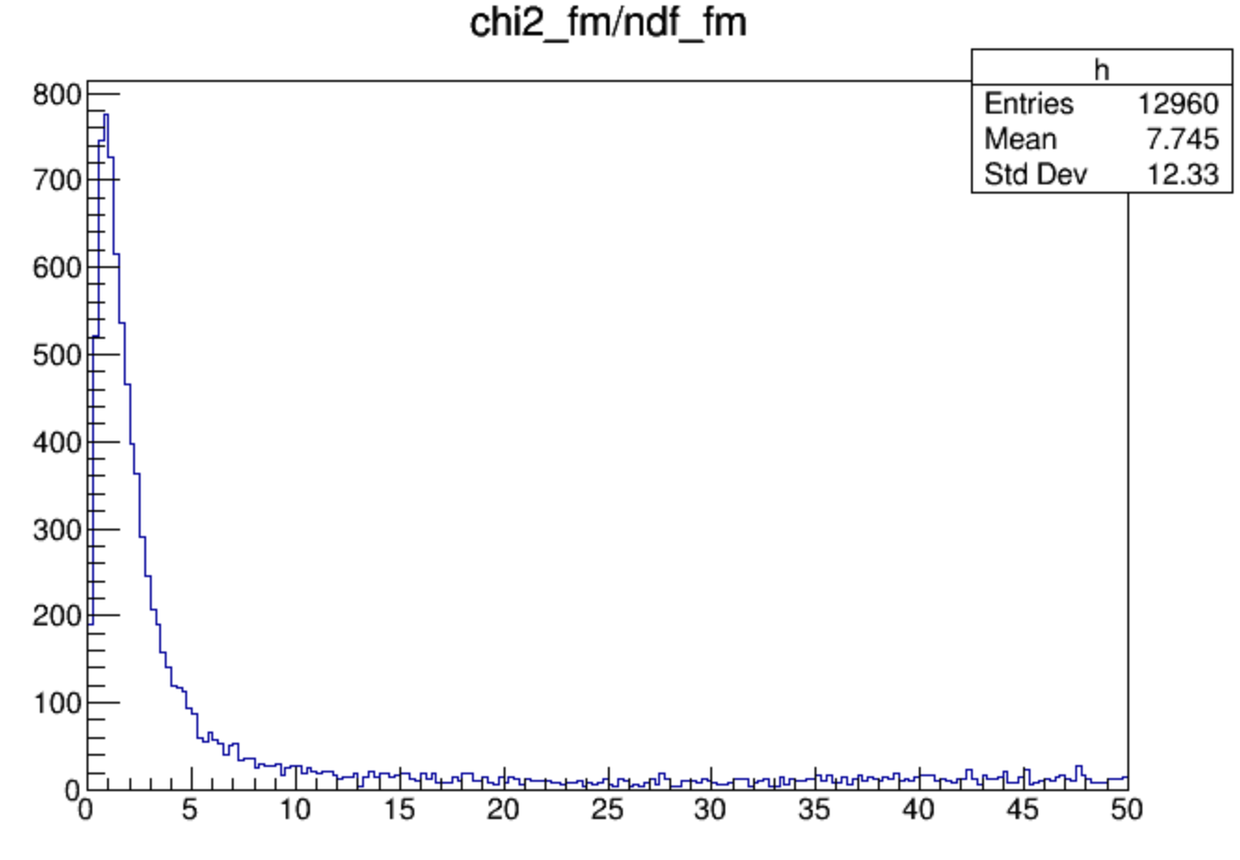
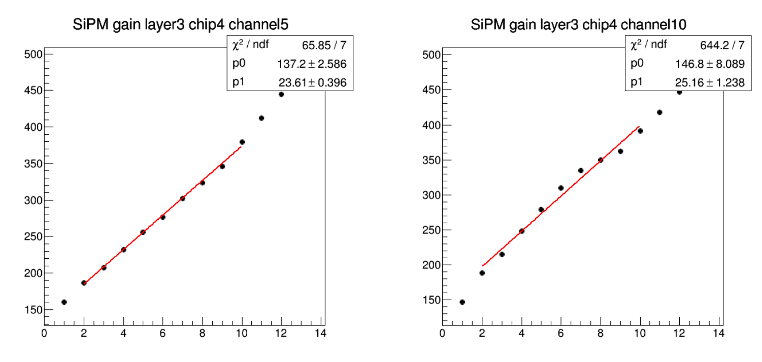
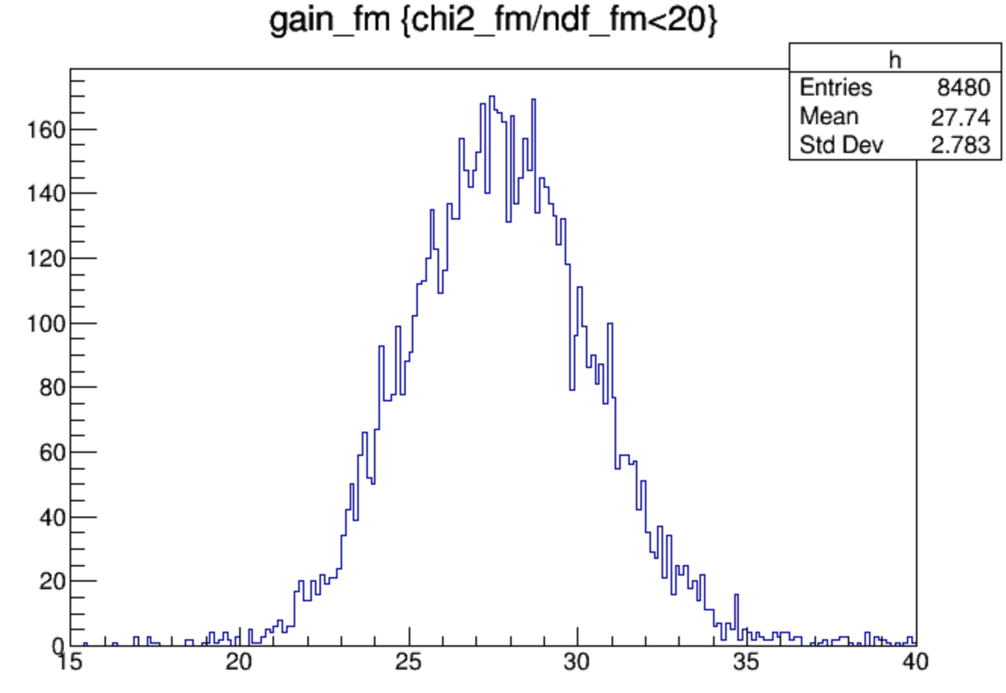
MIP spectrum
run1-57,139-166,312-357
good
bad

Slide 3
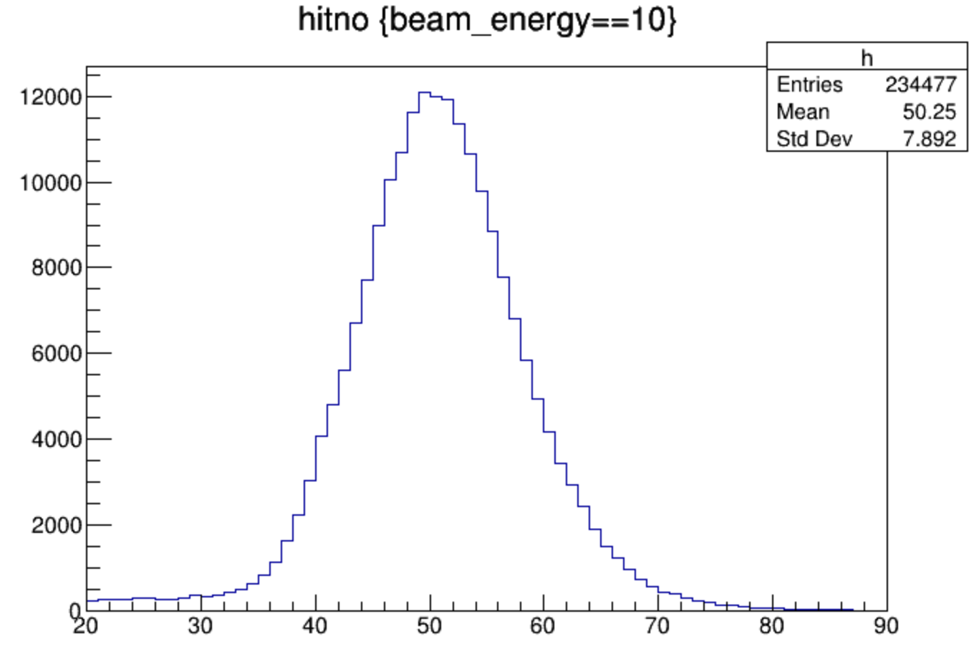
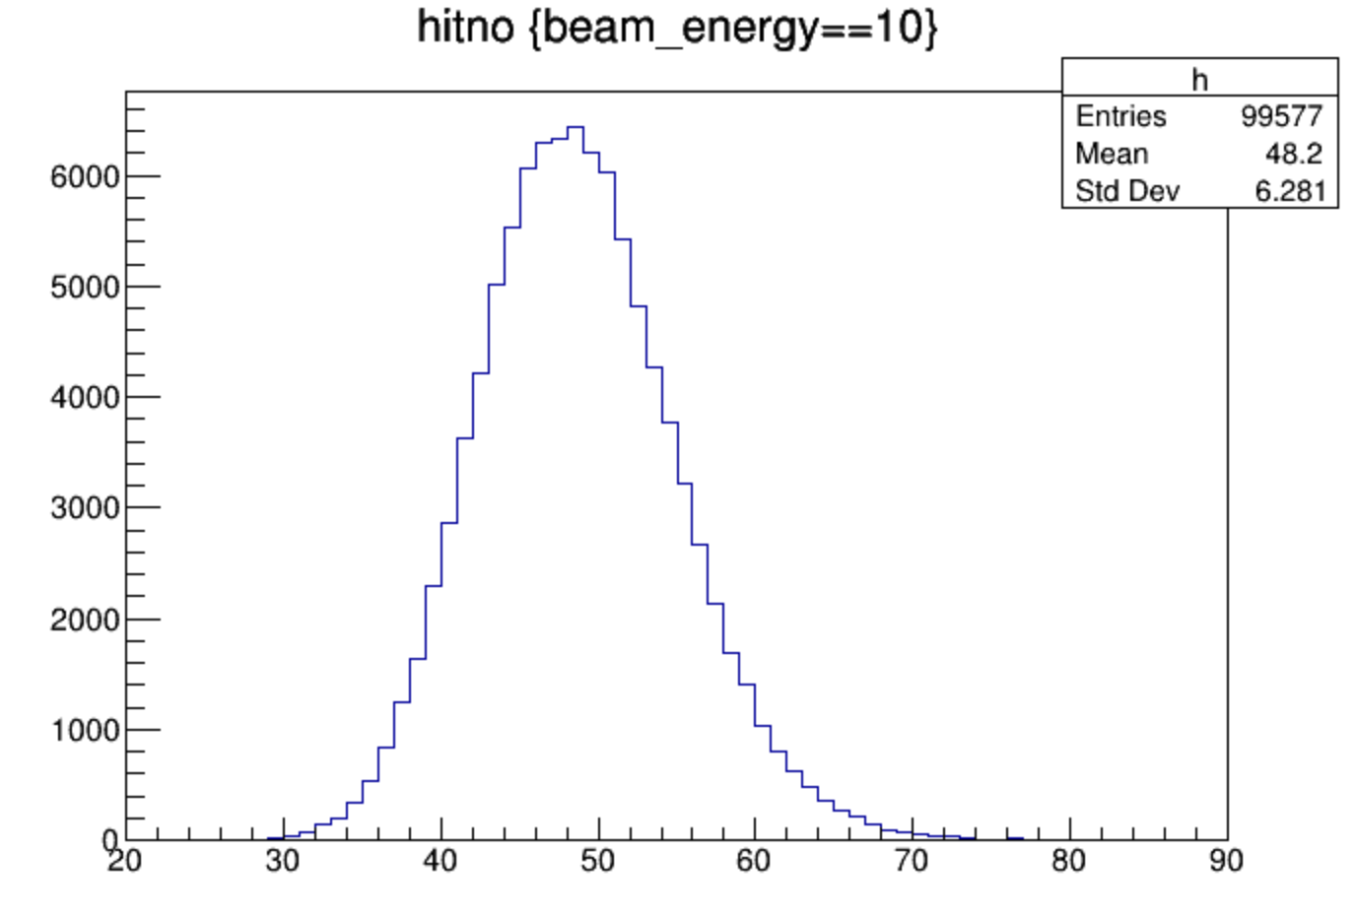
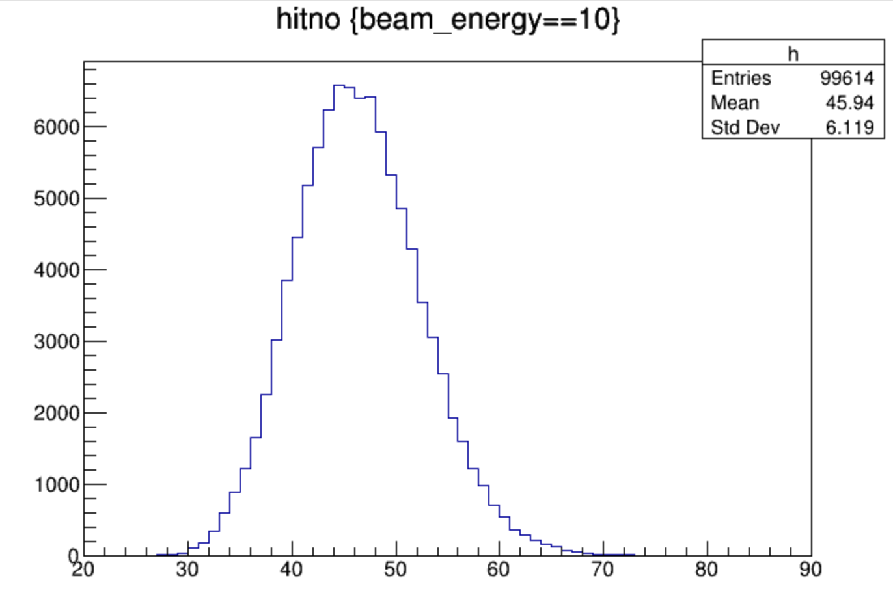
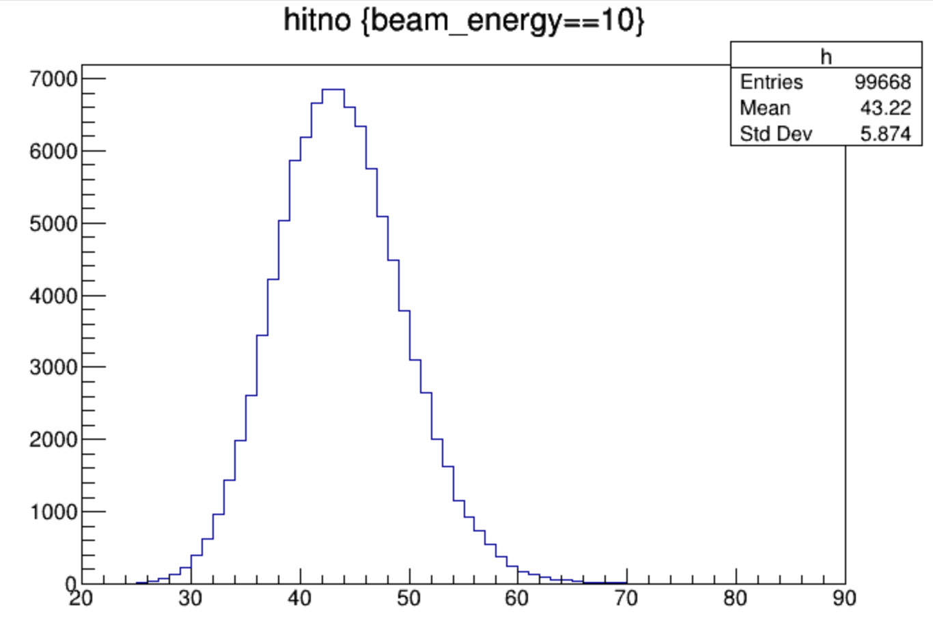
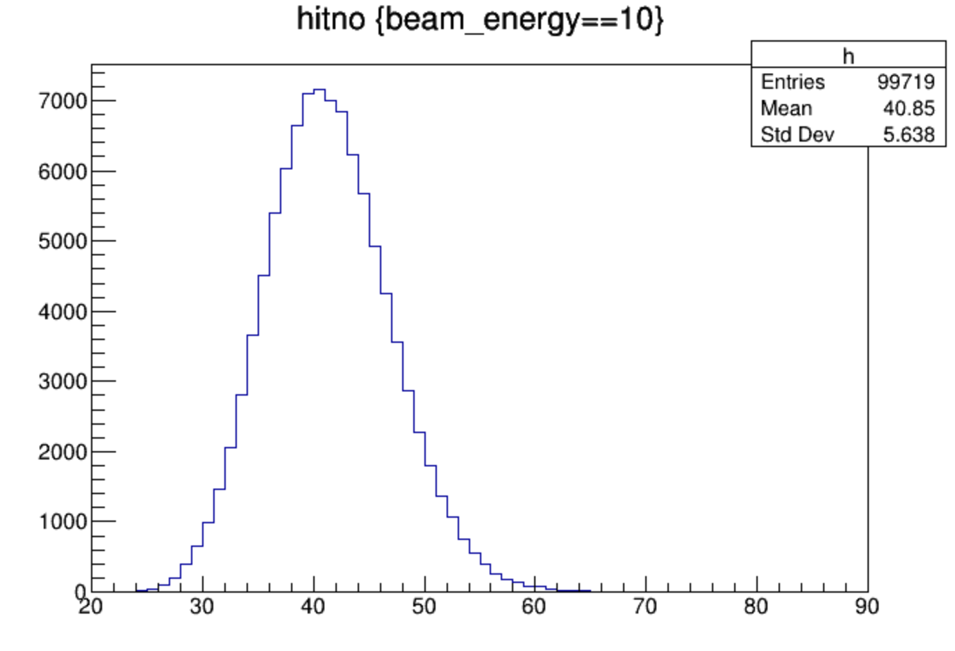
hitno
2.5/0.0: 2.5 stands for thickness of PCB, 0.0 stands for thickness of Cu
10GeV e-
data
2.5/0.0
2.5/0.5
3.5/1.0
3.5/2.0
3.5/3.0

Slide 4
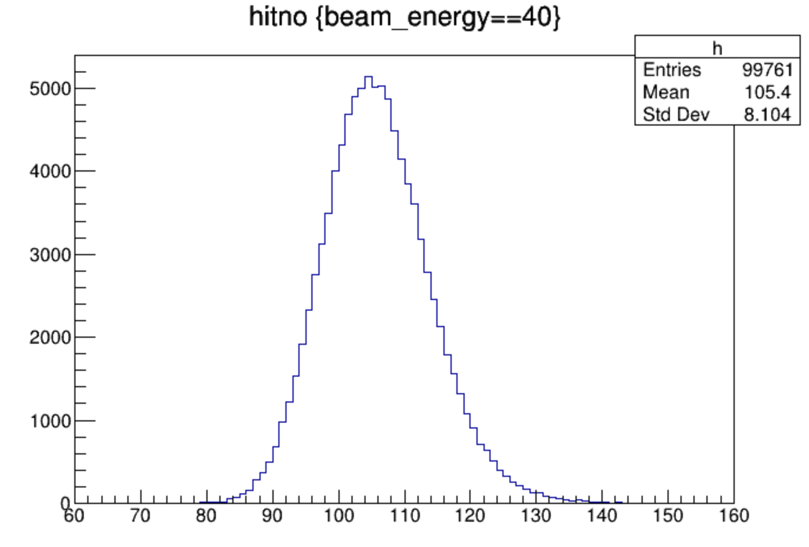
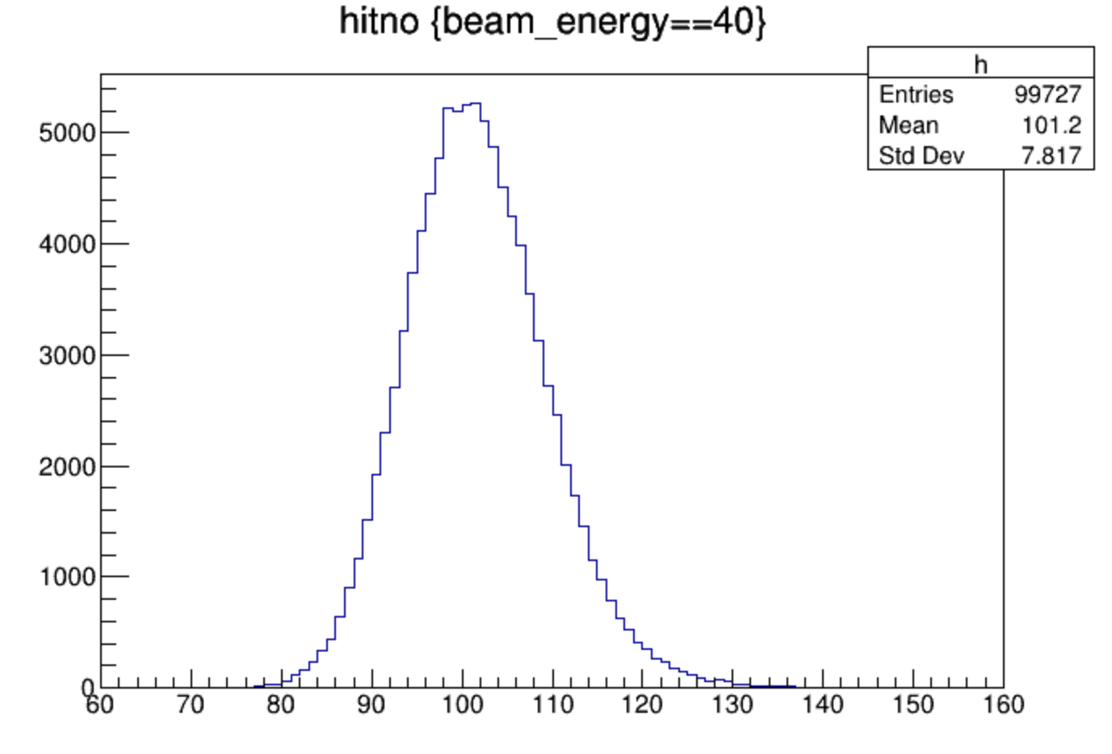
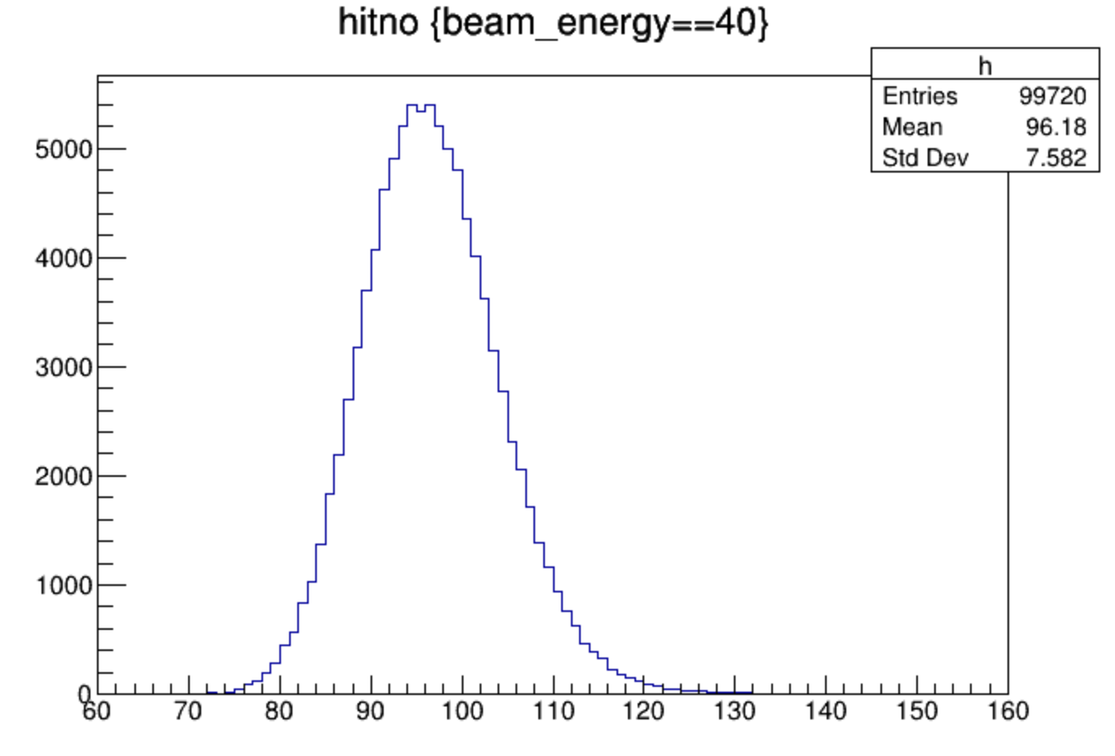
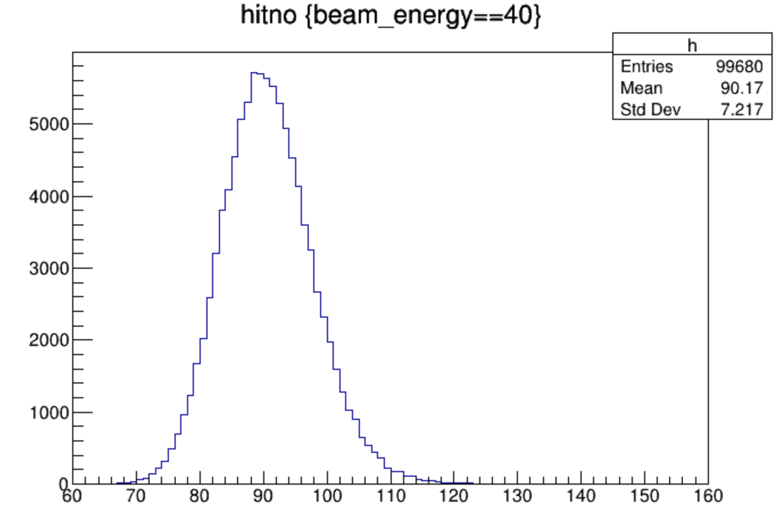
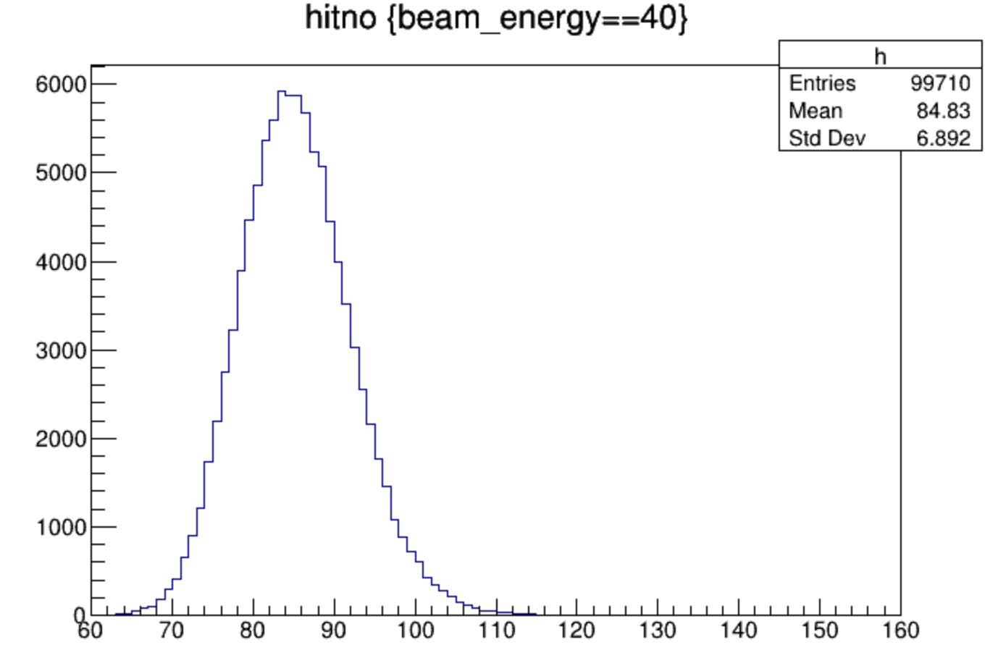
hitno
40GeV e-
data
2.5/0.0
2.5/0.5
3.5/1.0
3.5/2.0
3.5/3.0

Slide 5
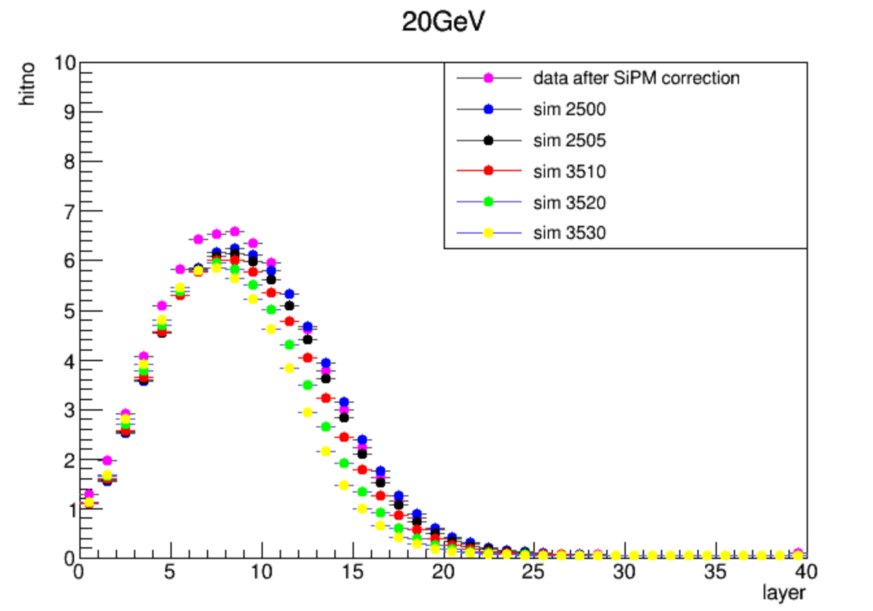
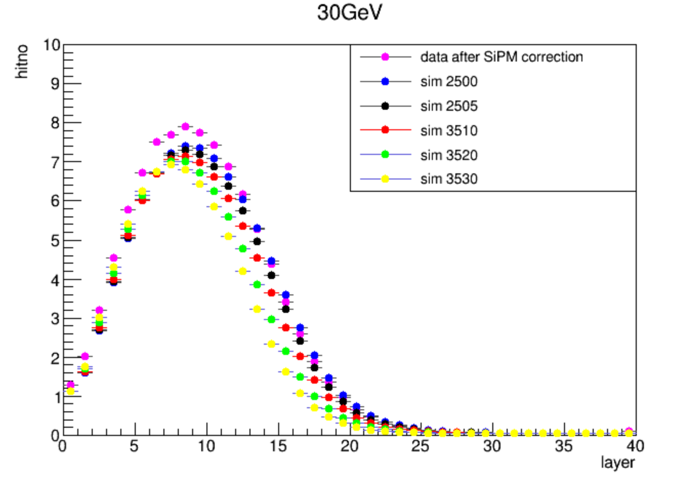
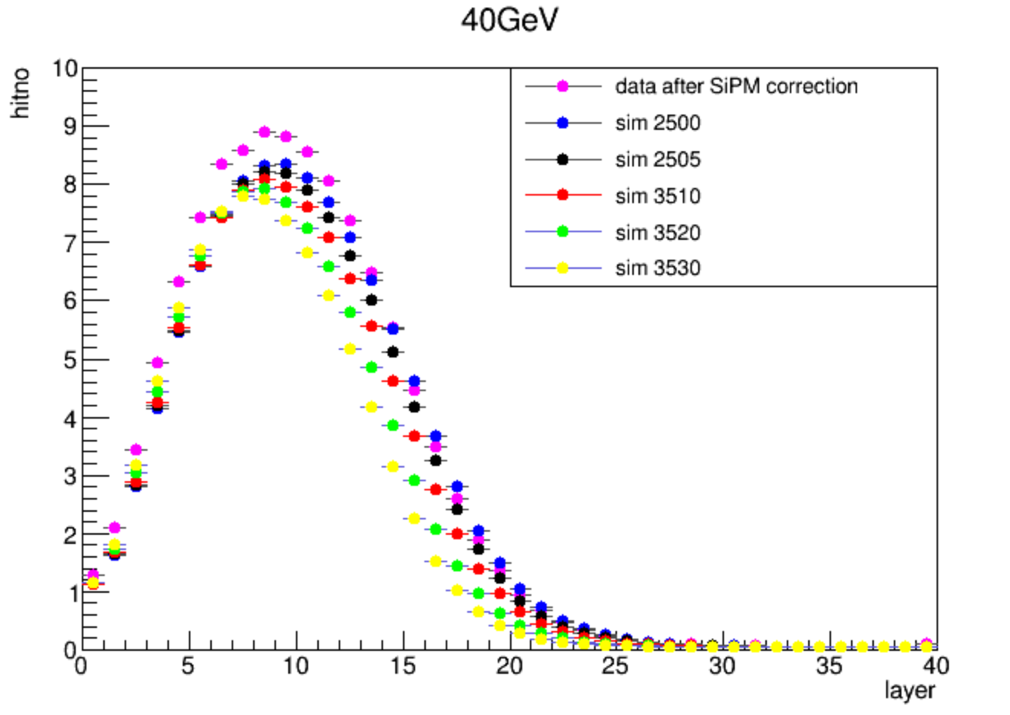
layer hitno profile

Slide 6
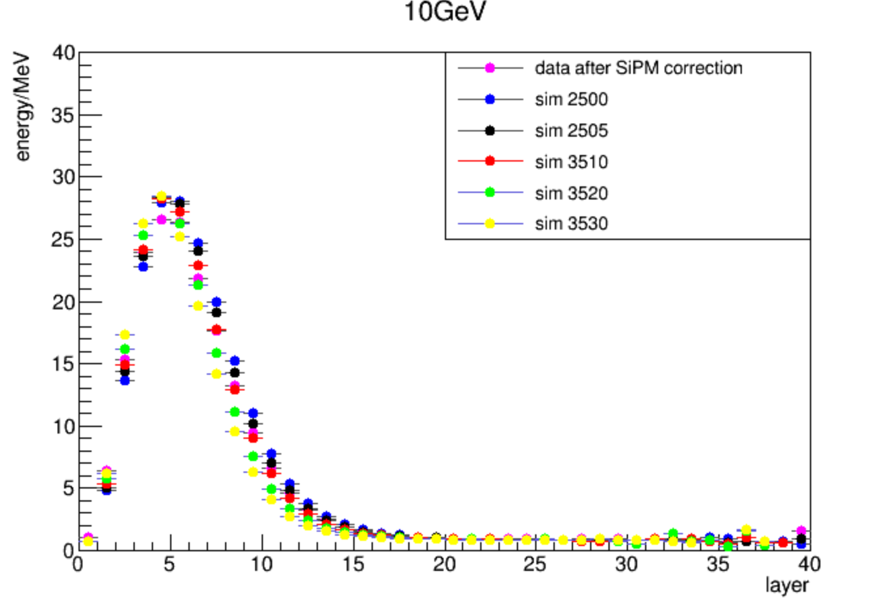
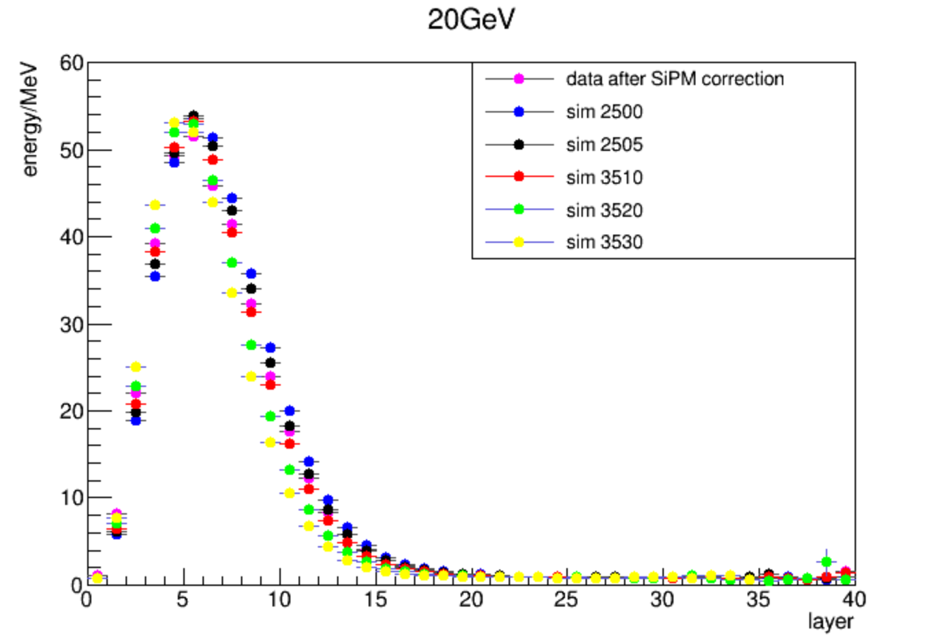
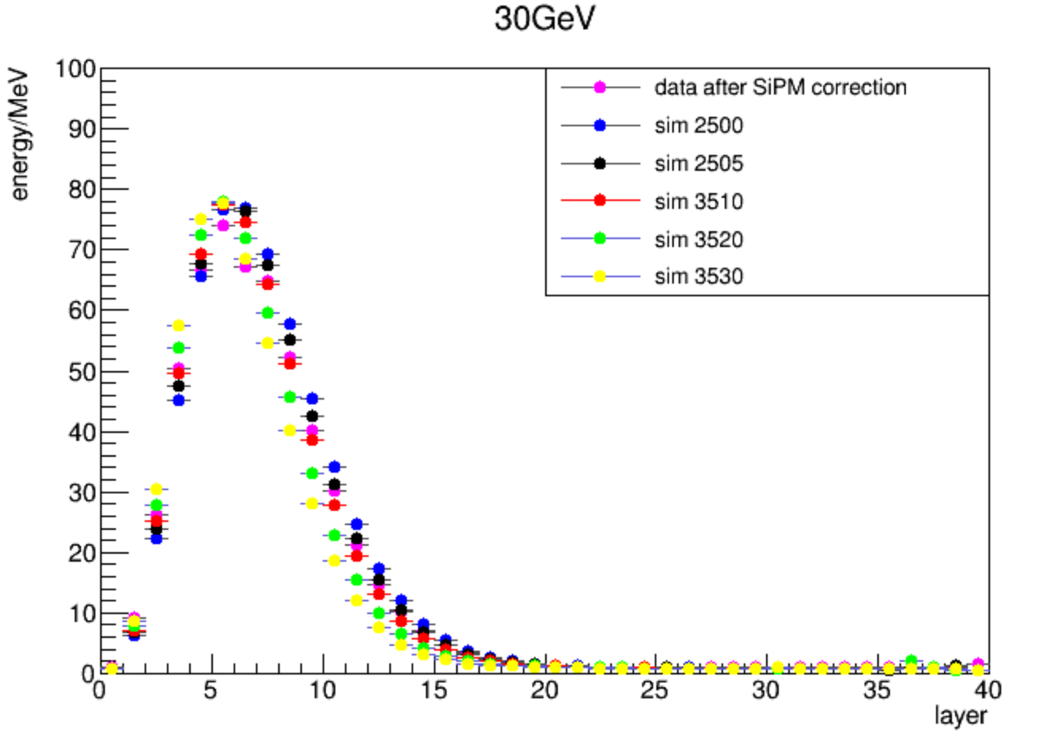
layer energy profile

Slide 7
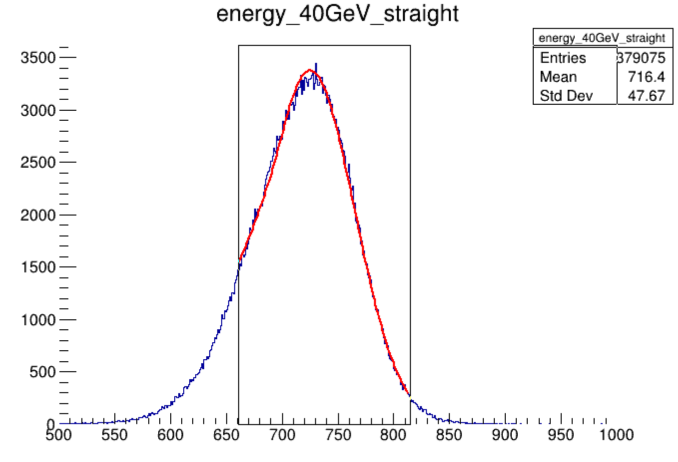
total energy
data
MC
0.126
mean(MeV) | 10GeV | 20GeV | 30GeV | 40GeV
data after correction | 187 | 374 | 555 | 725
PCB / Cu / birks
2.5 / 0.0 / 0.07943 | 191(2.1%) | 385(2.9%) | 578(4.1%) | 771(6.3%)
2.5 / 0.0 / 0.126 | 189(1.1%) | 380(1.6%) | 572(3.1%) | 763(5.2%)
2.5 / 0.0 / 0.25 | 184(-1.6%) | 370(-1.0%) | 556(0.2%) | 742(2.3%)
2.5 / 0.5 / 0.126 | 185(-1.1%) | 371(0.8%) | 558(0.5%) | 746(2.9%)

Slide 8
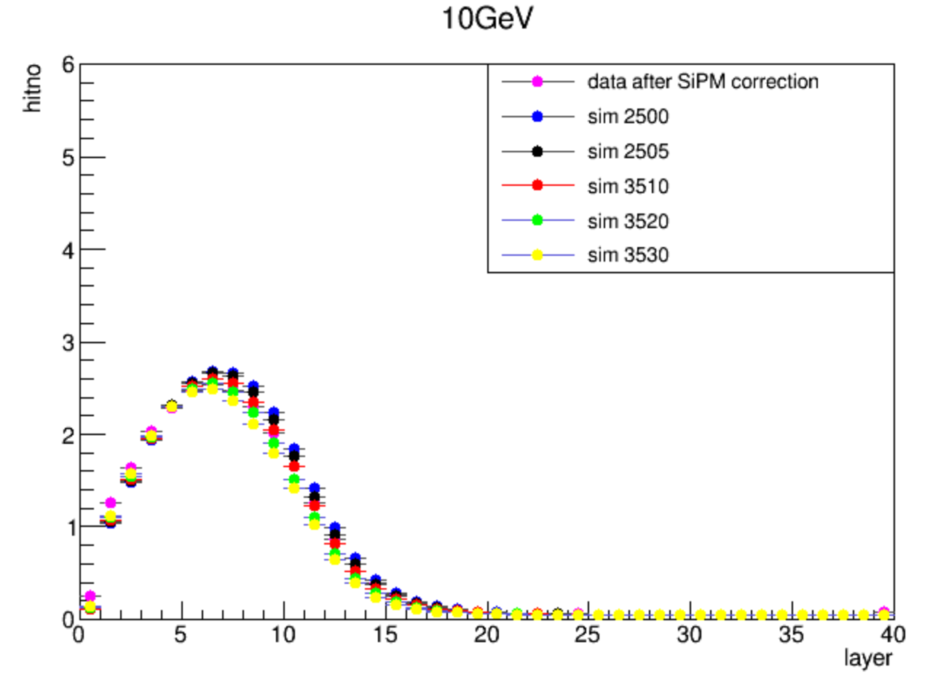
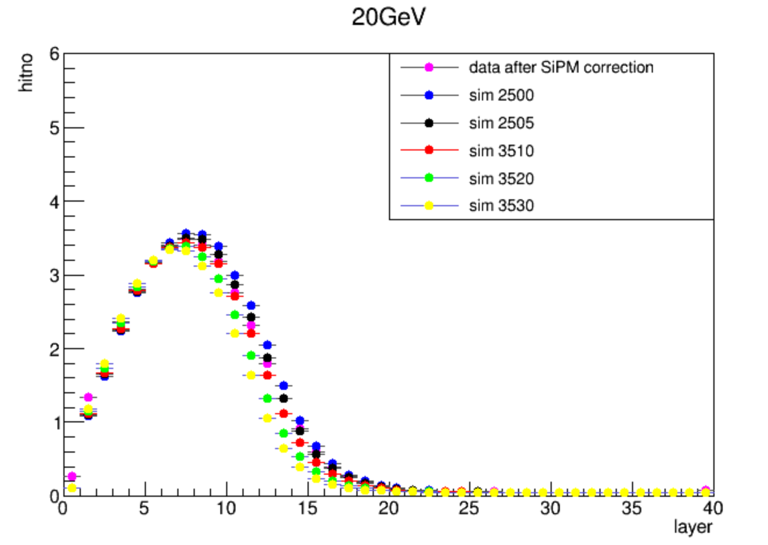
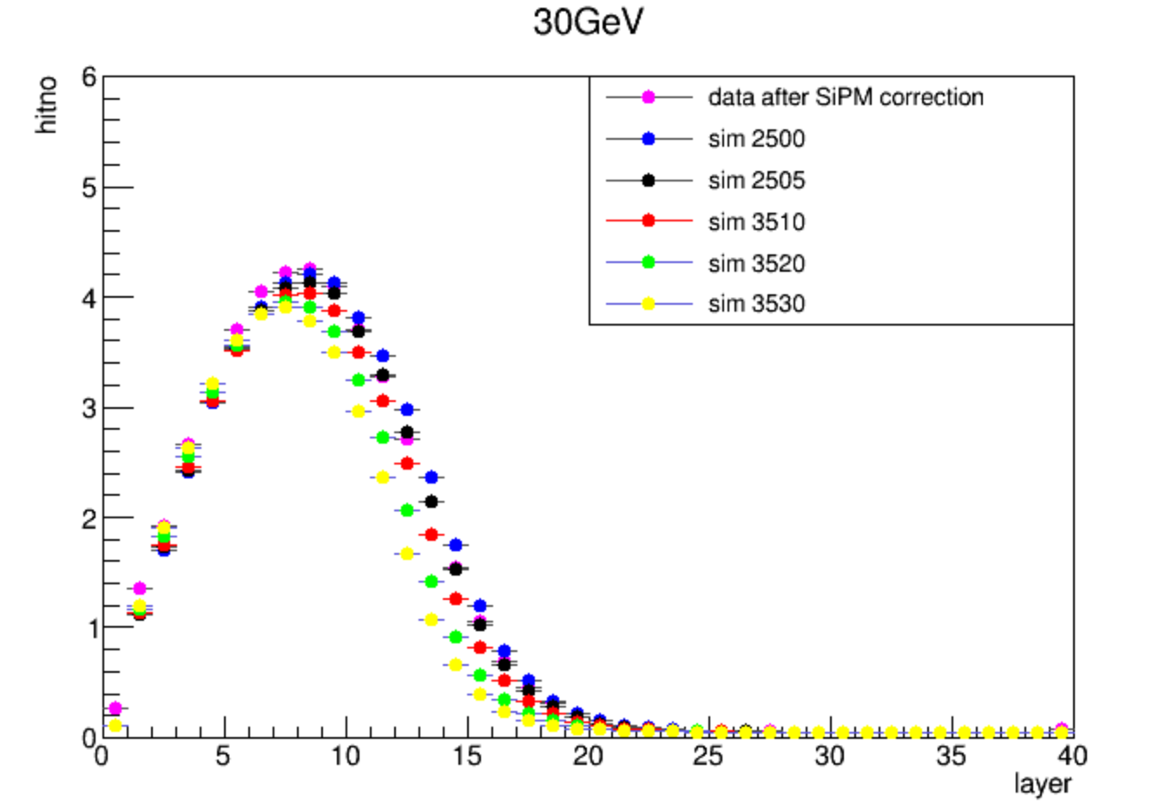
layer hitno profile --3mip

Slide 9
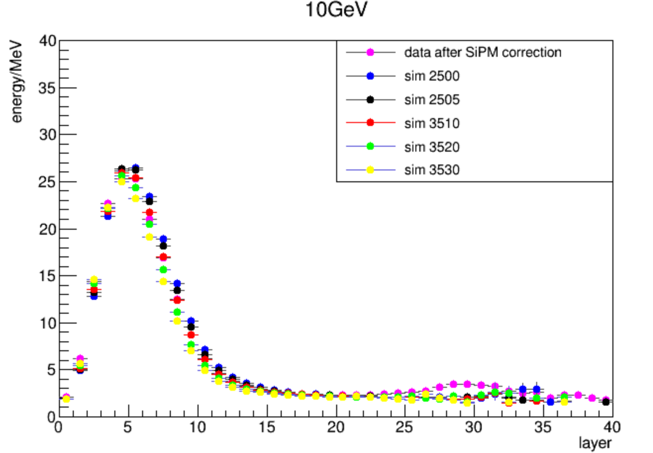
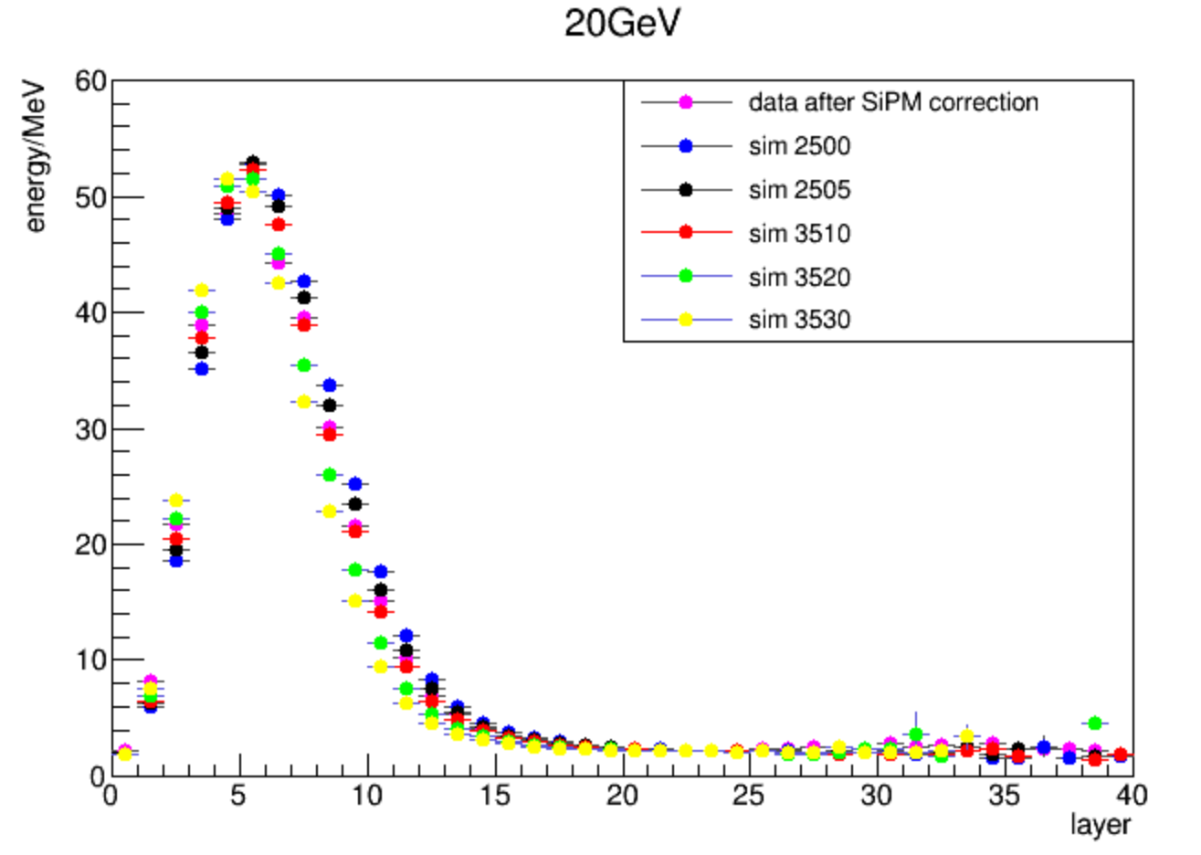
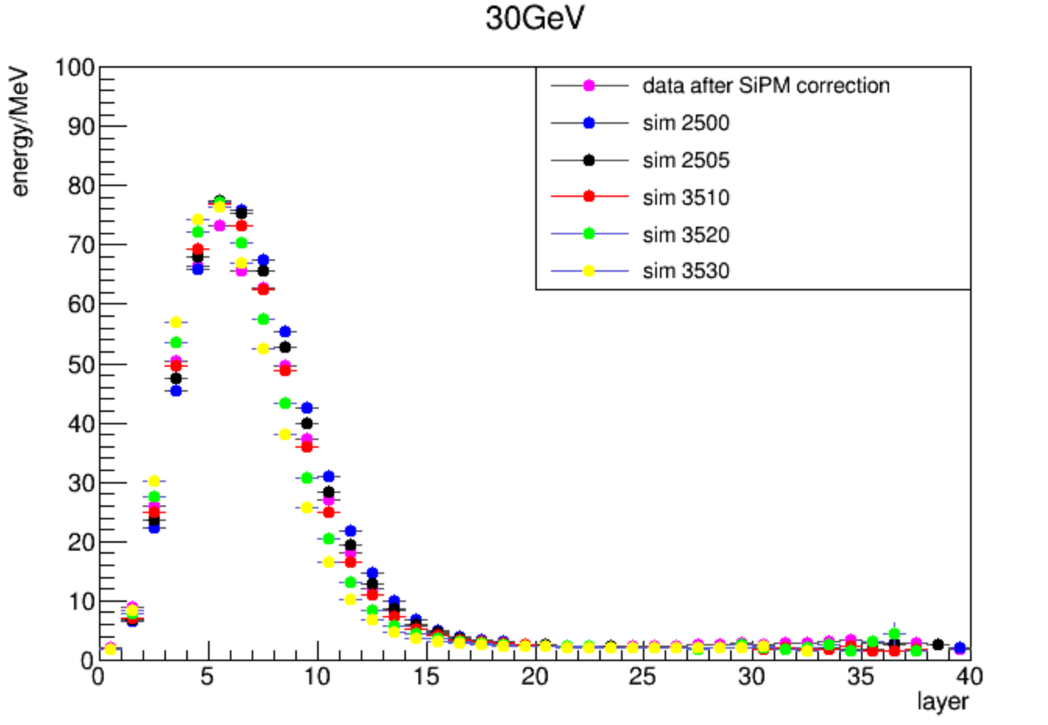
layer energy profile --3mip

Slide 10
total energy --3mip
mean(MeV) | 10GeV | 20GeV | 30GeV | 40GeV
data after correction | 158 | 329 | 500 | 659
PCB / Cu / birks
2.5 / 0.0 / 0.07943 | 163 | 344 | 528 | 714
2.5 / 0.0 / 0.126 | 161 | 340 | 522 | 706
2.5 / 0.0 / 0.25 | 157 | 330 | 507 | 686
2.5 / 0.5 / 0.126 | 159 | 333 | 511 | 691

Slide 11
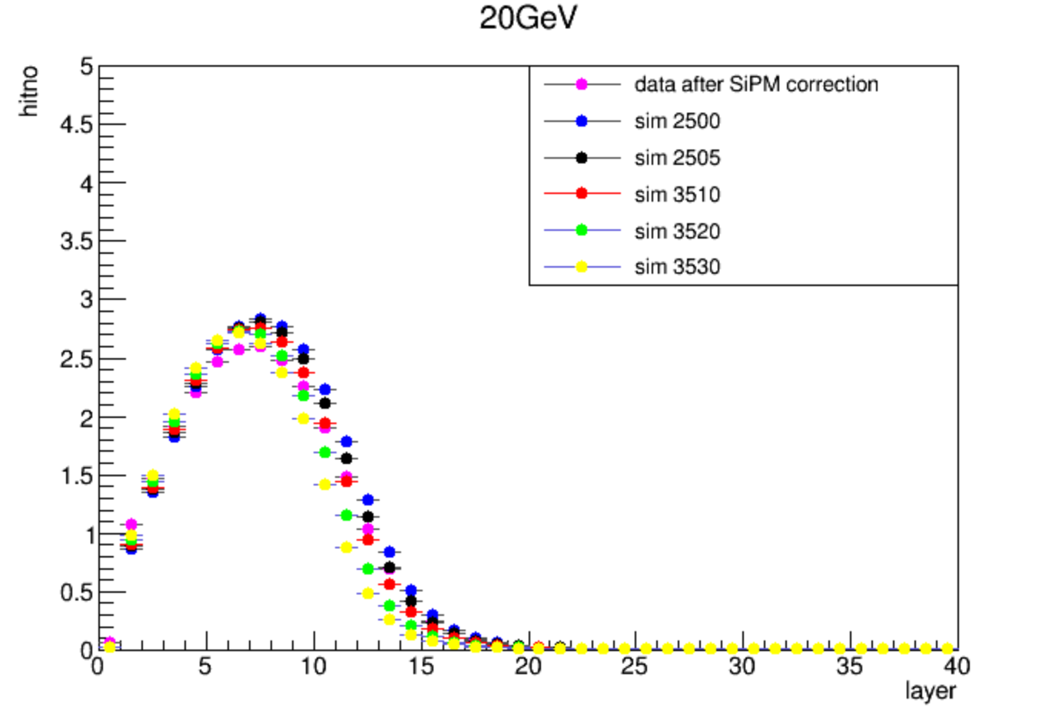
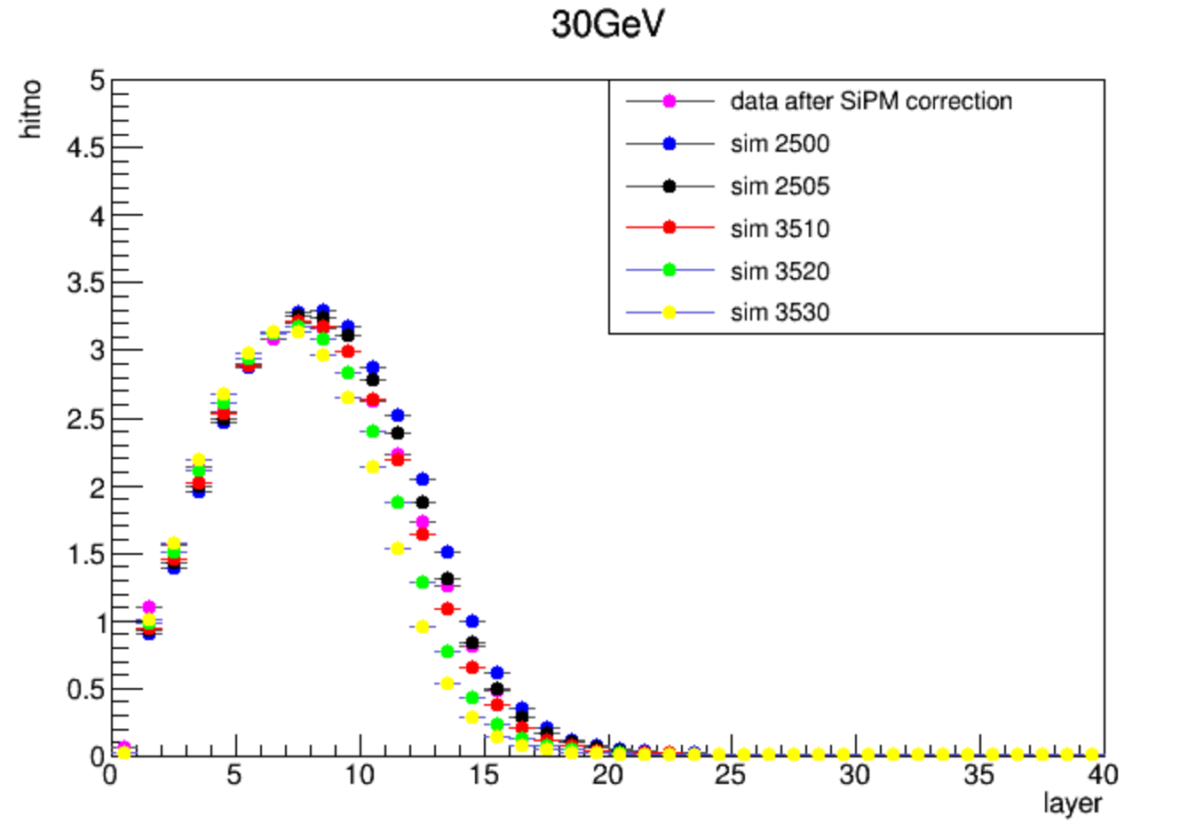
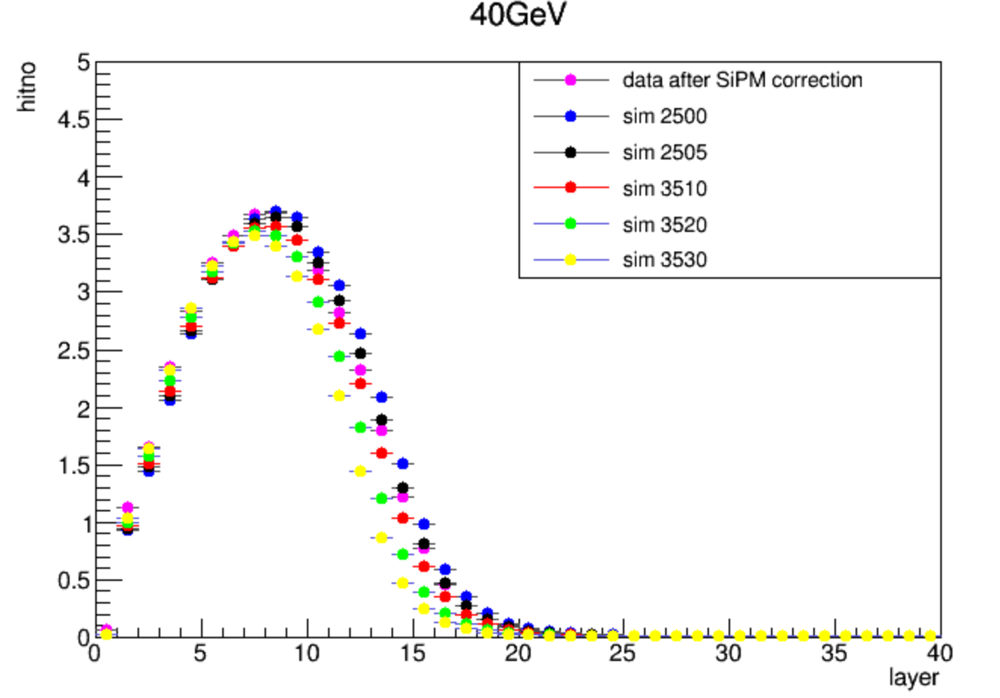
layer hitno profile --5mip

Slide 12
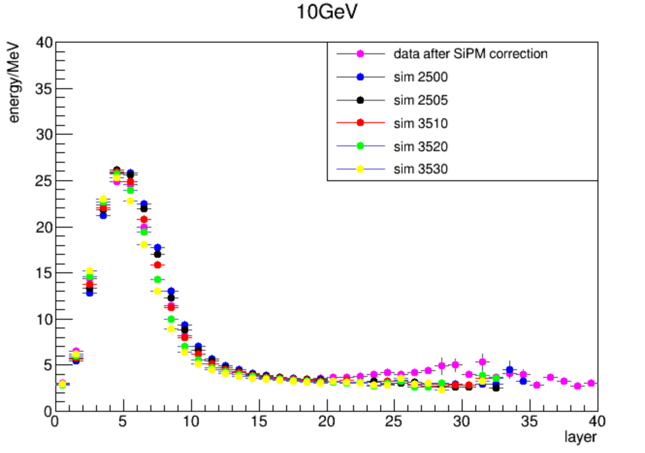
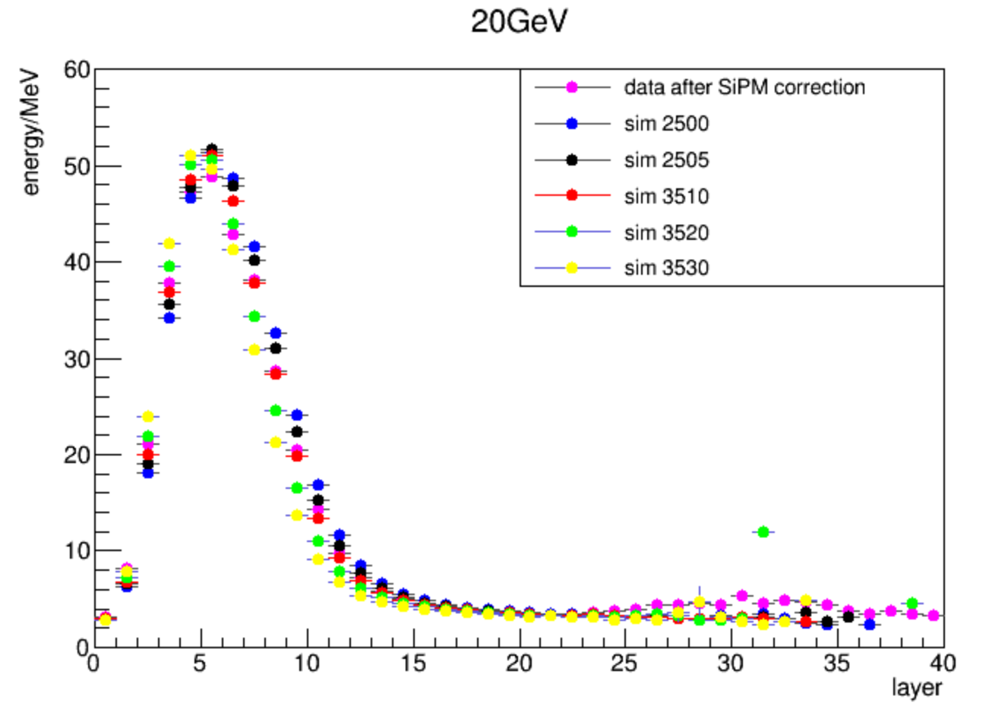
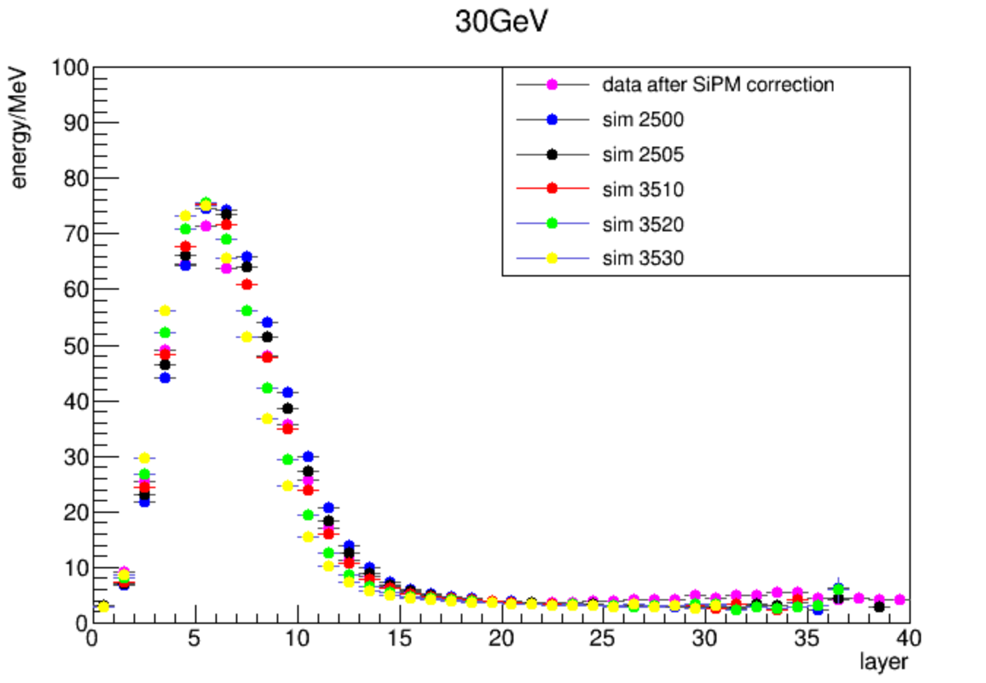
layer energy profile --5mip

