Slide 1
Data-simulation comparison update
2023/12/15
Jiaxuan Wang

Slide 2
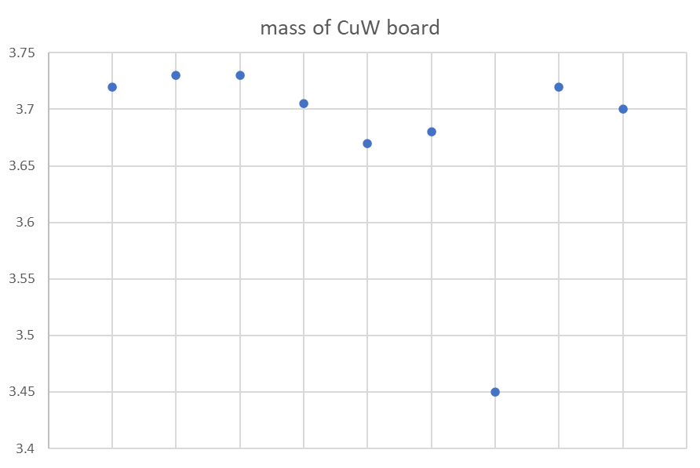
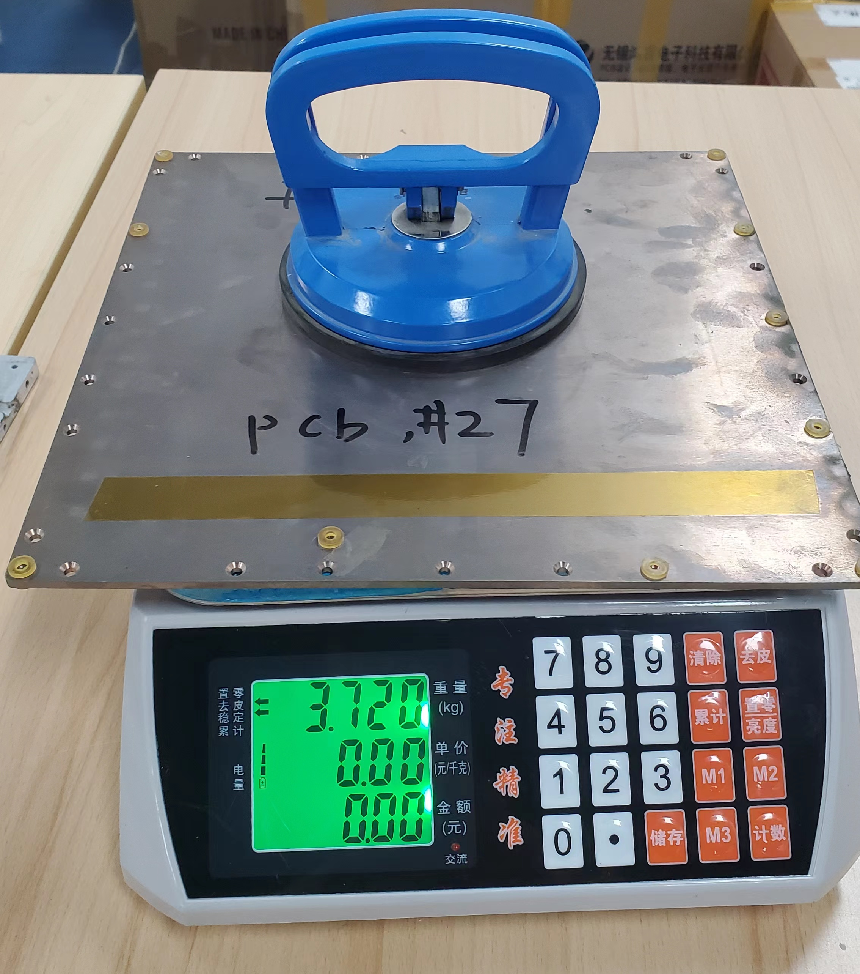
Absorber board - mass
Measurements for 6 absorber boards in prototype and 3 spare absorber boards
Same size 264.5mm*264.5mm*3.2mm for all board
Spare board 1 has a 8% mass difference.
Spare board 2
Average 3.706 kg
Spare board 3
Six boards in ECAL prototype
Spare board 1

Slide 3
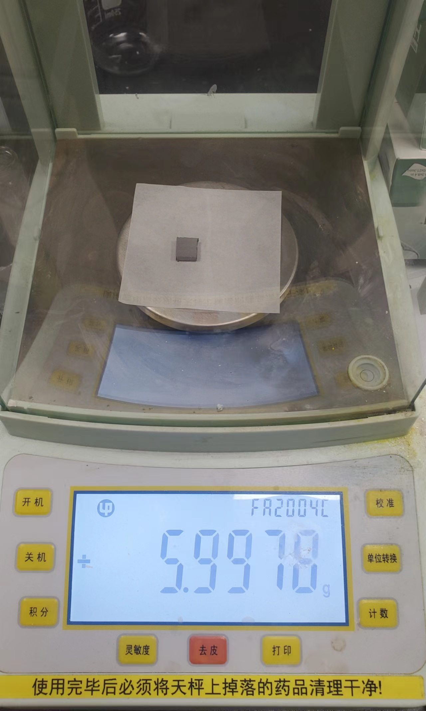
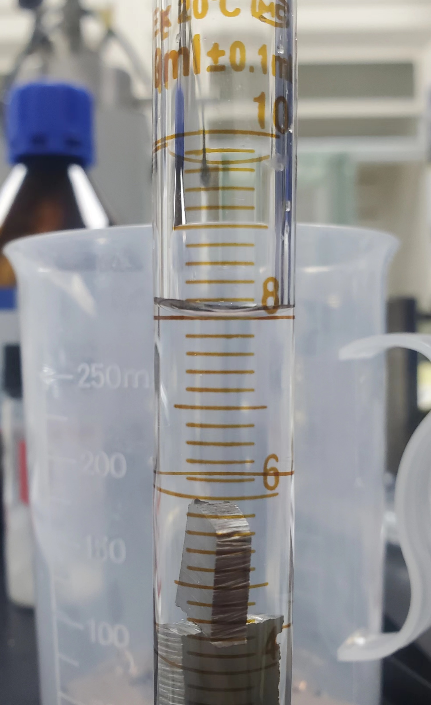
Absorber board – density
 | Mass(g) | Volume(cm3) | Density(g/cm3)
Sample 1 | 17.2505 | 1.17 | 14.74
Sample 2 | 17.2316 | 1.18 | 14.6
Sample 3 | 23.2294 | 1.58 | 14.7
Density of spare board 1 = 14.68 g/cm3
 | Mass(g) | Volume(cm3) | Density(g/cm3)
Sample 1 | 10.0615 | 0.63 | 15.97
Sample 2 | 9.5484 | 0.61 | 16.18
Density of spare board 2 = 16.08 g/cm3
Now only 1 board seems to have a large density difference with others
The density value of Spare board 2 get much closer to 16.32 g/cm3 than spare board 1
Set absorber density back to 16.32g/cm3, W-Cu mass fraction 85:15

Slide 4
Digitization for ECAL simulation
Energy Deposition -> Photon electron(Poisson smearing)
SiPM saturation correction
Photon electron -> ADC value(Gaussian smearing)
ADC value-> Energy deposition(digitization)
Dead channel cut
0.5 MIP cut

Slide 5
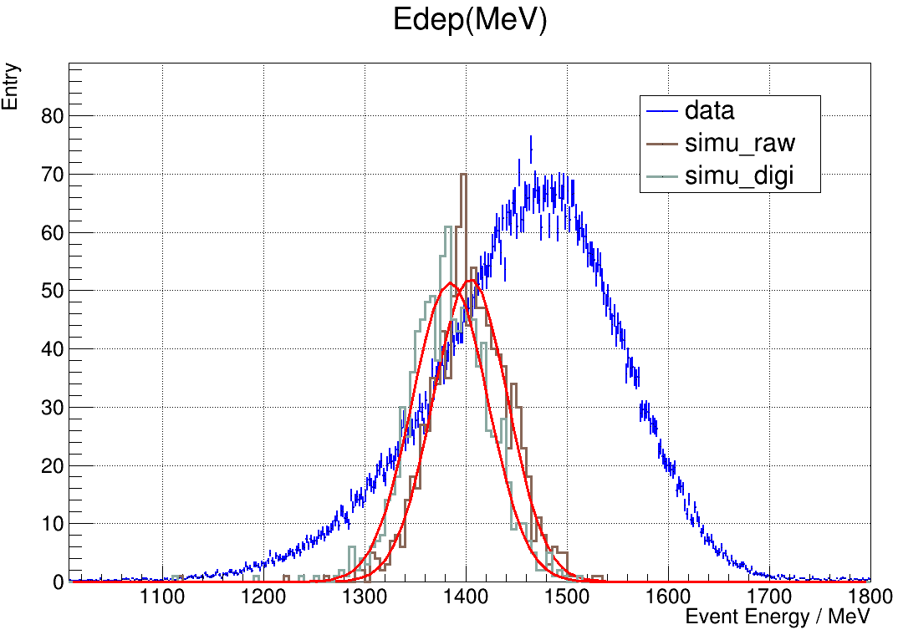
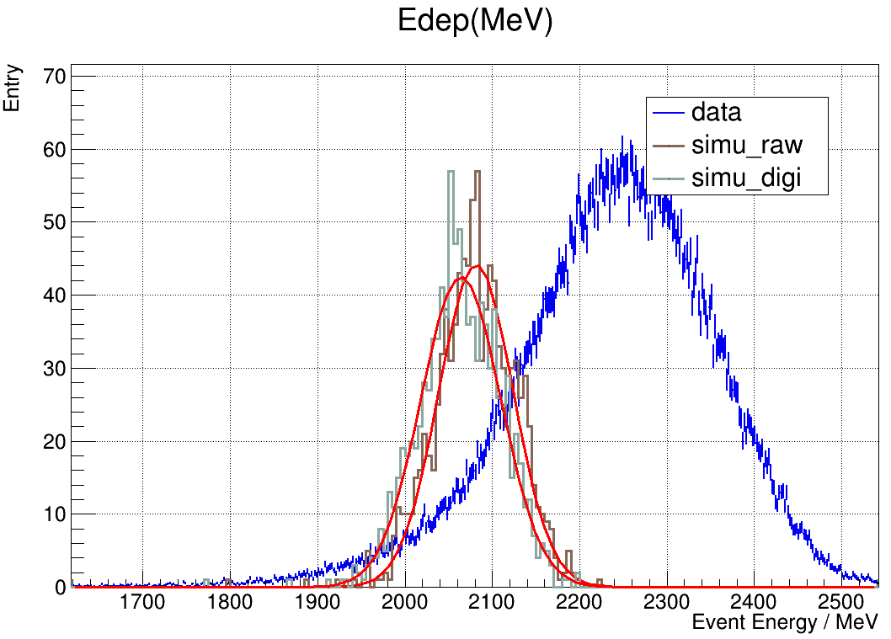
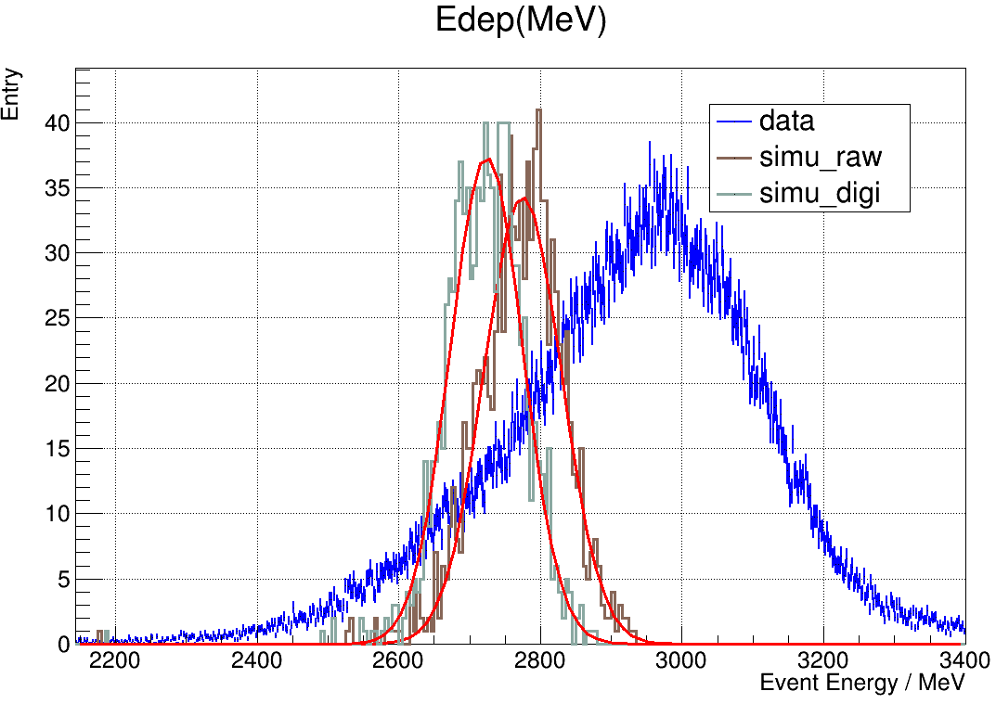
Total energy deposition
20GeV e-
40GeV e-
60GeV e-
80GeV e-

Slide 6
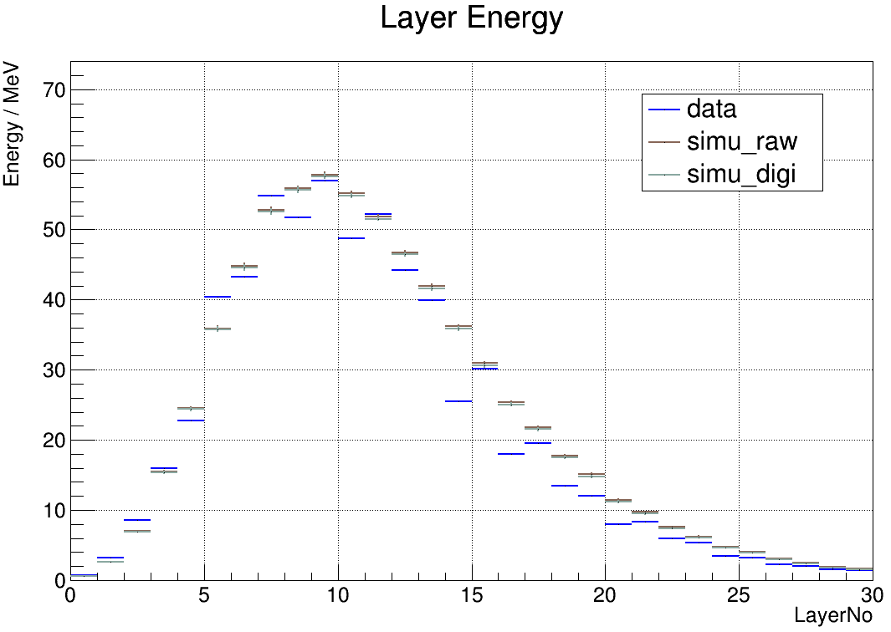
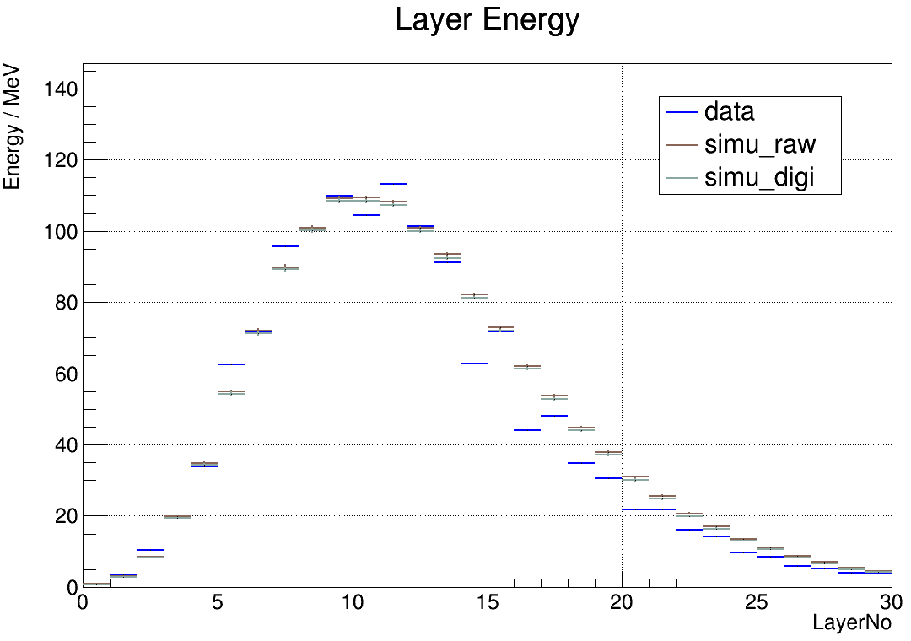
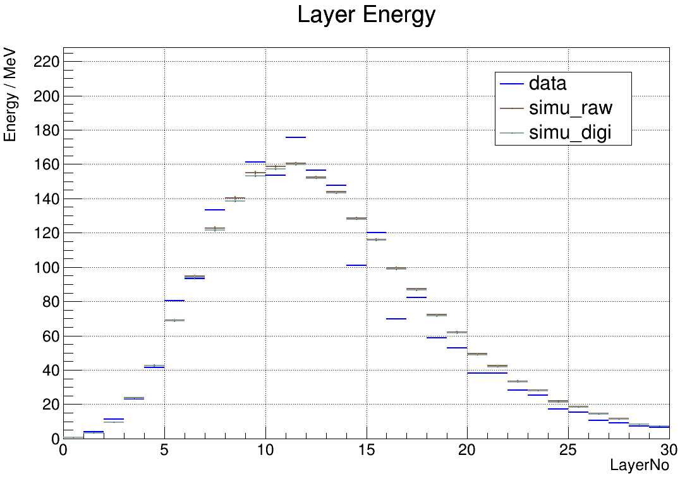
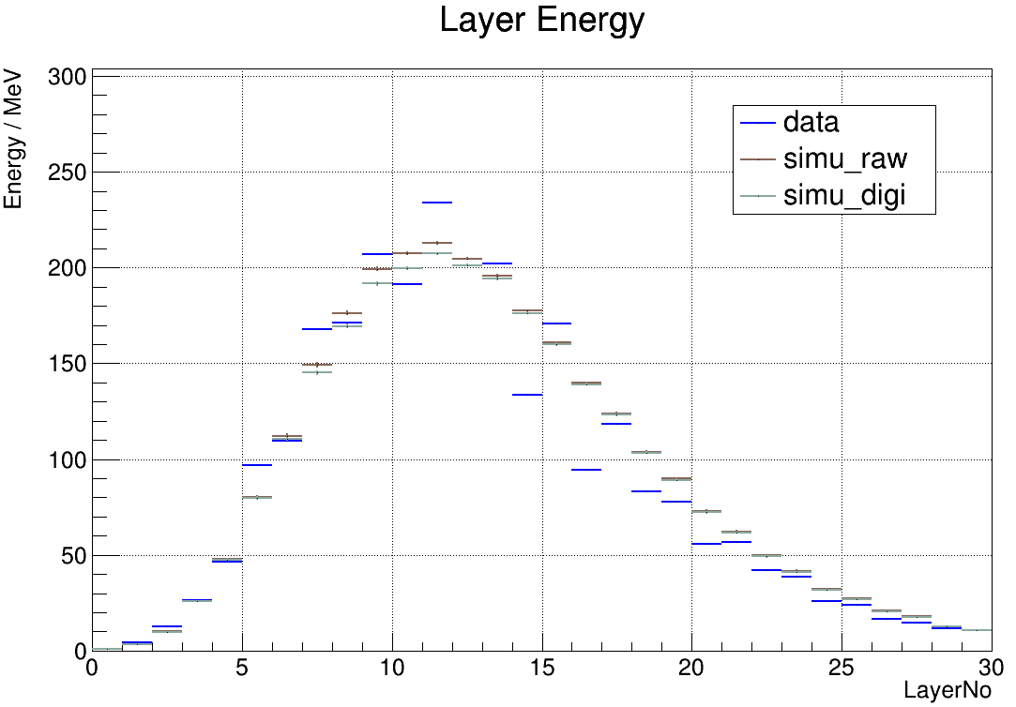
Layer energy profile
20GeV e-
40GeV e-
60GeV e-
80GeV e-

Slide 7
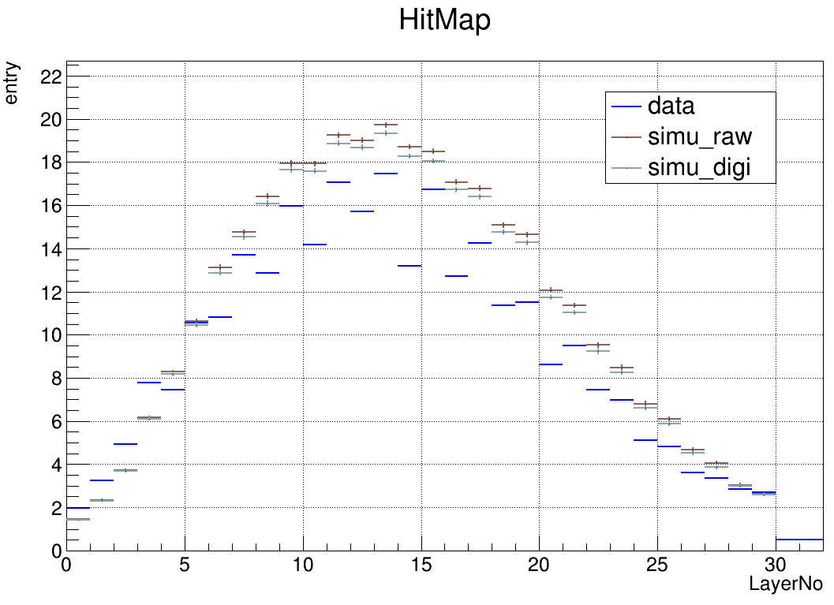
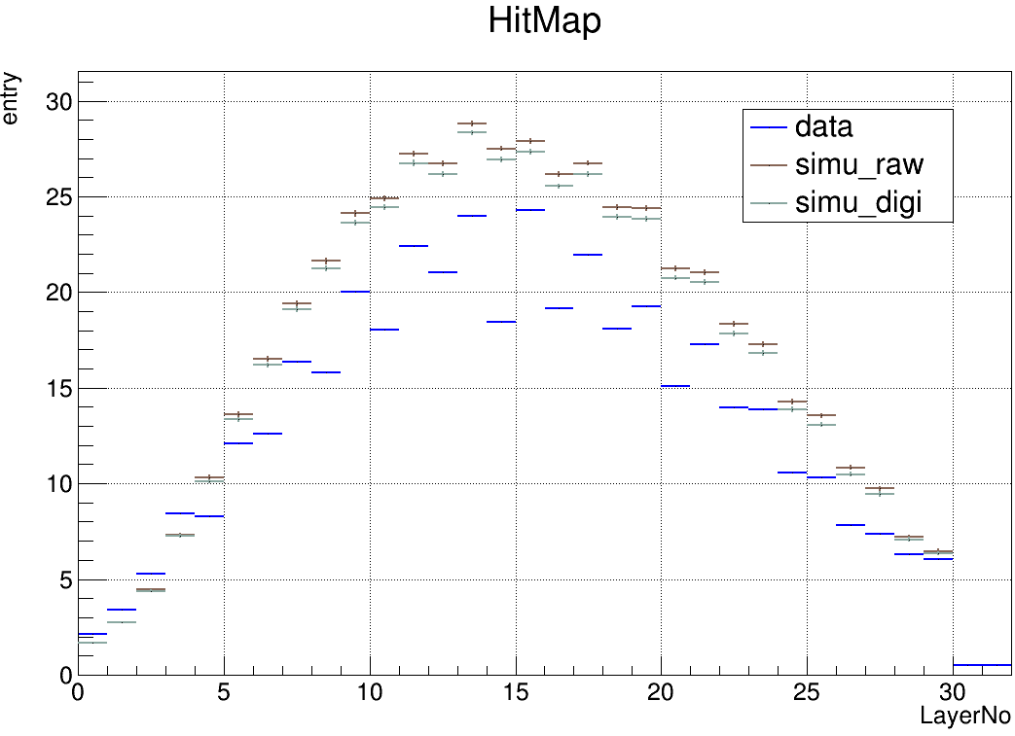
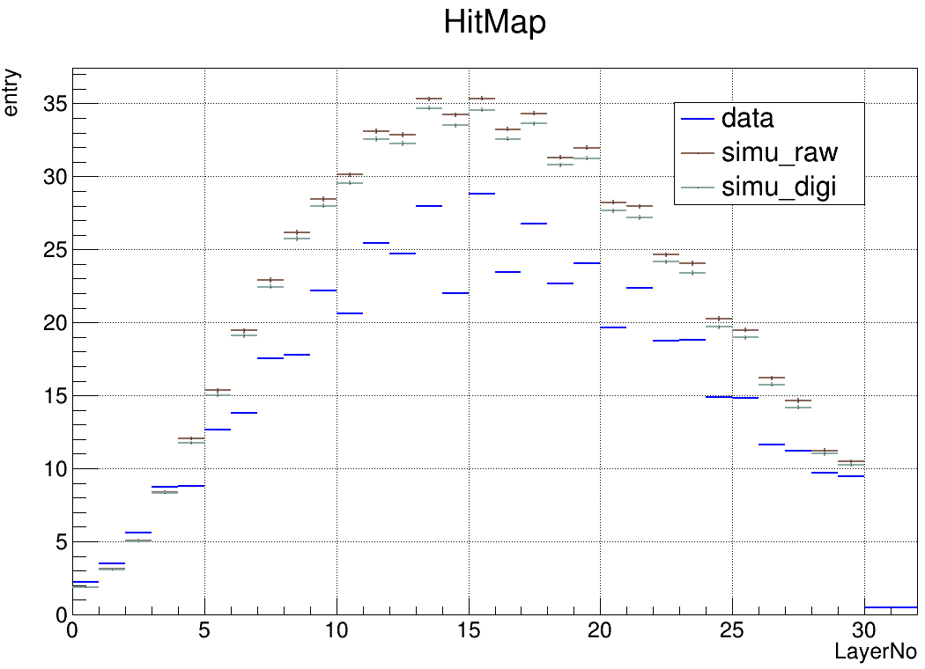
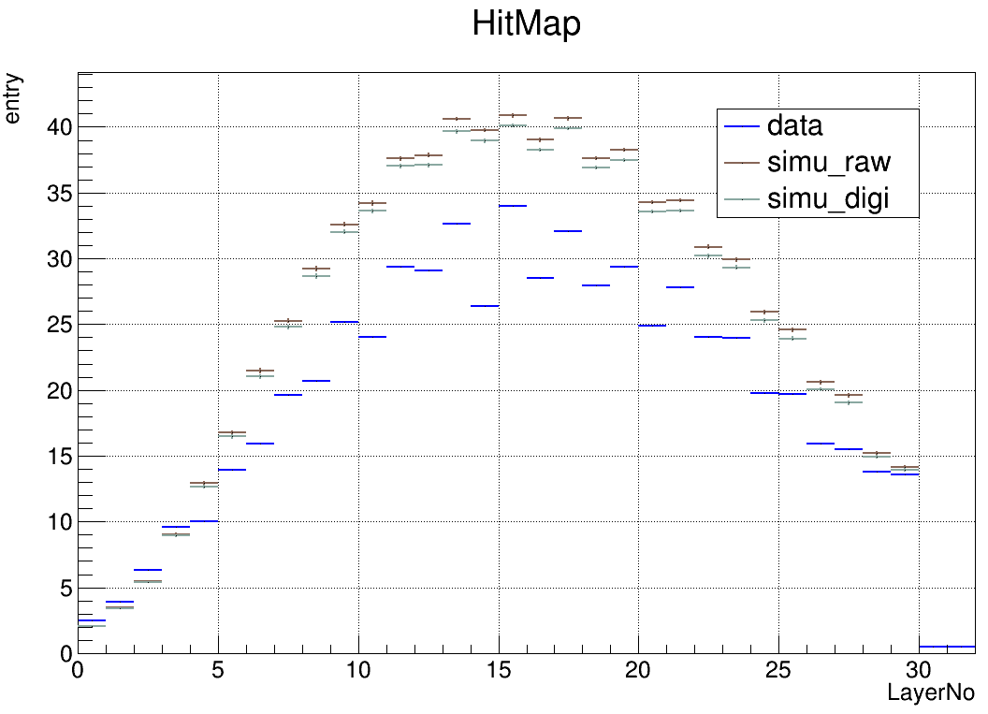
Hit-No profile
20GeV e-
40GeV e-
60GeV e-
80GeV e-

Slide 8
Summary
More energy seem to deposit in Simulation
Little difference between simulation truth and simulation digitization at low energy point, saturation effect shows when the value of energy of electron increases
Other more comparison could be used
For layer energy deposition, more study on layer 14 and layer 16 is ongoing

