Slide 1
Update MC Geometry
diao hongbin

Slide 2
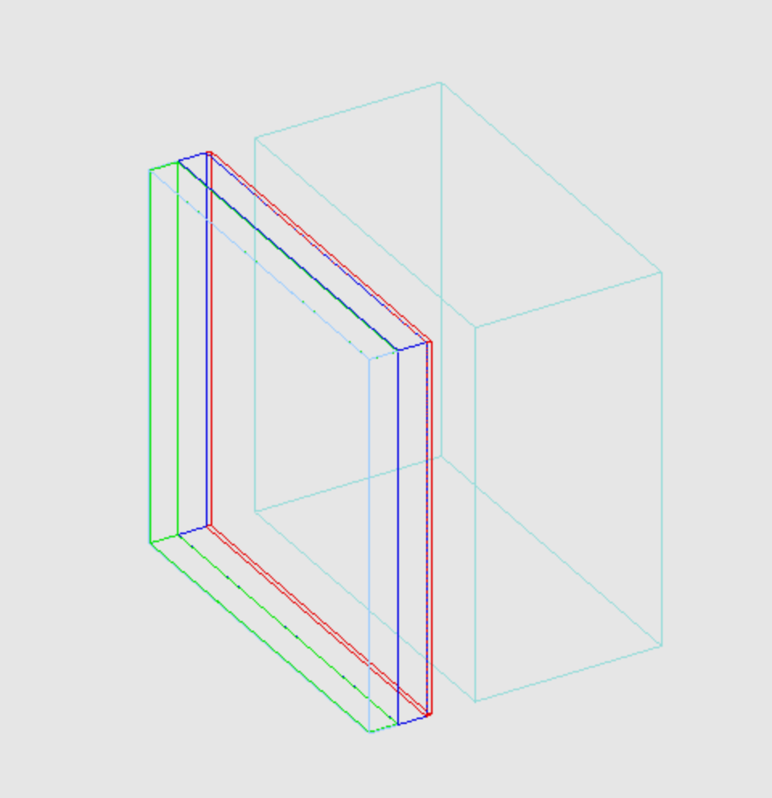
geometry update
ESR thick: 150um&&250um->65um
PCB thick: 2.5mm->3.0mm
Cu thick: 0->0.5mm
ESR material: 0.9g/cm^3 C2H4 -> 1.38g/cm^3 C10H8O4
Epoxy material: 1.3g/cm^3 C15H44O7 -> 1.25g/cm^3 C11H12O3
green: sensitive
dark blue: PCB
red: Cu
light blue: absorber

Slide 3
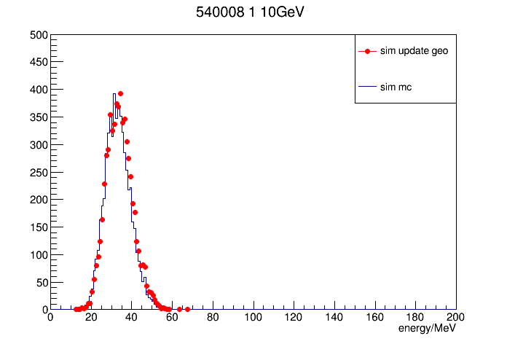
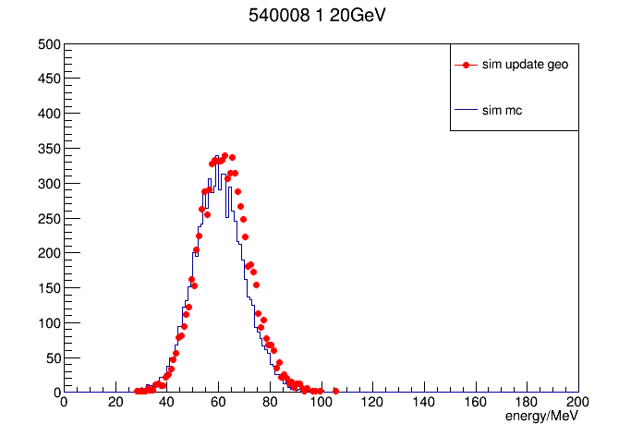
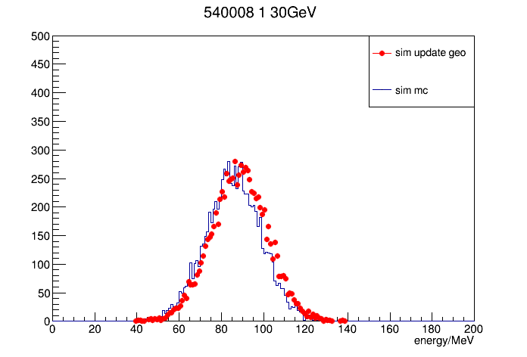
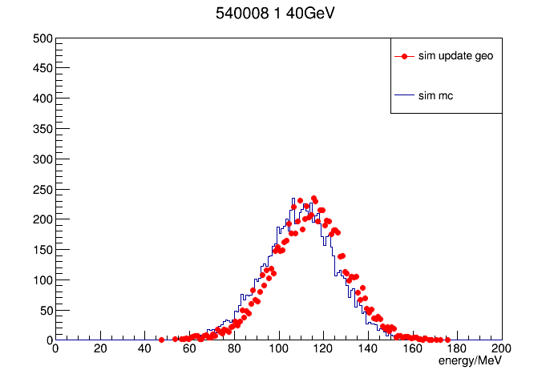
showmax
mean(MeV) | 10GeV | 20GeV | 30GeV | 40GeV
MC | 33.1 | 60.3 | 85.6 | 109
MC update geo | 33.9 | 62.0 | 88.4 | 113
difference | 2.4% | 2.8% | 3.3% | 3.7%

Slide 4
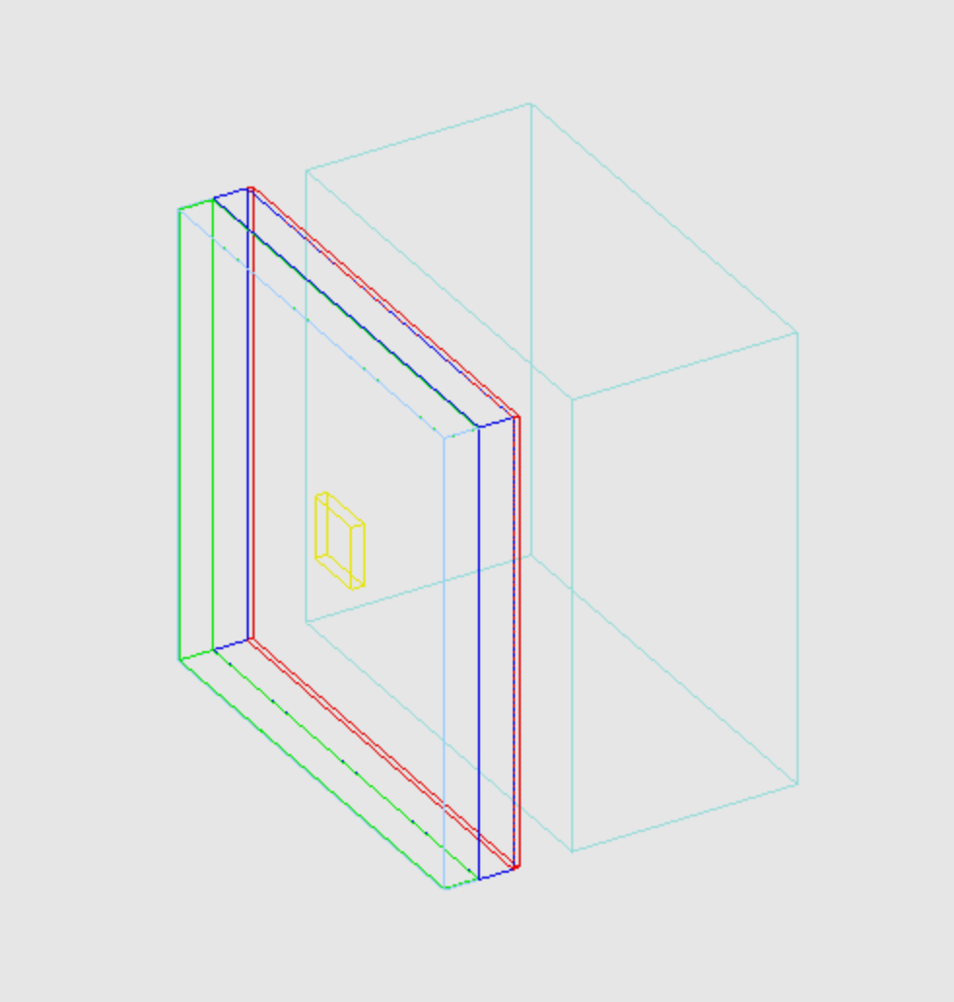
geometry update
dig out a small cube 5.5*5.5*1.1 mm^3
yellow: removed part

Slide 5
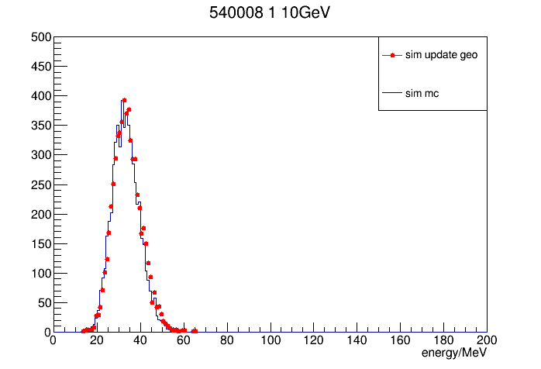
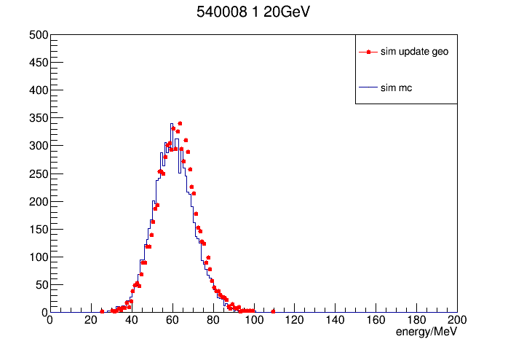
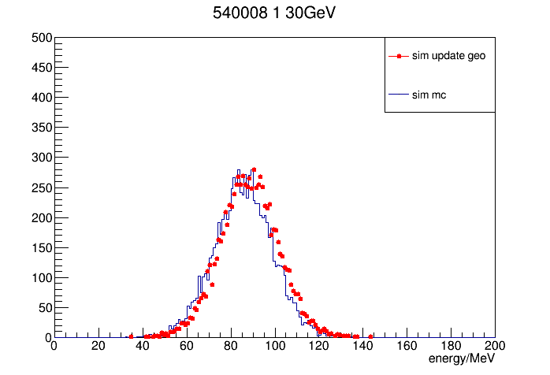
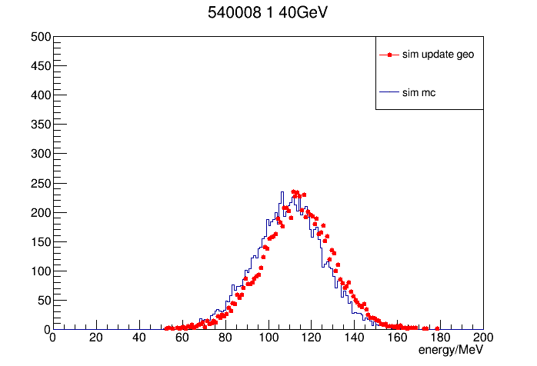
showmax
mean(MeV) | 10GeV | 20GeV | 30GeV | 40GeV
MC | 33.1 | 60.3 | 85.6 | 109
MC update geo | 33.8 | 61.8 | 88.4 | 113
difference | 2.1% | 2.5% | 3.3% | 3.7%

Slide 6
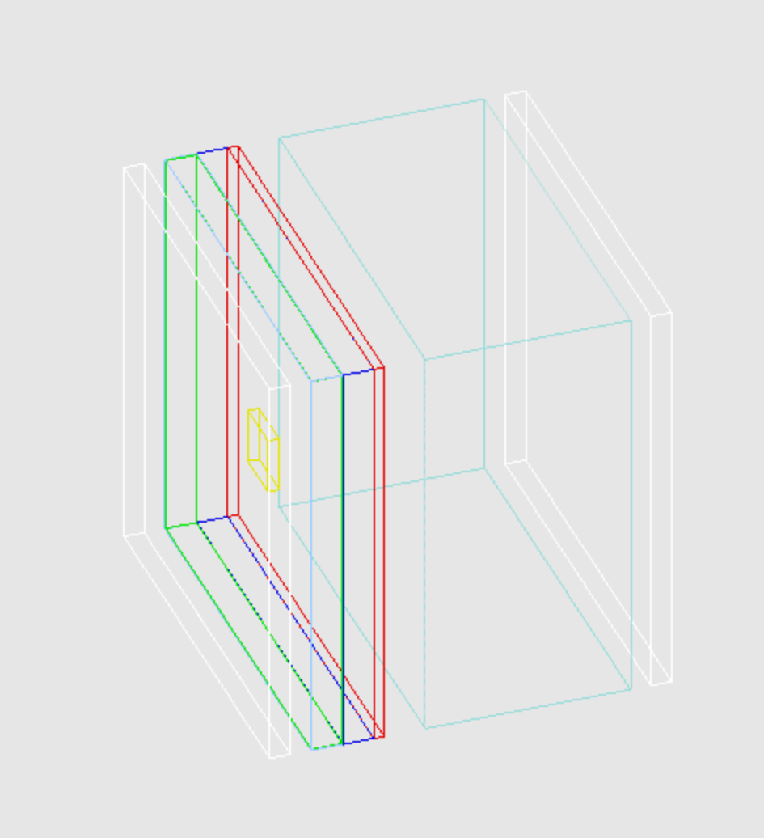
geometry update
Cu thick: 0.5mm -> 1mm

