Slide 1
Simulation update
2023/11/17
Jiaxuan Wang

Slide 2
Motivation
Make simulation settings match prototype
Comparison between data and simulation
Data with temperature correction and SiPM saturation correction
Different simulation setup

Slide 3
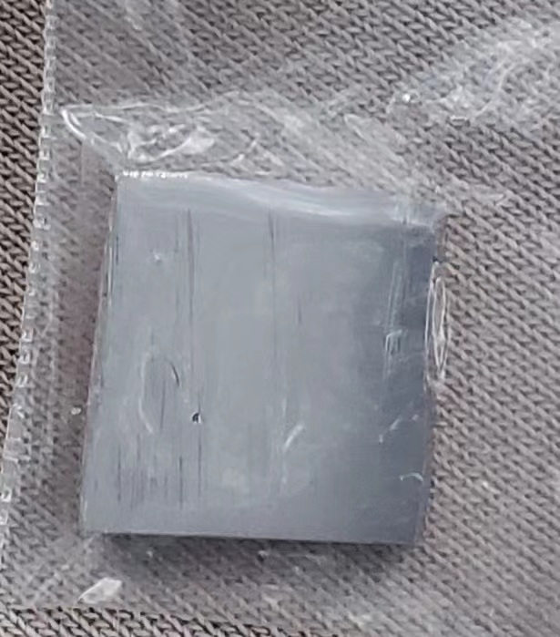
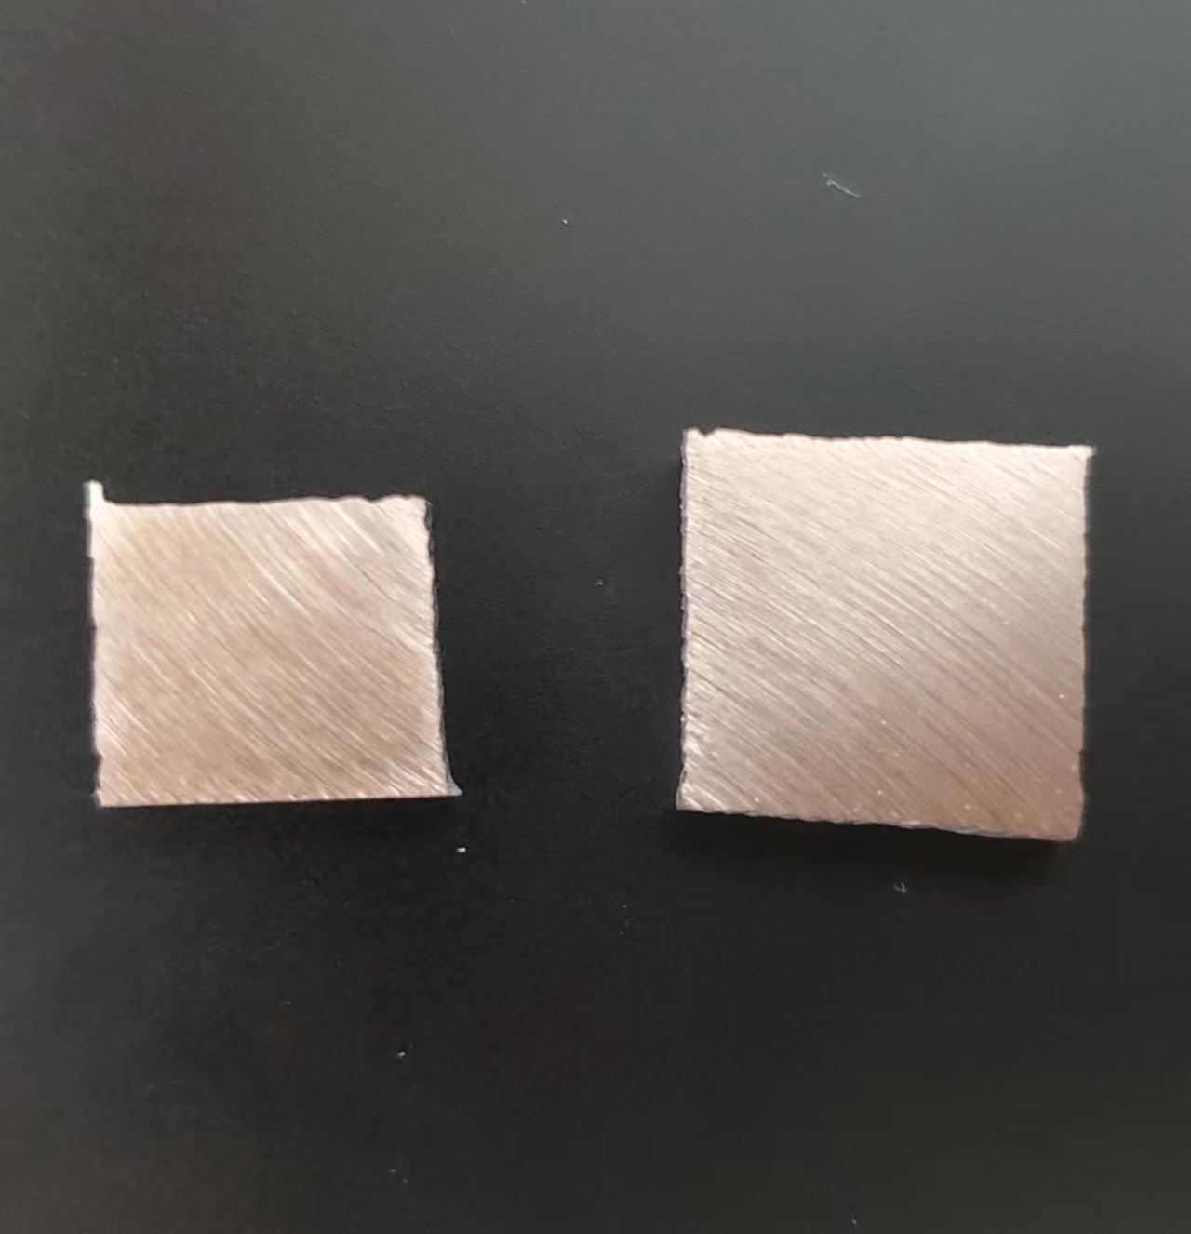
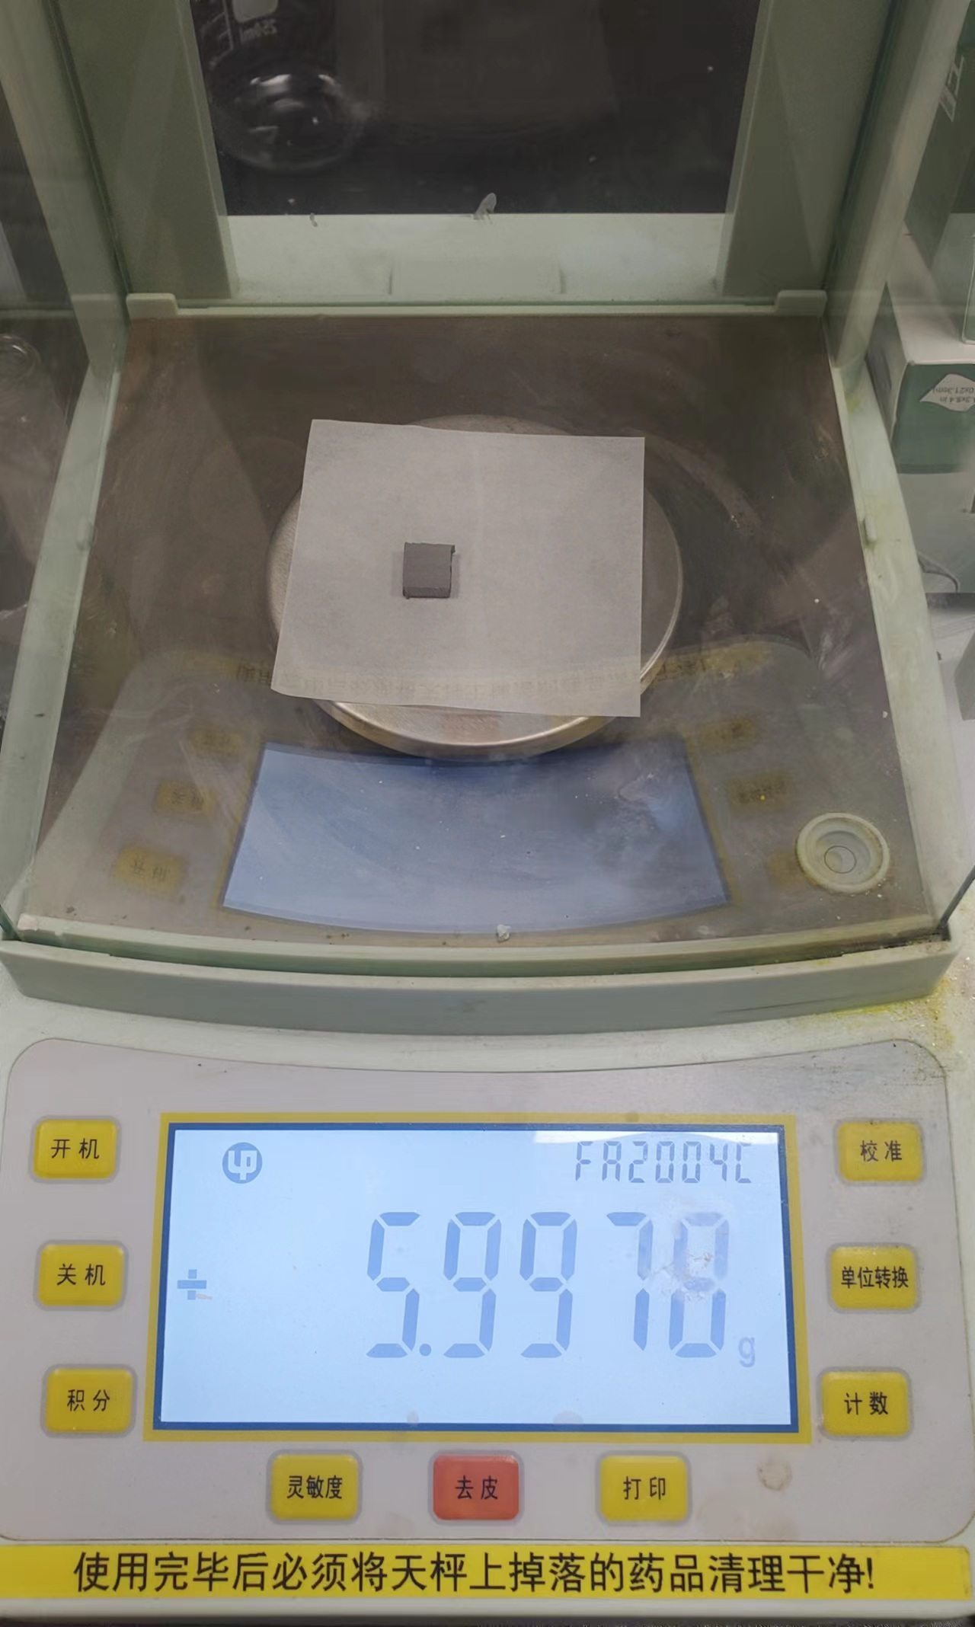
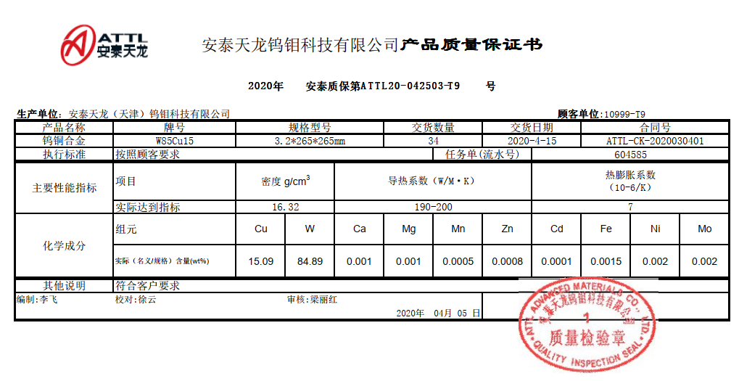
Cu-W alloy density
 | Mass(g) | Volume(cm3) | Density(g/cm3)
Sample 1 | 17.2505 | 1.17 | 14.74
Sample 2 | 17.2316 | 1.18 | 14.6
Sample 3 | 23.2294 | 1.58 | 14.7
14.68g/cm3

Slide 4
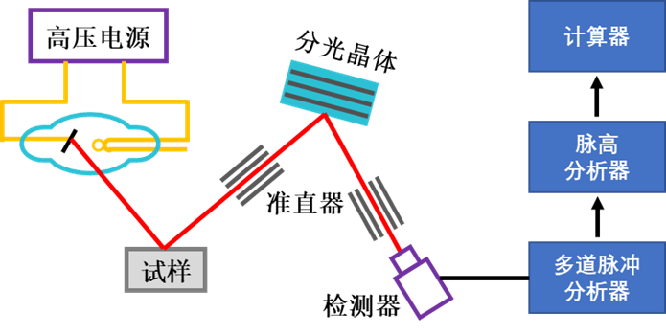
Cu-W alloy
80.95% W
19.05% Cu

Slide 5
Simulation Settings Update
PCB
Electronic components
1.8mm MAX -> 0.6mm(SiO2 + epoxy)
PCB board
1.2mm (Cu:FR4=1:4, FR4(SiO2 : epoxy = 1: 1) )
Absorber
Cu-W alloy
16.45 g/cm3 -> 14.7 g/cm3
Cu : W =15: 85 -> 20 : 80
Kapton
0 -> 0.05mm
ESR(PET)
0.075mm -> 0.08mm

Slide 6
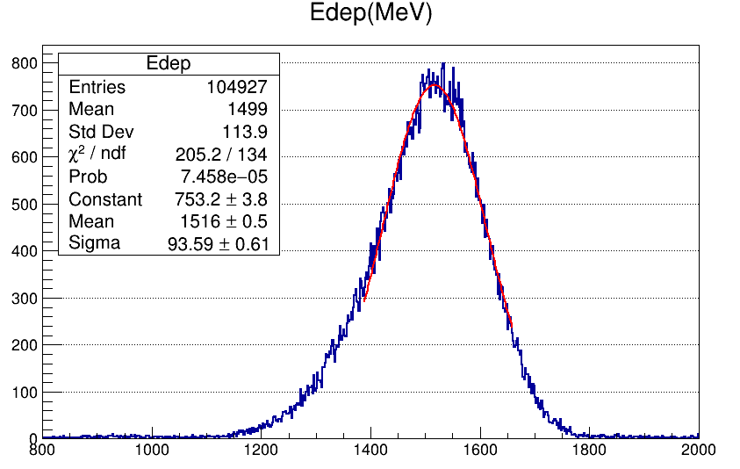
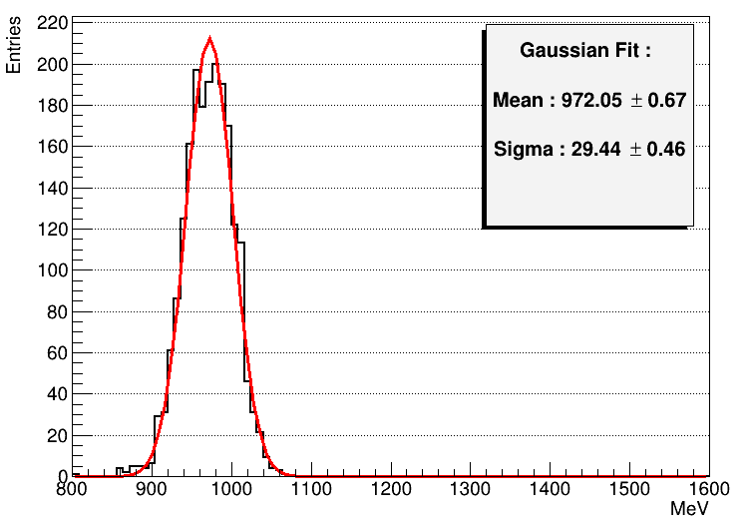
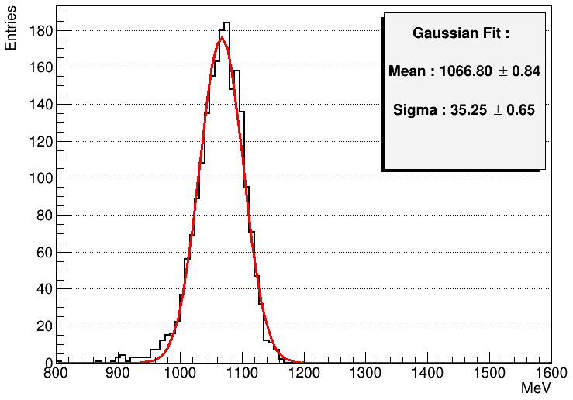
Total Energy Deposition
Data: 40GeV e-
Simulation:
40GeV e- before update
Simulation:
40GeV e-
after update

Slide 7
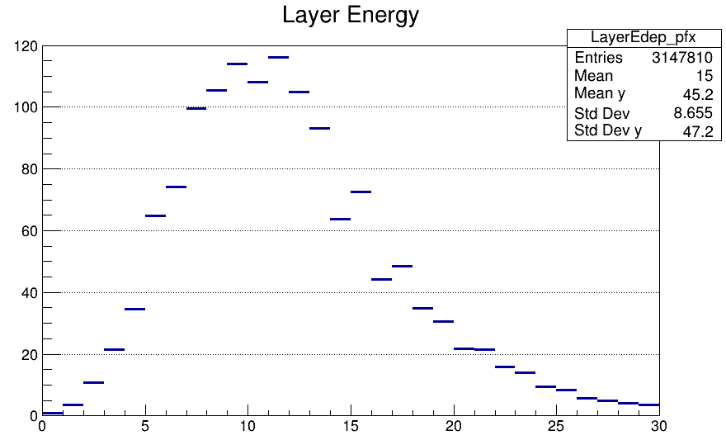
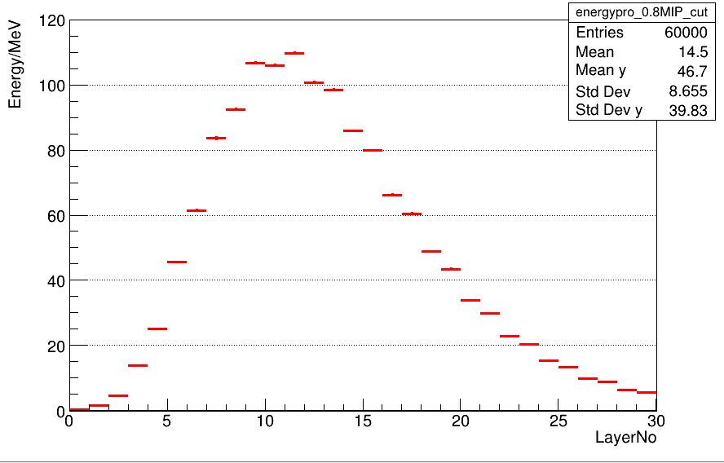
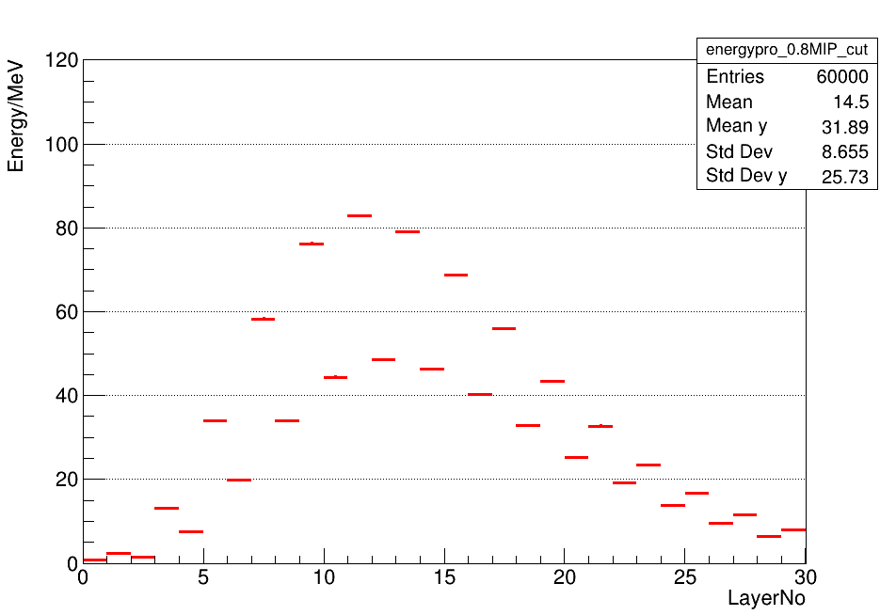
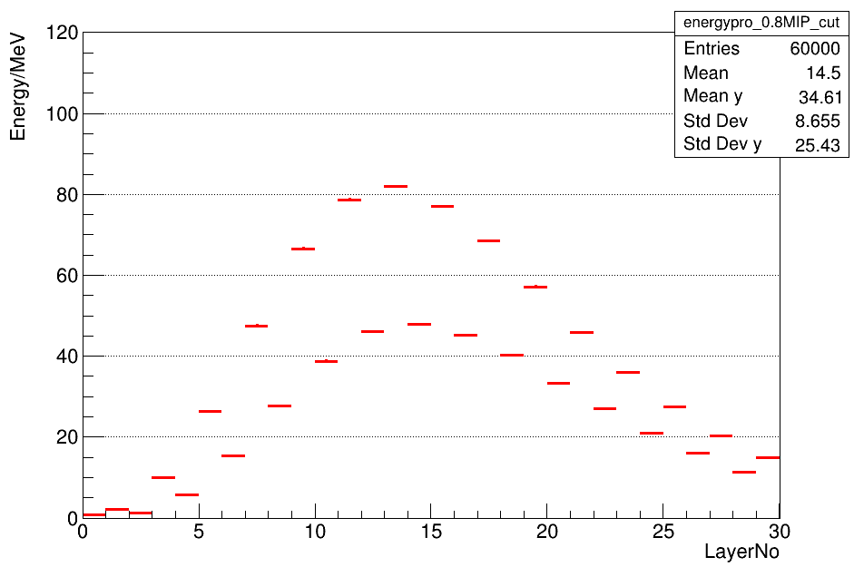
Layer Energy Deposition
Data: 40GeV e-
Simulation:
40GeV e- before update
Simulation:
40GeV e-
after update

Slide 8
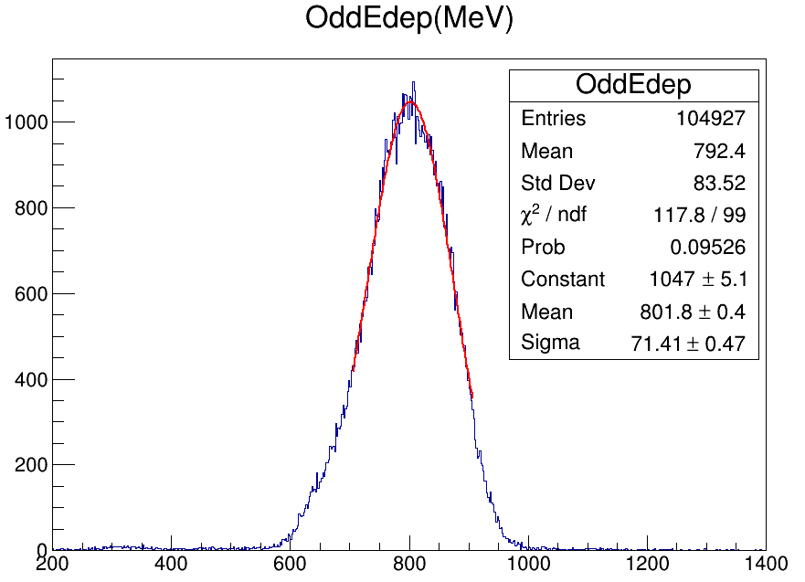
Odd/Even Layer

Slide 9
Summary
Much more difference between data and mc setup
Adjust simulation setup
Odd/Even layer difference

